Slide 1



The Ethical Issues and Challenges of Medical Research in Low-Income Countries : Ethiopia
Adamu Addissie MD MPH
BSMS (Brighton) & SPH (Addis Ababa)
July 19, 2013
Notes:
Objective : To outline the range of problems and issues around the research ethics process in low income countries such as Ethiopia
Outline
Introduction and Background
Ethical Issues in developing Countries
Findings from recent assessment
Ethiopian situation
Questions for thought

Slide 2
Introduction
Universal International Ethical Guidelines Vs Varied and Dynamic Contexts in Low-Income countries
Notes:
Guidance on and regulation of the ethics of medical research have primarily evolved in the developed world, using principles that stem from Western values and social traditions (The International Conference of Harmonization Guidance on Good Clinical Practice, 1996). International research collaborations now commonly include investigators and participants from developing countries, and while ‘international’ ethical guidelines may govern these collaborations, in reality, these take very little account of the different social structures, cultural norms, legal frameworks and communication channels of the countries involved (Nuffield Council on Bioethics, 1999).
The inflexible use of international ethical guidelines in health research has at times led to situations which have prompted investigators to seek an approach to adapting these guidelines to local situations (Angell, 1997; Beebe, 2001; Farmer, 2002).
Even though most biomedical research are done in developed countries the past couple of decades have witnessed a great number of biomedical research in African and other developing countries. The array of research works by different researchers has emphasized the need for special attention to the way in which western ethical principles are applied to a research project in the developing world. They have emphasized that the challenges associated with research ethics in developing countries are complex and can not be addressed by regulatory processes alone. There is a need to move to a debate beyond guidelines and mere ethical review to a broader system perspective cognizant of the spectrum of additional determinants in developing countries (Bhutta, 2004; Hyder, 2009).
With advances in technology and medical knowledge the research has grown in scale and dimension. Advancements in medical technologies and associated research are also associated with ethical dilemma and challenges to the public and the scientific community (Bonair, 1989).
Others have proposed a participatory model that would enhance Informed Consent based on experience. Such models illustrate the significance of working with community members in the creation of a consent form that is comprehensible to potential participants and an informed consent process that remains active thorough out the study, by addressing issues like undue inducement, psychological risks, lack of awareness of basic principles. This was shown to strengthen research efforts through recruitment and retention of participants who better understand their roles and responsibilities in the study (Woodsong, 2005).

Slide 3
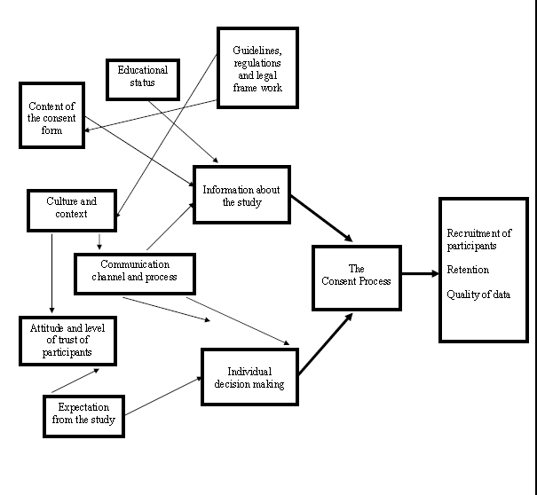
Conceptual Framework

Slide 4
Study Objective
To assess the major ethical issues and perceived gaps in the current medical research consent processes in Ethiopia

Slide 5
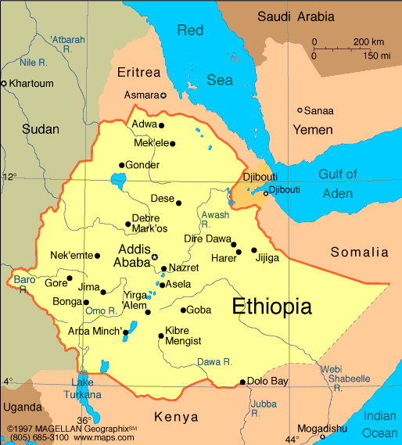
Notes:
Ethiopia is a country with significant cultural, religious and linguistic diversity, there is enormous expansion in education at graduate and post-graduate levels. [The number of universities have reached to 31 in two decades, with more than 20 in the last 10 years. The number of entrants and gradates also remarkably increased. AAU this year graduated 8,817 students (6,122 entrants with bachelor’s degree, 2,593 with master’s degree and 102 with doctorate degree). Currently, it is training more than 51 thousand students in different fields of study.].
Consequently, the number of health-related research projects has increased greatly over the past decade.
In Ethiopia research ethics is a relatively recent phenomenon. The mandate to ensure ethics in health research falls in the hands of the Ethiopian Science and Technology Ministry and is governed by the internationally held principles and guiding documents (ESTC, 2005).
It is not much known how often the principles are tailored to the local contexts of the research participants. Having a country of diverse ethnic groups and culture makes this issue really important. It is believed that the current project serves a very important purpose in identifying a better, more practical strategy whereby ethical approaches will be geared to local contexts of developing countries in general and Ethiopia in particular.

Slide 6
Method
A Mixed Methods study was conducted in July-September 2012,
Ethiopian research institutions and universities
Quantitative: 241 self-administered interviews
http://www.surveymonkey.com
Qualitative: 19 in-depth interviews
  (health researchers, ethics committee members and health research regulators

Slide 7
GONDAR
AAU
EHNRI
JIMMA U.
Notes:
The study was conducted in four major Ethiopian health research centers: Addis Ababa University (AAU), the Ethiopian Health and Nutrition Institute (EHNRI), Jima University (JU) and the University of Gondar (UoG). These institutions were identified as they are Ethiopian centers for health related research within Ethiopia and have experienced staff covering a range of health-related disciplines.

Slide 8
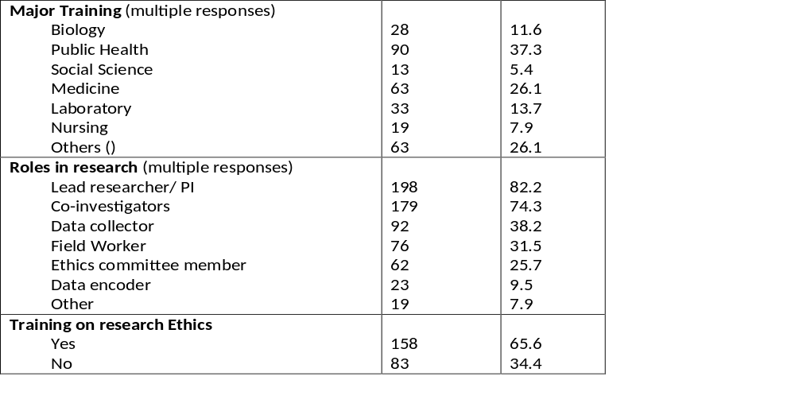
Profile of researchers, ethics committee members from various Ethiopian research institutions, September, 2012 (n=241)

Slide 9
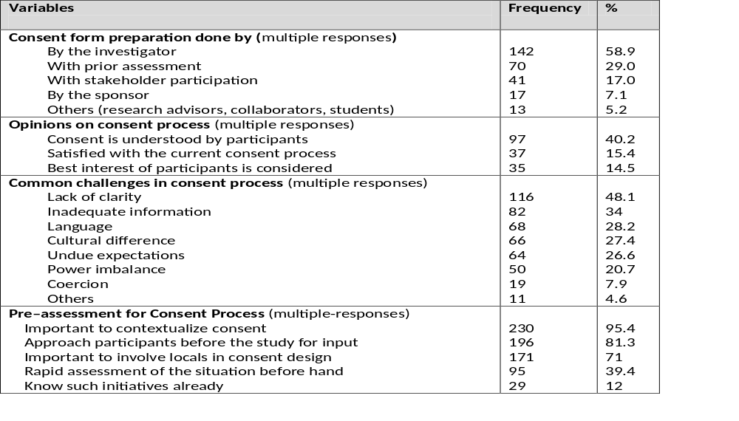
Opinions of Researchers from Various Ethiopian Institutions on the Consent Processes and Development of REA, September, 2012 (n=241)

Slide 10
Perceived gaps and problems in the current consent process (Qualitative)
Language:
Lack of awareness about research, health and ethics:
Undue Expectations by participants and Manipulation by researchers:
Undue Focus on consent and recruitment [without adequate information]:
Undue Emphasis on rules and procedures:

Slide 11
Language
“When we come to information, there is a problem of language, ... Ethiopia is a diverse country, so even when you translate to Amharic, it is hard to bring the understanding, it is hard to translate scientific words to Amharic. ..." [Researcher and ethicist, AAU]
Notes:
The problem of language was repeatedly mentioned as a challenge to the consent process. In Ethiopia it is mostly assumed that Amharic, the national language, will be used in all parts of the country and will serve the purposes of gaining consent. However, Ethiopia is a diverse and multi-ethnic country, so there are many languages and dialects. Failure to understand differences may be problematic. According to the national guidelines, all consent documents in a research protocol need to be translated into the national language and the language of data collection. This is an important point in the ethics review checklists of key ethics committees, since otherwise, the mechanisms of ensuring the right language is used in the field are lacking. In certain societies, the terms and concepts of research and most medical terminologies are lacking. In addition, concepts of health and disease may be based on local traditional understandings rather than the modern medical models used by researchers.

Slide 12
Lack of awareness about research, health and ethics:
" The society might be where they have no knowledge about research... People might also not understand what is written if they can’t read. These are (some) loop holes " [Researcher, EHNRI]
" Even, the participants don’t know what .. research is ... they don’t know whether the research has benefit or harm ... [they] say yes without knowing it" [ Researcher, JU]
".......In Ethiopia, most places where research is done, the people don’t know how to read and write, so how much do the researchers need to explain? " [ Researcher and ethicist, AAU]
Notes:
Generally there is little awareness about science and research. Especially those with very low levels of literacy have limited understanding about this. Participants as a result might consent or decline based on their lack of comprehensive understanding about the research process.

Slide 13
Undue Expectations by participants and Manipulation by researchers:
" There is also this thing, ... there is (even with) the tone of your voice, you might emphasis mainly the benefit, there might be some persuasion. (And), they have to believe in it " [Researcher, JU]
Notes:
Due to misconceptions and failure to comprehend the intended purpose of research, especially in rural communities, there is a tendency to expect direct benefits and undue promises given by field workers just for the sake of obtaining the consent.

Slide 14
Focus on consent and recruitment [without adequate information]:
" .. there is a lot of negotiation and bargaining (around consent), which is not a proper way of getting a consent or is a proper consent (process) application" [Researcher, JU]
Notes:
There is also a tendency to focus more on the consent i.e. the decision to participate than on ‘informed consent’ which should be based on prior information and comprehension. As long as consent is given it is considered alright.

Slide 15
Emphasis on rules and procedures:
" Even the Ethiopian Civil law has been too protective to the extent of not allowing the conduct of trials – Ethics should not hamper Science!" [Researcher, AAU]
Notes:
The respondents feel that there is too much emphasis on fulfilling requirements and procedures than genuine concern for the rights and welfare of study subjects. There is too much emphasis on fulfilling paper works. This is done due to the fact that the rules are there and researchers cannot proceed without fulfilling those. For most researchers 'research ethics' is about having the 'ethical clearance letter'. The regulators also focus more on the enforcement of the rules without proportional levels of creating awareness among researchers and the research community. The regulators do not mostly explain the reasons why the review is needed. The undue emphasis on rules and procedures has created discouragement on the researchers’ side. Researchers expressed their concern that too much emphasis on the rules and procedures my eventually discourage and hamper the progress of research and science. .

Slide 16
Suggestions to improve the current consent process.
Involvement of the community/participants:
Training:
Differentiated approach:
Pre-assessment:
Field visits:
Balanced approach, ‘not to be a hurdle for research’:
Notes:
Involvement of the community/participants: Respondents suggested that the community needed to be involved in the research process in various ways - by including community representatives in ethics committees, and by seeking the opinions of community leaders prior to and during research. Mechanisms suggested included approaching and involving the community through Community Advisory Boards (CAB). Some of the responses in this category are included later as quotes.
Training: Various types of ethics training courses were also suggested by the respondents as important avenues for improving the consent process in developing countries. The training courses might be for researchers, health professionals or the general public. Suggestions were given on how the training courses might be delivered. These included integrating the course into research methodology courses and making them part of undergraduate and postgraduate degrees.
Differentiated approach – depending on the type of research: Participants emphasized the importance of acknowledging differences in contexts and designing approaches accordingly. The application of REA as an approach would depend on prior knowledge of the research design and anticipation of emerging ethical issues. Approaches would depend on the type of research design and the sensitivity of the issue to be addressed by the research. It was repeatedly mentioned that clinical trials would be ideal for this.
Pre-assessment: Doing assessment prior to the actual field study and involving the study participants [others said it might be better to involve the community advisory board rather than study participants themselves] - see theme ‘involvement of community’ above.
Field visits: Field visits to follow how ethical procedures stated in the protocol are actually being implemented in the field. These visits might be before the study or after the study, to monitor the implementation of consent or any emerging issues, depending on the nature of the study. The mandate of deciding which projects need the field follow-up, and coordinating follow-up would be that of the IRB.
Balanced approach, ‘not to be a hurdle for research’: Out of concern that too much emphasis on rules and regulations might discourage researchers, respondents mentioned how important it was that ethical regulations did not become a hurdle for the research itself. The importance of striking the correct balance was also reflected in informal discussions with researchers.

Slide 17
Conclusion
Even though there is a huge expansion of health and medical research activities in Ethiopia, the capacity of ethics review systems lags behind.
There are critical gaps in ensuring a fully ethical consent process.
Problems arise in three distinct areas: –
The health research review system,
Amongst researchers, and
Amongst potential participants.

Slide 18



Acknowledgment

Slide 19
አመሰግናለሁ !
Thank you !

Slide 20
