Slide 1

The Price of Life: Intellectual Property, Patents and Standards in Global Health
Dr Phoebe Li
Lecturer, Sussex Law School
University of Sussex

Slide 2
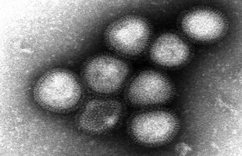
Mapping the scene
Intellectual Property deriving from a virus – the risk factor of IP
Avian influenza A(H7N9) virus
Courtesy of WHO Collaborating Centre for Reference and Research on Influenza, National Institute of Infectious Diseases, Japan
http://www.who.int/influenza/human_animal_interface/influenza_h7n9/en/index.html

Slide 3
Outline
Introduction
Research questions
Methodology
Dilemmas
Recent development
The way forward

Slide 4
Intro: Key words
Precautionary approach (PA)
Risk analysis: risk assessment; risk management; risk communication
Pre-grant measure: Patentability
Post-grant measure: Compulsory licensing
TRIPS: WTO Agreement on Trade-Related Aspects of Intellectual Property Rights
SPS: WTO Agreement on the Applications of Sanitary and Phytosanitary Measures
TBT: WTO Agreement on Technical Barriers to Trade

Slide 5
Intro: Reflections on IP v Innovation
‘[T] here is a growing consensus among economists that the current IP regime actually stifles innovation’. (Stiglitz & Jayadev, ‘India’s Patent Wise Decision, Project Syndicate, 08/04/2013)
‘[A] global intellectual property landscape that is heavily shaped by corporate interests – usually American’ (Stiglitz, ‘How Intellectual Property Reinforces Inequality’, NY Times, 14/07/13)
Why should patent term be 20 years rather than, say, 10 or 30 years? Evidence? Is there room for different views among different countries? Should the US government be pushing other countries to adopt their model? (Simon Lester, 'Debating Intellectual Property’, CATO Institute, 15/03/2013)

Slide 6
Fundamental and technical research questions
What is the right balance between innovation and access? What counts for right innovation?
How to embody human rights claims in the world trade system by promoting access to essential technologies?
How can intellectual property (IP) rights be harnessed by the legitimate interests of health and (national) security?
What is the relationship between science and IP? Does risk analysis/PA have a role to play in the regulation of technology? If so, then how?
To what extent can WTO Members use the inbuilt flexibilities of TRIPS by subjective interpretation according to levels of development?

Slide 7
Methodology

Slide 8
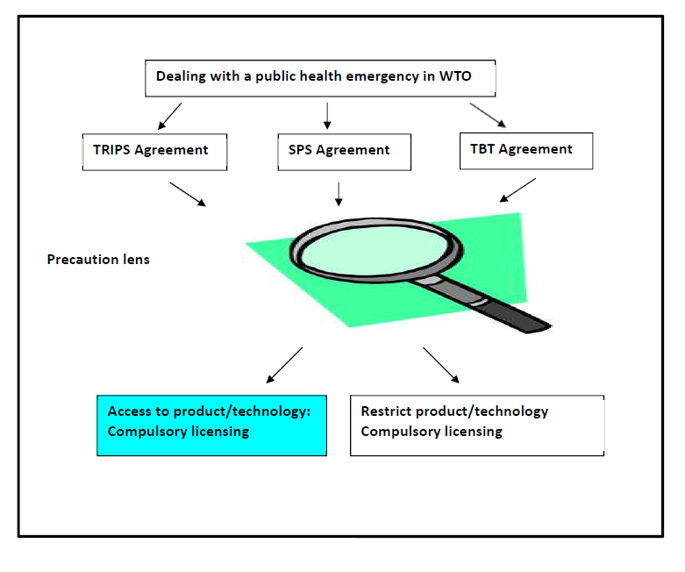

Slide 9
Rights and responsibilities in WTO law
 | Rights | Responsibilities
WTO Members | Rights to protect health | Grant minimum IP protection
IP right holders | Exclusive IP rights | Prevent abuse of IP
The public | Right to health | What is the right expectation?

Slide 10
Dilemmas
The scope of protection: The more useful/essential a technology is, the higher the chance of force sharing (compulsory licensing)
Products/Technologies are assumed safe in WTO law unless proven otherwise (EU – Biotech) ; virus is assumed acceptable unless proven otherwise? (Burden of proof in a pending pandemic)
Does the ‘local working’ requirement in compulsory licensing (a strict or relaxed approach to IP) contribute to or deter international technology transfer?
An organic/sustainable concept to IP acting in accordance to the swift mutation of viruses poses a challenge to the value of stability in traditional property law

Slide 11
Recent cases in India: Pre-grant
Novartis AG, NATCO Pharma Ltd & M/S Cancer Patients Aid Association v Union of India & Others, Civil Appeal Nos. 2706-2716, 2728, 2717-2727 of 2013
Section 3(d) of the Indian Patents (Amendment) Act 2005: A stringent criterion of ‘therapeutic efficacy’ for patentability (prevent evergreening)
‘the same patent law would operate differently in two countries at two different levels of technological and economic development, and hence the need to regulate the patent law in accordance with the need of the country’ (para. 37).

Slide 12
Recent cases in India: Post-grant
India Compulsory License Application No. 1 of 2011
Compulsory licensing on the ground of ‘local working’
(a) The reasonable requirements of the public with respect to the patented invention have not been satisfied;
(b) The patented invention is not available at a reasonably affordable price ;
(c) The patented invention is not worked in India
‘I only wonder why the Patentee did not execute this concept by offering differential pricing for different classes/sections of public in India. ..they offer this drug at a similar price… to patients all over the world.’ (p. 35)

Slide 13
Proposed different pricing models
Considerations: reference pricing, differential pricing, cost based pricing, and price negotiations,
Drugs are classified into three groups for the purpose of price negotiation: medicines having no therapeutic equivalence in India, medicines having a therapeutic equivalent in India, and medicines introduced for the first time in India – each merits a tailored pricing strategy.
(‘Report of the Committee on Price Negotiation for Patented Drugs’, Government of India, Ministry of Chemicals & Fertilizers, Department of Pharmaceuticals, No. 31011/5/2009-PI-II (pt), 21 February 2013)
Note: WHO (2013) ‘Priority Medicines for Europe and the World 2013 Update’ , Chapter 8.3

Slide 14
Recent development
Post-grant opposition:
  Association for Molecular Pathology v. Myriad Genetics, Inc., 106 U.S.P.Q.2d 1972 (U.S. 2013) [2013 BL 155804]
  Consumer Watchdog v Wisconsin Alumni Research Foundation, Case: 13-1377, Filed: 02/07/2013
The Brazil Patent Act (Law no. 9279) reform: Bill no. H.R. 5402/2013

Slide 15
The way forward
Innovation beyond IP: government–financed research; foundations, and the prize system; Health Impact Fund; Public-Private Partnerships
Tempering IP in accordance with levels of development
A fast track to file opposition ?
Fostering an encompassing/organic/adaptive approach to international IP? Application of risk analysis to IP
  Risk assessment: pre-grant examination (Brazil ANVISA; WHO Pandemic preparedness)
  Risk management: A precautionary approach to IP
  Risk communication: Patient and citizen involvement in innovation; A Bottom-up approach to IP? How to engage the public for IP policy making? Public debate? Political considerations?

Slide 16
Thank you!
‘Rights and responsibilities in patents – A precautionary patent framework in WTO law’ (2013) 9 European Intellectual Property Review
Health technologies and international intellectual property: A precautionary approach (2014) Routledge
Contact: Phoebe.Li@sussex.ac.uk

