Slide 1
Issues and Challenges Surrounding Medical Countermeasure Development for Bioterrorism
Pharmaceuticals and Global Health: Inequalities and Innovation in the 21st Century
Dr Paul Russell
Principal Medical Officer (Research), DSTL Porton Down
Consultant Medical Microbiology and Virology, Salisbury District Hospital
Notes:
Intro

Slide 2
Who? And What?
    Individual(s) with individual agenda (“lone wolf”)
      “Technically impoverished”
      “Gifted amateur”
  Individual/group as part of organised network
    - De novo group
    - Faction/recognised Terrorist Group
State sponsored Terrorist Group
Sophistication
Agent
Delivery
Resources
Financial
Materiel
People
Scale
of
Production
Hostile nation state
Notes:
In order to determine what the challenges are, we need to know who might commit such an act which is linked to what they may have available to use, how much they can make and how to deliver it. As a general rule, the more people involved, with political will, the more sophisticated the program.

Slide 3
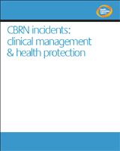


Agents
Anthrax
Plague
Tularemia
Botulinum
Brucella
Venezualan Equine Encephalitis
Smallpox
Viral haemorrhagic fever
Notes:
Various bodies produce lists with exotic diseases that cause fear usually out of ignorance, which extends to healthcare professionals. The fear factor can often be disproportionate and will lead to overwhelming demands on health and public services should an event occur.

Slide 4
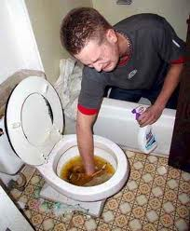
Reality…………?
Notes:
Is this, however, a more likely scenario. Low tech, cheap and will cause casualties.

Slide 5

Bhagwan Shree Rajneesh Sect 1984
Salmonella typhimurium
Ordered from a collection
Propagated by individuals with some technical skill
Simple delivery
751 cases: 45 hospitalised: No fatalities
Used to influence local elections
Not discovered as deliberate release for a year after the incident
Notes:
Slightly more elaborate means than the previous slide but the principle is the same. Purpose was to influence local elections by contaminating salad bars in various restaurants. It was over a year before deliberate release was confirmed and the perpetrators were caught. Note the culture was ordered from a collection held in a lab. This is one of the key areas of security in order to prevent unlicenced individuals or groups from obtaining stocks of pathogens. It also should be noted that the group was trying to get hold of Salmonella typhi. The outcome may have been far more different had they been successful.

Slide 6

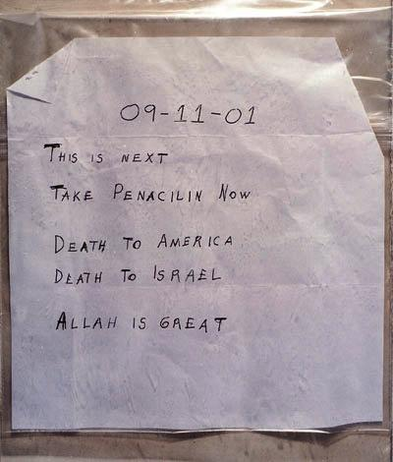

But….
Bacillus anthracis
Alleged government scientist with mental health problems
Potential 32,000 exposures
22 cases; 11 inhalational
5 deaths
In the immediate aftermath of the September 11th attacks
FBI Investigation - "one of the largest and most complex in the history of law enforcement“
  Over 6 continents
  9,000 interviews
  67 searches
  6,000 subpoenas
Cost of clean up in excess $1 billion
$5.6 billion allocated over 10 years for vaccines and medical countermeasures
Notes:
Anthrax used allegedly by a government scientist. 32000 people given prophylaxis. 5 deaths, 2 were apparently unrelated to the incident but may have been susceptible to anthrax and received contaminated mail.

Slide 7
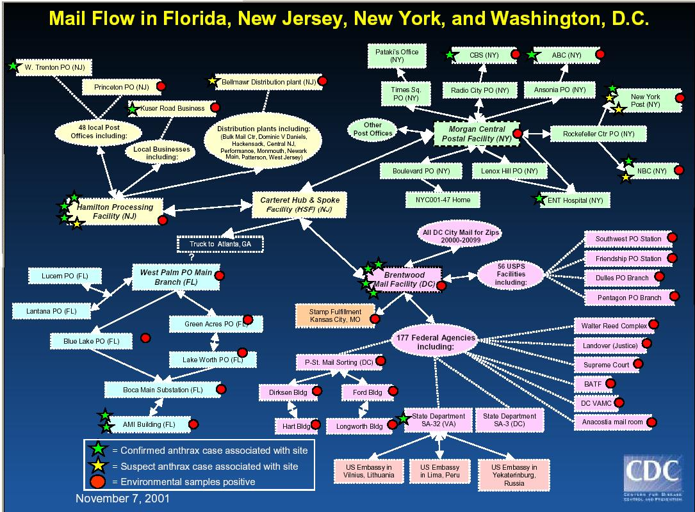
Notes:
Illustrates the complexity with dealing with an outbreak and a criminal event.

Slide 8
Deliberate release
Disease outbreak from deliberate release is essentially the same as a natural outbreak
  Point source
  Disseminated cases as people disperse
    Secondary spread if transmissible
Difficult to discriminate between the two
  Unusual disease
  Unusual presentation
Notes:
Disease outbreak are essentially the same whether natural or deliberate. Often a point source with dispersion of affected cases, plus onward transmission if the disease is transmissible. Unusual disease or presentation may provide some clues.

Slide 9
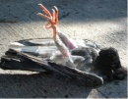
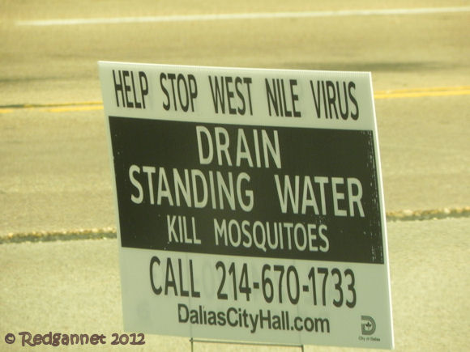
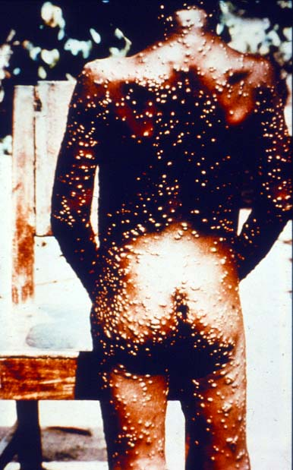
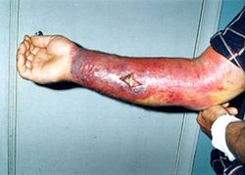
Notes:
But beware, unusual diseases do occur unexpectedly, e.g. West Nile and monkeypox is the US, anthrax in IVDUs in UK

Slide 10
Infectious Disease Outbreak
As with any disease outbreak
Multi-agency
  NHS
  DoH
  PHE
  DEFRA
Implications but not necessarily direct involvement
  Education, Home Office, MoD, Treasury and other national and local government departments/agencies
Notes:
Outbreaks require multi-agency participation. In the UK, patients will present to the NHS. Medical microbiologists will report unusual infection to Public Health England especially if notifiable, or if unusual activity. Public Health England will issue alerts to broadcast any events that warrant surveillance. DEFRA will be alerted with regard to diseases which have impact on animals, and vice versa. In some cases other departments may be alerted or involved. Schools may have to consider shutting in a pandemic, the military via the MoD provided logistic support and command and control during the foot and mouth outbreak.

Slide 11
Deliberate Release
Crime
  Law enforcement agencies
  Counter-terrorism
  Security services
Requirement for technical advice and forensic exploitation
  Home Office
  MoD
  Foreign and Commonwealth Office
Notes:
Deliberate release adds another dimension in that a crime has been committed. Further support is required from law enforcement to investiage crime, gather forensic evidence and provide security. There may be political ramifications and a robust political response in some circumstances.

Slide 12
Deliberate Release - Challenges
Political
  Political pressure
    Repugnant act
    Who did it?
    Retaliation?
    “Something must be done”
Social
  Fear
  Ignorance
  Treating the sick – may be large numbers
  Treating the well – will be even bigger numbers!
  Social interventions
    Closing schools, restricting travel etc.
Notes:
There will be political pressure applied to government of a nation subjected to deliberate release. There will be a desire to find those responsible and be seen to act decisively both in response to the perpetrators but also those affected by the attack. There will be a lot of fear based on ignorance with the possibility of severe sanctions on normal day-to-day routines. Those genuinely sick will be in the minority, yet may be in sufficient numbers to overwhelm health care providers, which will be under considerable strain from the attendance of the “worried well”.

Slide 13
Medical Countermeasures – What?
Bacterial infection can be treated with antibiotics
  Which ones?
  Route
    Difficult to establish intra-venous lines in large numbers of people
    Preferably oral
      Problematic in patients with vomiting and/or diarrhoea
    ?Intra-muscular
  Stock-piling
    Expensive
    Storage
    Drug shelf life – turnover and restock
  Prophylaxis?
  Timely administration
    Rapid onset of disease
    Too late once symptoms appear
Notes:
The demand for countermeasures will be considerable. The sick will need treatment, the worried well, at least a proportion of them will require, or even demand prophylaxis. Oral formulation is convenient and people can self medicate under supervision, but the affected individuals may be unable to tolerate oral medication. Although IV access can circumvent this, the number of people may make this difficult. Of the diseases listed, many have a rapid progression with high mortality once symptoms appear. Prophylaxis is expensive and can be wasteful. The risks of exposure need to be outweighed against risks of taking the antibiotic.

Slide 14
Medical Countermeasures – What?
Antivirals
  Very few
  Poor efficacy or paucity of evidence of efficacy against some of the viruses
  Bioterrorism virus threats not likely to give an adequate financial return for research and licensing (e.g. compared to influenza or HIV)
Vaccines
  Very few
  Where available
    Limited production and supply
    Non-licensed use
  Ethics of vaccinating against “non-public health” threats
  Acceptable to the population
    Influenza immunisation rates in healthcare staff!!
  As with antiviral drugs little incentive to develop
Notes:
There are few antivirals with little appetite for development apart from HIV, hepatitis and HIV. There a few vaccines, again with little interest in development. Where they are available, they are often in short supply and may have license restrictions or used off licence. Vaccinations on the whole have been subject to irrational backlash and media scrutiny resulting in the reduced uptake of some of the “public health” vaccines with serious consequences recently. Even in a well informed group of people, vaccine uptake is low – the uptake of flu vaccine among healthcare staff is often <50%.

Slide 15
Dstl
Medical countermeasures to deliberate release agents on a background of expertise in working in high level microbiological containment
  De novo vaccine research
  Candidate vaccine testing in collaboration with other institutions
  Antibiotic/antiviral efficacy
    Old and new antibiotics/antivirals
  Generic countermeasures
  Horizon scanning
Notes:
Dstl does some medical countermeasures research against some of these agents, seen as a threat to UK Armed Forces as part of a research program looking at protecting Armed Forces personnel from all manner of threats. From the microbiological perspective, it has the most up to date high containment facilities, including CL4 in the UK, with an expert complement of staff. Research includes basic research into prospective candidates for vaccines, with successful candidates pushed out for clinical trials. New antibiotics/antivirals produced by industry and old antibiotics returning to use, can be tested in vitro and in vivo for efficacy against some of the bacterial agents. An aspiration would be to have a generic countermeasure that effectively would be a broad spectrum agent and various immunomodulators are being looked at. There is watching brief to see what is coming out of academia and industry that may also could be exploited as potential countermeasures in the future.

Slide 16
Dstl
Research coupled with
  Diagnostics and detection to provide earliest opportunity to treat infection
  Management of sepsis
  Provide specialist advice to government to prevent the proliferation of biological weapons and maintain security of potential deliberate release agents
  Collaborate nationally and internationally with academia and industry
Notes:
Countermeasures is done against a background of diagnostics and detection to refine the use of medical countermeasures especially in a timely manner plus there is advice at political level to prevent such agents getting into the hands of individuals or groups with intent to use them as weapons.

Slide 17
The Biggest Bioterrorist of All……
Notes:
Bioterrorism is seen as a credible threat with the potential to cause numerous casualties, an aspiration yet to be fulfilled. It is sometimes considered to be over-hyped. In the context of global infection the biggest threat comes from…..

Slide 18
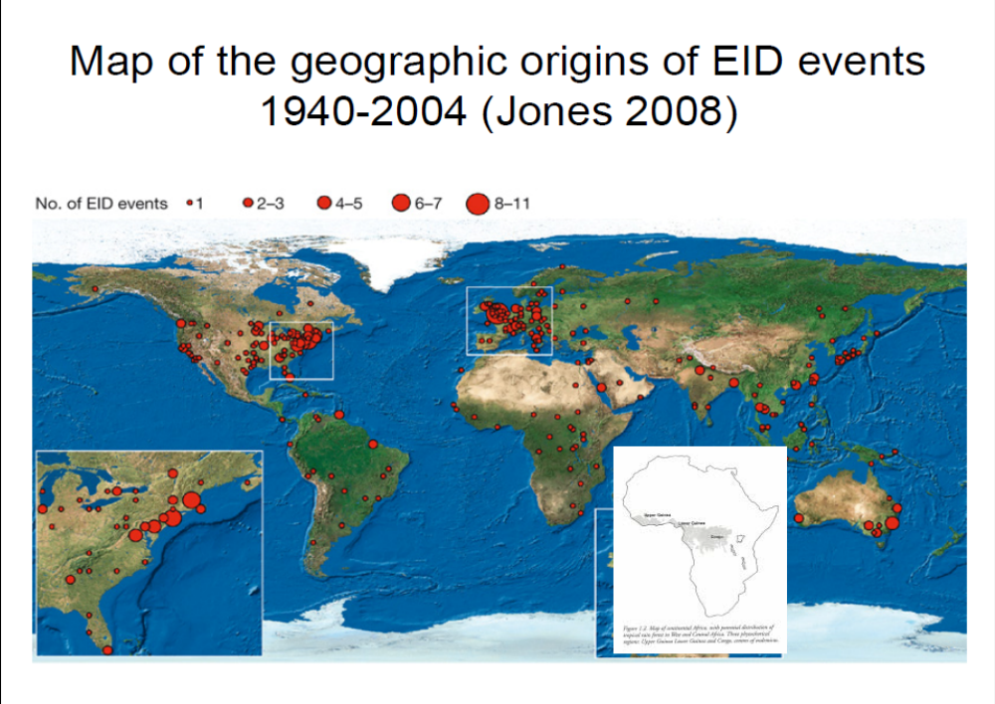
………Is Mother Nature
Notes:
…. Emerging and re-emerging infections. There is a suggestion that a new infection appears every 18 months. Some of the research carried out by Dstl will have applications to the emerging disease threat

Slide 19
Any questions?

