Slide 1
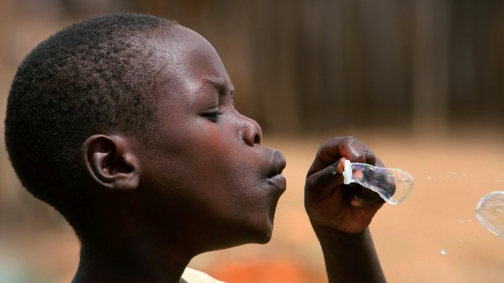
Pharmaceuticals and Global Health
Inequalities and Innovation in the 21st Century

Slide 2

1
What has been invested in neglected disease R&D?
2
New business models for global health R&D
3
Challenges and solutions for the future
Global trends in neglected disease R&D investment
Enabling health impact in developing countries
Improved sustainability
in global health R&D
Levels of funding
Nature of funding
Product development partnerships
Innovative developing countries
What has been delivered?
High risk R&D, long development / short political timelines
Targeted funding to match R&D needs
Diversification of funding
Notes:
EU investment in PRN R&D
2 objectives:
Improved health in DCs
Increased growth & competitiveness in the EU
Timely to review, given debate on Horizon 2020 & climate of austerity in Europe
PC approach – 3 steps
What has EU invested in PRND? – levels & nature of funding, MS & EC
How have developing countries benefitted? – health & economic impact of new products, research capacity
What is the return on investment for Europe? – jobs, leveraged investment, scientific excellence, industrial competitiveness, PRNDs in Europe. integration
Data from 2007 to 2010 using variety of data sources – G-Finder, published reports, telephone interviews

Slide 3
1
What has been invested in neglected disease R&D?
$2.5-3.3 billion per year in neglected disease R&D between 2007 and 2011

Slide 4
1
Which diseases are funded?
3rd tier/diseases
Top tier diseases
2nd tier/
semi-commercial
Notes:
1st tier – HIV/AIDS, Malaria and TB (18-34%)
2nd tier – Dengue, Pneumo, Diarrhoeal diseases, Kinetoplastids (Chagas, HAT and Leish), salmonella (1-8% funding each)
3rd tier – Helminths, Buruli, Trachoma, RF – less than 1% each
Semi commercial diseases – Dengue, TB and Pneumonia/Meningitis – have increased their share of global ND funding between 2008 and 2011 (driven by industry investments)
Dengue – Sanofi phase III candidate, GSK/Aeras TB vaccines, Pneumo – AMC funding

Slide 5
1
Who is investing in neglected disease R&D?
Notes:
Public - Aid agencies vs. S&T
Philanthropic – high concentration of funding - Gates
Global financial crisis has affected public and philanthropic funding. Increases in private sector funding – driven by semi-commercial diseases
Shifts in funding affect the type of research funding – basic vs. development, and types of diseases.

Slide 6
1
Top funders: Average annual funding 2007-2011
1. US NIH $1,159m
2. Bill & Melinda Gates Foundation $506m
3. Pharmaceutical industry $407m
4. European Commission: Research Directorate-General $113m
5. US Agency for International Development (USAID) $83m
6. US Department of Defense (DOD) $80m
7 Wellcome Trust $72m
8. UK Department for International Development (DFID) $69m
Notes:
High concentration of funding
NIH – 40%
Gates – 17%
Industry – 14% (aggregated for confidentiality)

Slide 7







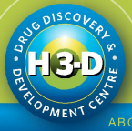

2
How have developing countries benefitted?
2
New business models for neglected disease R&D
Product Development Partnerships
Involved in 40% of new products for global health R&D in last decade
Innovative Developing Countries
Increasing government investment in domestic biotech innovation
Notes:
PDPs – non-profit public health driven product developers – collaborations between non-profits, industry and academia
LMIC innovation and partnerships
GSK and South Africa, Brazil, Indian biotech grants

Slide 8
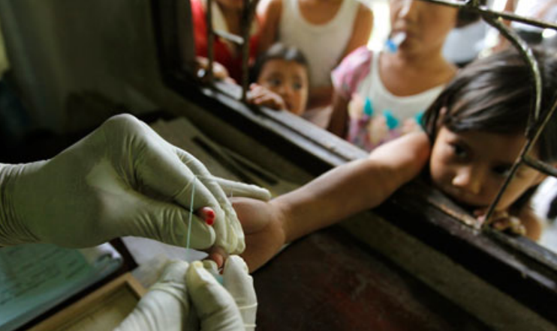
2
How have developing countries benefitted?
MAJOR PHARMACEUTICAL INNOVATIONS
MenAfriVac
Xpert MTB/RIF
Coartem
Notes:
Malaria infects more than 216 million people each year and is responsible for the deaths of an estimated 655,000 people, mostly children living in Africa.
Around 40% of the world’s population are at risk of contracting malaria. Malaria is preventable and treatable, but the emergence of drug-resistant malaria parasites has rendered the old
Development of three new products to combat malaria that are already saving lives in malaria endemic countries.
COARTEM -Novartis, partnered with Chinese scientists at the Beijing Institute of Science and Technology to develop Coartem®, the first artemisinin-based combination therapy (ACT), with a cure rate in excess of 95%7. Novartis later collaborated with a Swiss-based PDP, the Medicines for Malaria Venture (MMV), to develop Coartem® Dispersible, the first water-dispersible ACT specifically designed for children. Since 2001, Novartis has provided more than 400 million Coartem® treatments on a not-for-profit basis through an agreement with the WHO, saving an estimated 1 million lives; Since launch in 2009, over 171 million Coartem dispersible delivered to more than 30 malaria endemic countries, at a cost as low as $0.38 per course of treatment.
ASAQ - Sanofi partnered with two organisations, the Drugs for Neglected Diseases Initiative (DNDi) and World Health Organization Special Programme for Research Training in Tropical Diseases (WHO/TDR), to develop the first fixed-dose ACT formulation for children. The fixed-dose combination pill, ASAQ, is simple to administer and improves patient compliance, which is critical to avoid the risk of resistance. The collaboration was funded by several EU Member States including France, the Netherlands, Spain and the UK and the EC through the Fifth Framework Programme for Research and Technological Development (FP5). over 150 million treatments of ASAQ have been distributed in 30 African countries by Sanofi on a not-for-profit basis
EUARTESIM - Sigma-Tau, biotech, partnered with MMV and the University of Oxford to develop Eurartesim®, another simpler-to-use ACT. Initial studies were conducted in Vietnam at a site funded by the UK-based Wellcome Trust. The collaboration is funded by Ireland, the Netherlands, Spain, UK and Switzerland, in addition to philanthropic foundations. Eurartesim® was the first antimalarial to be approved by the European Medicines Agency in October 2011, and Sigma-Tau and MMV are currently developing it in a paediatric formulation. Eurartesim® is now being delivered to Cambodia, the first malaria-endemic country to receive the new drug.

Slide 9

2
How have developing countries benefitted?
MenAfriVac. 56m vaccinated since 2011
Predicted to prevent 437,000 cases in next decade
Xpert MTB/RIF. Expected to triple diagnosis of drug resistant TB.
India alone, predicted to avert 100,000 deaths/year
Coartem. Since 2001, 400+ mil treatments provided on non-profit basis by Novartis.
Estimated 1mil lives saved.
Coartem Dispersible Over 171m delivered to 30+ malaria endemic countries
At costs as low as $0.38 per course of treatment.
Pharmaceutical Innovation
Notes:
MenAfriVac – no new cases since vaccination started, saving 43,500 lives and averting 105,000 disabilities.
Xpert – triple patients diagnosed with drug resistance TB, allowing correct treatment. Double patients diagnosed with TB infected HIV, allowing early treatment. In India alone, modelling predicts to avert 100,000 deaths/year

Slide 10
2
New business models for neglected disease R&D
360 products in development
234 in preclinical, 289 in early clinical, 42 phase III trials
THERE ARE PROMISING CANDIDATES FOR
HIV/AIDS, MALARIA, TUBERCULOSIS AND DENGUE
Notes:
HIV preventives
Malaria vaccine
TB drugs
Dengue vaccine
Development times are long and outlast political timelines
Basic research and translational research is difficult – bridging the valley of death with funding is a challenge – how do funders and different sectors play a role?
How do the different stages of research inform each other – clinical research defining basic research questions?
Fragmented landscape of funding difficult for researchers

Slide 11
3
Challenges and solutions for the future
Currently growing pipeline may face untimely funding cuts
R&D pipelines need reliable long-term funding
Financial pressures mean smarter funding needed:
  Outcome driven and flexible
  Aligned with product and portfolio developments
  Coordinated
  Targeted to deliver the highest health impact
Notes:
Progress in global health R&D in the past decade has been remarkable but the gains are fragile.
Sustained funding over the last decade has created a critical mass within the global health R&D community and built momentum steadily over the decade.
Scaling back funds for global health R&D puts the entire product development pipeline at risk.
Decommissioned research programs cannot easily be restarted, skilled scientists will be lost and the hard-won build-up of political will, expertise, and industry and philanthropic commitment may never be regained.
A retreat from funding R&D would waste billions of dollars of investment, and condemn promising drugs, vaccines, and diagnostics now in the final stages of development to the scrapheap.

Slide 12
3
Challenges and solutions for the future
Building Capacity in Developing Countries
Collaboration & partnerships
+
+
+
Quality Research
Targeted and flexible funding
Enabling health impact in developing countries
Improved sustainability
in global health R&D
Investment in neglected disease = R&D
+

Slide 13
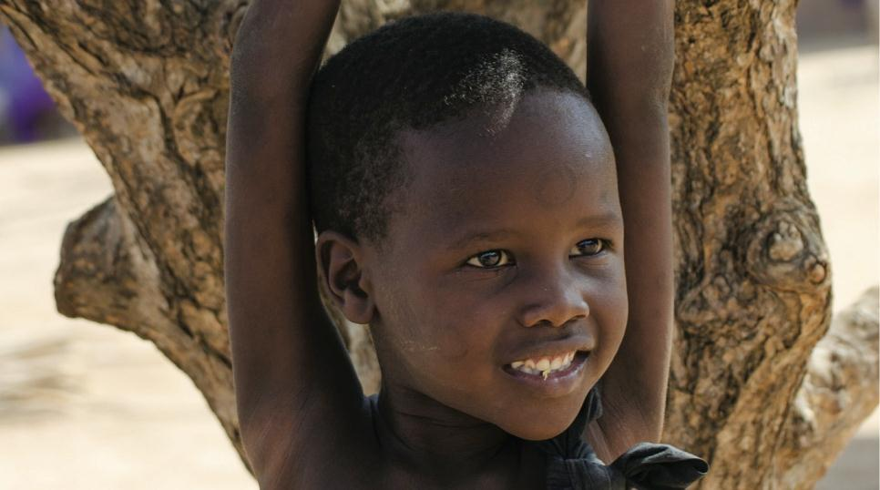
Thank you
Lindsey Wu
Senior Analyst, Policy Cures
lwu@policycures.org

