Slide 1


The Medicines Patent Pool advancing innovation, expanding access, promoting public health
Charles Clift
Chair, Medicines Patent Pool
www.medicinespatentpool.org
University of Sussex, 19 July 2013

Slide 2
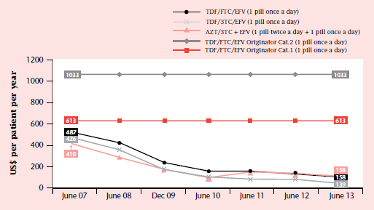
First Line Regimens: Price Changes
Source: MSF Untangling the Web of Antiretroviral Price Reductions 16th Edition. July 2013

Slide 3
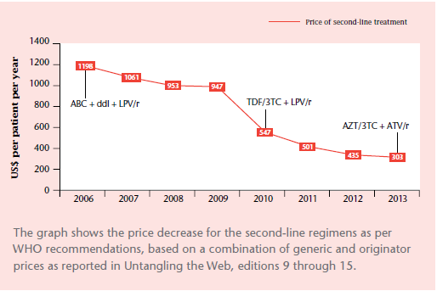
Second Line Regimens: Price Changes
Source:MSF Untangling the Web of Antiretroviral Price Reductions 16th Edition. July 2013

Slide 4
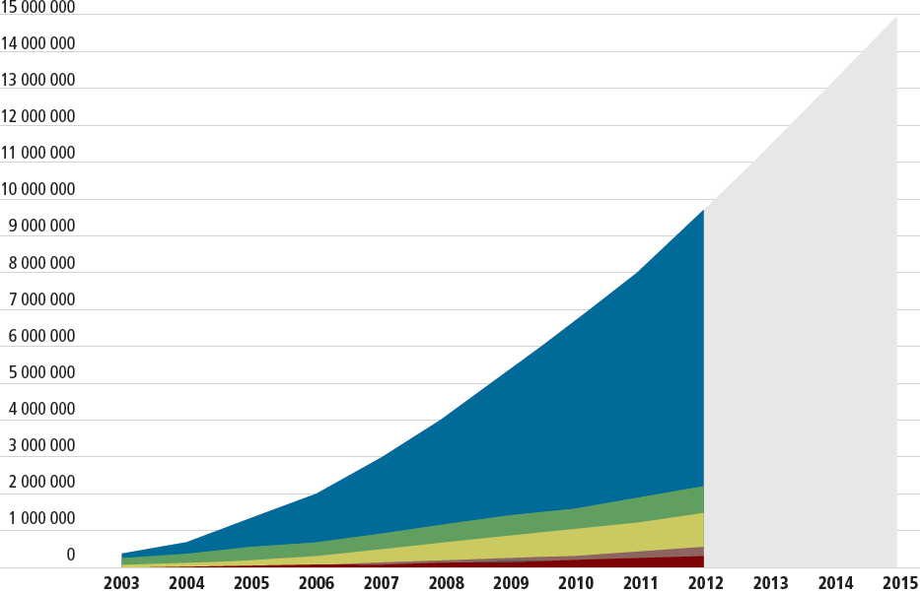
Numbers in treatment (actual and projected) 2003-15
Source: UNAIDS. Global Update on HIV treatment 2013: results, impacts, opportunities. WHO, Geneva 2013.

Slide 5
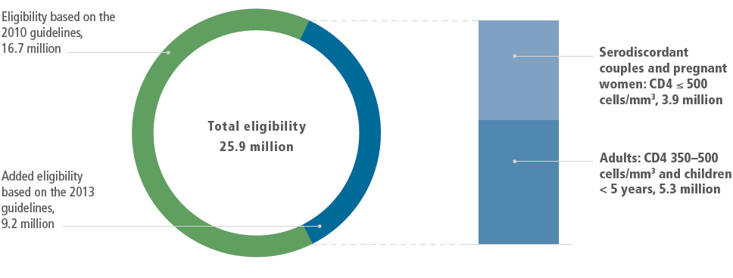
Impact of New WHO Treatment Guidelines
Source: UNAIDS. Global Update on HIV treatment 2013: results, impacts, opportunities. WHO, Geneva 2013.

Slide 6
Increasing patents in developing countries
Patent applications for countries pre- and post-TRIPS, basic patent*
* Patent applicant intention defined as categories A (granted), B (filed, under appeal, designated under international agreement, opposed), C (revoked, expired, lapsed) and D (rejected, withdrawn, abandoned).

Slide 7
Changing ARV Patent Landscape
1985 |  |  |  | 1990 |  |  |  |  | 1995 |  |  |  |  | 2000 |  |  |  |  | 2005 |  |  |  |  | 2010 |  |  |  |  | 2015 |  |  |  |  | 2020 |  |  |  |  | 2025 |  |  |  | 2030
 |  |  |  |  |  |  |  |  | TRIPS Transition for Developing Countries
 |  |  |  |  |  |  |  |  | TRIPS Transition for Least Developed Countries
 | Zidovudine
 | Didanosine
 |  | Stavudine
 |  |  |  | Saquinavir
 |  |  |  | Nevirapine
 |  |  |  | Abacavir
 |  |  |  | Emtricitabine
 |  |  |  | Lamivudine
 |  |  |  |  |  | Indinavir
 |  |  |  |  |  |  | Efavirenz
1985 |  |  |  | 1990 |  |  |  |  | 1995 |  |  |  |  | 2000 |  |  |  |  | 2005 |  |  |  |  | 2010 |  |  |  |  | 2015 |  |  |  |  | 2020 |  |  |  |  | 2025 |  |  |  | 2030
 |  |  |  |  |  |  | Darunavir
 |  |  |  |  |  |  | Ritonavir
 | ` |  |  |  |  |  |  |  |  |  | Lopinavir
 |  |  |  |  |  |  |  |  |  |  | Atazanavir
 |  |  |  |  |  |  |  |  |  |  |  | Tenofovir DF
 |  |  |  |  |  |  |  |  |  |  |  | Fosamprenavir
 |  |  |  |  |  |  |  |  |  |  |  |  | Maraviroc
 |  |  |  |  |  |  |  |  |  |  |  |  | Etravirine
 |  |  |  |  |  |  |  |  |  |  |  |  |  |  |  | Rilpivirine
 |  |  |  |  |  |  |  |  |  |  |  |  |  |  |  | Raltegravir
 |  |  |  |  |  |  |  |  |  |  |  |  |  |  |  |  | Elvitegravir
 |  |  |  |  |  |  |  |  |  |  |  |  |  |  |  |  |  |  |  | Dolutegravir
 |  |  |  |  |  |  |  |  |  |  |  |  |  |  |  |  |  |  |  |  | Cobicistat
 |  |  |  |  |  |  |  |  |  |  |  |  |  |  |  |  |  |  |  |  | SPI-452
1985 |  |  |  | 1990 |  |  |  |  | 1995 |  |  |  |  | 2000 |  |  |  |  | 2005 |  |  |  |  | 2010 |  |  |  |  | 2015 |  |  |  |  | 2020 |  |  |  |  | 2025 |  |  |  | 2030

Slide 8
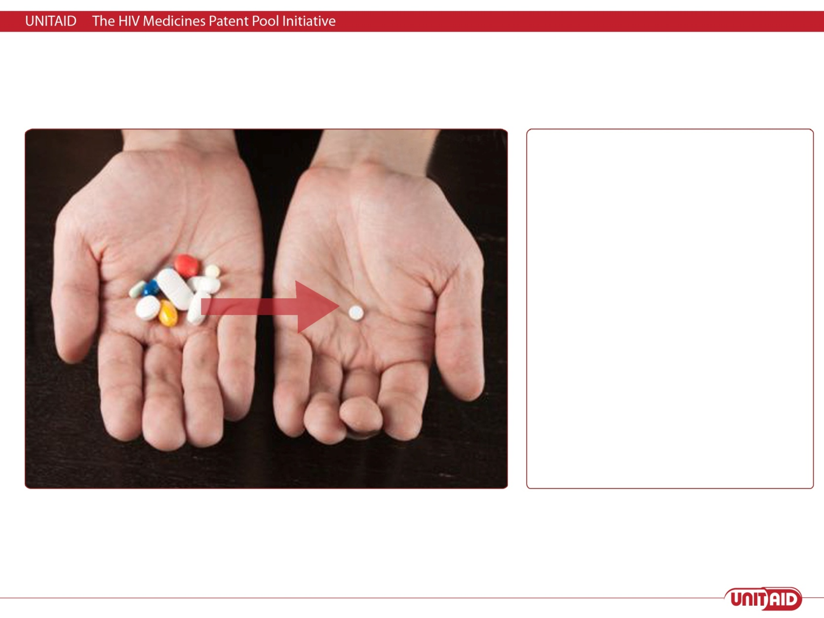
Three Main Objectives
  Accelerate the availability of generic versions of new ARVs in developing countries
  Enable the development of fixed dose combinations (FDCs) of which the patents are held by different entities
  Enable the development of adapted formulations for children or for specific developing country needs (e.g., heat stable)

Slide 9
Impact
The MPP has licences covering the ARVs recommended by WHO for the preferred first line regimen for adults and for children
At least 20 developing countries already benefitting from access to more affordable quality-assured first-line regimens as a result of Pool licences
6 ARV manufacturers have licensed ARVs from the MPP and are actively working on the development and registration of new ARVs (more being discussed)
Technology transfer to generic manufacturers carried out in relation to four ARVs
Public-health oriented licences have set new standards for licensing; publication of full text of licence
Patent Status Database is "an invaluable step towards furthering access to treatment of HIV/AIDS" by UN agencies and major organizations procuring ARVs. http://www.medicinespatentpool.org/patent-data/patent-status-of-arvs/

Slide 10
Issues
The patent pool is voluntary – companies need to see the benefit to them of joining (and assess the possible costs)
Issues over the geographical scope of agreements
Companies now undertaking much more voluntary licensing on their own account
Some activists distrust the Pool because it collaborates with a system they basically disapprove of – and want more transparency than is consistent with negotiations with companies
But five companies are in active negotiations with the Pool and more deals are expected this year.

