Slide 1

Panel 3. Designing Pharmaceutical Markets: Pharmaceuticalisation, Regulation and Global Health
1. G. Bloom –‘Addressing the challenge of unorganised markets for pharmaceuticals in low and middle income countries’.
2. I. Harper – ‘Understanding TB drug markets in South Asia: The case of Nepal’
3. A .Faulkner – ‘The pharmaceutical imperative: extension of the European Union’s medicines regulation’
4. P. Martin - ‘Pharmaceutical Futures’
5. J. Abraham - 'The Challenge of Evaluating Pharmaceuticalisation'.

Slide 2
The pharmaceutical imperative: extension of the European Union’s medicines regulation’
Alex Faulkner
Centre for Global Health Policy
University of Sussex
a.faulkner@sussex.ac.uk
Pharmaceuticals and Global Health -
Inequalities and Innovation in the 21st Century
University of Sussex, 19 July 2013
Notes:
Title slide of presentation.

Slide 3

Global medical bioeconomy

Slide 4
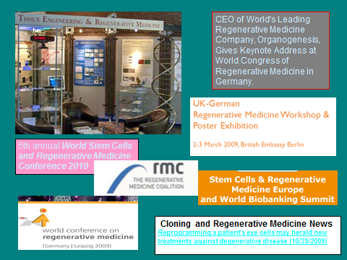
Revolution in emerging global healthcare?

Slide 5
Global regulatory politics of innovative medical products
      Medicines and medical devices
      Variegated national/regional regulatory patchwork
      Regulatory regimes and agencies compete and collaborate
      -> Innovation and medical need vs. ‘quality, safety, efficacy’

Slide 6
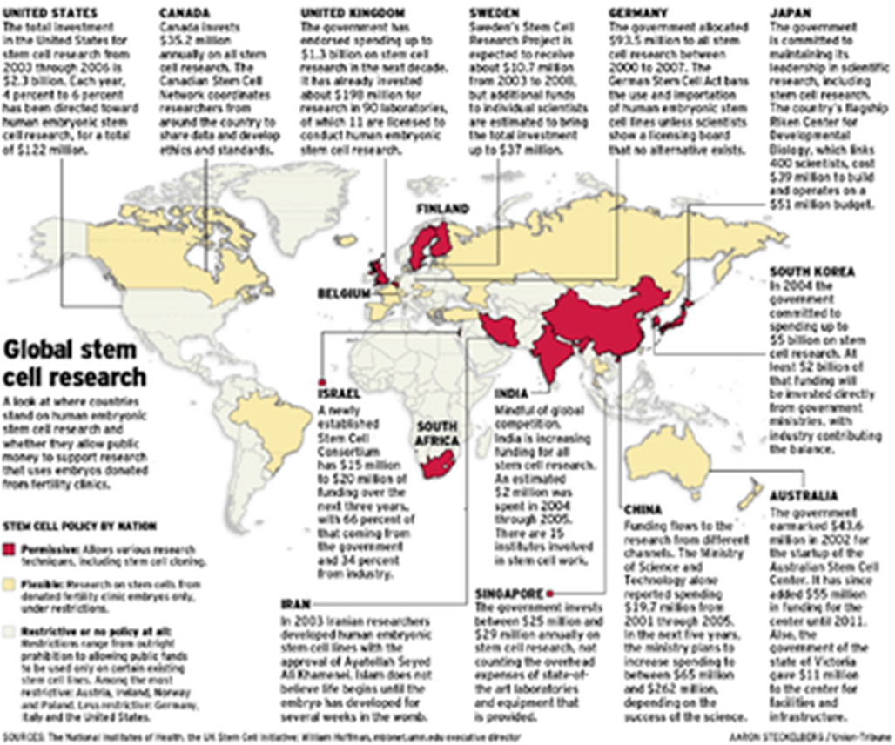
Global variegation in regulation
Notes:
Introduction slide.

Slide 7
The EU’s ‘Advanced Therapy Medicinal Products’ 2007
    Cell therapy
    Gene therapy
    Tissue engineered products
    ‘Medical devices’ and combined products
    - a ‘coherent ensemble’
    - cancers, diabetes, arthritis, heart repair….

Slide 8
The regenerative medicine and cell therapy sector
-- High government and charity-invested sector
-- Fragile, with many SME and clinical trial failures and lack of clear business model; majority trial preclinical
-- few marketised products
-- most activity in EU is in hospitals/academia
-- technical ‘scale-up’ and production standards issues
-- Gradual interest of big pharma

Slide 9
Pharmaceuticals: The European Medicines Agency
Essentially centralised regulatory system for medicines authorisation (incl mutual recognition etc)
Focus on pre-market data on quality, safety, efficacy
Industry ‘blockbuster’ model
Notes:
Not discussing decline of & threats to blockbuster model here

Slide 10
Medical Devices: Directives regulation in EU
Very different industry and regulatory model
Directives transposed into national law
Technical standards-based
No central agency
Devolved product assessment agencies
Focus on post-market/clinic data
Incremental innovation
-Regarded as softer than pharma regulation and the US device system

Slide 11
Medicine vs. Device politics – e.g. products combining cells and device
‘The Presidency has also suggested…all combined products containing viable cells or tissues should be considered ATMPs:
Support: Belgian, Estonian, Lithuanian, Hungarian, Portuguese and Slovenian delegations;
Against: Danish, Spanish, French, Netherlands, Swedish and United Kingdom delegations hold that the principal mode of action should be decisive.
(Health Council of Europe Working Party on
Pharmaceuticals & Medical Devices, 2006)

Slide 12
Medicine or Device? Politics of medicinal mode of action
‘… say a heart valve covered by cells. .. the main mode of action is…not the cells, it’s the valve itself. However the cells are there for a certain function but it might be secondary to the physical mode of action by the valve…’
(MHRA interview with medical device
regulator, 2006).

Slide 13
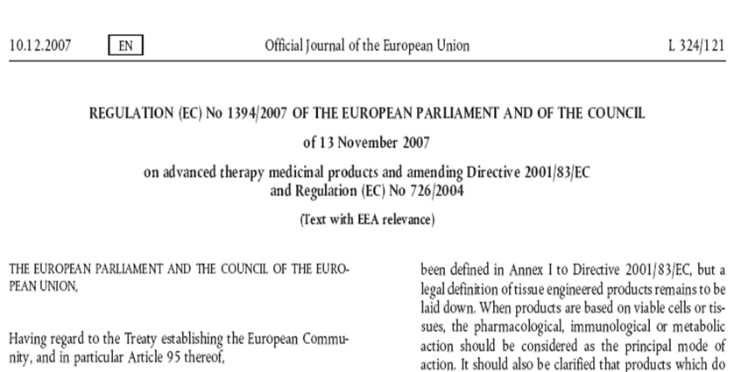
The Pharmaceutical Imperative
‘Advanced Therapy Medicinal Products Regulation’ 2007

Slide 14
Effects of Regulation
- Harmonised pan-EU centralised regulation
-But Member State-level exemptions to encourage small scale innovation within the harmonised standards – hospital/academia bias
- Review of medical device features of Regulation
- high-risk devices under EMA?
Notes:
Possibly also rare disease and compassionate use bias

Slide 15
EXTENSION OF EU/EC REACH:
European Medicines Agency (EMA)

Slide 16
Countering challenge to IP threats to European cell therapy R&D
‘“To maintain its global edge in this area of research, Europe must ensure all avenues of stem cell research continue to be financially supported, including through Horizon 2020.Europe’s strengths in this field present valuable opportunities to attract skilled scientists, biopharmaceutical companies and international investment in stem cell research to Europe…and to influence the international agenda”. (Wellcome Trust and others, 2012)

Slide 17
Clinical trials outside EU
‘clinical trials conducted in countries outside EU/EEA… (to be) conducted in accordance with the principle of Good Clinical Practice (GCP) and equivalent ethical standards as those applied/requested in the EU’
(EMA ‘Reflection paper’ 2012)

Slide 18
Regulatory ‘cooperation’ EC-India
EMA
“working with India in the application of international standards in manufacturing and clinical trial activities, and is facilitating capacity building and regulatory contacts through the GMP”.

Slide 19
Regulatory ‘cooperation’ EC-India - standardisation
EU Council of Ministers for Health and the Indian Department of Biotechnology joint programmes, e.g.
“ALZBIOINDIGO aims to develop an indo-euro network to accelerate the development of new molecular biomarkers for Alzheimer's Disease
…ensuring a predictive and efficient drug development, thus concomitantly reinforcing the EU and Indian biotech collaboration and competitiveness
…in agreement with EMA guidelines”.

Slide 20
Regulatory ‘cooperation’ EC-China
2010 European Commission/EMA- Chinese State FDA specific action plan on manufacturing and clinical facility GCP inspections
EMA + WHO to support activities with the China FDA, providing support for training and capacity building activities; invitation of inspectors to GCP training

Slide 21
EMA-WHO –areas of cooperation
Regulatory capacity building
Pharmacovigilance
Pandemic influenza

Slide 22
Conclusion
‘Pharmaceuticalisation’ – various forms
Extension of EC/EMA regulatory reach
- new biomedical materials
- geopolitical reach
- transnational actors
Conflicting regulatory regimes for biomedical innovation globally but pharma ascendant

