Slide 1
Unmitigated Prejudice or Simple Negligence? The impact of biomedicine and EBM on pandemic influenza public policy
Pharmaceuticals and Global Health: Inequalities and Innovation in the 21st Century
University of Sussex, 19 July 2013
Dr Adam Kamradt-Scott
Centre for International Security Studies

Slide 2
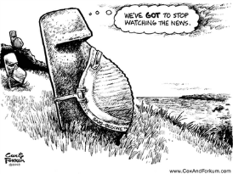
Prejudice or Negligence: EBM & flu policy
Important clarifications, disclaimers & acknowledgements…
I am not a conspiracy theorist (!)
Research originally funded by ERC (Ideas Grant 230489) to examine how different arguments, ideas and belief structures shape pandemic influenza public policy
“The politics of medicine and the global governance of pandemic influenza” International Journal of Health Services, 43(1): 105-121.

Slide 3

Prejudice or Negligence: EBM & flu policy
A short history of flu governance…
World Influenza Centre established in London in 1947
Global Influenza Surveillance Network established in 1952 with 40 laboratories (NICs) but by 1977 = 98 NICS in 70 countries
Renamed “Global Influenza Surveillance and Response System” in 2011 following PIPF
Currently 141 NICs including 6 WHO CCs (as of 10 June 2013).

Slide 4
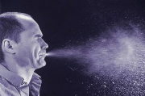
Prejudice or Negligence: EBM & flu policy
Pharmaceuticals in Pandemic Flu Public Policy
Post-1918, causal agent believed to be bacteria
Influenza virus discovered in 1933 by Smith, Andrewes & Laidlaw
Experimentation with vaccines initially led by military scientists, but picked up by civilian authorities who initiated a number of clinical trials to assess efficacy
In 1952, vaccines were “still, in the opinion of the [WHO Expert Influenza] committee, an experimental procedure”
By 1959, the WHO Expert Committee on Respiratory Viruses concluded “Experience in many countries has now established vaccination as the most efficient method for the prevention of influenza”.

Slide 5
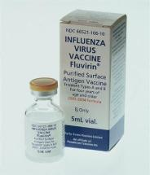
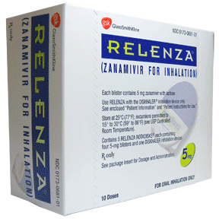
Prejudice or Negligence: EBM & flu policy
Pharmaceuticals in Pandemic Flu Public Policy
Pharmacological arsenal added to in 1960s with advent of antiviral medications, but vaccines “cornerstone” of pandemic preparedness
1997 H5N1 outbreak in Hong Kong increases global anxiety of new “overdue” pandemic, but WHO influenza personnel = 1 staff member
1999 WHO releases pandemic guidelines, updated in 2005 and 2009 (beside topic-specific guidelines)
By 2005 and ‘Bird Flu’ crisis all leading governance institutions (WHO, UNSIC, World Bank, IMF, etc) were advocating vaccines & antivirals as 1st line of defence
By 2006 securitization & EBM = ‘perfect storm’ for inadequate global supply.

Slide 6

Prejudice or Negligence: EBM & flu policy
Is there really anything wrong with this picture though?
According to WHO, global vaccine production capacity increased from 500 million doses in 2006 to almost 1 billion by 2010, nonetheless significant global shortfalls
Focus on “evidence” preferences pharmaceutical interventions over non-pharmaceutical as more readily assessed (e.g. RCTs)
Other potential pharmaceutical interventions are downplayed or derided (statins, elderberry extract, etc)
No incentive for pharmaceutical companies to initiate clinical trials of statins as off-patent and already widespread generic production
Even new universal flu vaccine will be unlikely to address global shortfall or affordability.

Slide 7
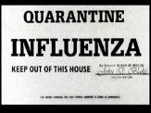
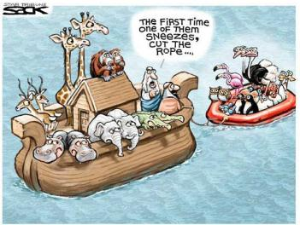
Prejudice or Negligence: EBM & flu policy
Is there really anything wrong with this picture though?
Not to suggest that the desire for “evidence” is wrong, but it is not, in itself, the answer to every problem
A re-balancing is required to obtain evidence on effectiveness of non-pharmaceutical interventions
Political pressure will be needed to investigate non-antiviral options (e.g. statins)
Questions?
Thank you.

