Slide 1
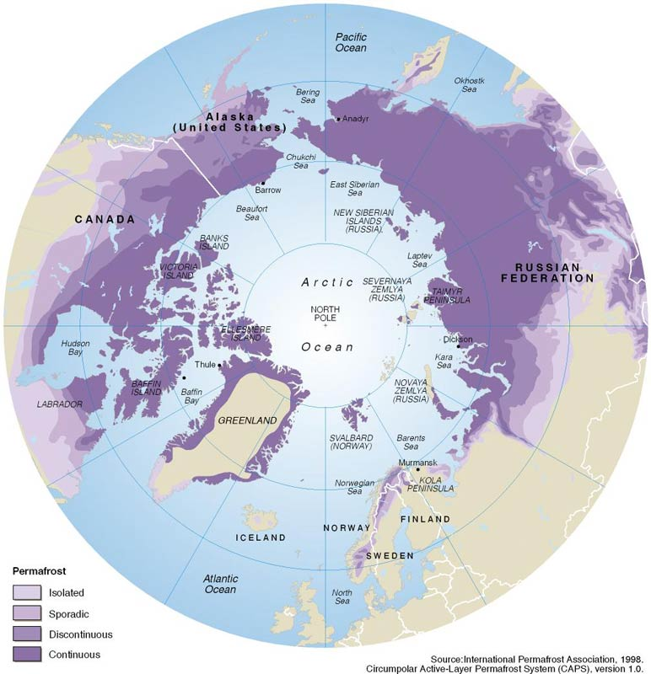
Permafrost & Environmental Change (F8023A)
Third-year geography module (open to BSc Geography)
Autumn term 2025
30 credits
No pre-requisites or co-requisites
Convenor & tutor
Prof. Julian Murton, Chichester 1-148, e-mail: j.b.murton@sussex.ac.uk
Notes:
Permafrost regions are amongst the most sensitive to environmental change. The climates of northern Alaska, Canada and Russia are warming more rapidly than almost all other regions on Earth. Such warming is causing major changes in the earth-surface conditions: permafrost is warming and disappearing, frozen peatlands are degrading, wetlands are replacing some boreal forest and treeline is advancing northward into the Arctic. The study of such phenomena therefore provides an important indication of the magnitude and rate of environmental change – a yardstick to evaluate the effects of global warming.

Slide 2
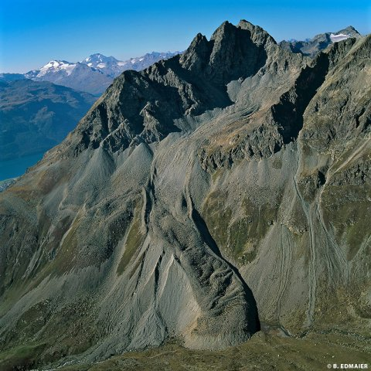
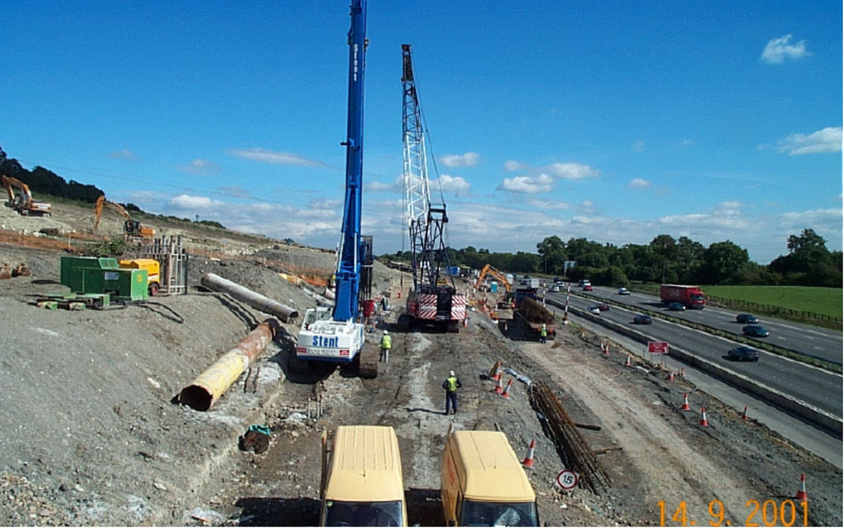
Permafrost & Environmental Change (F8023A)
Summary:
Examines present and past permafrost regions from an interdisciplinary perspective, linking permafrost science with physical geography, geology, ecology, engineering & Quaternary science.
Aims:
to provide a framework of knowledge and understanding of earth-surface processes and environmental change in permafrost regions;
to consider problems and solutions of economic development and land management on modern permafrost terrain and past permafrost regions.
Permafrost hazards,
Rock glacier, Swiss Alps
Periglacial geohazards,
M25 Motorway stabilisation, near Junction 6

Slide 3
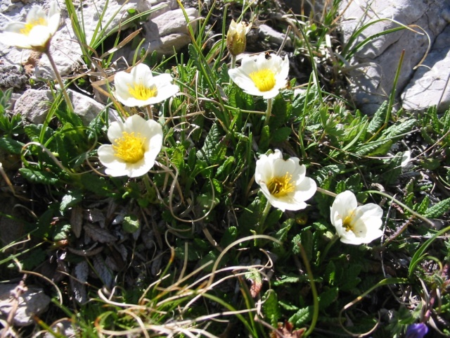
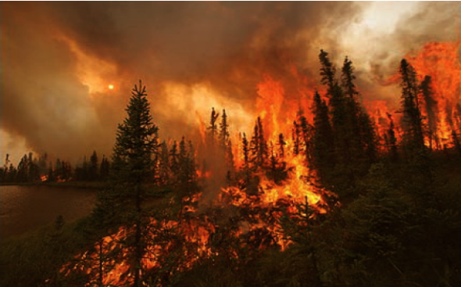
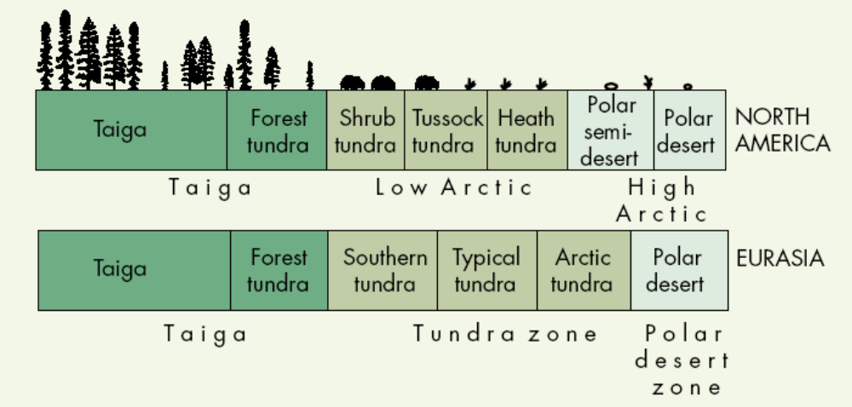
Permafrost & Environmental Change (F8023A)
Topics
Week 1: Introduction
Week 2: Permafrost
Week 3: Microclimate & ground thermal regime
Week 4: Active layer & soil freezing
Week 5: Ground ice & hydrology
Week 6: Periglacial geomorphology
Week 7: Permafrost geomorphology
Week 8: Carbon, permafrost & climate
Week 9: Permafrost geohazards & engineering
Week 10: Pleistocene permafrost & periglacial environments
Week 11: Periglaciation & periglacial geohazards
Tundra flowers
Boreal forest fire

Slide 4
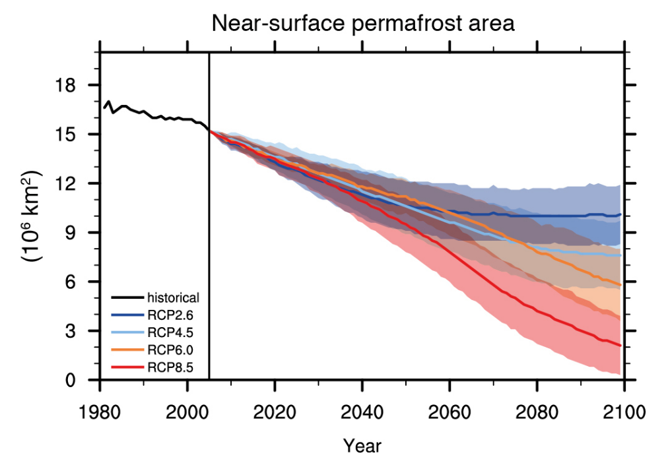
Permafrost & Environmental Change (F8023A)
Teaching and learning methods
Lectures: x 22, each 2 hours, with a break in the middle
Practicals: x 4, each 1 hour, in computing cluster room
Assessment
Problem set (PRB): 2000 words, combining practicals 1 and 2, due week 6, 30% weighting
Report (REP): 2000 words, combining practicals 3 and 4, due week 11, 30% weighting
Exam: 2 hours in 24-hour period, assessment period 1, 40% weighting
Week | 1 | 2 | 3 | 4 | 5 | 6 | 7 | 8 | 9 | 10 | 11 | Ass. Per. 1
Lectures | 2 x 2 hr | 2 x 2 hr | 2 x 2 hr | 2 x 2 hr | 2 x 2 hr | 2 x 2 hr | 2 x 2 hr | 2 x 2 hr | 2 x 2 hr | 2 x 2 hr | 2 x 2 hr
Practicals |  | 1 x 1 hr |  | 1 x 1 hr |  |  | 1 x 1 hr |  | 1 x 1 hr
Assessment |  |  |  |  |  | PRB (30%) |  |  |  |  | REP (30%) | EXAM (40%)

Slide 5
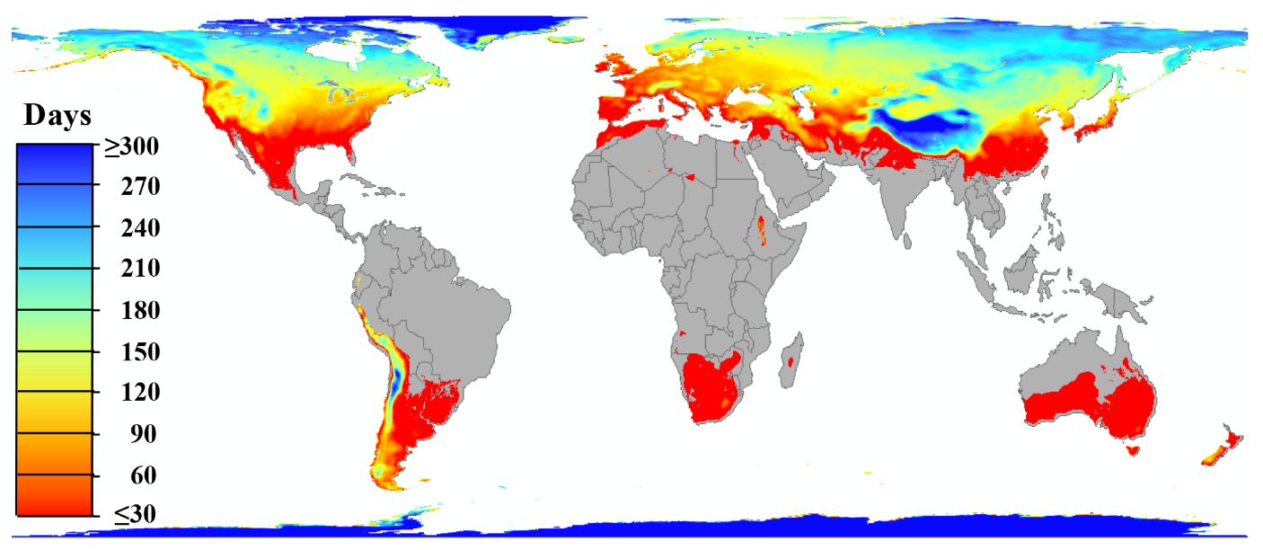
Permafrost & Environmental Change (F8023A)
Transferable skills
Data processing
Data analysis
Report writing
⇨ Good for CV, final-year project & applications for MSc courses or jobs in environmental / land management
Annual Freezing

Slide 6
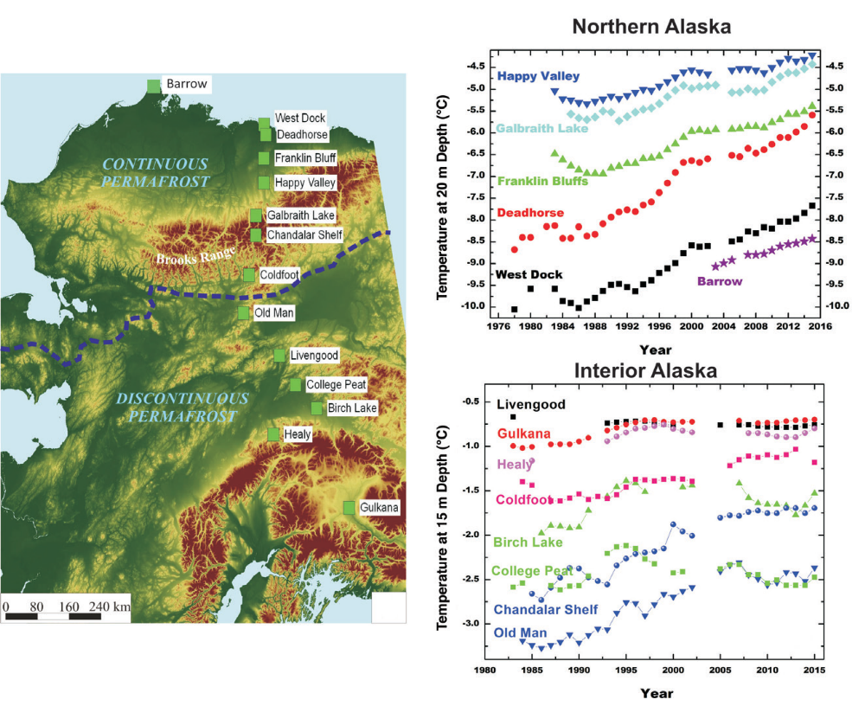
Permafrost & Environmental Change (F8023A)
Selling points
Small-group teaching: usually <20 students
Research-led content benefits from focus on internationally leading research
Interdisciplinary approach encourages lateral thinking and mental flexibility
Annual Freezing

