Slide 1
International Development Thesis (l2153)
Dr Melissa Gatter
Assistant Professor, ID & Anthropology
M.gatter@Sussex.ac.uk

Slide 2
About the module
Optional final-year module
30 credits (weighted in Spring)
Teaching in Autumn term
  9 x 2-hour workshops
Supervisions in Spring term
  4 x 30-minute meetings
2 assessments
  1000-word research outline (AB1, 10%)
  8000-word thesis (AB 2, 90%)

Slide 3
What does the thesis entail?
Independent research on a topic of your choice, supported by academic supervisor
Design a research question, collect and analyse data, formulate an argument, and write it up
Primary and/or secondary data
Your choice of methods
  Interviews
  Observation
  Focus groups
  Surveys
  Archival research
  Participatory research
  And more!

Slide 4
The Challenging bit
The exciting stuff
What to expect
Carry out a project from start to finish
Become an expert on a topic that interests you
Gain employable skills in research and project management
Conduct independent fieldwork, which could be supported by the Nicole Anderson bursary
Establish your own voice
Prepare for postgraduate research
Win the annual prize for best ID thesis
Prepare to take ownership of the project!
Working independently
Organising your time across the year

Slide 5
Dissertations past
  Public art, tourism, and urban transformations in South Korea
  Fieldwork in two cities during year abroad, included interviews with residents and artists, supported by Nicola Anderson bursary
  ‘Why U Ruin Ridley Road?’: Effects of gentrification on Ridley Road Market
  Discourse analysis of government policy reports, participant observation of Ridley Road Market, interviews with market traders
  Implementation of inclusive education in Tanzania: What are the benefits and challenges for inclusive schools in Dar Es Salaam
  Phone interviews
  The exploitation of hope: Exploring child labour across three industries in Dhaka, Bangladesh
  Analysis of existing literature

Slide 6
Module workshops
Week | Workshop
1 | Refining research questions
2 | Locating the literature
3 | Methods & methodology
4 | Ethics
5 | Writing workshop + time management (*research topics due)
6 | 1-1 ethics tutorials (no workshop, *ethics apps due)
7 | Dealing with data
8 | Structuring the thesis
9 | Critical writing & editing
10 | Writing workshop
Autumn term only
2 hours each
Interactive lectures
Writing exercises
Individual + group work

Slide 7
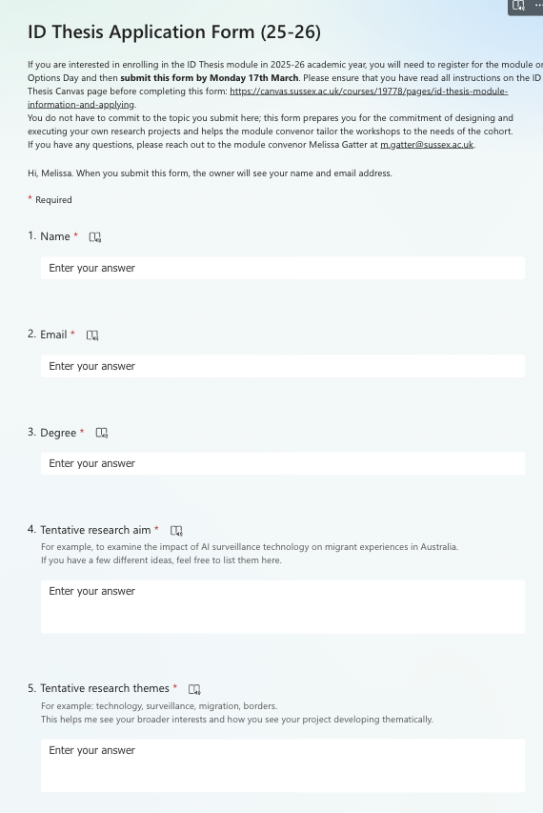
Applying to the thesis module
Register for L2153 Thesis Module on Options Day
Submit the application form by Monday 31st March.
  Tentative research aim, themes, and abstract
  Tentative methods + timeline for data collection
Your place will be confirmed in week 9

Slide 8
How many other options can you take with the id thesis?
The module counts as 1 x 30-credit ID module in the Spring term
You will write the thesis assessment in the Spring alongside only 1 other 30-credit module
ID Thesis students should have 60 credits of other modules in the Autumn term + 30 credits of other modules in the Spring
Degree | Autumn | Spring
Single honours ID (+ with lang.) | ID Thesis (teaching) 2 ID options | ID Thesis (writing) 1 ID option
Joint honours ID | ID Thesis (teaching) 2 other options | ID Thesis (writing) 1 option
ID/Econ joints | ID Thesis (teaching) 1 ID option 2 x 15-credit econ modules | ID Thesis (writing) 2 x 15-credit econ modules

Slide 9
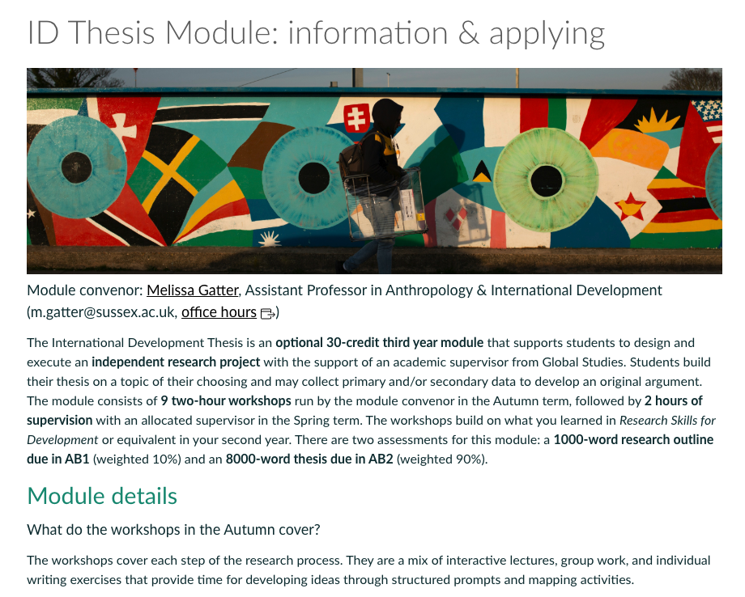
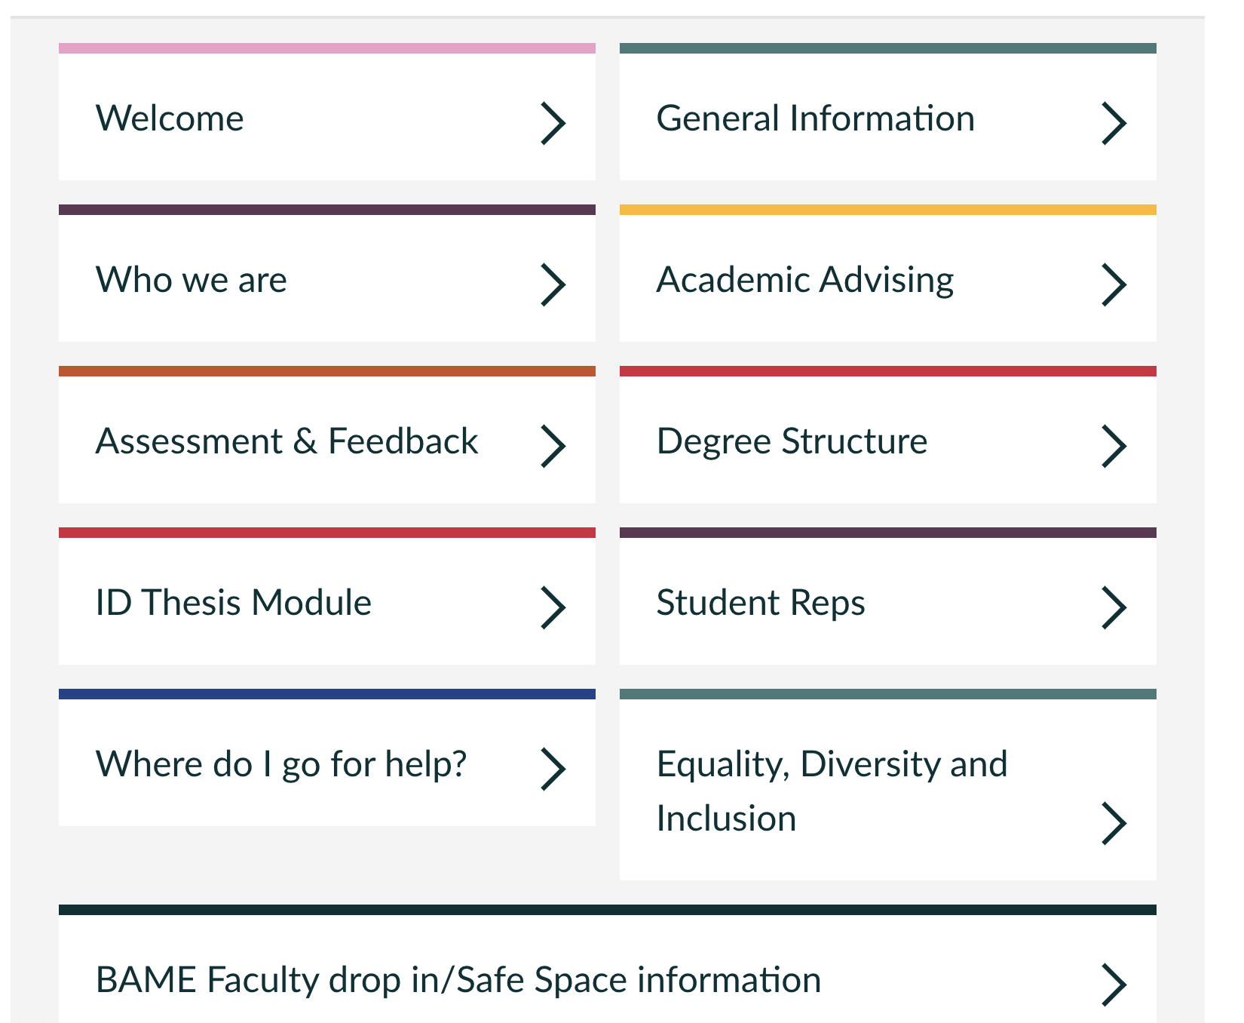
Studying International Development (Canvas)

