Slide 1
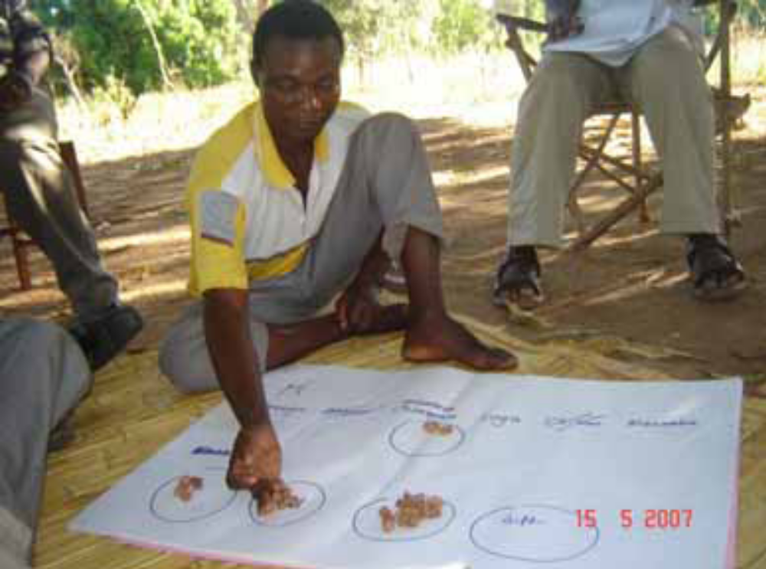
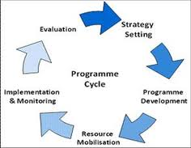

Development Tools and Skills
Term 2: 30 credit 3rd year option
International Development

Slide 2
Feedback from A previous student
“I’m working on the Africa Desk in the International Programmes department in Care International, doing general programme management, but focusing mainly on a new multi-country health initiative which has just begun… I was working for MERLIN before that out in Haiti and London internships there and at the Red Cross since graduation….
I’ve been pretty lucky, but yes a lot of hard work has gone in as well! To be honest I think a lot of that was due to my degree at Sussex... I know for myself the Development Tools and Skills was particularly useful - although it didn’t feel like it at the time doing something that different – that grounding in project management has been invaluable for me since.”
(Leila Varley)

Slide 3
Aim and learning outcomes
Aim: To give students an overview of the key steps and processes involved in designing development programmes and to introduce them to a range of key tools, approaches and skills used in by development organisations in the “Global South and North” to understand development issues and design and evaluate development programmes.
Learning outcomes
To demonstrate knowledge of the key steps and processes involved in designing development programmes and consider how these can be decolonised to better contribute to global solidarity and social justice.
To demonstrate knowledge of a range of tools, skills and approaches used by organisations in the Global South and North to understand development issues and to design and evaluate development programmes.
To gain practical experience of using and applying several tools, skills and approaches.
To critically evaluate the strengths, weaknesses and consequences of using alternative tools, skills and approaches
To develop interpersonal skills of building relationships, working in teams and in presenting clear and convincing analysis.

Slide 4
KEY TOPICS
Introduction: Designing and managing development programmes
(Approaches: The programme cycle, adaptive programming, human-centred design)
Understanding development issues in context
(Skill: Situation analysis; Tools: evidence review, problem analysis)
Understanding actors and relationships
(Tools: stakeholder analysis, social network analysis, power analysis)
Understanding people’s needs, priorities and experiences
(Approach: Participatory analysis; Tools: Various participatory tools; Skill: Facilitation)
Envisioning change
(Skill: visioning; Tools: theories of change, actor-based behavioural analysis)
Risk analysis and management
(Skill: Understanding risks; Tools: Risk analysis, opportunity analysis)
Planning and justifying resources
(Approach: Value for money; Skill: economic appraisal; Tools: cost-benefit analysis)
Managing for results
(Approach: results-based management, Tools: logical frameworks)
Monitoring and evaluating change
(Approaches: impact evaluations, outcome mapping, most significant change)

Slide 5
LEARNING METHODS
Weekly 3-hour interactive workshop (weeks 1-10)
  Students will work on a particular development issue and context during the term
  They will work in teams of 4-6 people to prepare a weekly group task applying a key tool or skill to analyse and design a development project
  Each workshop will start with two student presentations of the week’s task
  We will then have a plenary discussion about the tool / skill, discussing how it is used, its strengths, weaknesses and alternatives
  The tutor will then give a mini-lecture to introduce the next tool / skill
  This will followed by an interactive group exercise in class
  Finally, we will discuss the group task for the following week
This course is designed to develop both practical skills and applied critical analysis through ‘learning-by-doing’. Many of the tools and approaches used in the mainstream development sector are Western-centric and problematic. However, this module will ensure that you understand how and why they are used, that you are able to use them and also to evaluate their strengths, weaknesses and consequences and suggest alternatives.

Slide 6
MODULE ASSESSMENT
The assessment for this module consists of two elements:
A Take Away Paper (TAP), worth 80% of the total mark. You are given 48 hours to prepare and return your answer to an unseen exam paper. You will be allowed to use notes, books and online sources in preparing your answer. This assessment is designed to be as close as possible to a ‘real’ work situation and past students have responded well to this assessment mode. The TAP will be scheduled for the end of term 2 (usually the week after term).
A Group Presentation, worth 20% of the mark. You will make a presentation based on collective work by the group to apply and critique one of the tools or approaches covered during the course. Both the content and your presentation skills will be assessed. This will be scheduled for week 11 of term 2.

Slide 7
Comments FROM THE CONVENORS
“This module takes a 'hands on' approach and will allow students to develop and apply tools, skills and approaches which are widely used in the development sector, but also in the public policy, private and voluntary sectors.
The primary focus of this course is to ensure that students understand when, where and how these tools and skills are used in the development world and are able to use and apply them themselves. You will therefore mainly ‘learn by doing’, mostly through team work, which most students find stimulating and enjoyable.” Lyndsay McLean
“I will share examples from my own experiences of working in the international development sector, both in South Africa and the UK, over the last two decades. We will engage critically with a range of examples including your own practical experience and academic and policy documents to understand the strengths and limitations of different tools and approaches that are frequently used in the development sector.” Beth Mills

Slide 8
Feedback from A previous student
“I just started working on a project with a business led charity working with green initiatives across the UK…. I joined as Intern on a new project looking to make corporation’s car parking essentially 'carbon neutral’… I have assumed a role where I essentially co-ordinate the project, keeping in touch with relevant members, designing timelines and plans for the project…
The skills I learnt in the Development Tools and Skills course have been very useful here. Coming into the project understanding the project lifecycle has meant I was already familiar with many of the documents being thrown around and where the project was and what needed to happen. While of course nothing can really prepare you for the complexities of dealing with a real project, knowing some basics and being familiar with some of the processes helps to keep your head above water. This was a unique course in the fact that it covered very practical experiences that have a direct translation into work you will take up outside of your degree. I would really recommend it to students who are yet undecided.. “
(Oliver Fryatt)

