Slide 1



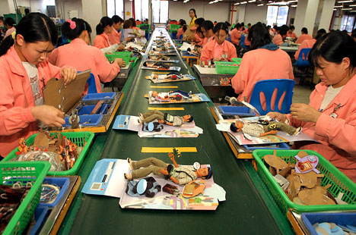








Development, Business &
Corporate Social (ir)Responsibility

Slide 2
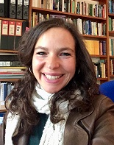
MODULE CONVENOR/LECTURER
Dr Dinah Rajak
Email: d.r.rajak@sussex.ac.uk
https://profiles.sussex.ac.uk/p116302-dinah-rajak

Slide 3
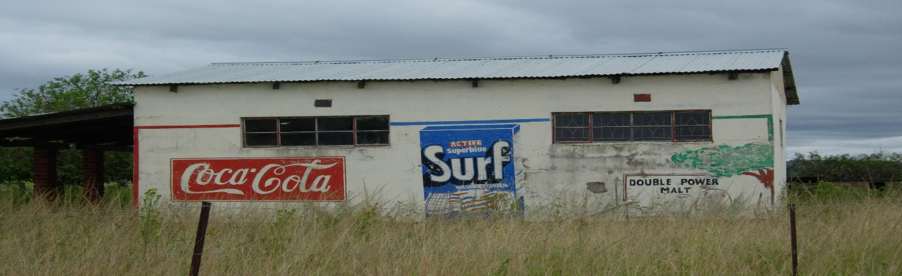
Development, Business &
Corporate Social Responsibility (CSR)
SPRING TERM
TOPICS:
1 Introduction to the course
2 The Rise & Role of Business in Development
3 Corporate Social Responsibility & the Market
4 Business, Civil Society & the State: Partnerships for Development
5 Rights, Resources & Conflict: CSR and the Extractive Industries
6 The Business of Health & Development
CSR & The Politics of Production: Producers, Consumers , Labour
CSR & the Ethics of Consumption
Inclusive Capitalism & the Bottom of the Pyramid
Margins of the Market: Informality and Entrepreneurialism

Slide 4
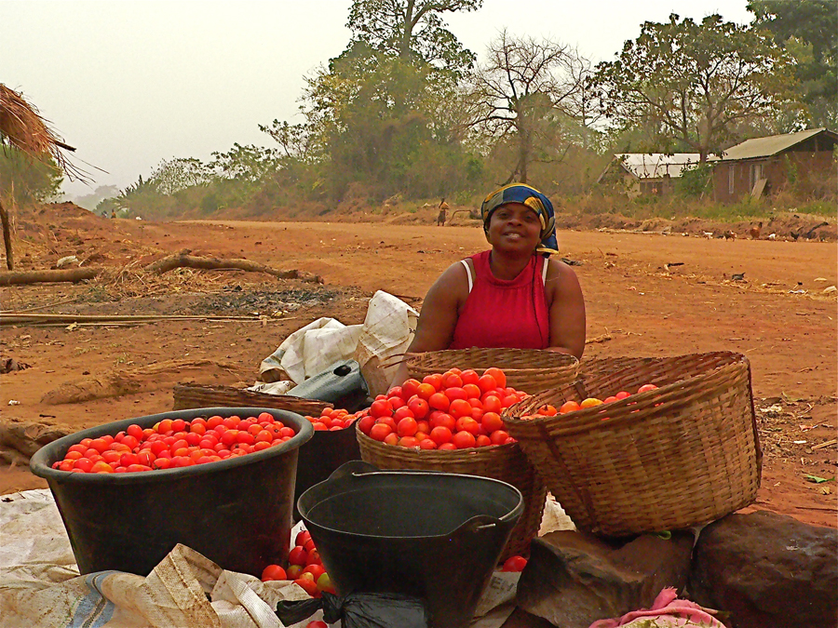
Teaching & Assessment
1 x 1hr Lecture per week
1 x 2hr Seminar per week
Assessment
5,000 word essay

Slide 5
Key Themes
Partnership and the relationship between states, civil society and business in development
The role of markets in development
Moral economy and questions of ethical capitalism – an oxymoron?
Social business and social entrepreneurship
CSR, state regulation and voluntarism
Resource wars, multinational business and the impact for development
Minerals, energy and oil – the politics and social impacts of extractive industries
The Business of Health: global health, development and the pharmaceutical industry
Labour, production and consumption
Fair trade and ethical consumption
The global assembly line: worker rights, child labour, worker agency
Informal and formal economies
Youth, Entrepreneurship and the Promise of Inclusion at the Bottom of the Pyramid
Precariousness, entrepreneurialism and humanitarian goods

Slide 6





Films
Black Gold
The Corporation (2003, Joel Bakan)
The Yes Men (2005, Chris Smith)
Up in Smoke (2008, Marty Otanez)
Crude: The Real Price of Oil (2009, Joe Berlinger)
Not-so-fair-trade (2006, Libby Potter)
The World According to Monsanto (2008, Marie-Monique Robin)
Walmart – The High Cost of Low Prices(2006, Robert Greenwald)

Slide 7
Past Dissertations Topics
The Complex Path of Cocoa: Tracing Commodity Trade, New Slavery and Tensions within Fairtrade Initiatives
The Global Biopolitics of Big Tobacco
Taking the Shine of the Diamond Industry: Is the Kimberley Process Furthering Colonialism
Bottling Out: Investigating the relationship between Bottled Water Consumption and the Global Water Crisis
Beating the ‘Climate Crunch’…with your Wallet? The Limitations of Green Consumerism
Pricing lives with antiretroviral drugs: the biopolitical power of pharmaceutical companies
The Business of Breastfeeding: Development, Market Forces & the Construction of Maternal Identities
Business at the Bottom of the Pyramid –The Way to Inclusive Capitalism? The Case of Mobile Phones
Constructing Community Boundaries: The Limitations of CSR for the Health of Mineworkers in South Africa
A Supply chain analysis of denim jeans: guilt-free garments?
Unhealthy Partnerships: corporate citizenship and public-private partnerships in healthcare

Slide 8
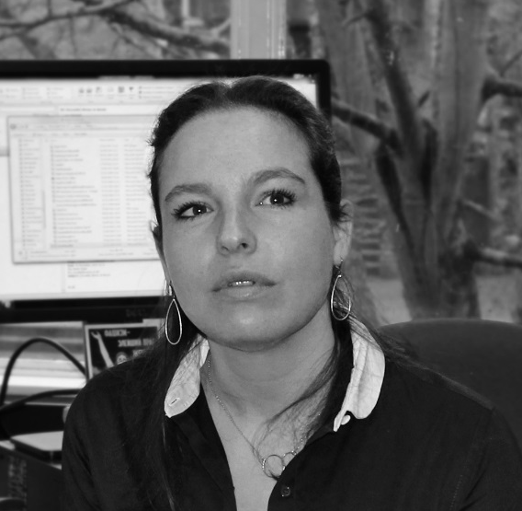

Module Convenor
Dr Dinah Rajak
Reader in Development & Anthropology
Email: d.r.rajak@sussex.ac.uk
Office: Arts C242
Research Expertise
My research interests lie at the intersection of the development, anthropology and the study of global capitalisms. My research concerns the role of transnational corporations in development, corporate social responsibility and moral economy, with a focus on the extractive industries and Sub-Saharan Africa. Other areas of interest include: economic empowerment, enterprise and entrepreneurialism; and the role of big business in the political economy of HIV/Aids management. My current research explores youth, entrepreneurship, 'bottom of the pyramid' business and the concept of inclusive markets. I am a co-founder of the Centre for New Economies of Development (http://responsiblebop.com/).

