Slide 1

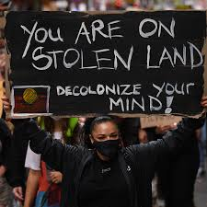
Indigenous Peoples, Development and the International
Dr Chris hesketh

Slide 2
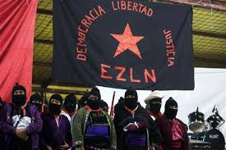
Overview
This module will explore the way in which Indigenous peoples and communities are embedded within International Relations and how this has changed over time. It also examines the way in which Indigenous subjectivities seek to contest dominant assumptions and practices within international development
Assessment:
1x 1000 words written assignment
1x 2500 word written assignment

Slide 3
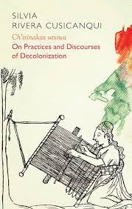
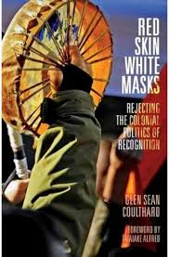
Indicative content
1. Colonisation and the construction of Indigenous subjects
2. From coerced inclusion to controlled marginalisation
3. Contesting sovereignty
4. The reemergence of Indigenous Politics
5. Neoliberal multiculturalism
6. Ethno-development and transnational activism
7. Zapatismo and the politics of autonomy
8. The promise and pitfalls of plurinationalism
9. Beyond recognition
10. Neo-extractivism, decolonisation and decolonial futures

