Slide 1

Information session + Q&A
International development thesis (L2153)
Dr Melissa Gatter
m.gatter@sussex.ac.uk | Arts C 250

Slide 2
About the module
Optional final-year module
30 credits
Taken either Autumn or Spring term
6 workshops with convenor
3 hours of supervision with assigned academic from ID (over 1 term)
Assessed by 8000-word thesis due in AB2

Slide 3
WHAT DOES THE THESIS ENTAIL?
Independent research on an issue of your choice
Executing your own research project: You design a research question, collect and analyse data, formulate an argument, and write 8000 words about it
Primary and/or secondary data
Methods are up to you: observation, interviews, focus groups, surveys, archival research, discourse analysis, extended literature review, analysis of existing datasets, and so on

Slide 4

MODULE WORKSHOPS
DEALING WITH DATA
4
REFINING RESEARCH AIMS
METHODS & METHODOLOGY
6
3
5
CRITICAL WRITING & OUTLINES
1
STRUCTURING THE THESIS
2
Locating the literature

Slide 5
WHAT TO EXPECT
THE EXCITING STUFF
THE CHALLENGING BIT
You get to carry out a research project from start to finish
It’s a chance to explore a topic that interests you
You gain transferable and practical skills for future employment
You can do independent fieldwork (locally or abroad), which could be supported by the Nicola Anderson bursary
It’s your own project – you get to establish your own voice!
Annual prize for best ID thesis
This is an independent project, so you should be prepared to take ownership of your project
There is only one deadline and one assessment, so you will need to stay organised
The module is structured to give you flexibility on your project, which means you will mainly work on your own

Slide 6
THESIS MYTHS
MYTH
FACT
I won’t graduate with honours without doing the thesis.
The thesis is an easy option.
If I don’t do a thesis, I can’t study for a master’s degree.
Not at Sussex!
Writing a thesis is hard (but fun)! Students need to be able to plan their time effectively and set their own deadlines. You can expect to work on the thesis in both terms.
Mostly untrue (check entry requirements)! But you might find a master’s dissertation slightly less overwhelming if you’ve written an undergraduate thesis.

Slide 7
PREVIOUS DISSERTATIONS
Public art, tourism, and urban transformations in South Korea
  Fieldwork in two cities during year abroad, included interviews with residents and artists, supported by Nicola Anderson bursary
‘Why U Ruin Ridley Road?’: Effects of gentrification on Ridley Road Market
  Discourse analysis of government/council policy reports, participant observation of Ridley Road Market, interviews with 18 market traders
Implementation of inclusive education in Tanzania: What are the benefits and challenges for inclusive schools in Dar Es Salaam
  Phone interviews
The exploitation of hope: Exploring child labour across three industries in Dhaka, Bangladesh
  Analysis of existing literature

Slide 8
COUNTDOWN TO SUBMISSION
26 February 2024 | Deadline for thesis applications
1 March 2024 | Applicants notified of application outcome
11-21 March 2024 | Successful applicants register for module via Sussex Direct
Late March 2024 | Students matched with supervisors
Summer 2024 (or year abroad) | Begin reading and data collection (if relevant)
Final year | Module workshops, supervisions, independent research, writing up
Assessment Block 2 2025 | Deadline for thesis submission
Data collection may require ethics approval

Slide 9
APPLYING TO THE THESIS MODULE
Proposal form (download on Canvas)
  Tentative dissertation title
  Research questions and 3 sub-questions
  Research keywords (up to 5)
  Annotated bibliography (~500 words)
  Potential contribution of your research (100-200 words)
  Your plans for collecting primary or secondary data
  Your interest in the topic (100-200 words)
Submit the proposal form through online submission link, which also asks you:
  Top 3 preferred supervisors
You need to formally register for the Autumn (L2153A) or Spring (L2153S) term of the module
The proposal is meant to help you think through your topic of interest, so you are not tied to the exact research questions you submit

Slide 10

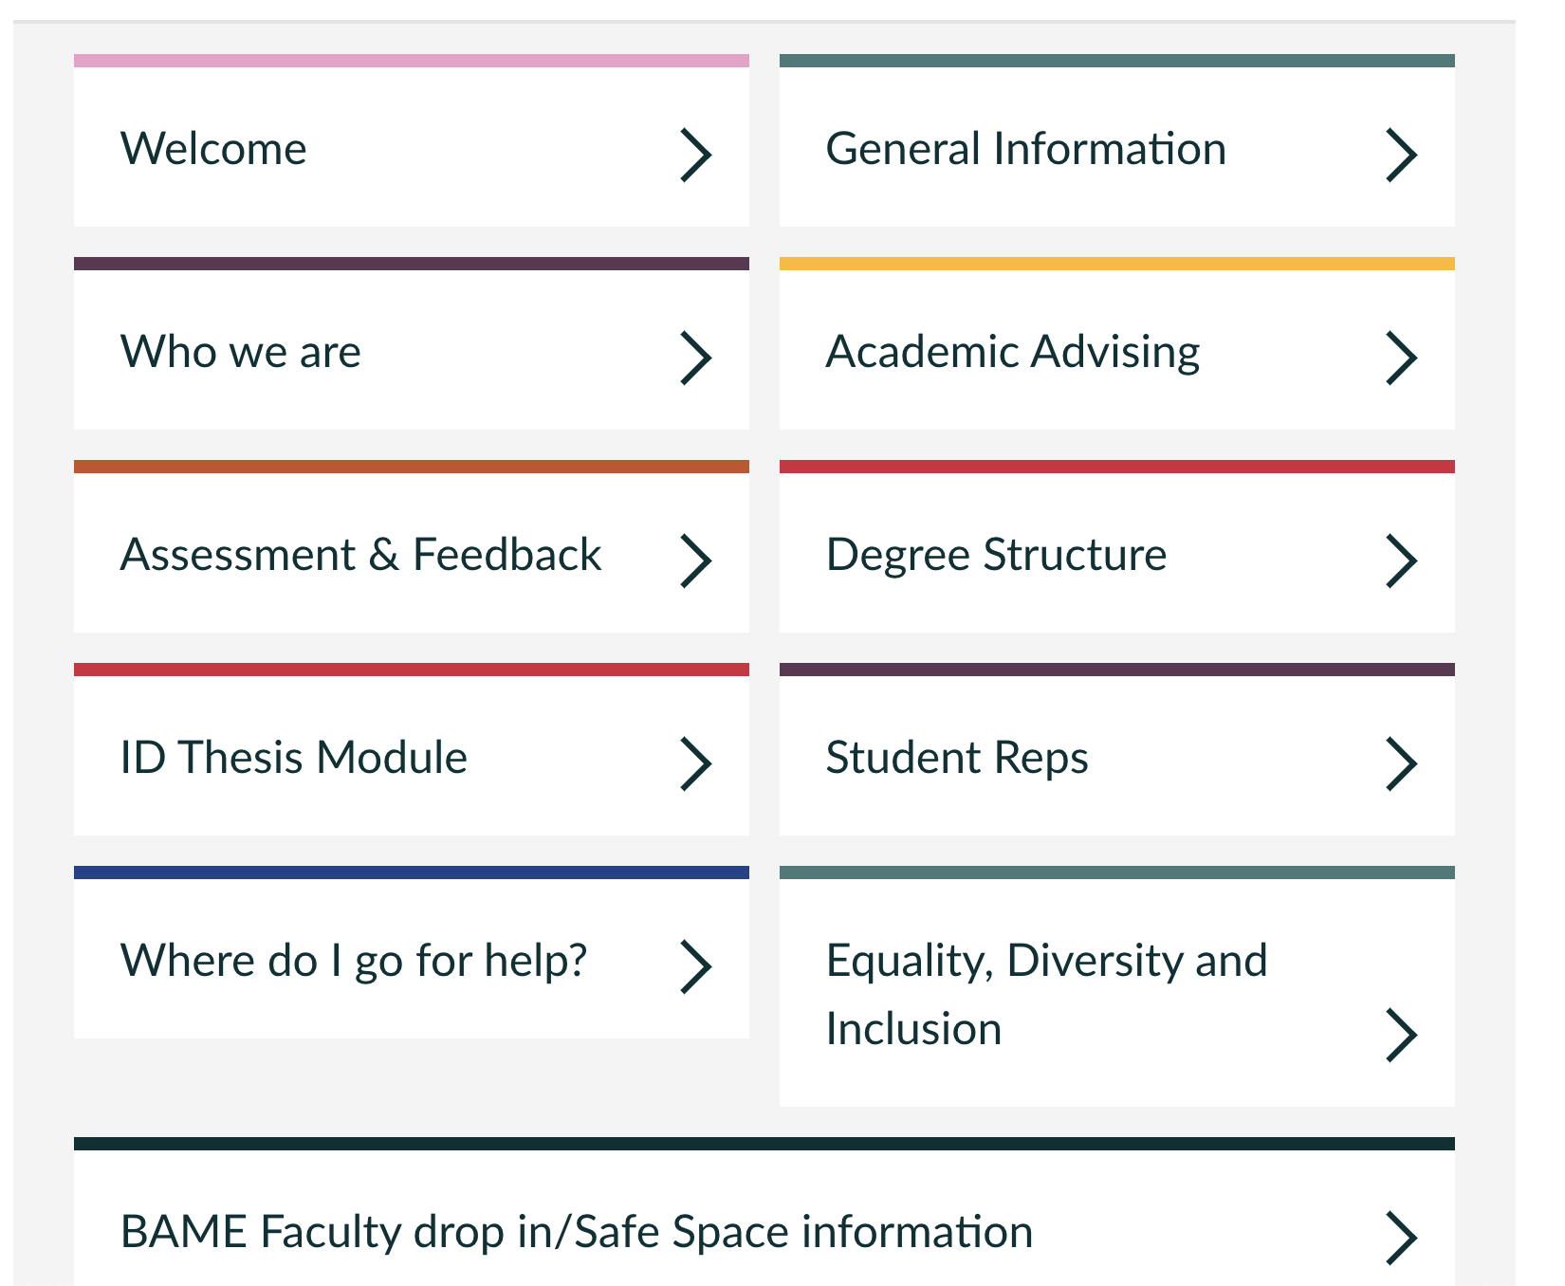
Studying International Development (Canvas)

