Slide 1
L2073A: Environment and Development in World Politics
Module convenor: Dr Chris hesketh

Slide 2
Module overview
In this module we will grapple with urgent questions linked to issues of environment and development, framed within a global context. The question of whether current forms of economic and political organisation are capable of responding to the challenge of environmental sustainability is more important than ever. Do we need to fundamentally rethink notions of growth and progress? How might any green, sustainable future be brought about? This module challenges students to expand their conceptions of the environment while reflecting on theoretical and empirical issues linked to environmental (in)justice and development. We will also develop analytical tools to critically evaluate alternative possibilities
TEACHING STYLE
  The module will be taught as an interactive three-hour workshop. The format of these workshops might vary from week to week, but will include lectures, short films, group discussions, class debates, case studies, and so on. There will also be student-led group presentations in Week 11.

Slide 3
Indicative weekly schedule
1. Introduction: Environment, development and world politics
2. The meaning and scope of environmental justice
3. Mainstream approaches to environment and development
4. Case study preparation
5. Critical approaches to environment and development
6. Extractive development and commodity frontiers
7. Environment, development and the politics of infrastructure
8. Climate change: war, chaos, migration?
9. Debating degrowth and green capitalism
10. Food security, food sovereignty and green grabbing
11. Presentations - Social ways forward

Slide 4
Module assessment
The module is assessed via three contributory assessments
Coursework (30%)
  Environmental case study 1000 words (70%)
  Group Presentation (30%)
Essay (70%)
  3500 words on any of the weekly topics or a title of your choice

Slide 5

Indicative readings

Slide 6
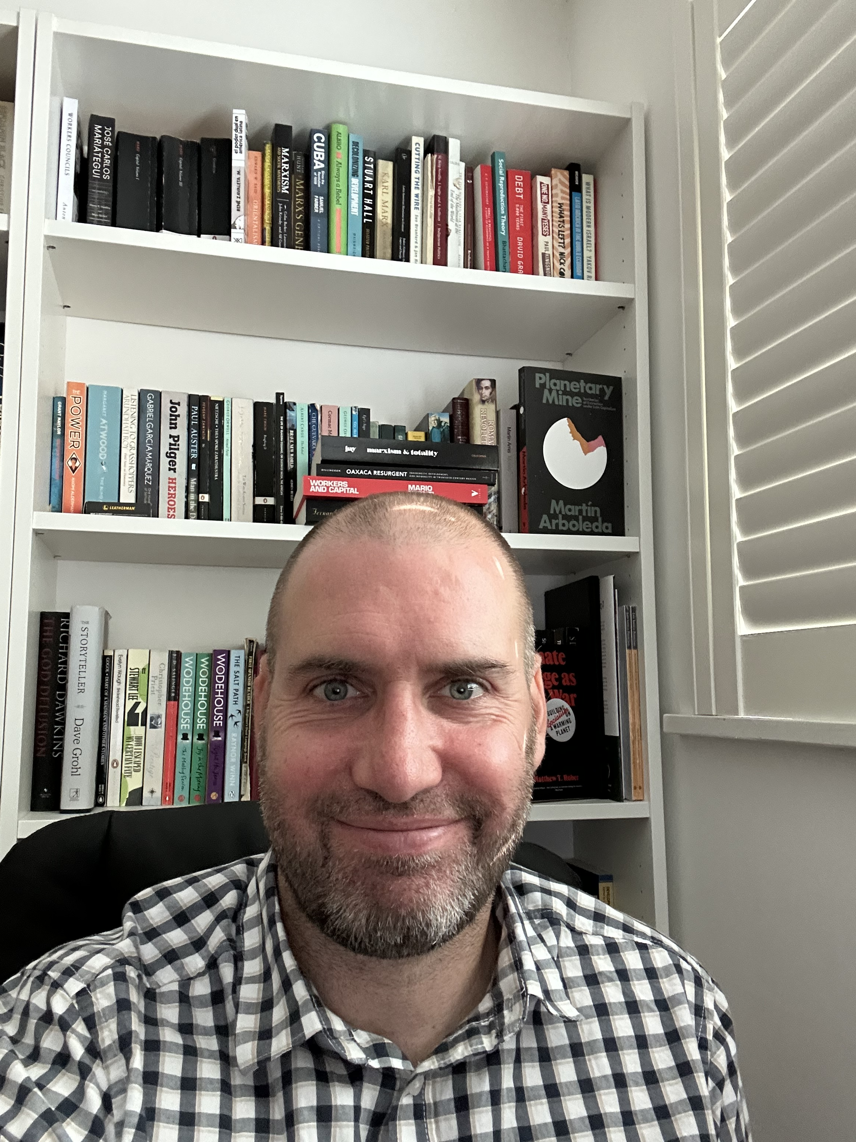
About me:
I am a Lecturer in International Relations. My main interests are in Latin America political economy and Indigenous resistance to extractive development. This has inspired my broader thinking about environmental justice.
If you have any questions about this module I would be very happy to answer them. You can get in contact with me via:
C.hesketh@susssex.ac.uk

