Slide 1

Global Work Experience
Course Convenor: Julia Hartviksen
j.hartviksen@sussex.ac.uk

Slide 2
Module Overview
This module is designed to allow students to gain practical work experience in an area of relevance to your degree course.
It will take the form of a series of 5 workshops, and a period of work experience, of a minimum of 50 hours or 5 weeks undertaken in the autumn term of Year 3.
The module provides an opportunity to experience the practical aspects of work, contribute to your personal development, and gain skills needed for graduate employability beyond university

Slide 3
Learning outcomes
LO 1 | Develop skills in relation to employability which makes a clear link with career planning
LO 2 | Reflect critically on their professional skills development in relation to employability
LO 3 | Critically evaluate their own personal objectives for career and academic planning
LO 4 | Integrate academic knowledge and understanding with work experience
LO5 | Use written communication to demonstrate a detailed understanding in appraising the knowledge gained during the work experience in a form that is accessible to the work experience provider

Slide 4
Teaching Methods and Assessment
- 1500-word Career Portfolio (30%)
Due Week 11
- 3500-word Reflexive Essay (70%)
Due AB1
Remote Independent CV activity + 1-2-1s (June)
Weekly skills workshops (3 hours) in Weeks 1-3
Placement/Work Experience in weeks 5-10
Closing and Assessment Workshop: week 11

Slide 5
What counts as a ‘Work Experience’
Minimum of 50 hours of work experience, ideally spread over 5 weeks during the Autumn term
Can be paid or volunteer work
Can be overseas (need to complete risk assessment)
NB: If you already are doing voluntary or paid work which is related to your degree, you may count this towards GWE, as long as this work continues during the Autumn term

Slide 6





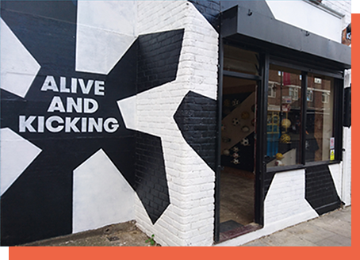

















Previous GWE Placements

Slide 7
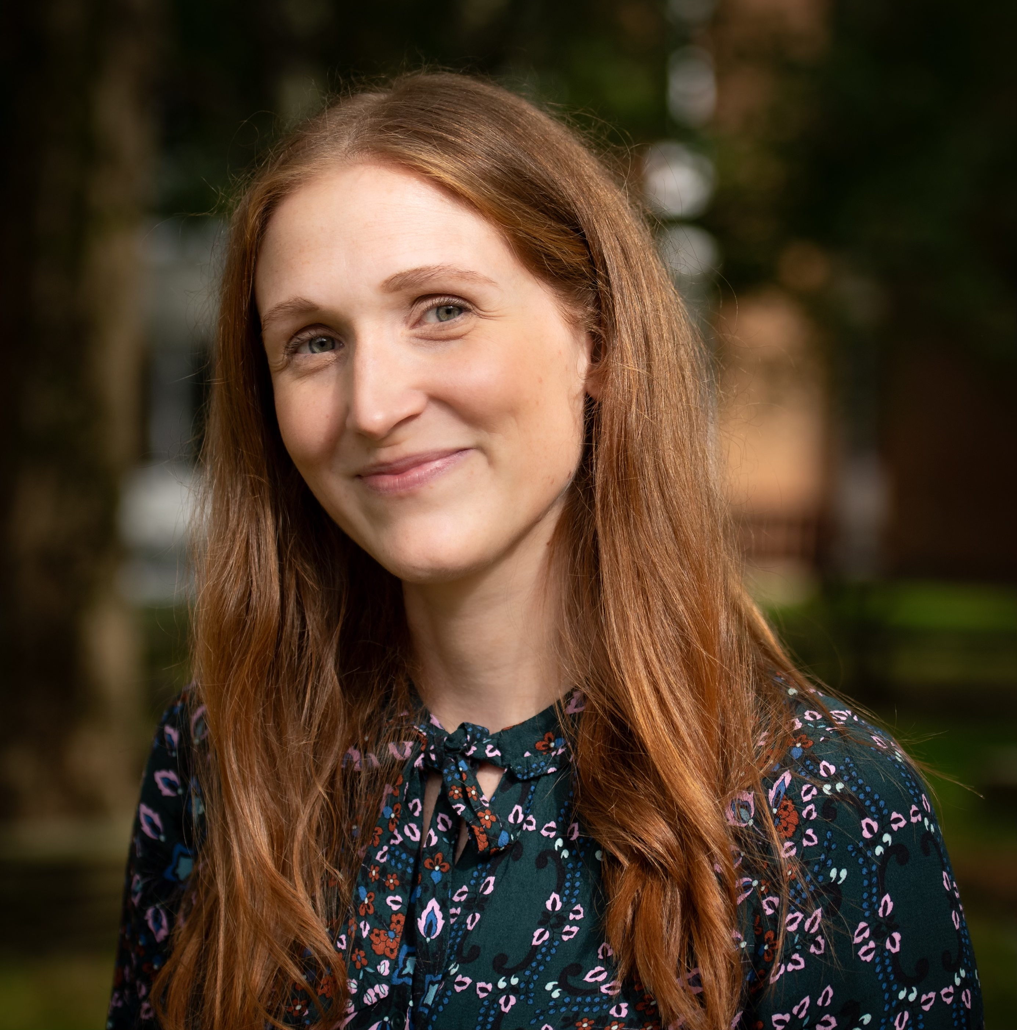
How does it work?
Select D6001 Global Work Experience when you choose your option
Julia will be in touch with next instructions, following your selection
In June, you will need to complete the ‘CV 360’ activity and attend a 1-2-1 meeting (in person or over zoom)
You will be expected to be proactive in finding your placement opportunity
NB: The final deadline to secure your work experience:
1 September 2025
Contact Julia Hartviksen
(module convenor) at
j.hartviksen@sussex.ac.uk if you have any questions and to discuss finding a work experience

