Slide 1
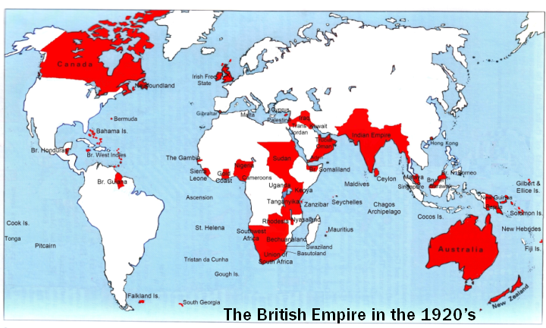
British Foreign Relations: Through Empire and Beyond

Slide 2
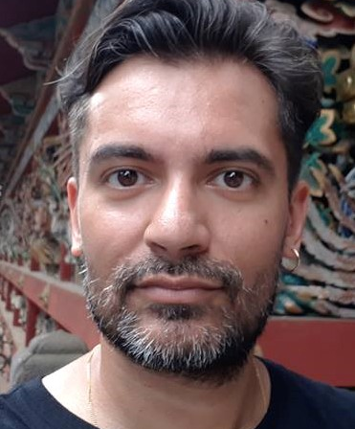
Module convenor: Dr David Wearing
Assistant Professor in UK foreign relations
Expert on UK foreign relations in the Middle East
Research interests in UK foreign relations as a legacy of the British empire.

Slide 3

Themes & topics
We’ll explore how UK foreign relations have evolved historically, from empire to the present day, particularly as they relate to the Global South.
We’ll examine how Britain transformed the world by bringing many regions and peoples into a new global system, often by force.
And we’ll look at how Britain itself was transformed by these processes, in terms of its own economy, culture and identity.

Slide 4
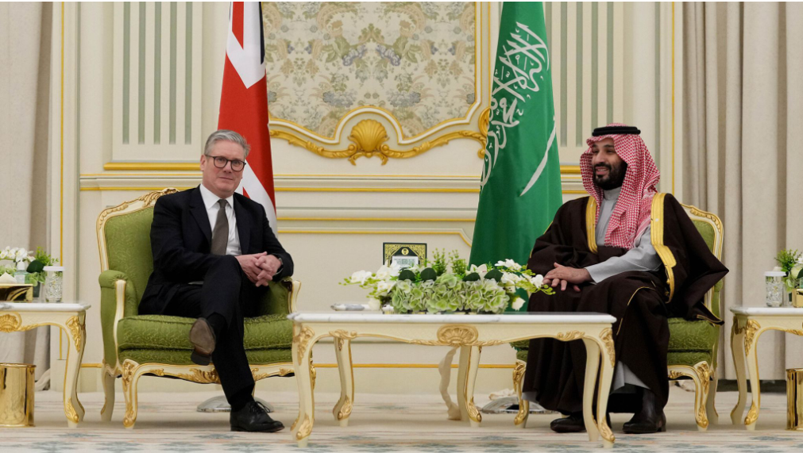
Learning outcomes: You will….
…demonstrate a strong grasp of the history of UK foreign relations, from empire to the present day.
…assess different ways of conceptualising the relationship between Britain’s colonial history and its current foreign relations.
…critically evaluate the merits and value of various texts and sources.
…critically evaluate the various ways in which concepts of ‘race’, national and cultural identity have shaped UK foreign relations, and domestic British society and politics.

Slide 5
Module Format & Assessment
ASSESSMENT
Book review: 15-minute oral assessment (30%)
3,500-word final essay (70%). You’ll be encouraged to develop your own essay question in consultation with me.
WEEKLY 3-HOUR WORKSHOPS
There will be a mix of small group and individual work, class discussions and lectures.
Our format will be flexible from week to week.

