Slide 1
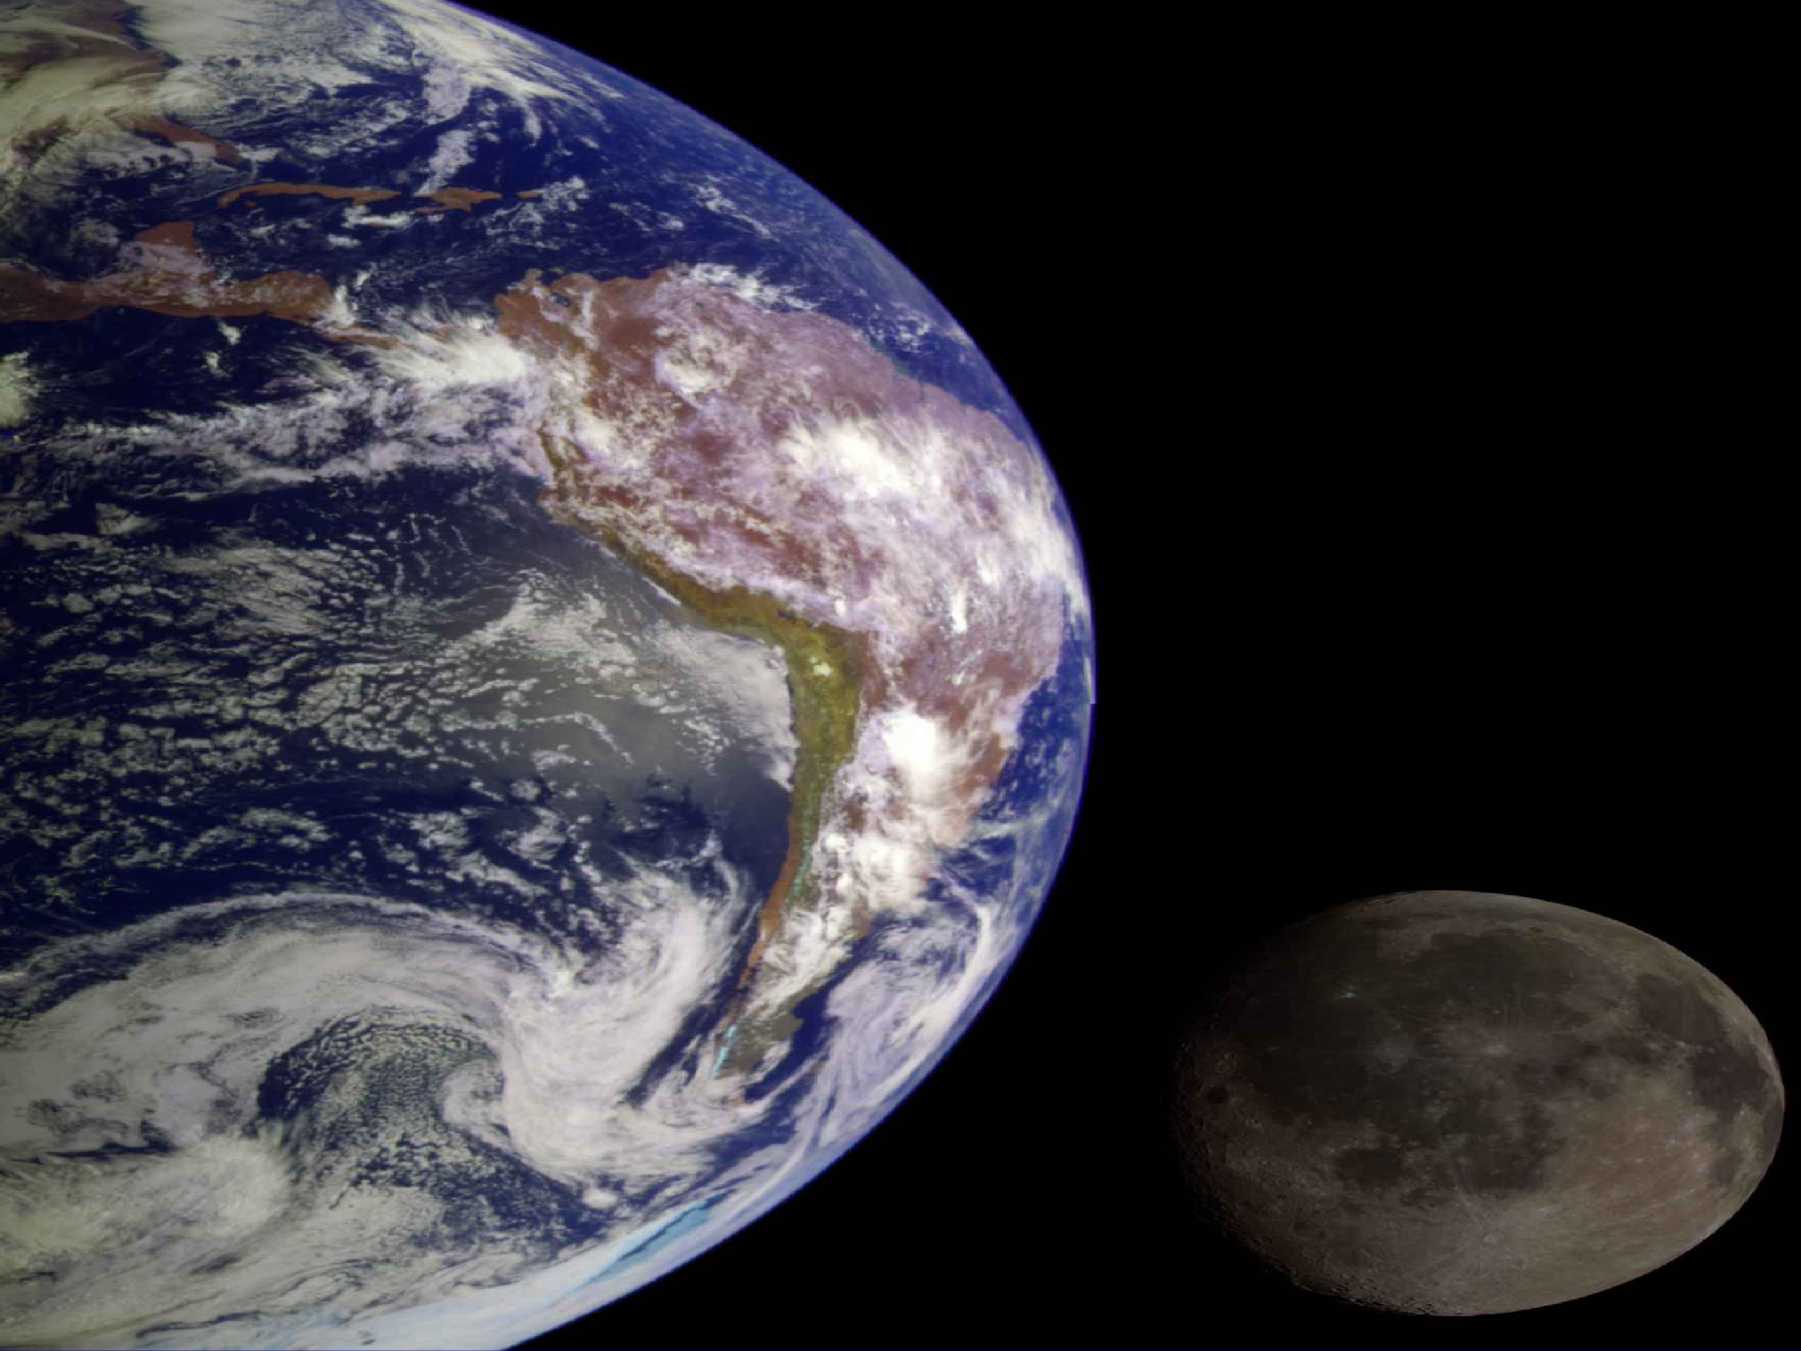
Advances in Climate Sciences, F8513S
Dr. Yi Wang Dept. of Geography
School of Global Studies University of Sussex (yi.wang@sussex.ac.uk)

Slide 2
Two Aspects of The Module
Climate variability at a wide range of timescales
  ENSO, Pacific Decadal Oscillation (PDO), North Atlantic Oscillation (NAO), Madden- Julian Oscillation (MJO)…..
  Major uncertainties in climate sciences, such as climate models, global carbon cycles…..

Slide 3
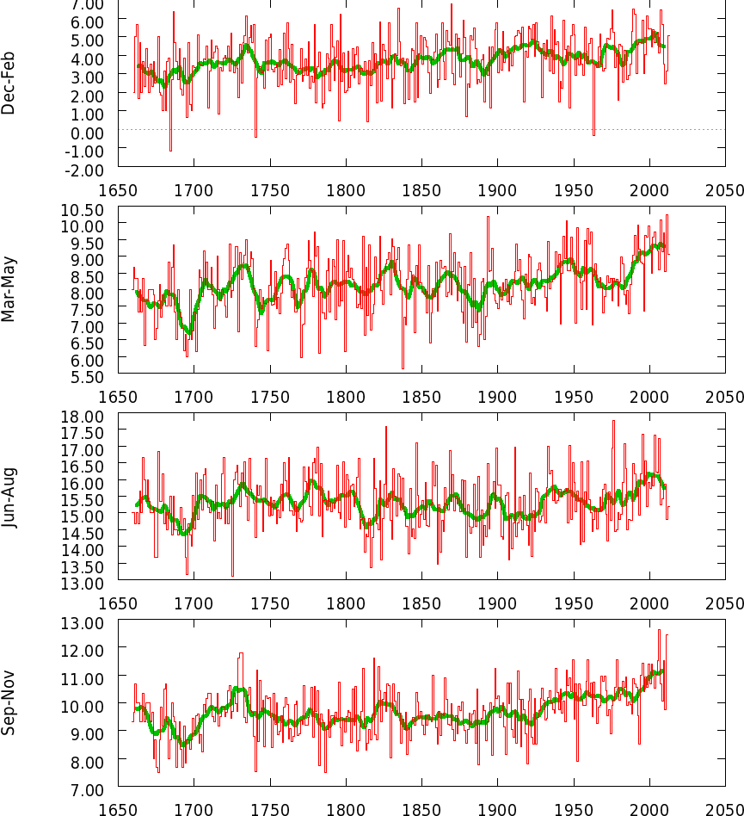
Two Aspects of The Module
Quantitative climate analyses
  Climate data formats (e.g., ascii or binary)
  KNMI Climate Explorer
  Statistics in climate sciences

Slide 4
Module Programme: Lectures
Lecture 1: Introduction to climate sciences
Lecture 2: ENSO climate variability One
Lecture 3: ENSO climate variability Two
Lecture 4: ENSO climate variability Three
Lecture 5: Climate variability at longer timescales
Lecture 6: Climate statistics review and research topics
Lecture 7: Climate variability at shorter timescales

Slide 5
Module Programme: Lectures
Lecture 8: No lesson (I will be in China field class.).
Lecture 9: Earth system and climate models
Lecture 10: IPCC climate projections
Lecture 11: End-of-term summary and report writing

Slide 6
Module Programme: Labs
Lab 1: Introduction to lab sessions
Lab 2: Introduction to KNMI Climate Explorer
Lab 3: KNMI analysis one
Lab 4: KNMI analysis two
Lab 5: Introduction to IPCC models
Lab 6: Assessment Oral Presentation
Lab 7: Assessment Oral Presentation

Slide 7
Module Programme: Labs
Lab 8: No lesson (I will be in China field class.)
Lab 9: Research project one
Lab 10: Research project two
Lab 11: Research project three
Two Assessments
  An outline of research project: 10-minute presentation at our lab session.
  Climate analysis report (4000-word) due during the mid-year assessment period (AB2) to Canvas (e-submission).

Slide 8
Module Outline
Teaching staff: Dr. Yi Wang (convenor)
One lecture per week (1H).
One lab session per week (2H).
I may offer additional lab sessions in the term.
Attendance is compulsory for both lecture and lab sessions.

Slide 9
Two Main Research Topics
ENSO and Climate Changes:
  ENSO and its correlations with rainfall (Asian, Australian, or African monsoons).
  ENSO and its correlations with temperature changes (in South Africa).
  ENSO and its correlations with Arctic sea ice
  ENSO and its correlations with NAO or AMO index
IPCC Climate Projections:
  What is projected rainfall change over the Sahel/Sahara boundary?
  What is projected change of snow season over Canada?

Slide 10
Module Recommended Textbooks
IPCC AR5 Working Group I Report (downloaded free online @ IPCC website)
IPCC AR6 Working Group I Report (also free@IPCC website)
Climate Change and Climate Modelling, David Neelin, Cambridge University Press (2011)
The Global Climate System, edited by Howard Bridgman and John Oliver, Cambridge University Press (2006)
Climate Change: A Multidisciplinary Approach, William Burroughs, Cambridge University Press (2010)

Slide 11
Module Learning Outcomes
Demonstrate some fundamental knowledge on the climate system and its variability (e.g., ENSO).
Understand the cause of climate change and variability (e.g., NAO).
Understand the key elements of climate models and their predictions.

Slide 12
Module Learning Outcomes
Summarise key debates and uncertainties in the climate change (e.g., ENSO)
Identify research topics and help you develop independent research questions on the climate sciences under two main streams.
Understand the fundamental approaches used in climate analyses and evaluations (e.g., statistics).

