Slide 1
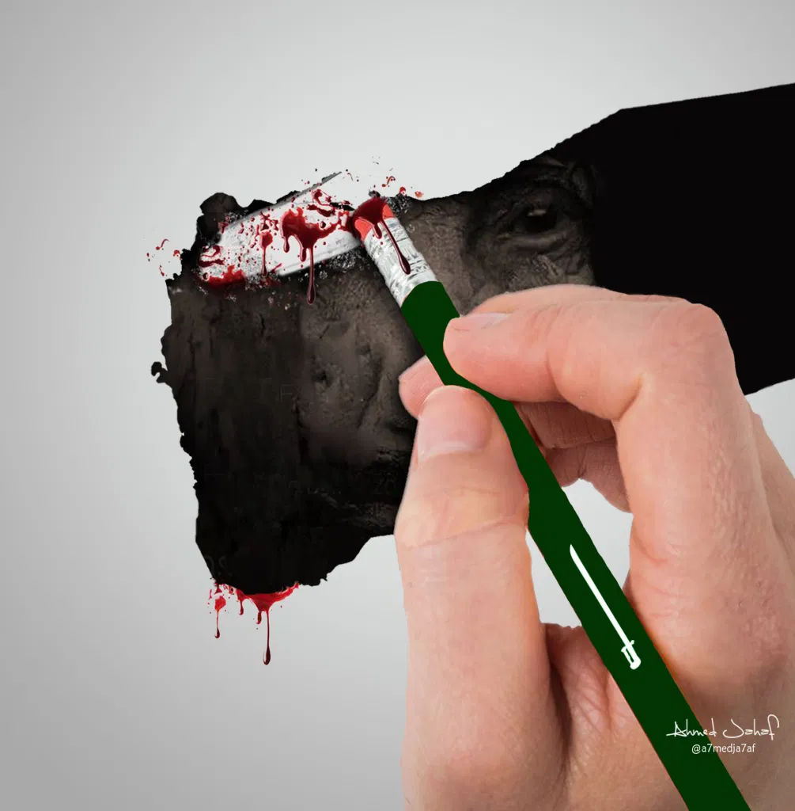
Activism, Development and Violence: Global Systems, Local Encounters
Dr Linda Tabar
3rd year option, Spring Term 25/26
Image credit: Ahmed Jahaf, @a7medja7af
Dr Linda Tabar
3rd year option, Spring Term 25/26
Image credit: Ahmed Jahaf, @a7medja7af

Slide 2
About the module
Goal: to rethink development via a focus on global systems of violence
Theories: decolonial, Indigenous, feminist, critical political economy, racial capitalist and activist perspectives
Community-based learning: we will visit local sites to help us understand global systems of violence e.g. the EDO/Harris arms factory, Cowley Club, Royal Pavilion
Places and issues: from Palestine to Yemen, across issues of war, policing and community development
You to reflect on what you associate with ‘development’ and how you/we might rethink it
This module was designed by Linda Tabar and Anna Stavrianakis, for this year it will be taught by Dr Tabar

Slide 3
Indicative schedule
Part One: Groundings
Rethinking development: between the bureaucratic and the political
Reform versus radical transformation
“Development beyond improvement”: solidarity, unsettling hegemony
Part Two: Encounters
Humanitarianism/war/Yemen/Palestine + site visit: EDO factory and/or Cowley Club
Colonialism/reparations/WWI + site visit: Royal Pavilion
Abolition/policing/alternative development + site/speaker visit: Movement for Black Lives Brighton
Part Three: Reflections
Consolidating community encounters through reflections
Essay planning/preparation

Slide 4
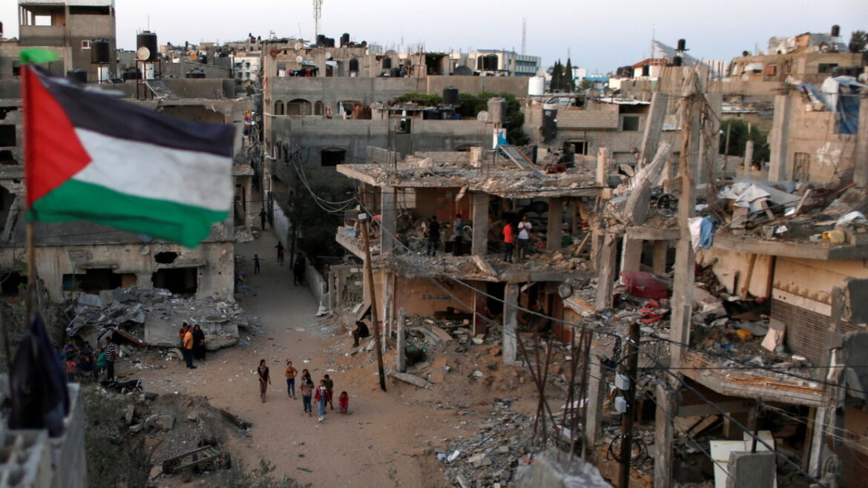
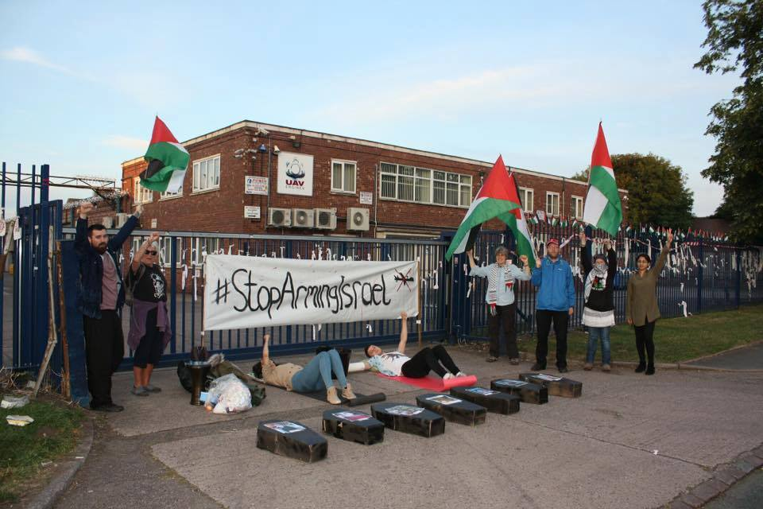
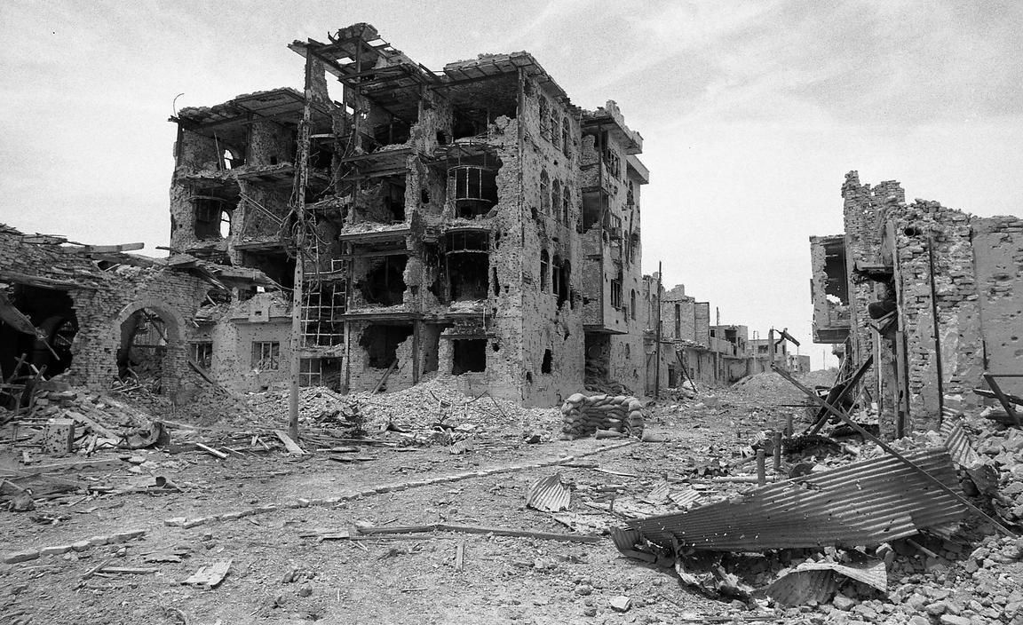
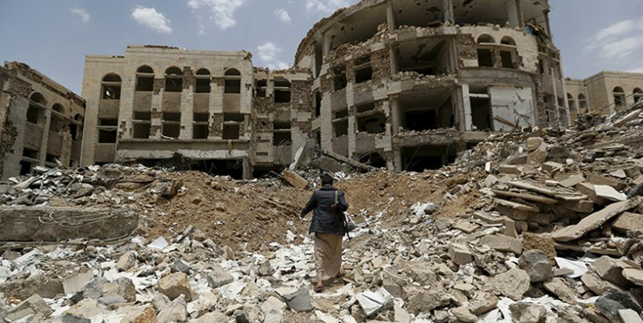
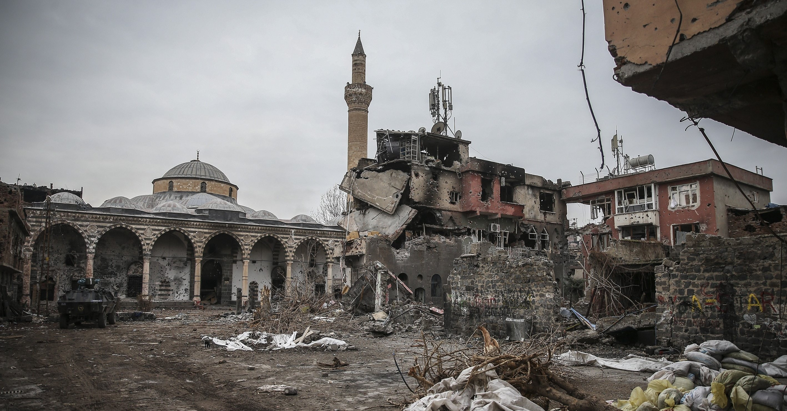
Sample site: EDO/MBM Harris factory
Palestine
Iraq
Yemen
Kurds

Slide 5
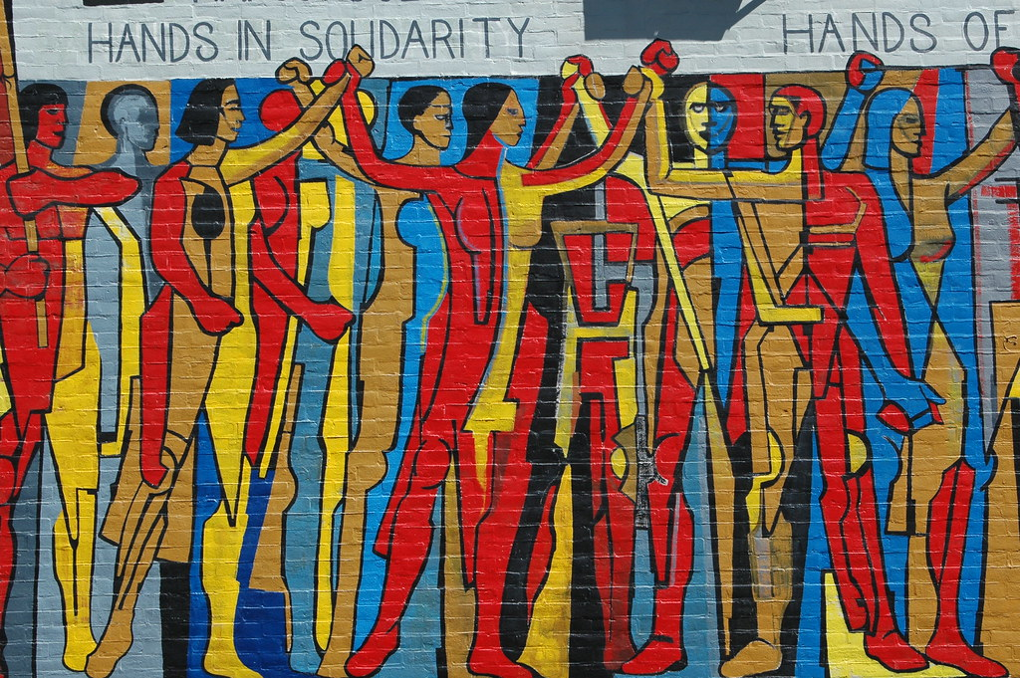
From the ‘will to improve’ to circuits of humanitarianism and war
WAR
DEVELOPMENT
SOLIDARITY
HUMANITARIANISM
This Photo by Unknown Author is licensed under CC BY-NC-ND

Slide 6
Seminar format
Weekly 3-hour seminar
Combination of small group and individual work, class discussions, some lecture material
We will use campaign materials, policy documents, NGO reports, journalism, videos as well as scholarly literature
Empirical analysis of specific cases combined with theoretical and conceptual analysis of the meaning and significance of global systems of violence and our local encounters with them for global ‘development’

Slide 7
Assessment
1500-word portfolio, due in week 10, worth 30% of your grade
Reflection on conceptual themes of the module through site encounters
3500-word essay, due in the Assessment Block, worth 70% of your grade
Either standard research question or collaborative knowledge production with community-based actors

Slide 8
Indicative readings
Cowen, Deb (2014) The Deadly Life of Logistics: Mapping Violence in Global Trade
Rutazibwa, Olivia (2018) "On babies and bathwater: Decolonizing International Development Studies"
Khalili, Laleh (2020) Sinews of Trade and War. Shipping and Capitalism in the Arabian Peninsula
Ziadah, Rafeef (2019) “Circulating Power: Humanitarian Logistics, Militarism and the United Arab Emirates”
RAZACK(2007) “Stealing the Pain of Others: Reflections on Canadian Humanitarian Responses”

Slide 9
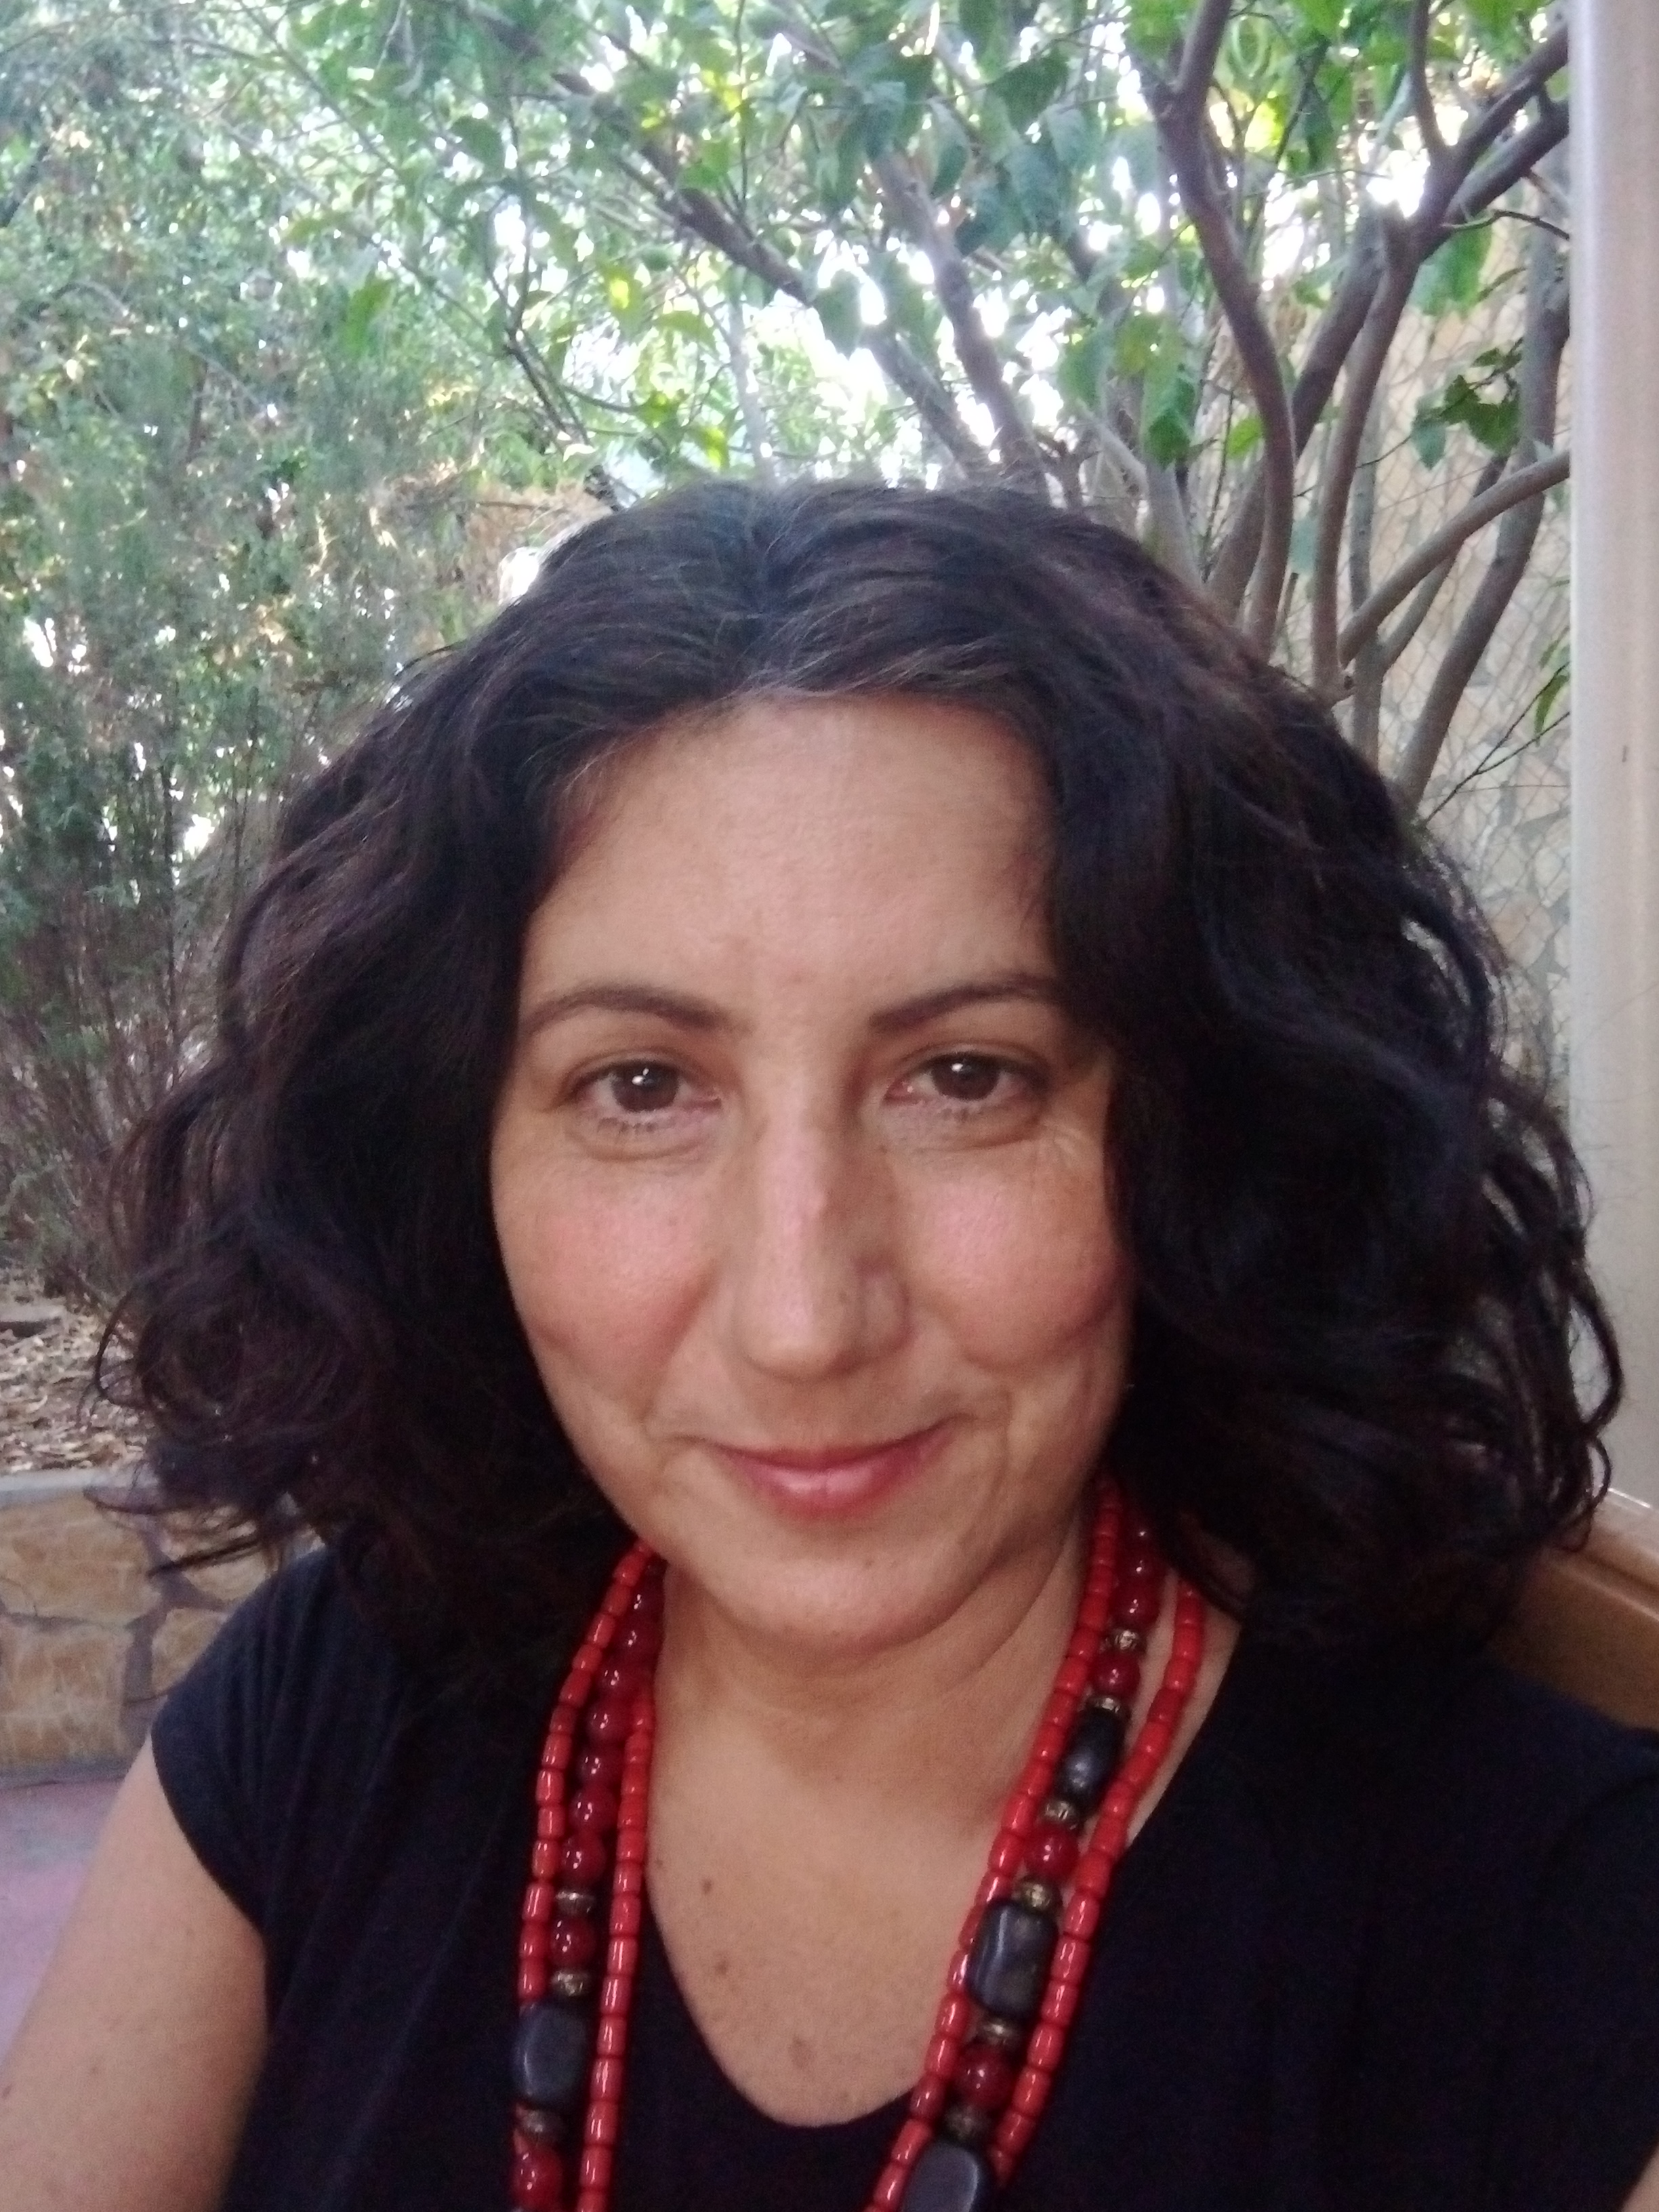
Meet your tutors
My name is Linda Tabar; you can contact me on L.Tabar@sussex.ac.uk
My research focuses on settler colonialism, dispossession, racialized and gendered violence, and their intersections with development and humanitarianism. I also explore feminist and anti-colonial struggles and their connections to transnational solidarity.
I have extensive experiences with development actors, grassroots movements and popular organizations in Palestine. I am excited to share these experiences and insights with you.

