Slide 1
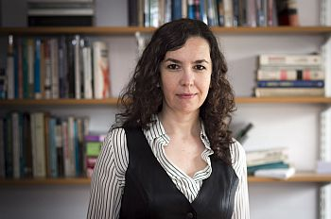
DESIGNING ALTERNATIVES FOR DEVELOPMENT
Tutor: Dr. Demet Dinler, Lecturer in Anthropology and International Development
Research expertise: Supply chains and markets, labour, alternative solidarity economies, activism and social change
Professional expertise: Practitioner and trainer for feminist development NGOs, cooperatives, global trade unions
Contact:
D.S.Dinler@sussex.ac.uk
Arts C 302

Slide 2
Background questions
Are development projects always bound to fail or can we still make a difference by working within development organisations?
Should alternative development initiatives seeking social justice and sustainability be always small and local? Can they be scaled up to challenge broader power relations and structural inequalities?
Are we too naïve and idealist for the realities of this world?
How can we live up to our ideals and implement realistic solutions to global development challenges?
What kind of critical perspectives, skills and knowledge do we need in order to design alternatives within and beyond development organisations once we graduate? How can we apply these in real life?

Slide 3
Purpose of module
This module aims to equip students with skills to design development projects of social and climate justice within and beyond development institutions.
First, the module examines drivers of change within past and current development agendas, institutions and policies.
Second, by deploying decolonial, feminist, queer, and diverse economies approaches, it explores multiple alternatives to transform relations of production, finance, social reproduction, care and common resource management with case studies from the Global South and North.
Finally, it invites students to build their own alternative economies and development policies from below.

Slide 4
Module structure:1 hour interactive lecture and 2 hour design workshops
(Reading discussion and group design work)
PART 1: Alternatives from above
Transforming development organisations and NGOs from within
Reimagining states as agents of change
PART 2: Alternatives from below:
Introduction to theoretical debates on alternative community economies
Re-imagining production, work and leisure: Creative, collaborative
Re-imagining exchange, money and finance: From fair markets to complementary currencies
Re-imagining social reproduction: From universal basic services to communal care
Re-imagining ecology of the common resources
Re-imagining international economic order
Re-imagining equality, diversity and inclusion: Is an anti-racist, queer and non-ableist development possible?
Assessment:
30 per cent group work based on 7 design workshops
70 per cent individual essay on one of the themes related to alternatives with a case study

Slide 5
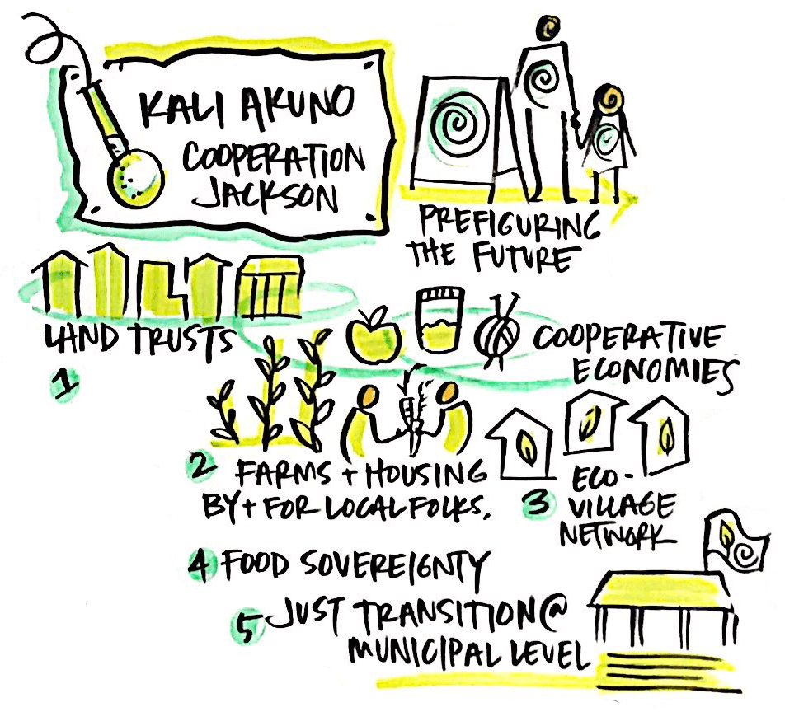
Theoretical approaches & case studies
Theoretical perspectives and case studies are embedded in the discussion on alternatives.
Example cases will include:
Solidarity/Community/Cooperative economies
Fair and transparent commodity auctions
Ethical Currencies and peer to peer lending
Universal Basic Income/Services
Participatory budget planning
Sustainable common resource management and degrowth
Communal forms of care and time banking
Food sovereignty and agro-ecology

Slide 6
DESIGN WORKSHOPS (Weeks 3-10)
Designing, implementing and sustaining an alternative network of sustainable cooperative economies to achieve social and climate justice and tackle inequalities of class, gender and race in selected real life scenarios.
The tutor will give new tasks and challenges (as in a playstation or video game) faced by the cooperatives
Groups of 5/6 students will develop solutions in the light of the knowledge and skills taught in specific countries of their choice: Brazil, Ghana, Kenya, Bolivia, Philippines, India…etc.
I will work closely with groups in class and group office hours to develop your alternative
Week 11: Group presentations in class based on design workshop

