Slide 1

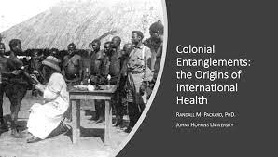

Critical Hope in Global Health: From Big Pharma to Local Wellbeing
Lecturer: Dr. Ushehwedu Kufakurinani
Office hours: Thursday and Friday 1-2pm
All welcome to come have a chat. Happy to arrange different meeting times just drop an email: U.Kufakurinani@sussex.ac.uk

Slide 2

Topics
Topic 1: Discoursing critical hope on health and wellbeing
Topic 2: Coloniality and health: Infectious diseases and beyond
Topic 3: Pandemics, epidemics and the pathocene: Victories and losses
Topic 4: Pharma and informal markets
Topic 5: Addiction and wellbeing
Topic 6: Discoursing animal diseases and society: Critical Perspectives
Topic 7: Indigenous pharma and indigenous health systems: A missed opportunity?
Topic 8: Health tourism and migration in healthcare
Topic 9: Digital health, Health technologies and wellbeing: opportunities and costs
Topic 10: Social lives of diseases

Slide 3
Teaching format and Assessment
3-hour workshop
‘interactive lecture’
guest speakers
film clips
Assessment:
5000-word learning diary

Slide 4

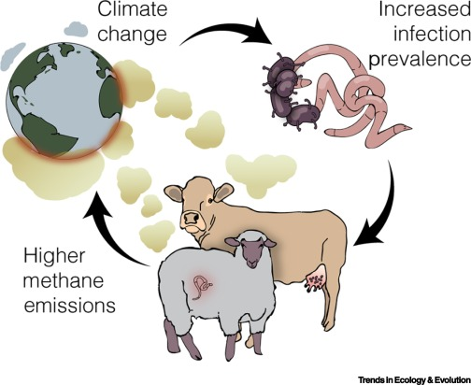
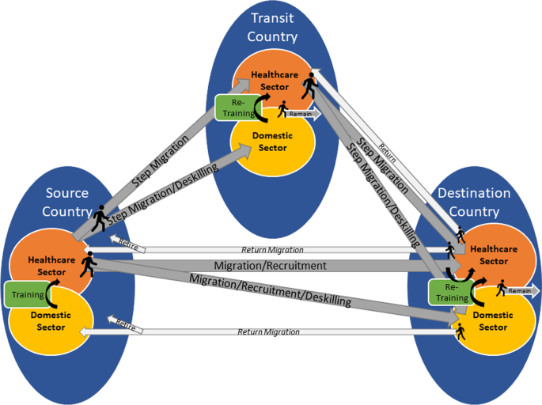

Slide 5

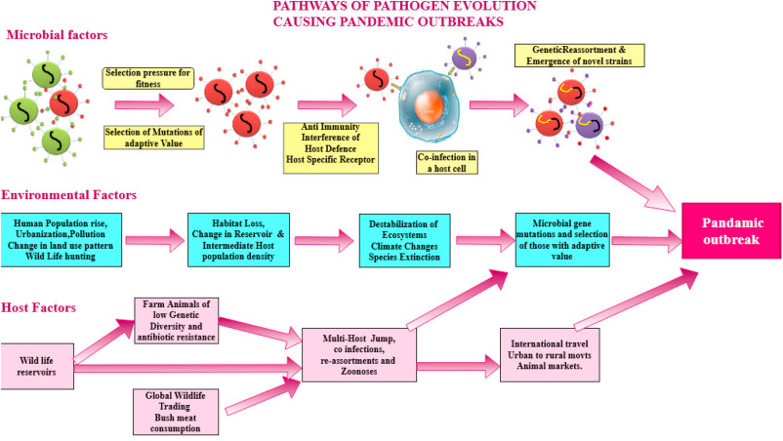
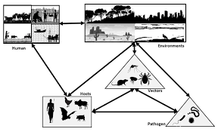

Slide 6
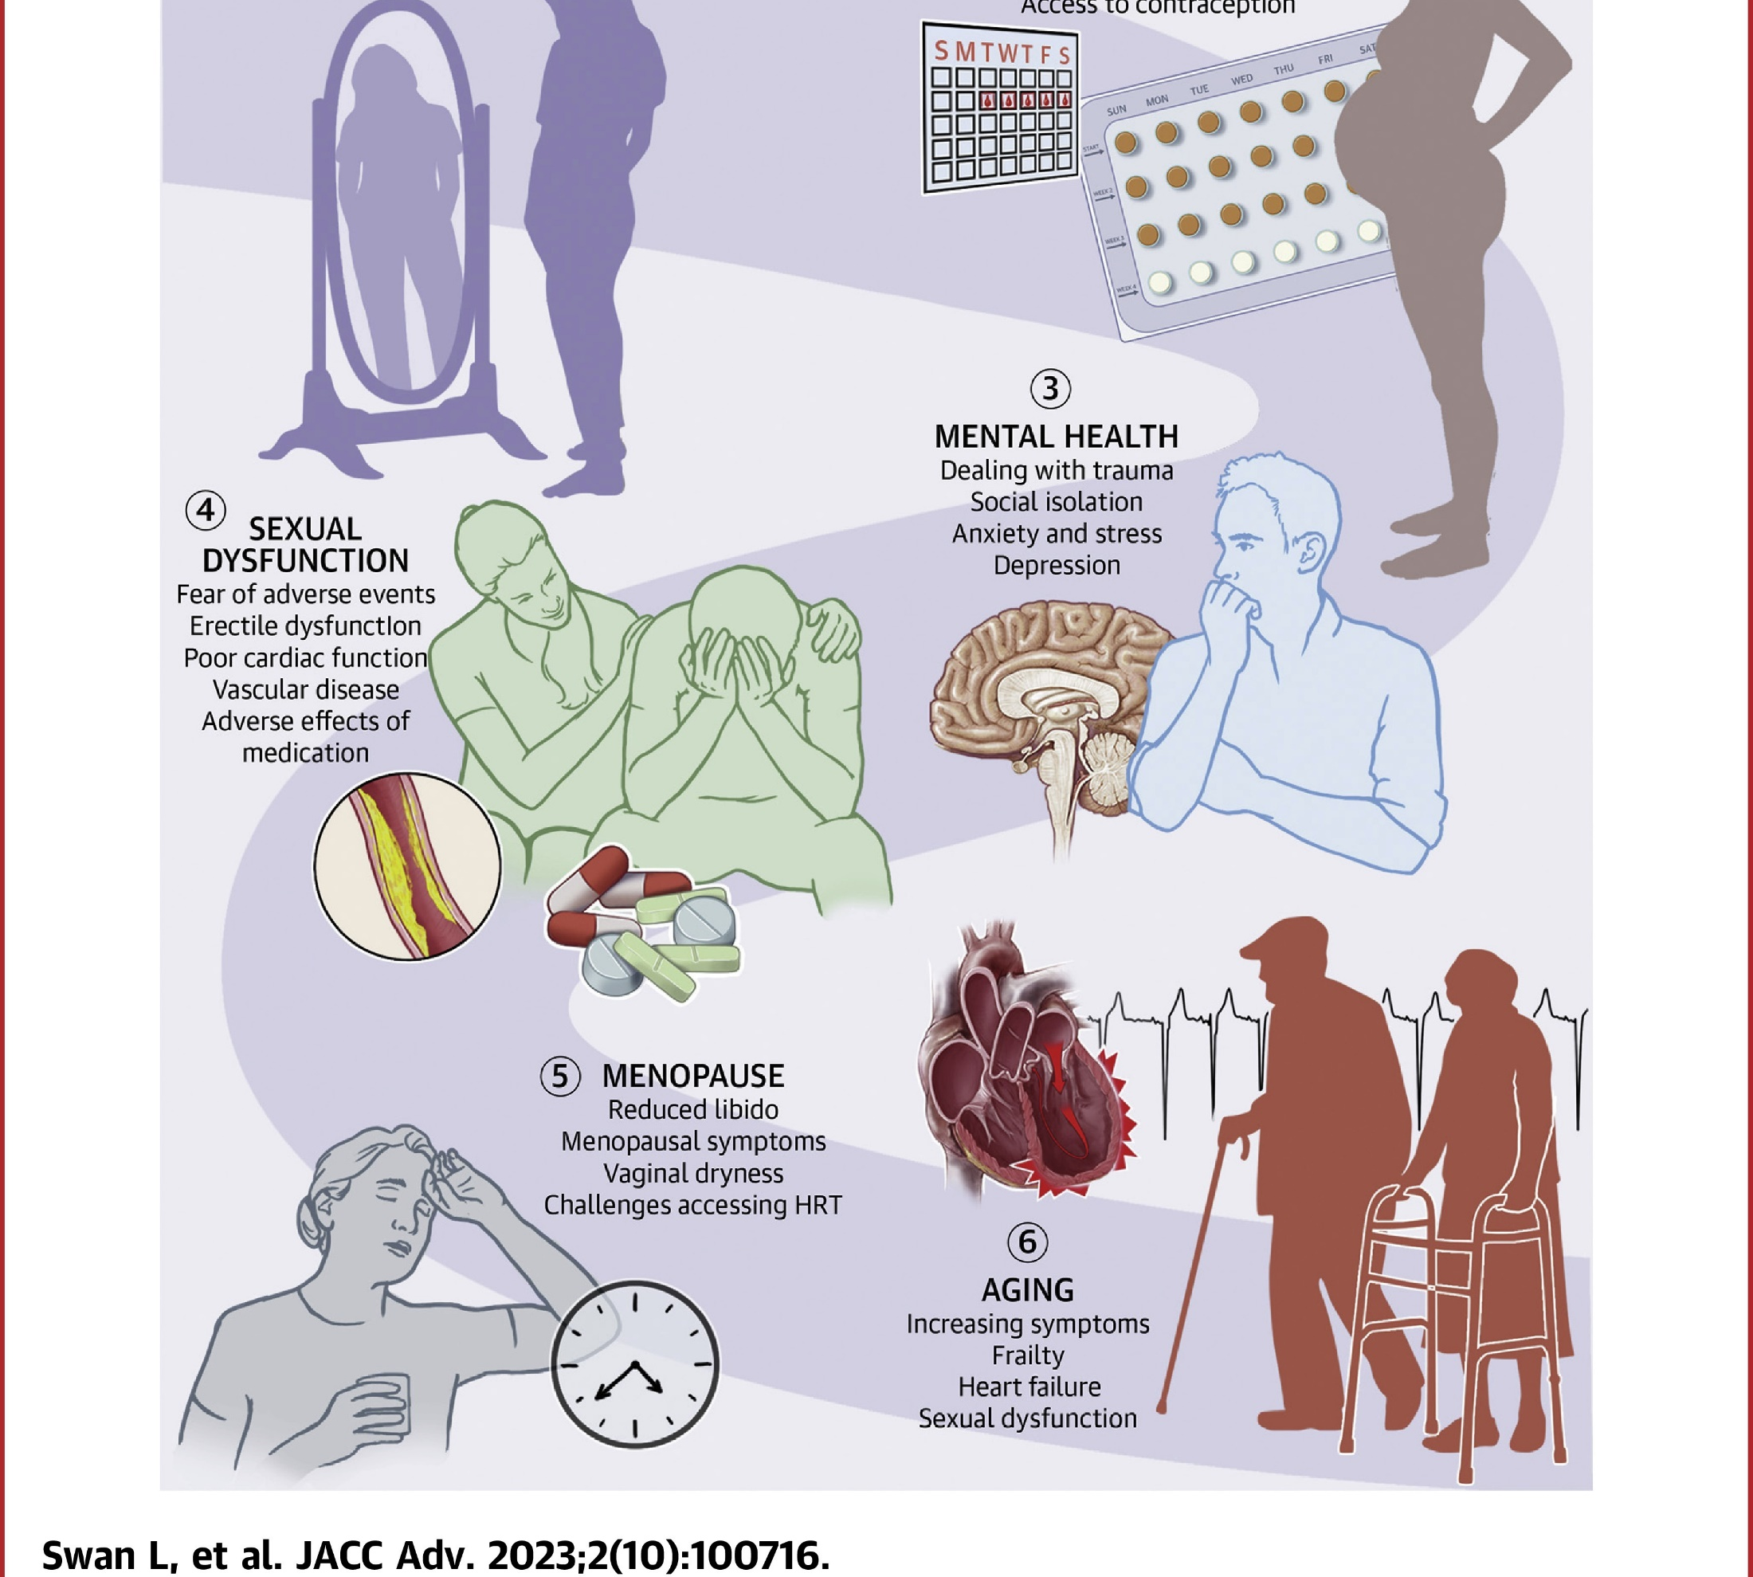



Source: https://doi.org/10.1016/j.jacadv.2023.100716

