Slide 1
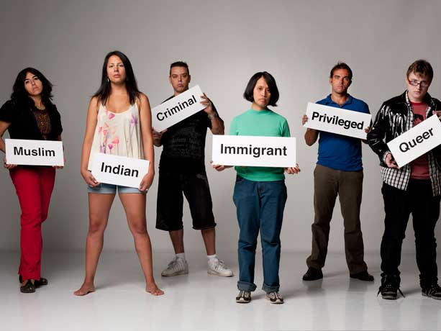
Race, Ethnicity and Identity
Professor Pamela Kea
Department of Anthropology
Final year module
This Photo by Unknown Author is licensed under CC BY-SA-NC

Slide 2


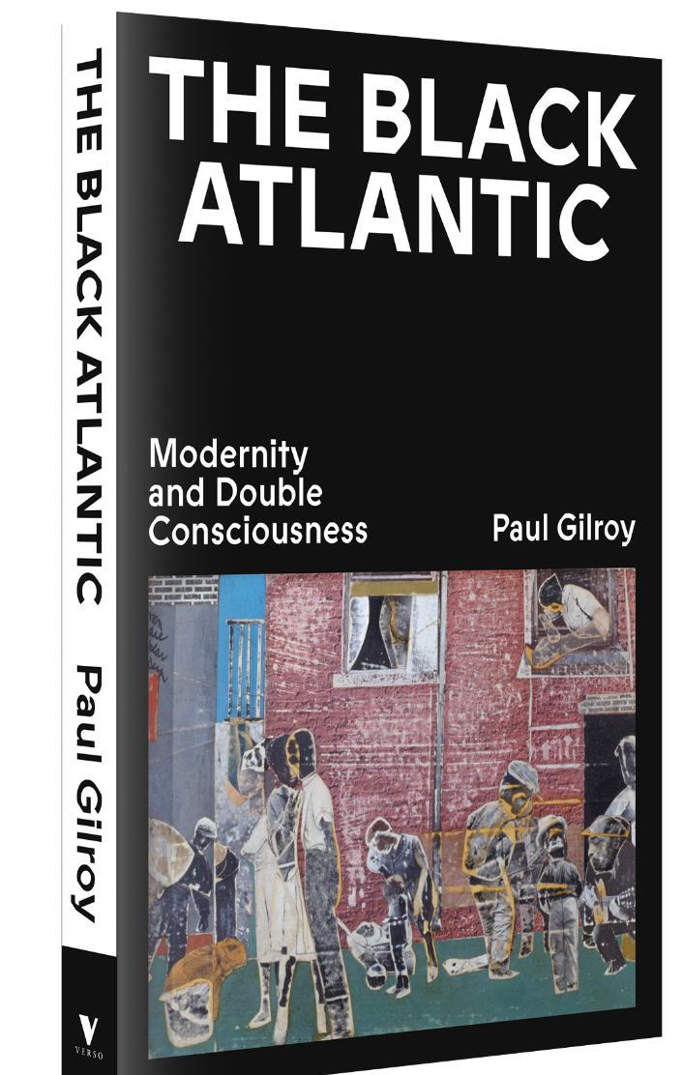
This module focuses on theories of race, ethnicity and identity. It applies diverse theoretical approaches to the terms in historical and contemporary contexts.

Slide 3

As well as examining the way in which racial and ethnic identities have been constructed across time and space, the course interrogates these constructions with specific reference to:

Slide 4

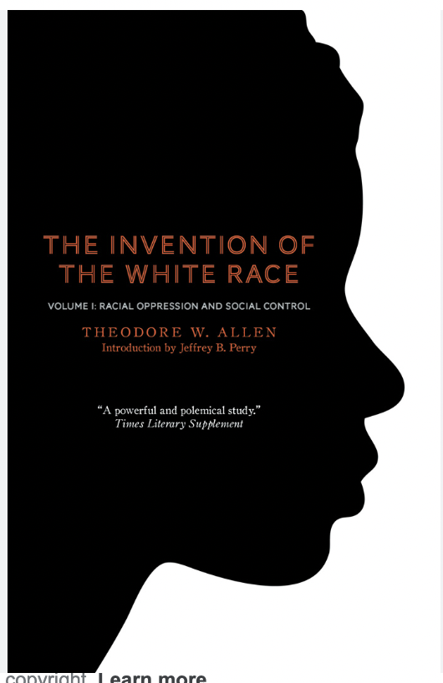
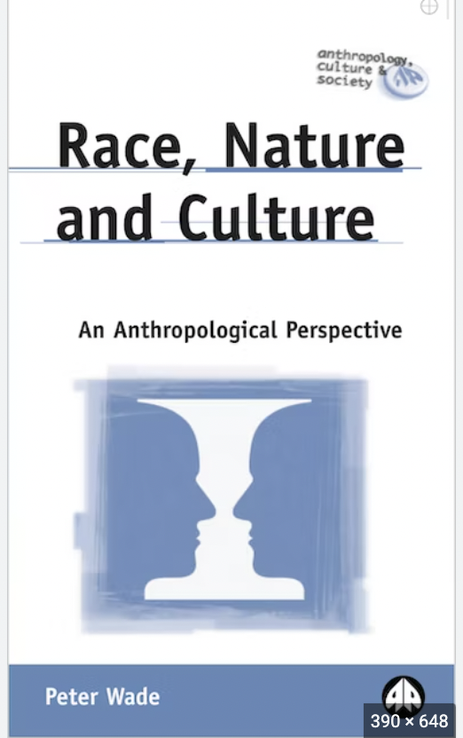
Weekly Topics:
Week 1: Historical Reflections on Race: Slavery, Colonialism and the Science of Race
Week 2: Race, Visual Culture and the Gaze
Week 3: Racial Capitalism, the Movement for Black Lives, Structural Violence and the State
Week 4: Feminism, Intersectionality and the Politics of Difference
Week 5: Whiteness studies and Critical Race Theory
Week 6: Migration and Decolonial perspectives
Week 7: Museum Collections and the Politics of Representation
Week 8: Mixed Race Identities
Week 9: Necropolitics and COVID-19

Slide 5

Some Key Questions:
How and when does race emerge as a concept, an object of study and a lived reality?
How does the movement for black lives (M4BL) theorise the relationship between race, capitalism and the current situation of black populations? / How is the M4BL informed by an intersectional feminist politics?
How does the myth of a post-racial society relate to white privilege?
How does racial capitalism articulate with class and / or unequal citizenship rights?
With respect to refugees and people claiming asylum, how does death become a part of the way of governing life?
How do mixed race / multi-racial identities challenge racial hierarchies of belonging?
How are racialized subjects produced through practices of looking?’ / How does an oppositional gaze challenge these practices?
This Photo by Unknown Author is licensed under CC BY

Slide 6
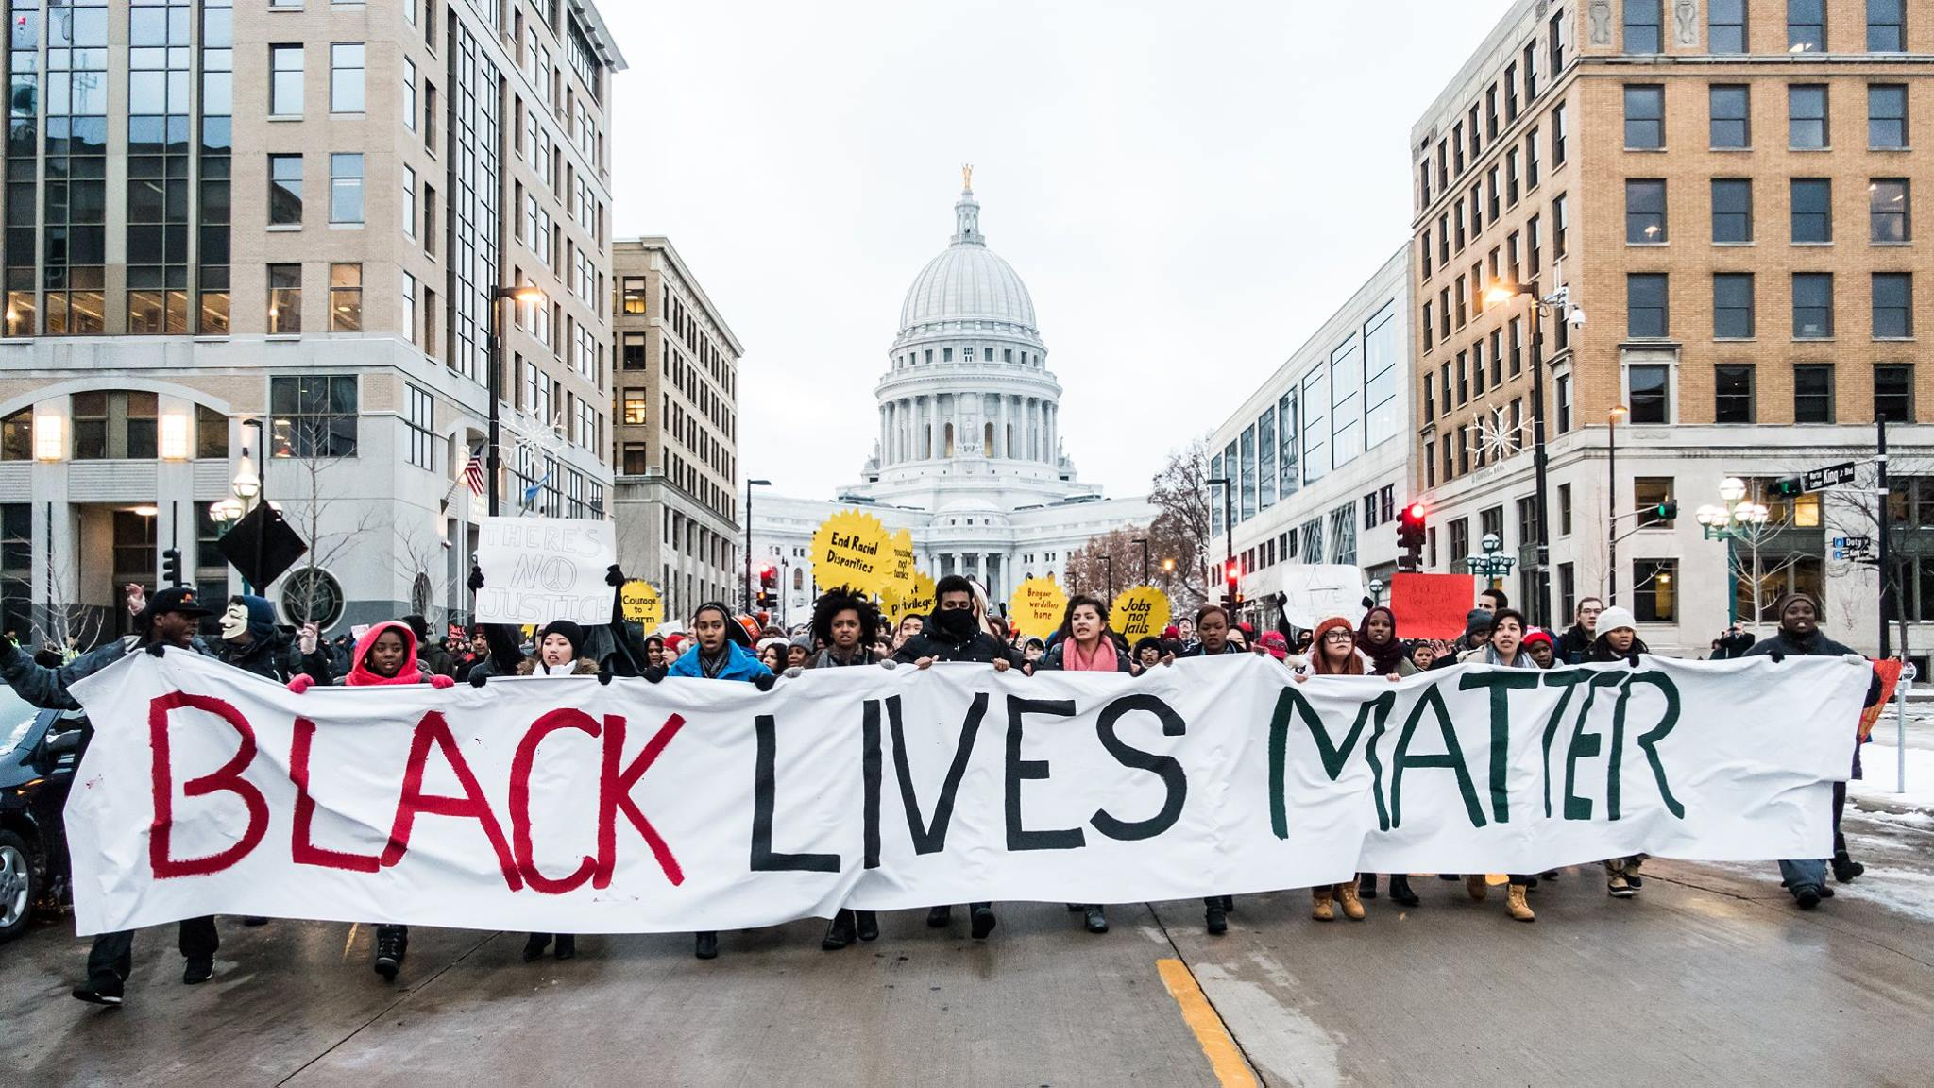


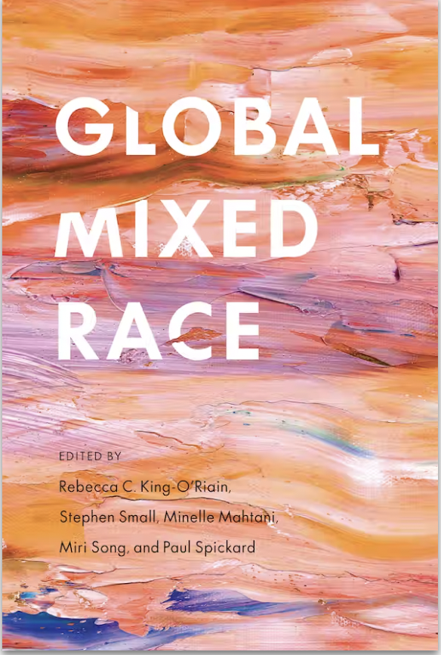
This Photo by Unknown Author is licensed under CC BY-NC-ND

Slide 7
Teaching
Weekly 3 hour seminar with lecture and student led activities.
You will be exposed to a range of written, and visual resources - from academic texts to films.
Two individual tutorials, as well as a dissertation writing session.

Slide 8
Previous dissertation topics
Entangled Islands, Shifting Identities: White Supremacy, Colonialism, and the Irish Diaspora
Zwarte Piet: The Affective Politics of Belonging
Consuming Candomble: The Baiana and the Navigation of Ethnic Identity in a ‘Racial Democracy’
Visibility and Invisibility of Native Indian Women in Contemporary Canada: An Anthropological Perspective on Marginalization and Representation
Identity Politics as a Social Justice Technology
Brazil’s Racial Democracy: Boa Aparência (good appearance) and the ‘Myth’ of Harmonious
Mixture

Slide 9
Previous dissertation topics
The American Nightmare: An Analysis of Slavery, Institutional Racism, and the Birth of the Carceral State in the USA
Creative Disruption: Afrofuturism as a Methodology for Resisting Racial Mythologies
Visibility and Invisibility of Native Indian Women in Contemporary Canada: An Anthropological Perspective on Marginalization and Representation
A Desire for Whiteness: Skin bleaching in Thailand/Asia
Forgotten Racism: Critiquing the Contemporary online Discussion of Cultural Appropriation

Slide 10
Learning Outcomes
Have an understanding of the history and theories of race and ethnicity, and how they interact with others forms of identity such as gender, sexuality, nationality and class.
Display a knowledge of a range of situated historical, contemporary and ethnographic case studies that reveal the dynamics of race and ethnicity in relation to hierarchy, power, resistance, representation and techniques of governance.

Slide 11

Learning Outcomes
Apply theory/insights/literature to empirical contexts and specific themes related to the topic with an appropriate degree of critical awareness and with reference to the literature.
Conduct independent research on a related topic.

Slide 12

Assessment
Dissertation presentation (non-contributory)
7,000 word dissertation

Slide 13

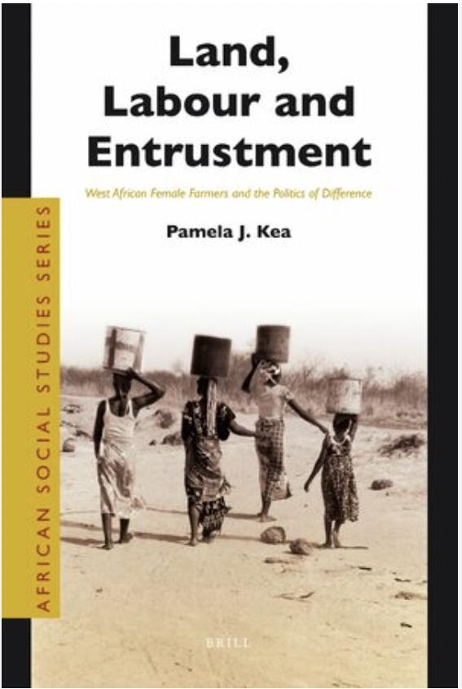
About the convenor
Pamela Kea, Professor of Social Anthropology
My research focuses on:
Asylum, displacement and migration governance in the UK and Europe
The West African diaspora in the UK, return to West Africa and transnational relations.
Hidden and counter narratives of West African migration and return
Decolonizing the study of migration

