Slide 1

Human Rights (L2124A)
Final Year Advanced Option – 30 credits

Slide 2

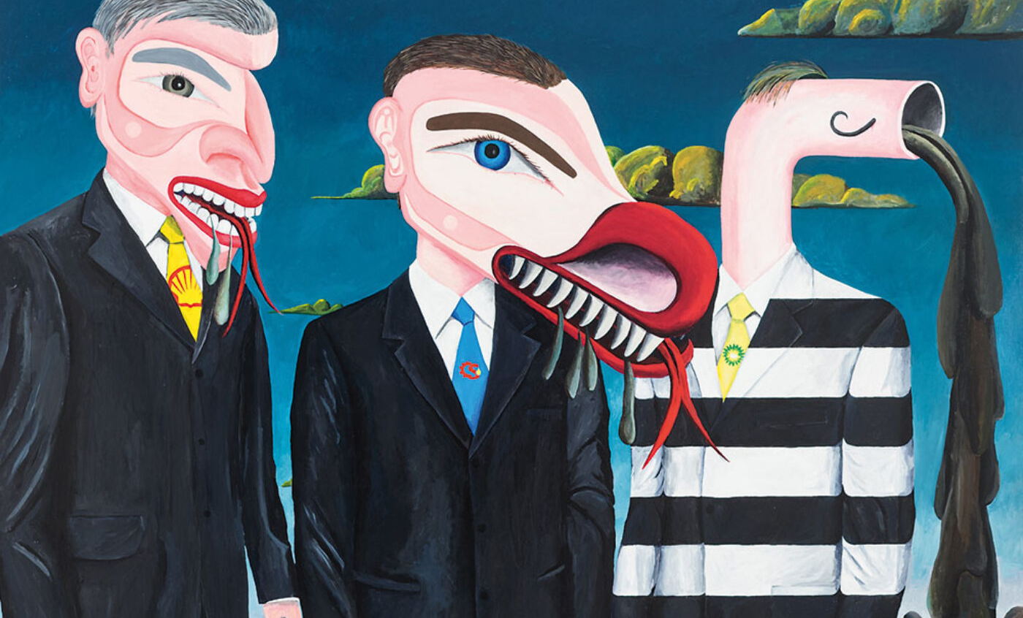
human rights – course overview
This module introduces you to key, interdisciplinary approaches, to human rights, including their philosophical and historical evolution, and contemporary forms and uses, of human rights.
The course examines the cultural encounters and human experiences that emerge out of contemporary human rights regimes, taking case studies from a range of different settings to focus on how culture and politics shapes these global practices, and how different groups understand, respond to, and challenge such interventions.
The module’s focus is on the multi-faceted and contingent ways in which human rights are socially enacted (defined, claimed, interpreted, challenged, implemented and monitored), as well as the possibilities and limitations of human rights to realise their utopian potential.
Top: Usufruct, bottom: Fucking Creeps, They’re Environmental Terrorists © Lawrence Paul Yuxweluptun

Slide 3
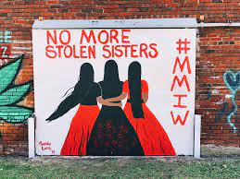


example weekly topics
What are Human Rights?
Claiming and contesting rights
Human rights and the environment
Refugees, migrants, and rhetoric
Citizen care, forensics and state failure
Women’s rights
Labour and rights
Indigenous rights and colonial genocide
More than human rights
Resistance
Future of human rights
NOTE: These may be subject to change, depending on contemporary situations

Slide 4
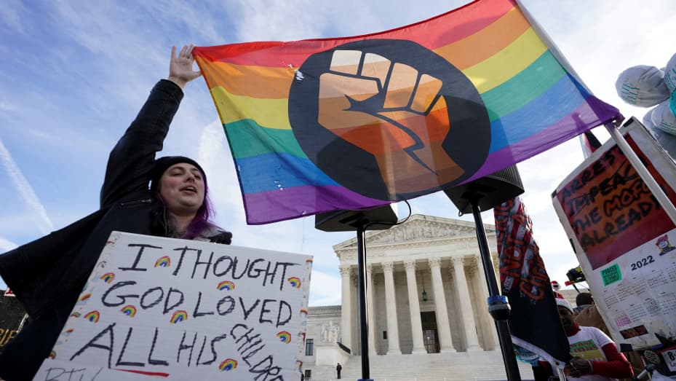



teaching modes
1-hour weekly lecture
2-hour weekly seminar
Learning is through a mixture of interactive lectures and seminars, drawing on film, photography, and art, as well as academic literature to think about the ways human rights are understood, enacted, and resisted globally. You will have the opportunity to critically engage with contemporary issues of your interest in both teaching and assessment, receiving feedback throughout.

Slide 5
learning outcomes
Systematically understand and critically evaluate key scholarly approaches to the philosophical and historical evolution, and contemporary forms, of human rights;
Extend and apply theoretical understanding to specific contexts in the analysis of human rights practice;
Independently research, synthesise and make arguments on specific themes and materials related to the module and your own interest;
Communicate your arguments to specialist and non-specialist audiences.

Slide 6

assessment
Coursework: (100%)
  Portfolio - 2500 words, Week 6
  Essay – 2500 words, Week 11
These can be on any subject related to human rights and are not restricted to the subjects that we consider in the lecture and seminar.
See the next slide for a list of past subjects

Slide 7
examples of previous assessment topics
The human rights project as a form of neo-colonialism/the globalisation of human rights
Government rhetoric on refugees as a form of legalised discrimination
Do the dead have human rights?
The weaponization of women’s rights in the global war on terror
Is toxic pollution a human rights issue?
Undefined terms? Are alternative framings of sexual orientation more effective than human rights at protecting sexual minorities?
Abortion law in Northern Ireland: exploring the relationship between stigma and reproductive rights
Is the prevalent narrative of child soldiers as coerced victims adequate for contemporary conflicts?
The right to education in conflict zones: Palestine
Enforced disappearance & extraordinary rendition: booksellers’ disappearance in Thailand & Hong Kong
Are disabled people fairly represented in International Human Rights Law?
How does protest in China use the framework of human rights to resist authority?
The human rights of indigenous people in a settler colonial state: Aotearoa New Zealand
What happens when states fail? Citizen forensics and care on the migrant trail at the US-Mexico border

Slide 8

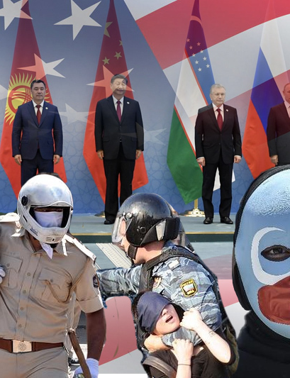
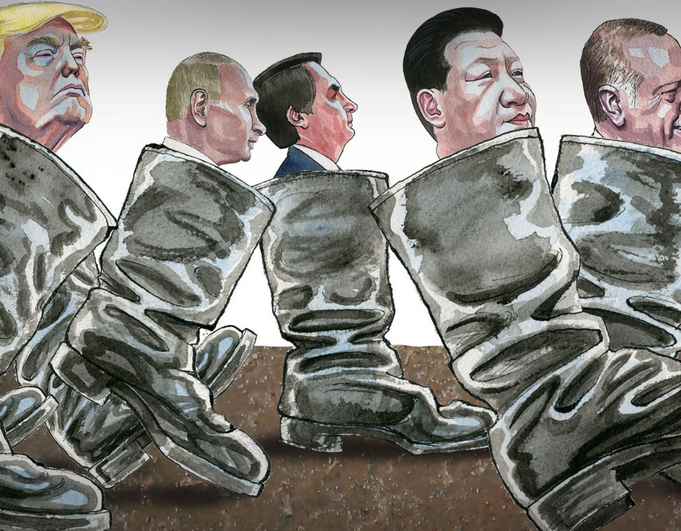

For any questions or further information, please email: intdevoffice@sussex.ac.uk
.

