Slide 1
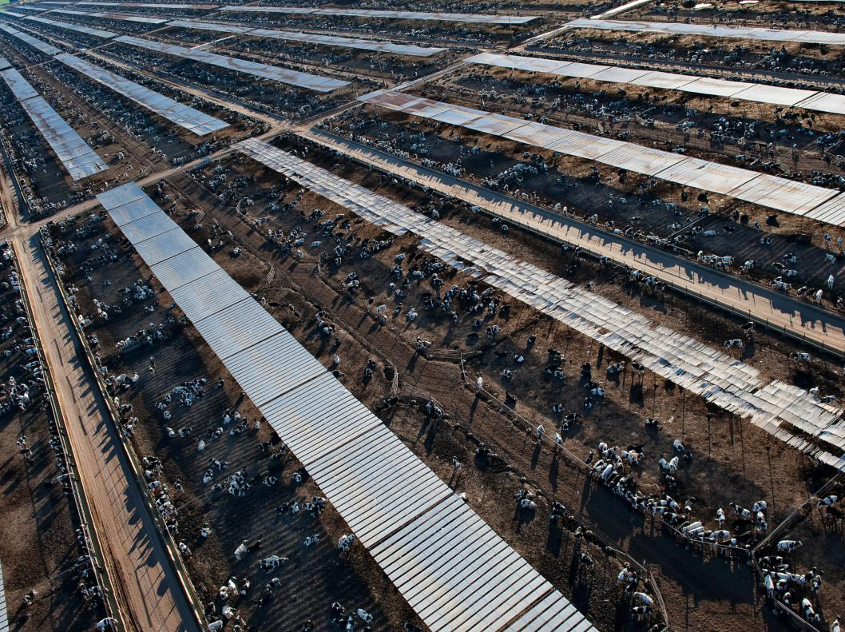
GLOBAL FOOD SECURITY (005GS)
Dr Pedram Rowhani

Slide 2
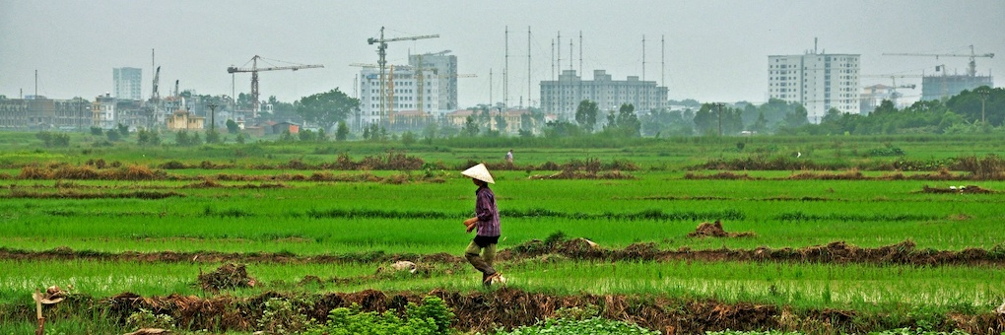
What’s the module about?
Why take this module?
Because you eat and drink multiple times a day and that simple action has one of the biggest impact on our planet.
Because it is an interdisciplinary module.
Because food is the biggest challenge that humanity faces.
Because billions of people are malnourished

Slide 3
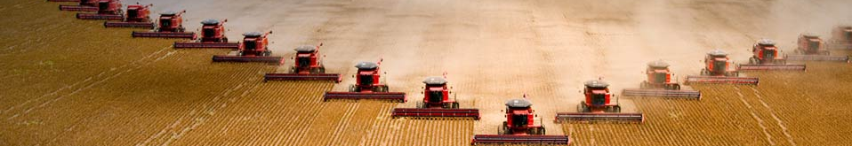
What’s the module about?
Level 6, 30 credit
We mainly focus on the following questions:
As we are producing so much food, why are there so many people suffering from obesity while many are hungry?
How can we develop a sustainable food system?

Slide 4
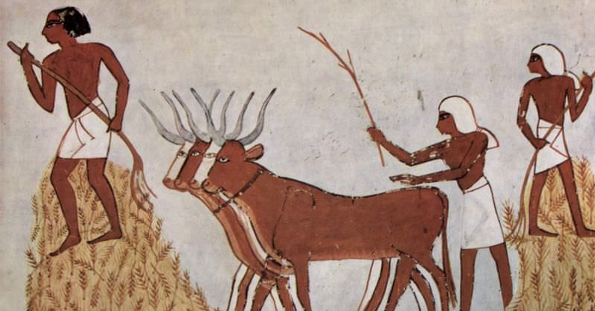
By the end of the module, you should be able to:
  discuss and analyse the complexity of the current food system, from seed to the plate, from the local to the global
  describe the various metrics, definitions and dimensions of food security and highlight their limitations and strengths by using current research literature research,
  appraise in detail scientific papers by assessing their significance, assumptions, and limitations of arguments
  work in a group environment to formulate arguments, develop and share ideas, reflect critically on scientific papers, and communicate to various audiences.

Slide 5
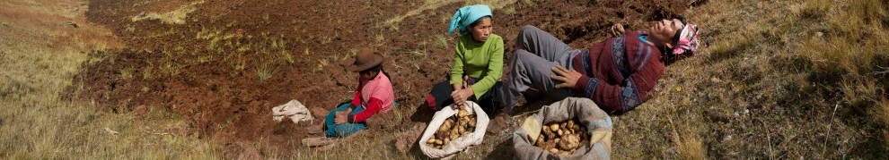
How will it be taught?
Weekly lecture (1 hour) and seminar (2 hours)
Student-led seminars & Guest speakers
Examples of key topics that we will try to cover:
  What is food security?
  Impact of climate change: mitigation and adaptation potential of agriculture
  Deforestation, pesticides, biodiversity and other environmental issues
  Famines and hunger
  Food waste
Assessment
  Coursework (20%): 15-min Group Presentation
  2-hour Open-book Exam (80%)

Slide 6
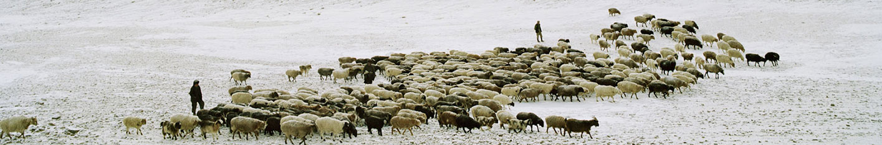
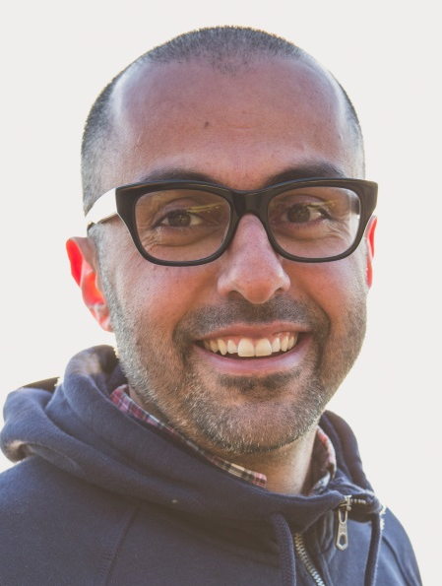
Who am I?
Dr. Pedram Rowhani
  I like eating food and my research focuses on global land use dynamics and the interaction between human society and their environment. I am currently working on the impacts of natural hazards on agriculture, the environmental and nutritional outcomes of the Common Agricultural Policy, mapping global irrigated areas, and land use change driven by Quinoa in Bolivia.
Questions?
  Email: p.rowhani@sussex.ac.uk (or see me in my office in Chichester 1).

