Slide 1
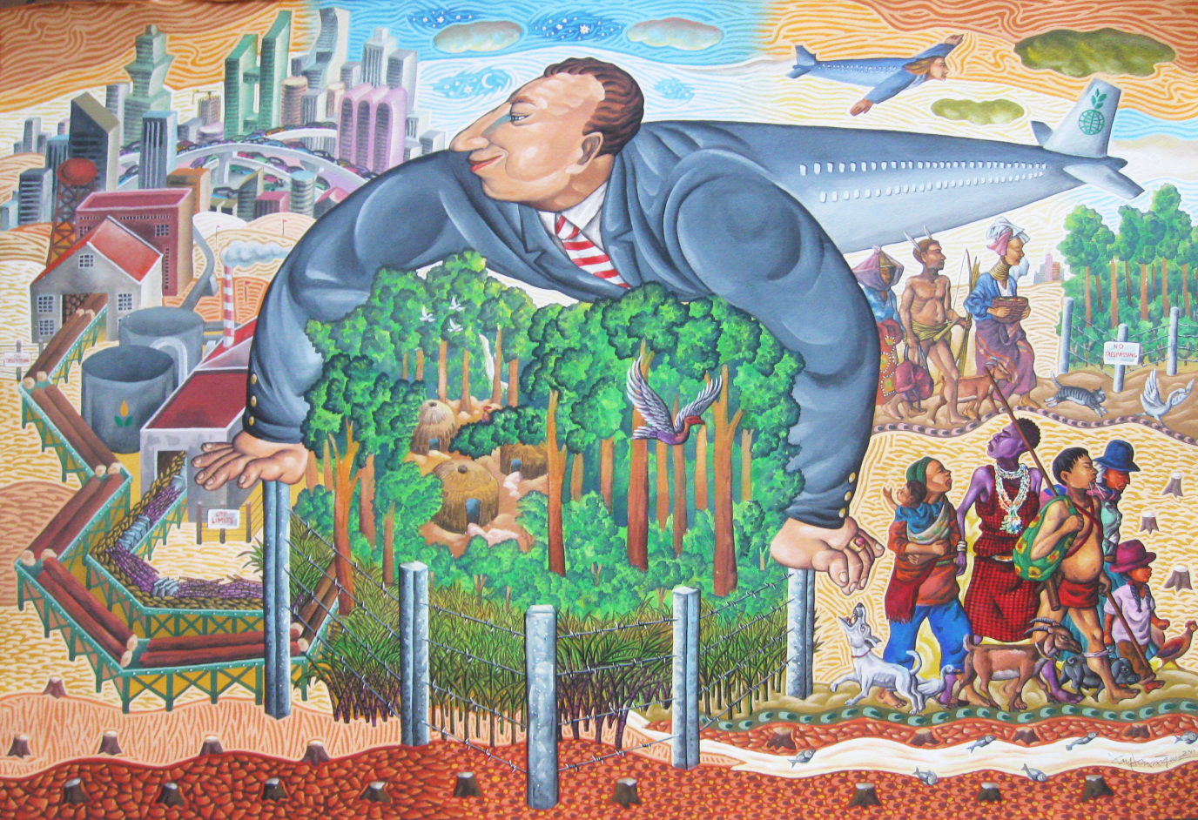
Environmental Anthropology

Slide 2
Environmental Anthropology
Structure of the Course
Built around a number of current debates (and ‘turns’)
Week
Week 1 | Lecture: Introduction; The ‘new’ environmental anthropology Class: What is ‘the environment’ (earth, air, fire, water, music, words, virtual?)
Week 2 | Anthropology and animal life & the turn to Multi-species ethnography
Week 3 | ‘Noble savage’, Indigeneity and the ontological and perspectivist turn.
Week 4 | NatureTM Inc. and the turn to commodification: What is ‘natural capital’?
Week 5 | Experiencing the environment: impoverishment and ‘reconnecting’
Week 6 | Conversing with the natural world? The posthuman turn No Class: One to one tutorial and preparation of formative essay
Week 7 | Anthropology of Climate and Climate Change
Week 8 | Anthropology and environmental politics, activism and conservation
Week 9 | Technofutures: Geoengineering, the Anthropocene, and apocalyptic futurism
Week 10 | Class Workshop – presenting outline ideas.
Week 11 | Essay Tutorials

Slide 3
Blurb
This course considers the cross-cultural study of relations between people and ‘our environment’ – broadly conceived. Environmental anthropology has transformed over the past decade or two as anthropologists engage in addressing the environmental challenges of our era. This has promoted many radical re-evaluations of what we study and how we study it. For example, whilst in the past anthropologist’s interest in the animal world considered its importance for human social relations, we now ask how our social relations actually extend to animals, plants and other living forces in multispecies relationships. To what extent are our affective relations of companionship and love, our economic relations of reciprocity and mutual interdependence not only with other people but with wider life? Is the ‘anthropo’ of anthropology too limited, and should we instead conduct ‘multispecies’ ethnography?
These boundaries are all the more blurred as our own relations with each other and with the natural world are increasingly mediated by media, new and old, and as we hook the planet up to the internet in the ‘internet of animals’ as well as the ‘internet of things’. Moreover, as more and more of nature becomes tradable, for example in carbon offsetting markets or in biodiversity offsetting markets, anthropologists have been asking what happens when the natural world becomes envisaged and treated as ‘natural capital’?
Climate change, the presence of plastic and other pollutants, deforestation, and industrial agriculture and foods have become pressing concerns and anthropological insights, methods and theorisation has a great deal to offer in understanding their social dimension and to movements and polices addressing them, from Rewilding movements to ‘Just Stop Oil’, ‘Extinction Rebellion’ and so on.
The course aims to ground you in what I would dub as this ‘new environmental anthropology’. To capture its excitement, I have constructed the module around various ‘turns’ in anthropology including the multispecies turn, the ontological turn, the neoliberal turn, the phenomenological turn, the climate turn, the activist turn, and the Anthropocene turn.
In the first session, however, we open the question of 'what is the environment', asking how it extends from issues we are familiar with to questions of sound, music, rhythm and words, to scent and odours, and to virtual environments and so on. Whose definititions or ontologies shape how with contemplate this?

Slide 4
Assessment
Long Essay / ‘Short Dissertation’
5,000 words + bibliography
You find topic that fascinates you. Do something original.
Does not have to relate directly to any element of the course so long as it addresses environmental questions (widely defined) and is approved by me.
They are a contribution to the discipline. Some have been published.
It is evidence of what you can do, helpful to future study, to future employment and for job references etc. etc.
It should be fun

Slide 5
Group work
Week 1: Groups
water;
Air (wind)
Air (scent)
earth,
music/words/rhythm/time
virtual
Week 2: Groups
Companion animals,
Hunting and Killing animals
Plants and people
Cyborgs / ‘internet of animals
Week 5 groups
Impoverishing nature;
Alienation from nature;
Mediating nature;
immersing in nature & environmental art;
Rewilding and regenerating
Week 7 groups
Perceiving climate change
Changing lifestyles
Anthropologies of climate science and politics
Other weeks we will have prepared discussions (week 3, 4, 9) and formal debate (week 8)
We will be relying on each other to have prepared!

Slide 6
Some of last year’s topics
Forest bathing and communication beyond the human
Giving Flowers
Vertical forestry and greenwashing architecture
Sound bathing: neoliberalising soundscapes
Killing animals
Geoengineering and indigenous resistance
The more than human turn and astrology
Houseplants and domestic life
Taxidermy beyond colonial critique
Surfing and resistance
Earthquakes and disasters
Projecting Earth to extraterrestrials: Voyager mission
Rhythm and embodiment
Settler colonialism and Canadian First Nations

Slide 7
Some of year before…
Metal Detecting and embodiment of past and present landscapes
“Stop calling me resilient” – Climate Crisis and Post disaster
Tobacco and colonization among Native American
Migrants and the alternative food movement in Spain
Place, pulse and politics of music
Coloniality and conservation in the Cayman Islands
Grassroots or philanthropy in charity-led alternative food movements
Buddhists and Bees
Communicating with psychedelic plants and mental health
Ecovillages and refugee camps
Cottagecore and counterculture
Rhino conservation and violence
Communicating with fungi
Ecofeminism and environmental art
Decolonial teaching and rewilding urban education

Slide 8
Rats and multispecies demining in Cambodia
Fairy Forests and Fairy Tales
Eco-habitus paradosx: Green ethics among destructive middle classes
White normativity in the vegan movement
Autism Spectrum disorder, animals and environment
Technoanimism
Rewilding: revolutionary or reactionary separation?
Carbon offsetting in Uganda
Commodification of bottled water and marketing
Companion animals and mental health
The cottagecore aesthetic: origins and significance
Harnessing gaming for indigenous futurisms
Beekeeping and urban environments
War and environment: what place for a multispecies approach
Rewilding and national identity
Cold water immersion: year round Brighton swimmers
Yosemite wilderness and the Miwuk nation
Ecofashion
Natural therapy for prison inmate mental health

Slide 9
Assessment and Work Schedule
The course delivers intensive content until week 9
Personal meetings to meet you all in week 1 (by appointment in my office)
In week 6 you write an analytical essay of 1,500- 2000 words to help build Long Essay ideas and analysis [this will be handed in at the beginning of week 7 and discussed in tutorials during week 8 (before Spring break) and in weeks 10 or 11.
By week 8 you have developed an outline and in week 11 (after the break), we present these dissertation outlines in a workshop
You will thus have two 15-20 minute tutorials (in Week 8 and Week 11)
The tutorial in week 11 will provide feedback on dissertation outlines. I can read and comment on the introduction as well as on overall structure and argument.

Slide 10
Some facts
30 Credits each
5,000 words (Spring)
This length INCLUDES footnotes, endnotes and quotations
5000 words DOES NOT INCLUDE abstract, bibliography or appendices
Referencing: Journal of Royal Anth. Inst.
E-Submission

