Slide 1
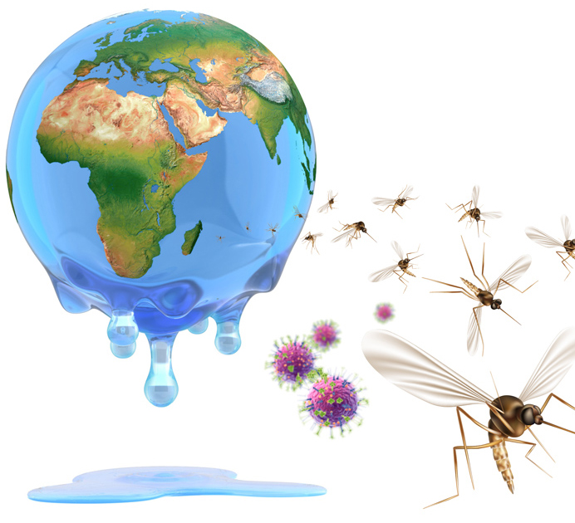
Disease, diplomacy and development
Anne Roemer-Mahler
& Stefan Elbe
This Photo by Unknown Author is licensed under CC BY-NC-ND

Slide 2
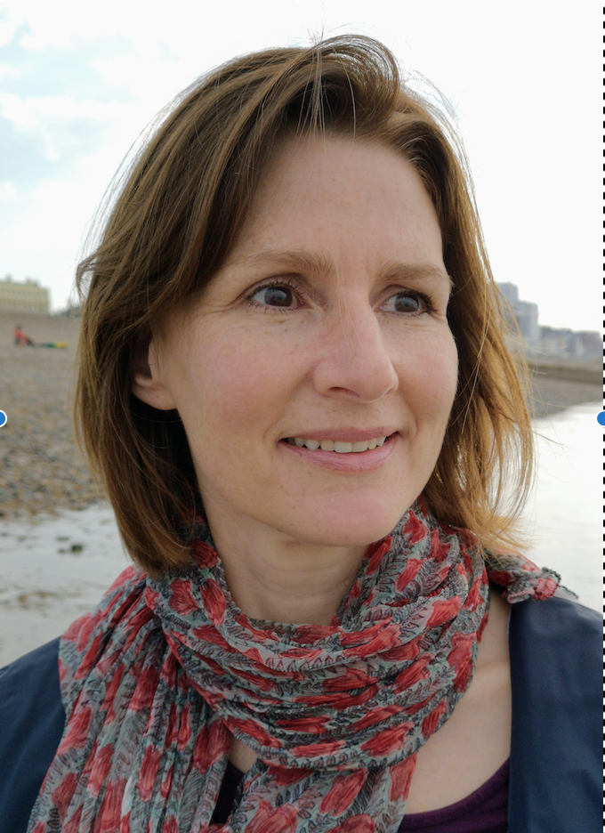
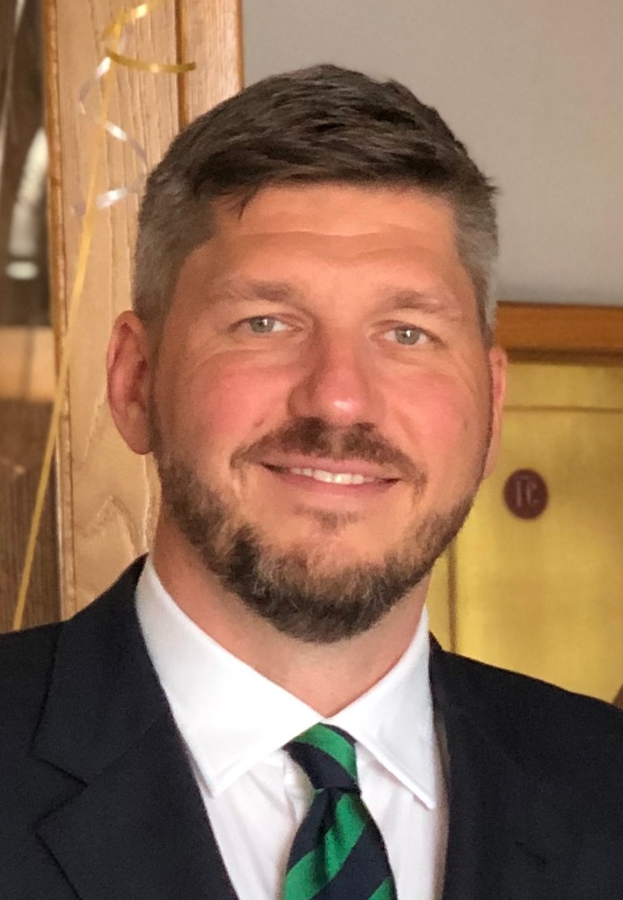
Module tutors:
Anne Roemer-Mahler &
Stefan Elbe
Hello!
We will be co-teaching the module ”Disease, Diplomacy and Development”, bringing together our expertise on the international politics of health, development and security.
Post-Covid, it is hard to imagine that, two decades ago, when we starting researching ‘global health’, this was quite a niche topic. Today, disease threats are discussed in the key arenas of international diplomacy, including the UN General Assembly and Security Council, G7, G20 and BRICS meetings, the World Trade Organisation, bioweapons and climate change negotiations, and the Sustainable Development Goals, to name but a few.
We look forward to exploring with you how disease threats have become central to diplomacy and development. Anne’s particular expertise is the politics of access to medicines and vaccines, the rise (and fall?) of global health governance, and health security in Africa. Stefan's expertise is in global health security, global health diplomacy, and pandemic politics.

Slide 3

This module is not about health
Rather, it is about the social and political processes that have brought (certain) diseases onto the international political agenda. This means that you can take this module without knowing anything about biology and medicine. You may, however, find your understanding of what ‘health’ is challenged in this module.
We will reflect on health and disease not as biological phenomena linked to the individual and the body. Rather, we will think about how health and disease are understood and addressed by social and, therefore, always also political processes.
Taking a political perspective on health is still far from mainstream, and there can be considerable reluctance in the public health and medical communities to engaging with the politics of health. Yet, the importance of politics in how we understand and respond to health threats was put into stark focus during the COVID pandemic.
This Photo by Unknown Author is licensed under CC BY-ND

Slide 4

This module is not about the pandemic
We have been offering this module for three years prior to the pandemic, and one session was reserved for the international politics of pandemic preparedness because it had long been predicted that a global pandemic was likely to happen.
We expect that our experiences during Covid will be a reference point for many of the discussions we are having during the module. Yet, this module is not about the pandemic. “Disease, Diplomacy and Development” spans a much wider field, including the rise of ‘international health’ in the era of colonialism and the impact that this history has on current ideas and practices of ‘global health’; the nexus between health and development as well as health and national security; the role of pharmaceutical companies in global health governance; and the rise of new powers, such as China and India.
The following slides give you an idea of some of the issues we will discuss. You can find all articles on: thinkglobalhealth.org
This Photo by Unknown Author is licensed under CC BY

Slide 5
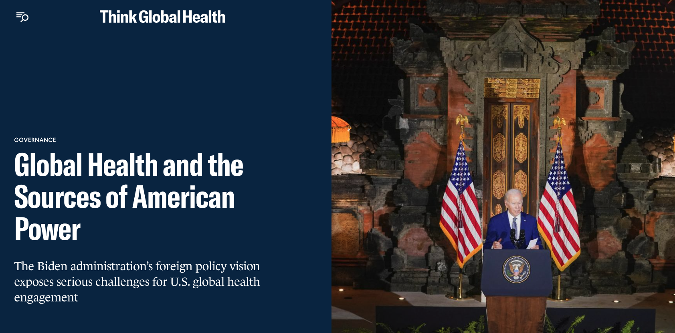

Slide 6
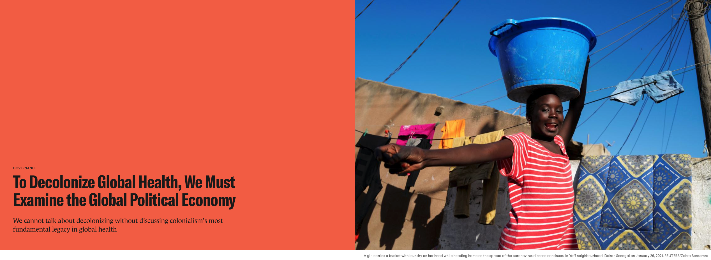

Slide 7
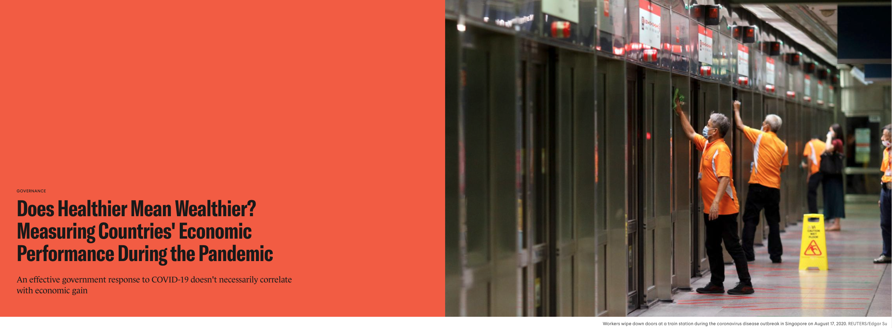

Slide 8
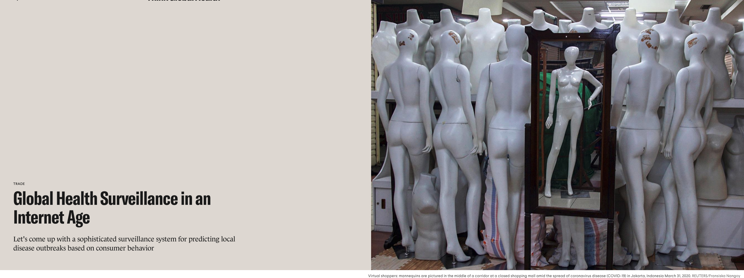

Slide 9
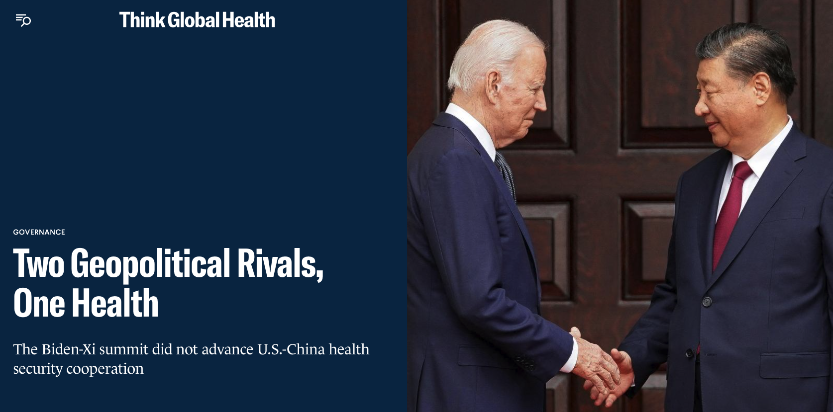

Slide 10
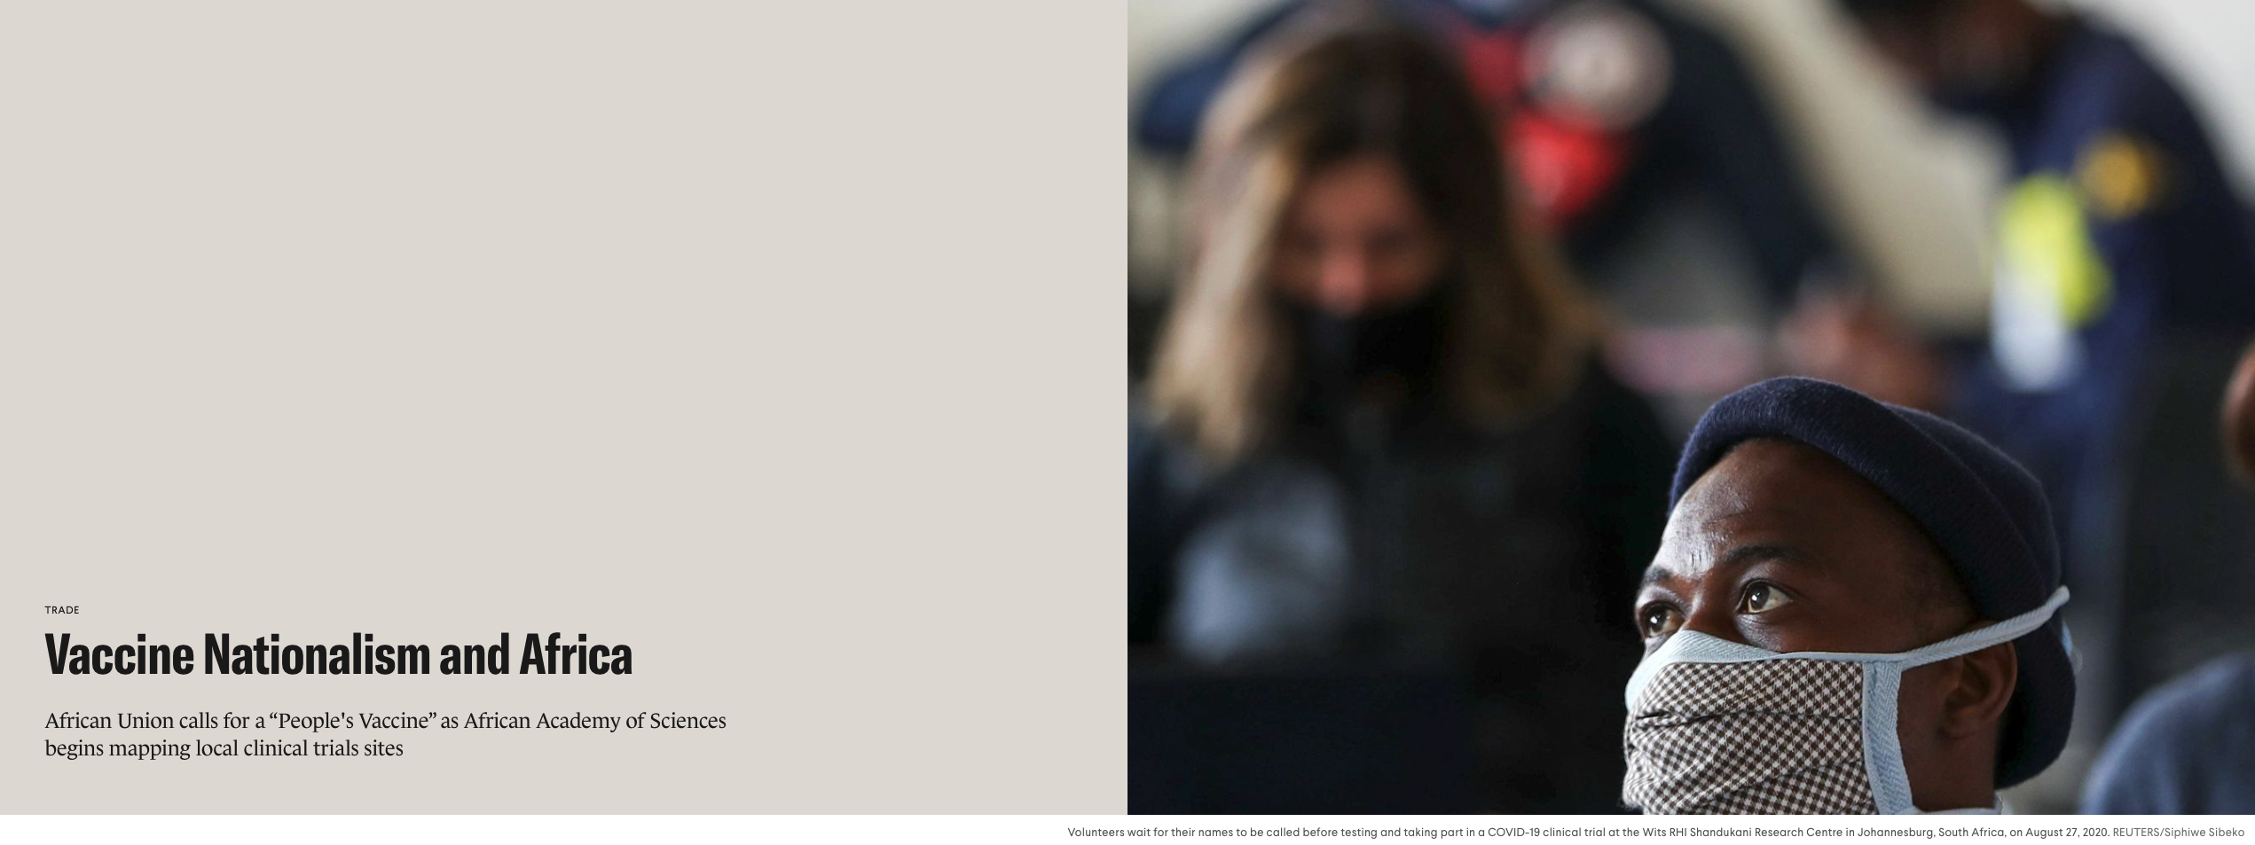

Slide 11
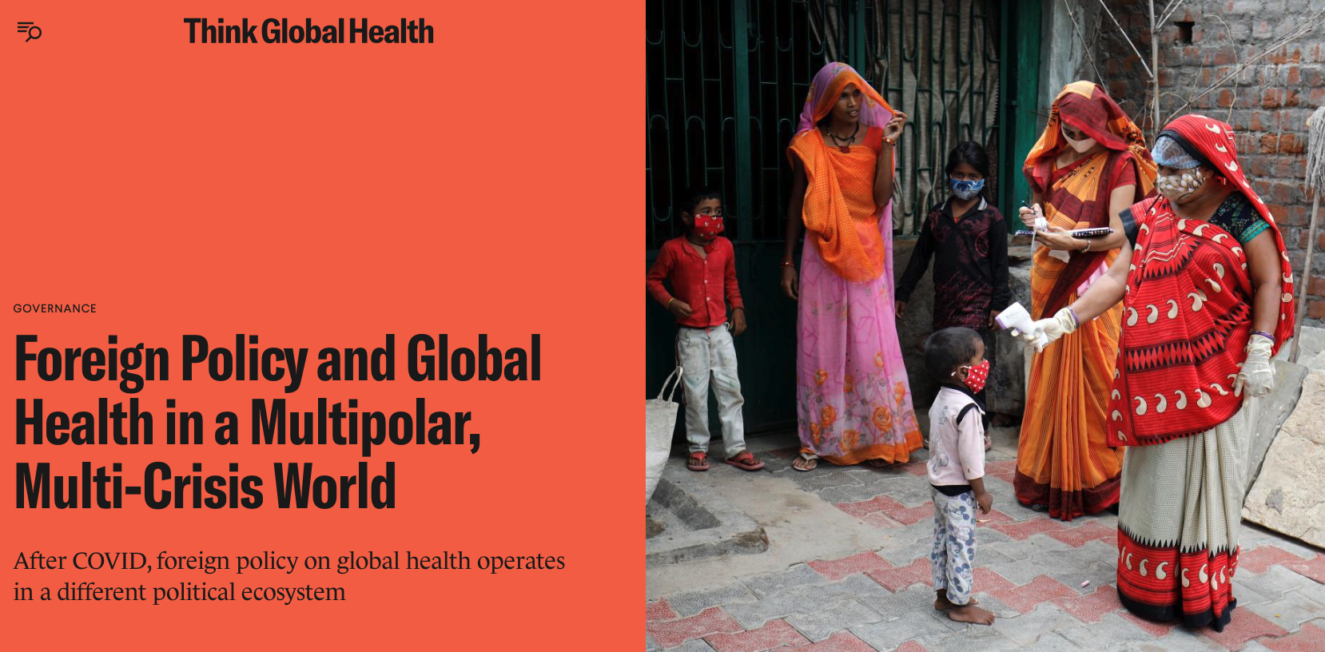

Slide 12

Module overview
The 21st century confronts a wide range of pressing global health challenges – from threatening pandemics like COVID-19, and endemic diseases that undermine development goals, through to increasingly risky forms of scientific research. Which are the major contemporary health challenges for sustainable development and international security? How are those intersecting health challenges governed at global level? What international political dynamics are shaping peoples’ health around the world? This module provides students with an in-depth understanding of the major global health challenges, as well as the international power dynamics shaping this field as it enters a post-COVID, post-global, and post-colonial era

Slide 13

Weekly topics
W1: What is ‘Global Health’? And how does politics come in?
W2: The rise (and fall?) of global health governance
W3: Health for Development?
W4: Disease as structural violence
W5: De-colonising ‘global’ health
W6: Essay Workshop
W7: Pandemic Politics
W8: Biosecurity & Bioterrorism
W9: Biological Danger in the Life Sciences
W10: Global Health Security in Africa
W11: Essay Tutorials

Slide 14

Taster readings
Stefan Elbe (2022) Who Owns a Deadly Virus? Viral Sovereignty, Global Health Emergencies, and the Matrix of the International’, International Political Sociology 16:2, olab037.
Melissa Parker & Tim Allen (2014) De-Politicizing Parasites: Reflections on Attempts to Control the Control of Neglected Tropical Diseases, Medical Anthropology, 33:3, 223-239.
Anne Roemer-Mahler & Stefan Elbe (2016) The Race for Ebola Drugs: Pharmaceuticalisation, Security and Global Health Governance, Third World Quarterly, 37:3, 487-506.

Slide 15

The module is assessed through three contributions:
3,500 words essay (70%)
1,000 words essay outline (20%)
Group presentation (10%)

Slide 16

Get in touch
If you are interested in the module and would like some more information, please email us:
a.roemer-mahler@sussex.ac.uk or s.elbe@sussex.ac.uk

