Slide 1
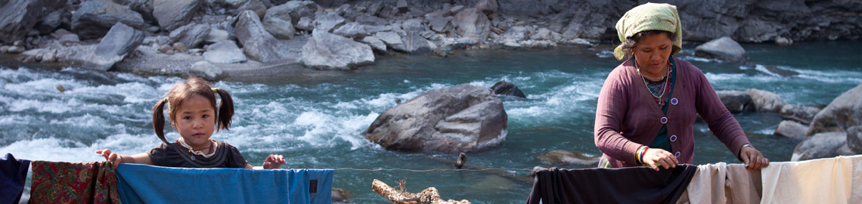
Disasters Environment and Development
Final year
Prof Dom Kniveton

Slide 2
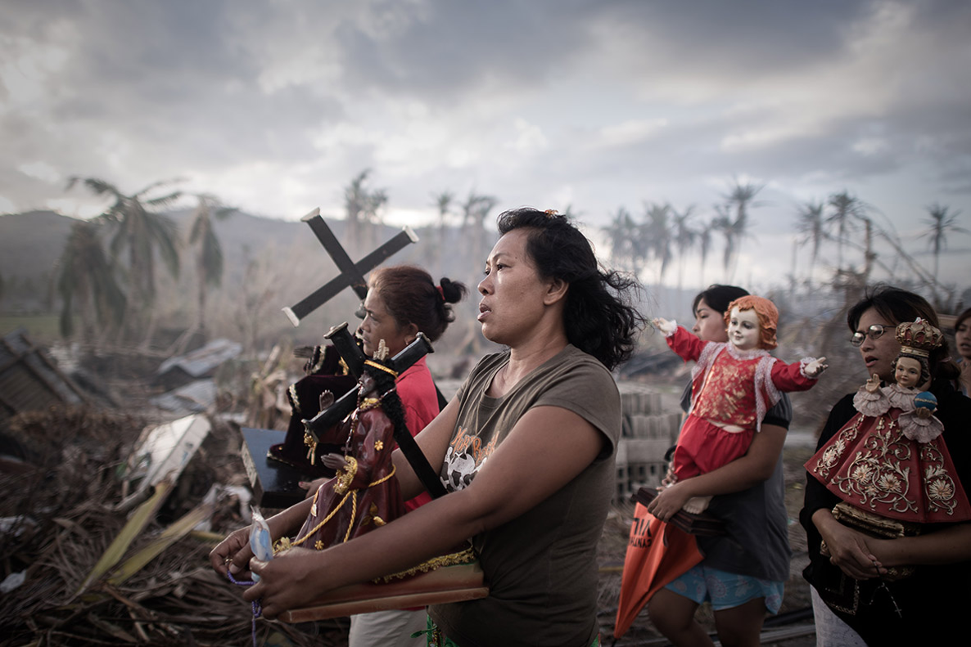
What’s the module about?
Disasters, related to natural hazards, threaten to roll back decades of health and development gains. The lives and livelihoods of poor people around the world are the most severely impacted by disasters. These impacts are accentuated by pre-existing environmental degradation, inequality and conflict.
The ultimate aim of this module is to explore pro-poor solutions to increasing disaster, environmental and climate risks.

Slide 3
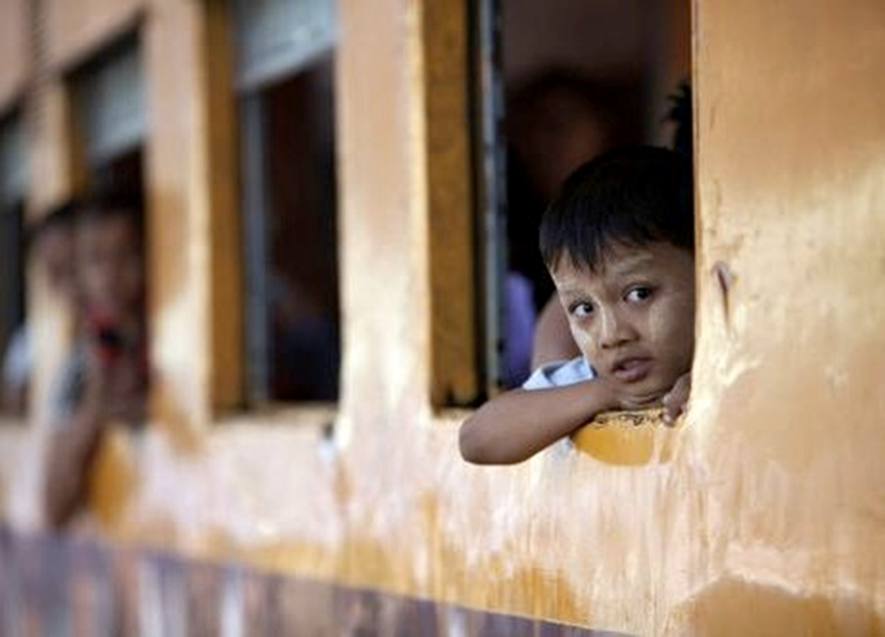
What is the structure of the module?
The module is split into three parts:
a conceptual part that explores similarities and differences in concepts, frameworks and terminology used in the management of the risk of disasters, environmental and climate change and development;
a problem part that looks at the issues of ‘Droughts, floods and food security’, ‘Complex disasters’, ‘Environmental migration’, ‘Trapped populations’ and ‘Resource wars’;
a ‘solution’ part that looks at some of the possible avenues that may help address these problems.

Slide 4
Do this module if you’ve ever wondered:
How natural are disasters? Have disasters become more frequent and catastrophic in recent years?
What is the relationship between the state of the environment and human well-being?
Why do people sometimes decide not to evacuate even though they receive an early warning message? What does religion or cultural beliefs have to do with disaster response planning? Are there any dangers in defining someone as vulnerable or resilient?
What is so special about climate change? Is climate change really an equality issue?
What is the difference between climate change adaptation and sustainable development?
What is vulnerability?
How do you make decisions when you have no idea what the outcome might be?
What solutions are there to reduce disaster risk, to adapt to environmental and climatic change and sustainably develop and how can I be part of these solutions?

Slide 5
The module will be assessed through two pieces of work:
Policy brief (Wk 8) - Using case studies from at least two different countries classified as lower or lower middle-income countries provide a robust case for the use of specific disaster risk reduction approaches including how they try to address the underlying causes of vulnerability. Briefs should not be more than 2500 words long (this includes citations and references) and counts for 50% of the module mark.
Policy brief (A1) - Detail a serious game that you have helped develop in the seminars, the overall aim of which is to facilitate disaster risk reduction or climate adaptation for vulnerable populations in lower or middle-income countries. Briefs should not be more than 2500 words and counts for 50% of the module mark.
Advice on writing policy briefs and developing serious games for development will be given during the module.

Slide 6
Additional information:
No pre-requisites for module
Suitable for students from either a social or more science based background – BA or BSc International Development and Geography – including joint majors.
One*2 hour lecture a week, One*2 hour seminar a week, 1* 4 hour games workshop
Convenor: Dom Kniveton
My research interests include disaster risk, climate change and development (surprise surprise) with a particular focus on decision making under uncertainty and promoting social change. My research is both global and local with a focus on Africa and south Asia.
Contact: Chichester 1 Room 155
Phone: ext 7757
Email: d.r.kniveton@sussex.ac.uk

Slide 7
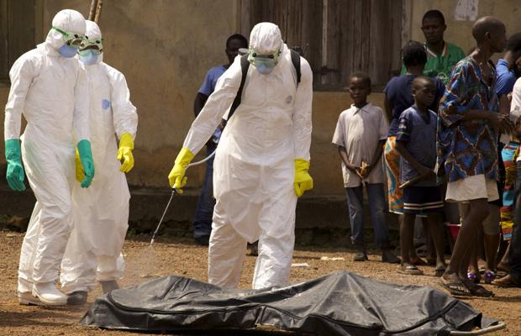
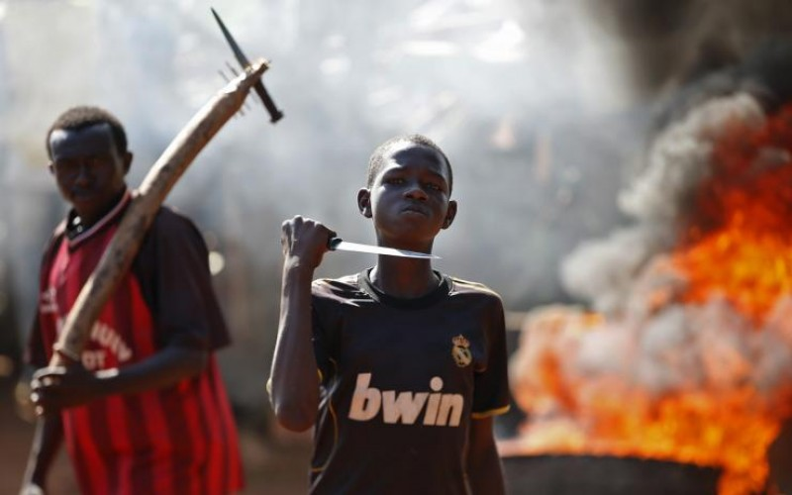
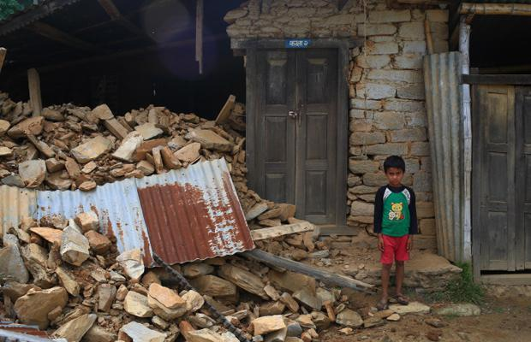
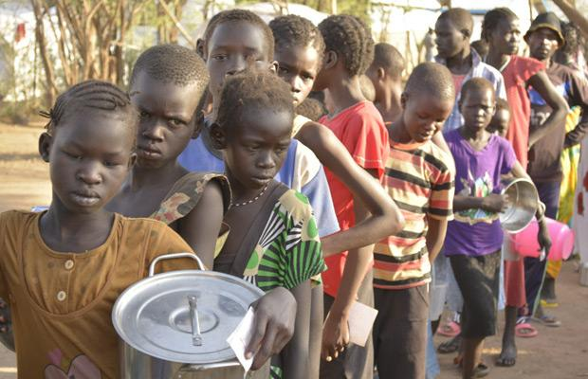
http://www.worldvision.org/news-stories-videos/top-humanitarian-crises-2015

