Slide 1
KPI’s
Contract Management

Slide 2
Why are we implementing KPI’s
The Contract Management Team has been diligently working on implementing Key Performance Indicators (KPIs) to gauge the university’s overall long-term performance. These KPIs will help us:
Monitor Performance: Track and report contract performance.
Identify Needs: Determine which contracts need support or guidance.
Assess Value & Improve Cost Efficiency: Identify cost-saving opportunities and evaluate if we are getting value for money.
Enhance and strengthen supplier Relationships: Foster ongoing supplier relationships, maintain open communication and address issues promptly.
Make Informed Decisions: Improve outcomes with data-driven decisions.

Slide 3
Why are we implementing KPI’s (cont’d)
Enhance Accountability: Promote transparency and responsibility among contract managers and suppliers.
Manage Risks: Identify and mitigate potential risks early.
Encourage Continuous Improvement: Foster a culture of excellence and ongoing enhancement.
Align Strategically: Ensure contract performance aligns with the university’s strategic goals.
Ensure Compliance: Meet relevant regulations and standards.
Benchmark Performance: Compare against industry standards and competitors.
Regular analysis of these KPIs will provide a comprehensive overview of our business performance, enabling us to decide whether to continue current operations or adjust our strategies as needed.

Slide 4
Four KPI’s
We are initially implementing four key performance indicators (KPIs):
Service
Quality
Price
Sustainability
Contract managers listed in the Proactis contract record will receive a link to a KPI questionnaire when their contract is selected. The questionnaire will present several questions with corresponding drop-down boxes for the contract managers to submit their responses.

Slide 5
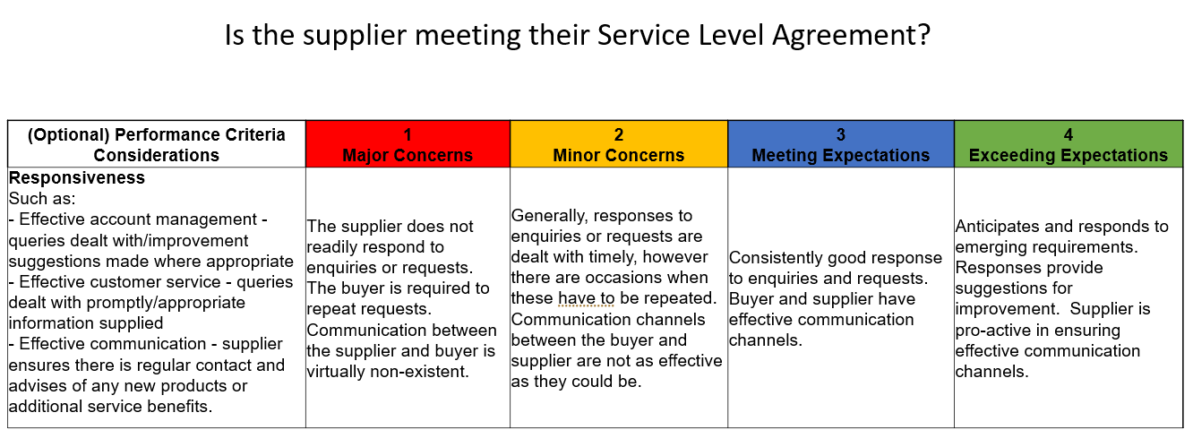
Service

Slide 6
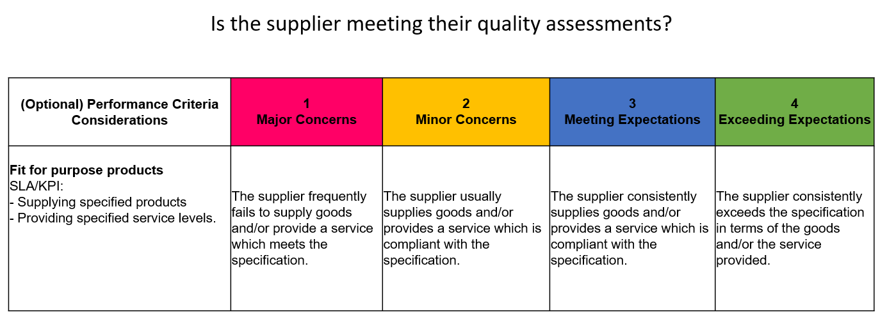
Quality

Slide 7
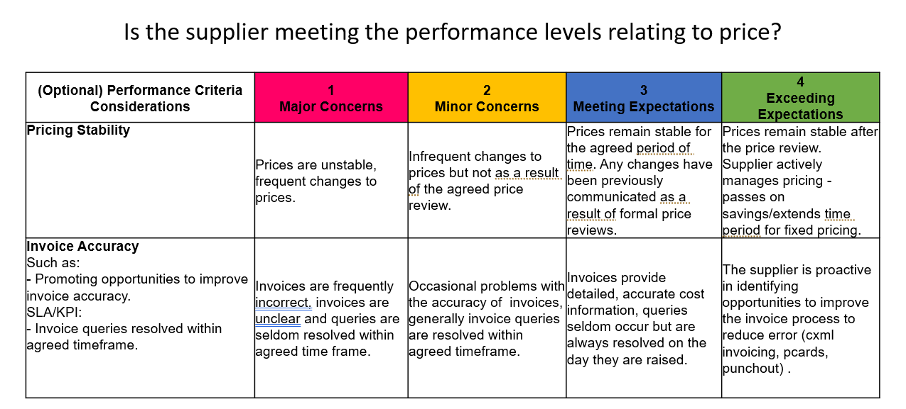
Price

Slide 8
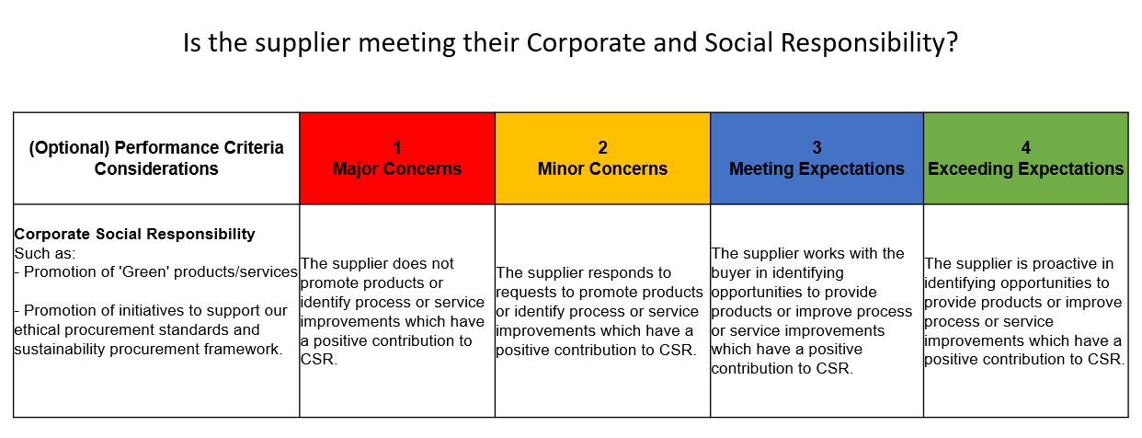
Sustainability

Slide 9
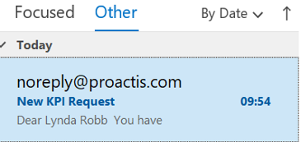
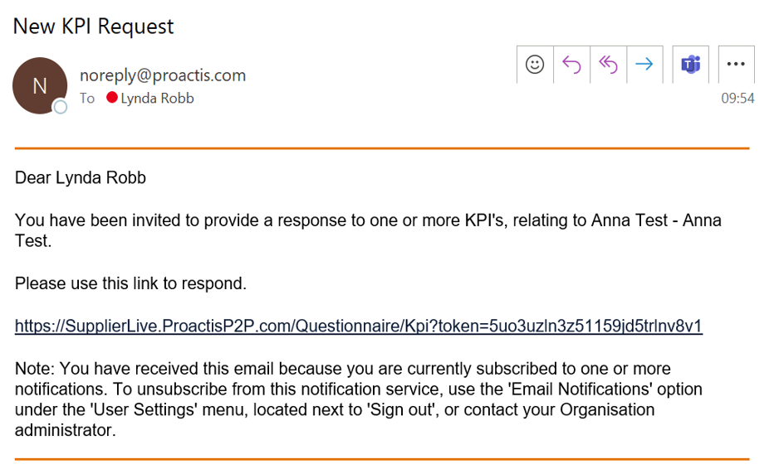
Notification
Once the Contract Management Team sends the KPI questionnaire via Proactis, the contract manager will receive a notification.
As this is a new process, the Contract Management Team will send an email beforehand attaching a user guide, the standard KPI’s and an overview of the new process.

Slide 10
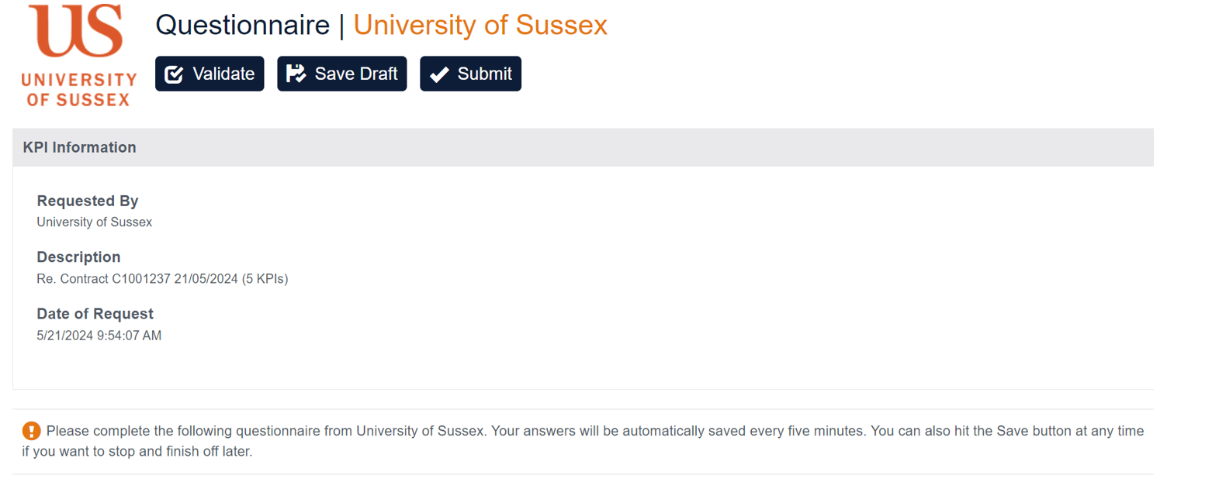
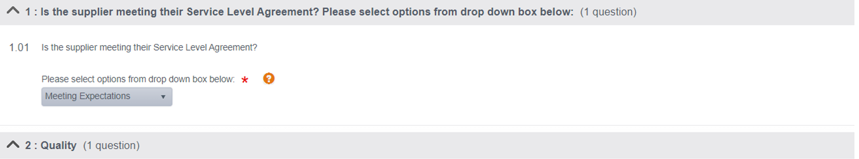
Questionnaire

Slide 11
KPI Process
Contracts Management Team
Create/ Maintain KPI library Develop and update a comprehensive library of Key Performance Indicators (KPIs)
Analyse Results
CM team produce/analyse Power BI Reports on results
Run/ Analyse Kraljic Report
Identify individual contracts that require KPIs
Validate Email Addresses
Ensure the email addresses of contract managers are accurate and up-to-date
Email Contract managers Attaching user guide, standard KPI’s and overview of process
Scheduling the KPI questionnaire
In Proactis setting up the KPI questionnaire to go to the individual contract managers
KPI Completed
CM team approve KPI questionnaire in Proactis
KPI questionnaire Issued
The KPI questionnaire is now sent via a Proactis email link to contract manager
KPI Pending
CM team receive notification of completed KPI questionnaire
System
Reporting
CM team run created KPI reports
Contract Managers
Contract manager receive email
with user guide for completing KPI questionnaire
Contract Manager Receives link
Contract Manager Completes the KPI questionnaire from drop down box

Slide 12
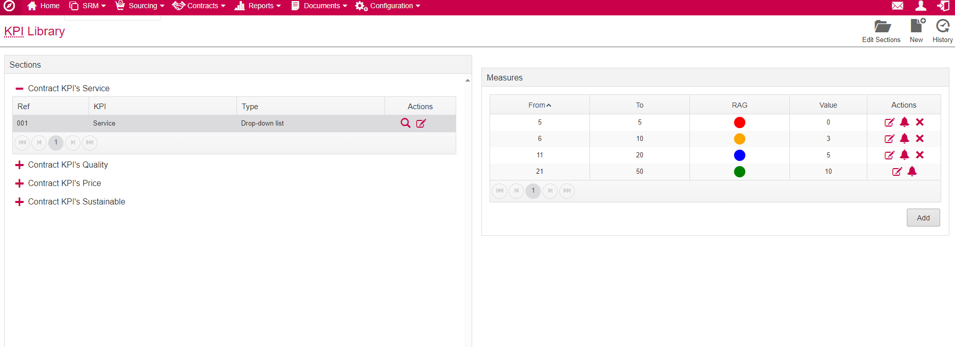
Proactis KPI Library

Slide 13
Future Plans
We will:
Produce regular BI reports on KPIs for the wider business.
Implement scoring trigger points, where scores of 1 (red) and 4 (green) will require action from the contracts team.
Share results with procurement teams and the wider finance teams.
Develop better supplier relationships and ensure value for money.

