Slide 1
From pillar to post: Disability and inclusion in ESW
Jacqui Shepherd with student panel
Wednesday 21st April

Slide 2
rationale
Discussion with EDI committee
Discussions with students
Seeing the EC claims, disability flags and sometimes complaints – correlation with disability
Doing our best for all our students
Striving towards being the most inclusive school we can be
Start by listening to the students

Slide 3
EDI strategy for sussex
‘We aim to be the most accessible University in the UK, transforming the University so that all members of our campus community have a fully inclusive experience, providing the kind of environment where people can achieve their ambitions and potential. We will provide equal access to excellent learning, research and employment opportunities regardless of physical or unseen disabilities. We will focus on all aspects of accessibility and move towards a campus where no areas are ‘out of bounds’ to people with disabilities. Our belief that what is necessary for some is generally good for all will be at the heart of how we design our services and facilities.’ (2018)

Slide 4
Unconscious bias
‘…and I just think it’s not that people miss things on purpose it’s that they aren’t fully aware of the daily struggles anyone with disabilities have. Everyone forgets things and bypasses things, but I think if more is made regular practice the education world would benefit.’
(ESW student, 2021)

Slide 5
ESW students
166 students flagged – 60 of those with specific learning differences
Mental health, chronic conditions, sensory impairment, autism etc
120 exceptional circumstances claims since January
6 complaints: 3 students with dyslexia, 1 with autism, 1 with physical disabilities and 1 BAME student

Slide 6
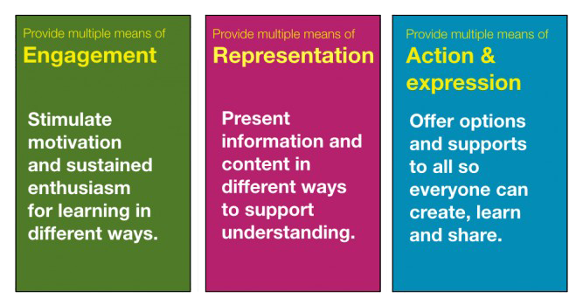
Universal Design for Learning:
Adapting environments to maximise learning opportunities for all
The three key principles of UDL:

Slide 7
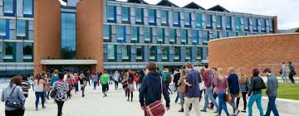
Pre-university
Open Days – ‘I didn’t talk to anyone on open day’
‘I didn’t know what to ask but it was sunny and I had a good feeling about it’
‘Sensory-safe spaces’ – how to negotiate the space, sensory guides - ‘there are points in the day where everything dissolves into hieroglyphics and the world becomes unintelligible’
‘As a positive, Sussex was the only university where I felt supported on the open days! At other universities the taster lectures were in inaccessible rooms and I was constantly told I was differently abled which I didn’t like at all! At Sussex I felt that the school had thought about having disabled students and the student support centre was actively showing what they could do to support me’

Slide 8
Accessing the university environment
Maps and plans: how to access quiet places beyond just the physical location; floor plans of all buildings
Support services: Fragmentation of support
– different supports for different things –
autism, epilepsy, ADHD, academic advisers, mentors, buddies, study support, security, health centre
Being told ‘It’s on the website’ is not helpful
‘Access to services can be overwhelming; where am I looking? Who am I asking?’

Slide 9
Academic expectations
Teaching and learning
‘staff need to be mindful that when a student with autism asks them a question and they do not give explicit answers then they will effectively be giving a non-answer and cause a great deal of uncertainty and stress’
‘Just saying it’s on Canvas is hard as sites are so different to navigate and I can’t always find the right bit’
Questions asked in seminars are too broad – not sure how to answer; Lecturers talk too much
‘I work much better when doing’
Knowing what I need to do before lectures/seminars is really helps to reduce anxiety especially if you missed the past session
  Academic support:
  fear of disclosure because of potential negative repercussions
  ‘it’s impossible to go to office hour and just drop-in’ ‘I feel quite alienated’ [from academics]
  ‘if I don’t know what the process is then I just won’t do it’ ‘I might say something that is wrong’

Slide 10
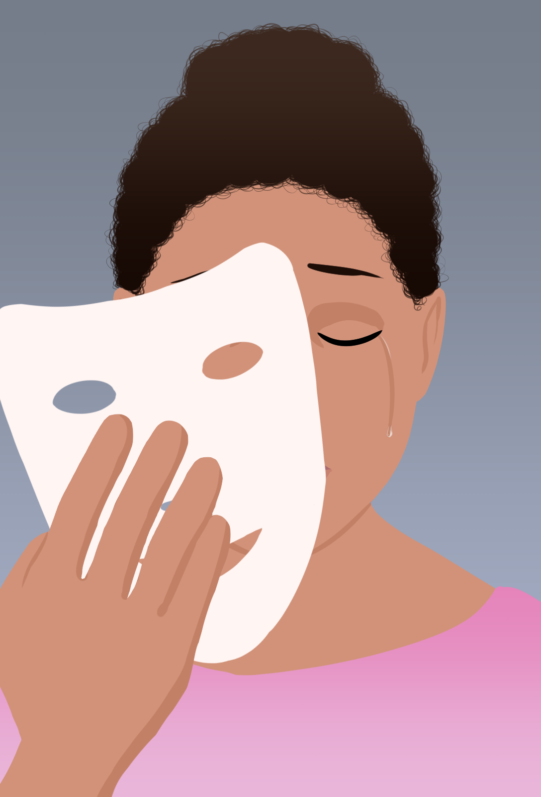
Looks can be deceptive
‘Don’t judge me by what you see, just because I don’t have a physical impairment.... invisible disabilities exist’
‘A smile doesn’t mean I’m OK’
‘I don’t look ‘sick’
‘My disability is invisible NOT imaginary’
‘Just because I am quiet doesn’t mean I am not taking the information in’
‘What is ok one day May not be doable the next’
‘Everyday is different, everyday I feel different’

Slide 11
Additional labour of being a disabled student
Managing disability on a daily basis – could be physical needs, pain management, negotiating social interactions, understanding requirements of course etc
‘This is another thing I have to do on top of current university work, catching up, keeping my self well and ordinary tasks (e.g. food shopping and washing clothes). When you have a disability/long term condition ‘simple’ tasks to others take so much longer for me’
Managing an additional administrative burden – getting diagnostic evidence or GP letters, assessments, registering with Disability Support to put reasonable adjustments in place, applying for Disabled Students’ Allowance,
Managing financial challenges – like any other student – but often not being able to undertake part time work for example
Managing the emotional burden of all this

Slide 12
How it feels when…I have to ask for the same support again
‘I need the support but others don’t think it’s important enough to put in place. I start to worry that people will think I’m making up/exaggerating the support I need as I have to ask for it again and again’
‘I hate having to ask for subtitles to be turned on, it makes me feel stigmatised’

Slide 13

Assessment
Assessment:
Stigma of extra time or working through the summer to do resits and having no break, difficult to navigate additional support procedures -need alternative modes of assessment
Exam stress
‘I found not having that kind of description of what to expect to access my exams more stressful than the exam itself, I would have appreciated a you need to wait in this place, you will be called to the room/you go to the room at x minutes before the exam is due, you can put your bag/belongings at the front of the room type instructions would have enabled me to concentrate more on revision than what is the process for getting to the exam’
‘anyone who is setting assignments for courses should not be allowed to do that without some basic autism awareness’
‘I stopped putting yellow stickers on my work and got higher marks’
Make assessment deadlines clear from the beginning but also support students who need help applying for additional time.

Slide 14

Social demands
Normative assumptions and expectations about all students
Clubs and societies ‘what do they do?’ Too difficult to access ‘too exhausted to socialise ’
‘I am a member of the Dr Who society, we call it the unofficial autism society’
Managing public transport
Managing time
Help to manage anxiety
Responses during pandemic:
‘I really am dreading the return to campus, during lockdown
I have been able to attend everything even if I feel anxious I
can just put my camera off’

Slide 15

Being Asked to put my camera on…
… makes me feel really anxious

Slide 16
Learning from Lockdown
COVID has meant lots has been put in place to make things accessible which disabled people have been wanting for a long time.
It’s vital these things don’t disappear when COVID starts to go away.
Examples include:
Recording lectures: important for students who can’t concentrate or miss sessions due to their health
Mentioning that it’s okay to apply for exceptional circumstances
Having options for virtual placement
Online tutorials

Slide 17

chat time

Slide 18

Questions to the panel?

Slide 19

It feels really good when…
I can have a reserved seat in a seminar room
I can access the slides 24 hours ahead of time
I am asked how I am feeling today
The assignment is clearly explained
The subtitles work, the powerpoint works, I can hear everything and I don’t have to ask

Slide 20
other recommendations…

