Slide 1
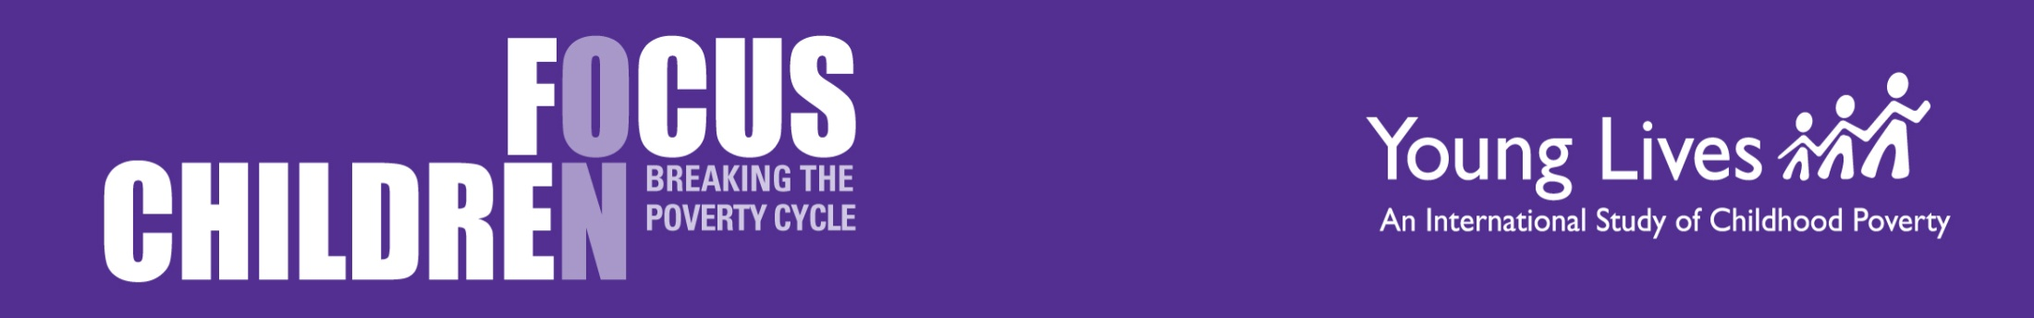

Child development and international development:
what can qualitative longitudinal research add?
Virginia Morrow
Child in Time conference
12th September 2013
University of Sussex
Notes:
1

Slide 2
Background: Young Lives
Longitudinal study of childhood poverty -Ethiopia, Andhra Pradesh, India, Peru and Vietnam
12,000 children 2001-2017 (MDG context)
Survey every 3 years
Qualitative research with ‘nested’ sample n=200
Improve the understanding of causes and consequences of childhood poverty over lifetime of MDGs -
Funded by UK Department for International Development
Examine how policies affect children
Notes:
2
NOTE –
Here I am talking about experience of QLR within Young Lives – (a) repeated visits to children, families and communities over time, collecting data BUT also: (b) we go beyond – iterative process – contribute within a multi-disciplinary longitudinal design – feeding backwards and forwards to survey, leading on ethics reflections and training for wider study, we record the research process (consent, people’s questions about the research etc)– analyse those etc- and we provide material for communications – eg the child profiles book - which links to the event today, about representations of children in time – the cases used come from QLR (Eg Ethiopia) we have to speak to policies!
Note that initially Young Lives not designed as a QLR study – but 5 years into the study and to take advantage of the long-term design a QLR element was introduced – was this a good decision? Had we gone for a sub-study approach to answer specific questions for the survey, things might have been different.
2

Slide 3
Data Collection
Round | Year | YC Ages | OC Ages
Round 1 | 2002 | 6-18 months | 7-8 years
Round 2 | 2006-7 | 5-6 years | 12-13 years
Qual-1 | 2007 | 5-6 | 12-13
Qual-2 | 2008 | 6-7 | 13-14
Round 3 | 2009 | 7-8 years | 14-15 years
Qual-3 | 2011 | 9-10 | 16-17
Round 4 | 2013 | 11-12 years | 18-19 years
Qual-4 | 2014 | 12-13 | 19-20
Round 5 | 2016 | 14-15 years | 21-22 years

Slide 4
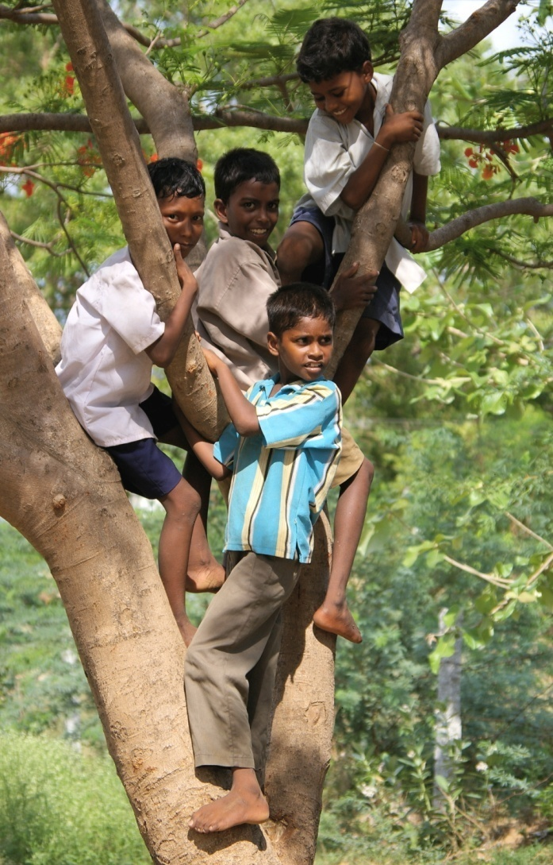
Qualitative longitudinal research: themes
Daily lives and well-being of children and young people in a selection of communities
Capture changes during childhood and transitions to adulthood
How policies and services (school, health) are experienced by children (and caregivers)
Data collection: 2007, 2008, 2010/11, 2014

Slide 5
Thinking about time in international development and child development
Temporality in development studies: goals of development are change and sustainability – but approaches to research in development are cross-sectional/snapshot = disjunction?
What is the status of qualitative research in development knowledge?
Marginality of children and young people’s experiences
Acceptance of developmental psychology approaches (ages/stages)
Notes:
5
For child development, the dominant approach has been age/stage theory, but from children’s perspectives, = problematic.
For international development: 3 problems:
International development knowledge is dominated by neo-liberal, individualistic development economics and micro-level household panel studies. Qualitative methods lack credibility. Where they do exist, they tend to be thematically focussed, giving value to subjective life accounts as revealing of wider changes. (L&LS). (ie not so interested in the narrative account itself…)
Lack of attention to time/temporality - longitudinal studies are rare …. Development studies ‘tend to fetishize the present’ predominance of cross sectional studies, but need to know what happens to individuals over time (some egs, Hulme, etc but rather at the level of ‘stories’). Of course there is a long tradition in social anthropology of ethnographic research like the work presented by Janine Anderson about one community in Peru she has been following over the years….
Children and youth research in the sense of co-producing data, marginal in development studies – which are dominated by human capital models.
Young Lives = opportunity to study the role of poverty in shaping children’s biographies within a life course framework – and Qual enables survey findings to be explored in context, looking at experiences and practices behind statistics/trends.
1 case study:
5

Slide 6
Haymanot, rural Ethiopia
Illustrates connections between poverty, time, school/work, and marriage
2006, age 11, father had ‘died’, she had been ill, missed school, but recovered after staying with an aunt. Moved back to look after her mother.
2007, aged 12, despondent and worried, caring for her sick mother, drought and food shortages but says she wants to work.
Notes:
6
Why this case? -
Individual biography – over time from multiple sources data (child-produced data…)
Migration example – will show generational time – a different way of using QL data –
Multiple layers of longitudinal research… layers of change – community household etc.
6

Slide 7
‘We used to have new clothes, chicken, meat and areke. My mother was not sick at that time and she used to work…’
Now she worries about providing for her family:
‘I will buy clothes for them, I wash their clothes and prepares their food…. I don’t want to be worried about my life’
Notes:
7
7

Slide 8
In 2011, Haymanot is married
Family-arranged wedding ‘I stopped doing paid work…’.
Living with her husband near her mother, in a better house, with a ‘better life … because we have enough farm products’.
Hopes to continue school – ‘my husband has to allow me’
Anticipates she ‘will be at home doing household chores, perhaps having a child… because my husband wants a child’ in 3 years time.
Notes:
8
what does QLR add? 1. her biography can only make sense with reference to her family situation, context of chronic poverty, food shortages caused by drought, ill health of herself and her mother, and lack of support from her father.
Knew in 2007 (2nd i/v) that the ideal age to marry was 20 or 25, but her poverty meant that early marriage was a way to solve some of her family problems, enabled her to gain respite from hard work generating income, and to continue to support her mother.
In international policy circles, Haymanot’s biography would be regarded as a ‘negative outcome she would be seen as needing to be empowered to continue in school, gain qualifications and get a job in an imagined labour market (unavailable in rural areas). A close reading of her circulmtances over time, highlights that early marriage is a strategy that she and her mother/family have taken to address poverty situation.
8

Slide 9
Exploring migration aspirations over time
Example: Peru
2002-2009, 1 in 4 YL households moved.
Persistent social and economic inequality; decades long rural → urban migration
QLR: to explore how aspirations change across time-space
Biographical change (between ages 12-16)
  How earlier aspirations relate to ‘migration outcomes’
  How changing circumstances impact on aspirations (motherhood, sibling migration, parental death, etc.)
Connections between different temporal elements in narratives of imagined futures
  Past, present, future: (eg, the way future projections influence present actions and practices)
  Generational time: ‘linked lives’ and histories, intergenerational poverty, generational shifts (eg, changing relations of child-adult dependency)
  Social becoming: underpinning aspirations are notions of ‘progress’, ‘backwardness’, ‘the future’
  (Forthcoming: ‘There’s no future here’: Childhood, migration aspirations and inequality in Peru’, Gina Crivello)
Notes:
9
9

Slide 10
Concluding thoughts
QLR illustrates the changing contexts of children’s lives
Interconnections with family members, interdependency, support for family of origin
And how these shape children’s decisions
QLR is a powerful way of linking individual biographies with structural factors
Understanding ‘dynamics of social and institutional change and their relationship with individual action and experience’ (Locke & Lloyd Sherlock 2011 p1149).
Notes:
10
10

