Slide 1

The Relevance of EU Citizenship to Children
Helen Stalford
Childhood, Youth and European Citizenship, Sussex, 30 April 2014

Slide 2
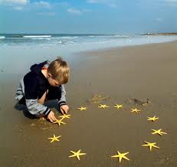
3 Key Manifestations of Children’s EU Citizenship
Citizenship as a status
Citizenship as a tool
Citizenship as a value

Slide 3
EU Citizenship as a Status
Art 20 TFEU: Citizenship is a status bestowed automatically on those who are nationals of any of the 28 EU Member States
Art 21 TFEU: Primarily associated with the exercise of Free Movement
Directive 2004/38 on the right of citizens of the Union and their family members to move and reside freely within the territory of the Member States
EU Citizenship is a ‘fundamental status’: Grzelczyk (Case C-184/99 [2001] ECR I-6193, para 31)
Notes:
Lesson descriptions should be brief.

Slide 4
Judicial constructions of children’s EU citizenship: key milestones
1960s onwards: Extension of citizenship rights to children as ‘dependants’ – ‘parasitic status’
Baumbast (1999) and Chen (2002): Children’s Citizenship Status upheld regardless of parents’ nationality – but money still important:
Ibrahim (2008) and Teixeira (2008): Children’s EU citizenship rights upheld regardless of parents’ financial status - but education still important;
Zambrano (2009): Citizenship rights upheld regardless of whether there is money, formal education or even free movement!
  Court recognised that refusing a residence permit to the parents inevitably implied that ‘those children, citizens of the Union, would have to leave the territory of the Union in order to accompany their parents’; and
  Children would be denied possibility of exercising full EU citizenship rights in the future

Slide 5

Citizenship as a tool – for stimulating political and legal reform
Articles 11(4) TEU and 24 TFEU: Citizens Initiative: ‘…a significant step forward in the democratic life of the Union’ (Commission, 2010)
Enables at least one million Union citizens from at least a quarter of the Member States (i.e. 7) to invite the Commission to propose legislation on any issue falling within its competence

Slide 6
‘Participation is a fundamental human right in itself. It is also a means through which to realise other rights. It recognises children as citizens entitled and –(…)- able to contribute towards decisions affecting them ….’ (Lansdown 2010)
…But no children allowed!
[Th e European Parliament] calls on the EU institutions to involve all interested civil society representatives in the civil dialogue; considers it essential, in this connection, for the voice of young Europeans, who will shape and take responsibility for the European Union of tomorrow, to be heard ; and
Calls on the EU institutions to ensure that all EU citizens – female, male, young and old, urban and rural – are able to take an active part, with equal rights, in civil dialogue, without being subjected to discrimination…’ (European Parliament, 2008: paras 7 and 8).

Slide 7
Citizenship as a value – enhancing individual engagement with and commitment to the EU project
EU Youth Strategy (2010-18)
‘ The European Commission promotes dialogue between youth and policy makers in order to increase active citizenship, foster social integration, and ensure inclusion of the young in EU policy development’
Two key priorities:
  to provide more and equal opportunities for young people in education and the job market;
  to encourage young people to actively participate in society
Notes:
Example objectives
At the end of this lesson, you will be able to:
Save files to the team Web server.
Move files to different locations on the team Web server.
Share files on the team Web server.

Slide 8
Some concluding thoughts:
EU Citizenship has offered a legislative and judicial platform for some of the most explicit and meaningful advancements of children’s entitlement;
EU Citizenship could be used as a tool to stimulate legislative and political reform but it is resource-intensive and exclusionary
But EU Citizenship has evolved in isolation from the Children’s rights framework;
Need for more correspondence between different strands of EU child-related activity

Slide 9
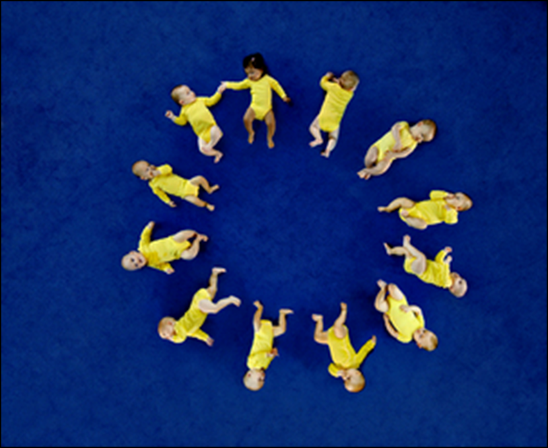
The Relevance of EU Citizenship to Children
stalford@liv.ac.uk
European Children’s Rights Unit (ECRU):
www.liv.ac.uk/law/research/european-childrens-rights-unit/

