Slide 1
Creating Alternative Narratives of Social Exclusion: Schooling, Employment and Identity
Social Exclusion and The Road Culture Continuum
Presented By: Yusef Bakkali
Supervisors: Prof. Rachel Thomson and Dr. Susie Scott
Monday 25th November 2013

Slide 2
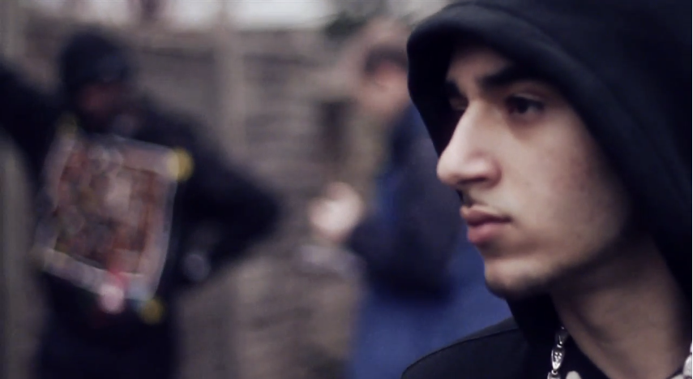
“….I’ll catch my dream for the whole universe to see. My dreams don’t include university.”
- ‘Ard Adz

Slide 3
Todays Agenda
What is social exclusion
What is Road Culture?
Social Exclusion & Road Culture
The Roads as a Site of Resilience
The Road Culture Continuum
A Personal Reflection
Summary

Slide 4
What is social exclusion?
There are a multitude of definitions of social exclusion, here are a couple:
“social exclusion as a perceived deﬁcit in Belongingness” (Stillman et al, 2009).
“Social exclusion is a complex and multi-dimensional process. It involves the lack or
denial of resources, rights, goods and services, and the inability to participate in the
normal relationships and activities, available to the majority of people in a society,
whether in economic, social, cultural or political arenas. It affects both the quality of
life of individuals and the equity and cohesion of society as a whole.” (Levitas et al, 2007).

Slide 5
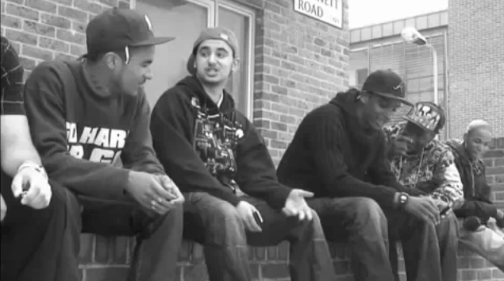
What is Road Culture? (1/2)
Road culture is a ‘black influenced’ subculture, finding it’s origins in more widely recognised Black Atlantic popular culture (Gilroy, 1993) in terms of musical expression, dress codes and common patterns of speech (Gunter and Watt, 2008).

Slide 6
What is Road Culture? (2/2)
“…All respondents saw life ‘on road’ as a space in which violence and its threat was everywhere…. ‘On road’ the choices are stark: survive or become a victim.” (Hallsworth and Silverstone, 2009:365-366)

Slide 7
Social Exclusion and Road Culture
Paradox of attainment: Young people ‘on road’ share neo-liberal values of wealth accumulation and status, but are largely excluded from legitimate and institutional means of attaining these goals.
‘Staying Fresh’ The pressure young people are under to maintain an appearance of wealth often in the context on economic adversity (Briggs, 2009).
School ‘crushing pressure’ for young people to conform to ethnocentric white middle class conventions causes them to risk ‘losing themselves’. Forcing many to drop out. (Bell, 2000; Reay, 2001)
‘Police Trawling’ The net of law enforcement is cast so wide and indiscriminately, that it drags those who are not involved in criminal behaviour into the penal state by association. This creates a set of ‘permanent suspects’ (Ralphs et al, 2009).
Notes:
“…street culture is in direct contradiction to the humble, obedient modes of subservient social interaction that are essential for upward mobility’ (Bourgois 1995) (Gunter and Watt 2008:525)

Slide 8
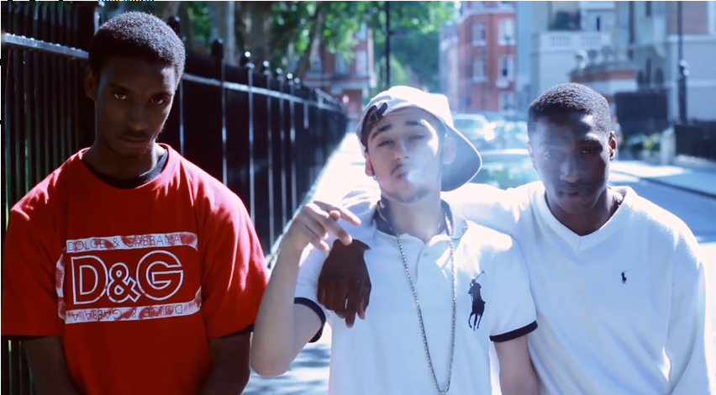
The Roads As A Site of Resilience
“Site of Resilience” The establishment of communal meanings around “feeling well, satisfied or accomplished”. In other words how communities create new meanings to cope in situations of exclusion or adversity. (Payne 2008)
‘The roads’ represent “a liminal space where they [young people]… find a form of authentic sovereignty, freedom from the constraints they experienced at the hands of… a hostile society”. (Hallsworth and Silverstone 2009:365)

Slide 9
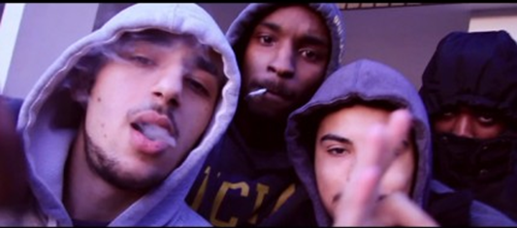
Road Culture Continuum (1/2)
The Road Culture Continuum illustrates the extent to which people are immersed in life on road. The vast majority occupy a middle space, whereby many of their mundane and leisure activities take place ‘on road’ (Gunter & Watt 2008).
Fluidity exists between a minority of hyper-aggressive central actors and those who tend to just spend their leisure time ‘on road’ Some… occasionally dip in and out of ‘badness’ as and when they see fit or, more to the point, when a particularly good opportunity arises.”
Notes:
Road culture… can be viewed as a continuum, where occupying the centre ground are the vast majority of non-spectacular young people, with a small minority of young males or ‘rude boys’ who immerse themselves in the world of ‘badness’…” (Gunter & Watt, 2008:525)

Slide 10
Road Culture Continuum (2/2)
Observers
YouTube Views
Central Actors
Road Men
Hyper-Aggression
Middle Ground
Cotching, Catching Joke
Fluid Transitions
‘Mainstream’ Society
Transitions into employment and education

Slide 11
Key Points
Young people living on road are ‘excluded’ and ‘included’ in many different ways.
A more nuanced understanding of these issues could help equip young people to avoid making ‘destructive’ (Payne, 2008) life choices at critical moments in their trajectories.

Slide 12
“…social exclusion is not just a problem for those who are excluded, its is a problem for social structure and social solidarity generally. If significant numbers of people are excluded then social order will likely become more polarized and unequal – and ultimately perhaps more unstable for all.” (Alcock, 2006.129)

