Slide 1
In conversation Together:
On Schooling and Values
HOSTED BY THE CENTRE FOR INNOVATION AND RESEARCH IN CHILDHOOD AND YOUTH
AND THE CENTRE FOR TEACHING AND LEARNING RESEARCH
Dr Rebecca Webb, Lecturer in Education
& Perpetua Kirby, Doctoral Researcher in Education

Slide 2
Values and Valuing
‘What Works?’ – IOE debate January 2018 on evidence informed practice – social justice for equitable outcomes
Gert Biesta - education as ‘open’, ‘semiotic’, ‘recursive’ (see debate)
Values and valuing – ‘the elephant in the room’

Slide 3
Chronology and Contextualisation
Chronology
Rebecca – research 2010-2014; field work 2011-12, 3 days per week
Perpetua – research 2014-2018; field work 2015-16, Year One classroom: whole class & in-depth with 6 children. Plus ‘rapid’ ethnography.
Context
Shifts in political climate and dominant political narratives from values of Pupil Participation (New Labour 1997-2010) to Teachers Take (Back?) Control (Conservative/Lib Dem coalition, 2010-2014 to Conservative govt. 2014-present)

Slide 4
The Gone Before
The Liberal and Progressive
  Rights
  Respect

Slide 5
The Here and Now
‘self’ care and self ‘value’
  Resilience
  Aiming high

Slide 6
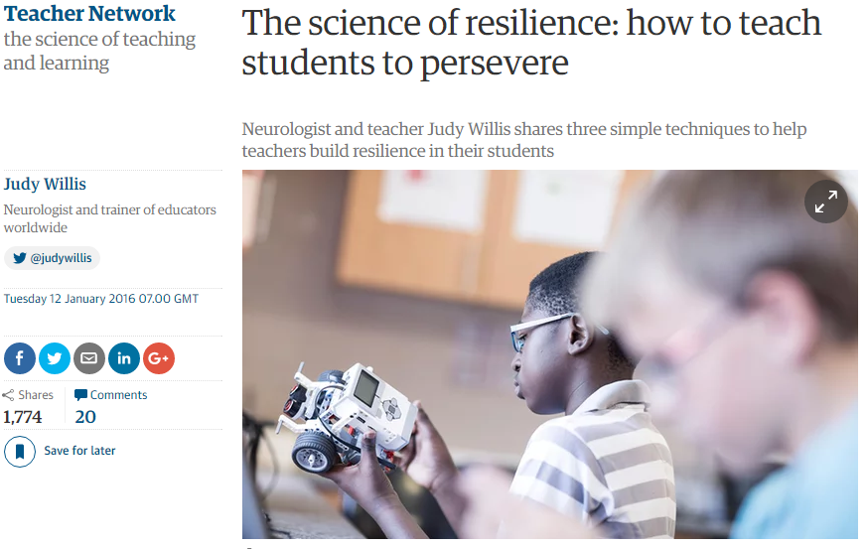
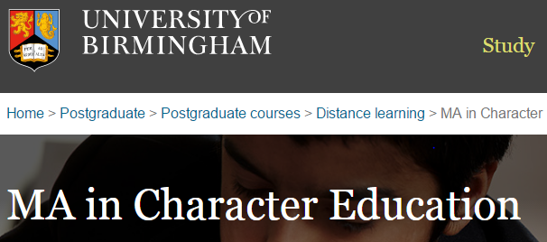

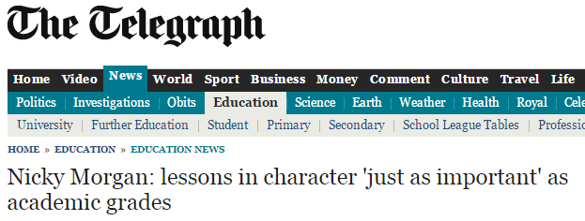
Resilience
  ‘Battle of Waterloo, marking the defeat of Napoleon . . . a moment that helped make our nation great. A moment that showed British grit in the face of adversity. And our ability to stick it out, bounce back, keep calm and carry on.’
  (Nicky Morgan)

Slide 7
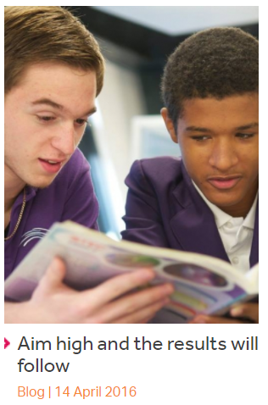
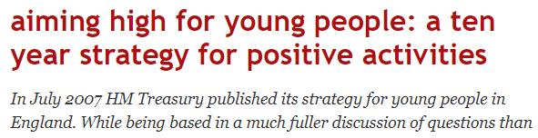


Aiming High
  ‘bridge the gap between what they are and what they have the wherewithal to become . . .
  to be world class in education and to move to the top of the global education league.’ (Gordon Brown)

Slide 8
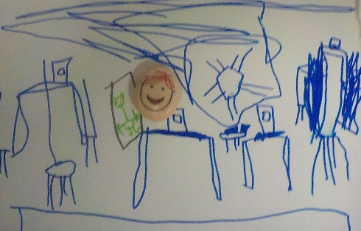
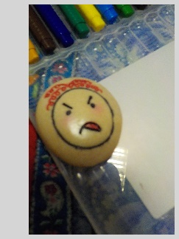
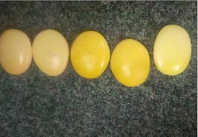
Marginalising emotions
‘[to be clever] you have to learn, you have to listen and do your work, and never be rude, and never be sad’ (Roman)
‘[When staff shout] sometime I grit my teeth but close my mouth so no one can see’ (Stuart)
‘It’s the first time we’ve read an orange book . . . no one got upset, when you got to a tricky word you tried and read it’ (Class teacher)

Slide 9
Resilience and Aiming High
Drivers
‘Children are increasingly being spoon-fed . . [Learning behaviours help] children to stand on their own two feet, to want to learn for themselves.’ (Senior teacher)
‘We don’t know the jobs they’ll be doing in the future . . . so it’s about giving them the learning skills.’ (Head teacher)
Resilience ‘don’t give up’ and ‘even if finding it tricky, they keep having a go’, ‘keep practicing.’
Aim high ‘try hard’; ‘try your best’; ‘You should be trying your best all the time.’

Slide 10
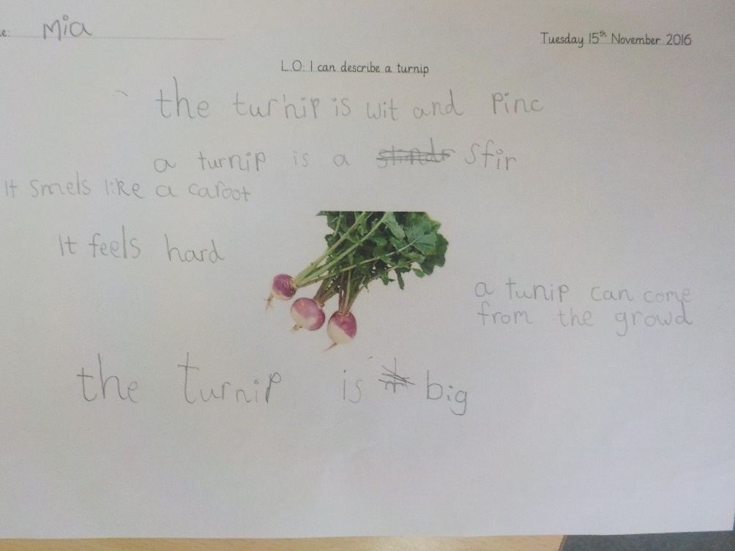
Learning Hard
Resilience means ‘learning hard . . . trying again, again and again [you cannot leave out the difficult bits] because you have to try harder when, you have to aim high.’ (Amelie)

Slide 11
Rebecca’s Data Vignettes –
the Gone Before
1 – attainment granting permission to a discourse of rights
2 – rights as material, felt, articulated and performed
3 – rights as universal, aspirational and future orientated
4 – dissonance and contradiction – grappling with power

Slide 12
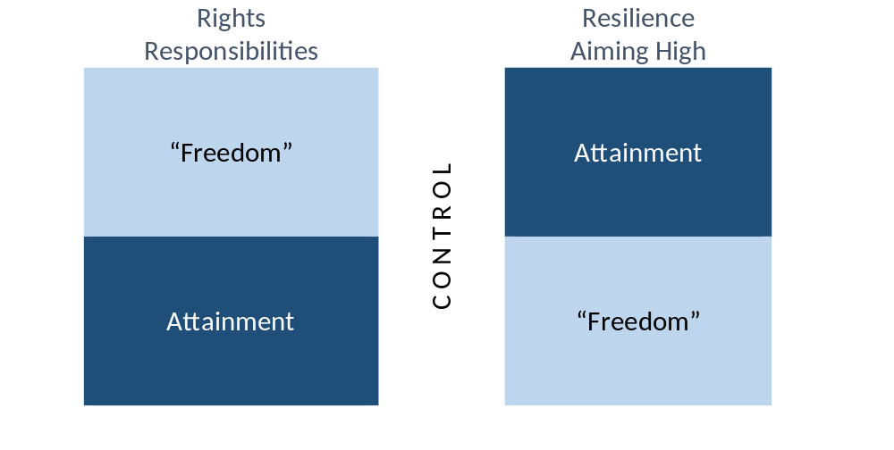
Values and Valuing…

Slide 13
And Over To You…
…with purposes in mind
Which of these values, if any, would you jettison? Or replace? Why?
If we kept some/all (or replaced with others), how might we practice a space of valuing.

