Slide 1
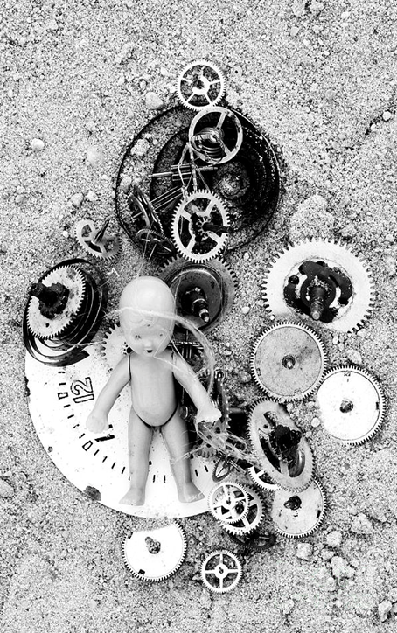


Child in Time animating ideas of development and transition
NCRM funded methodological innovation network: New frontiers in qualitative longitudinal research: design, definition and display
Event 1: What counts as QLR? (Oct 2012 University of Southampton)
Event 2: Research relationships in time. (Feb 2013, University of Cardiff)
Event 3: (Re)conceptualising the object of QLR: (March 2013, University of Manchester)
Event 4: QLR and practice traditions (June 2013, Birkbeck College University of London)
ECR/ doctoral workshops

Slide 2

Child in Time animating ideas of development and transition
11-12.45:
Perspectives from childhood studies
Lunch
1-3.30 pm:
Child time in popular culture
Tea
4-5.45pm:
Revisiting developmental time
6pm Close

Slide 3
New Frontiers in QLR: next steps
NCRM working paper
5 credit training module for national DTC network
Special issue of IJSRM (pending)
Sage 4 volume series
NCRM methodological innovation project: Face 2 face: tracing the real and the mediated in children’s cultural worlds.
Maintaining blog and website for next 12 months
July 8th 2014 session at ESRC festival of methods

