Slide 1
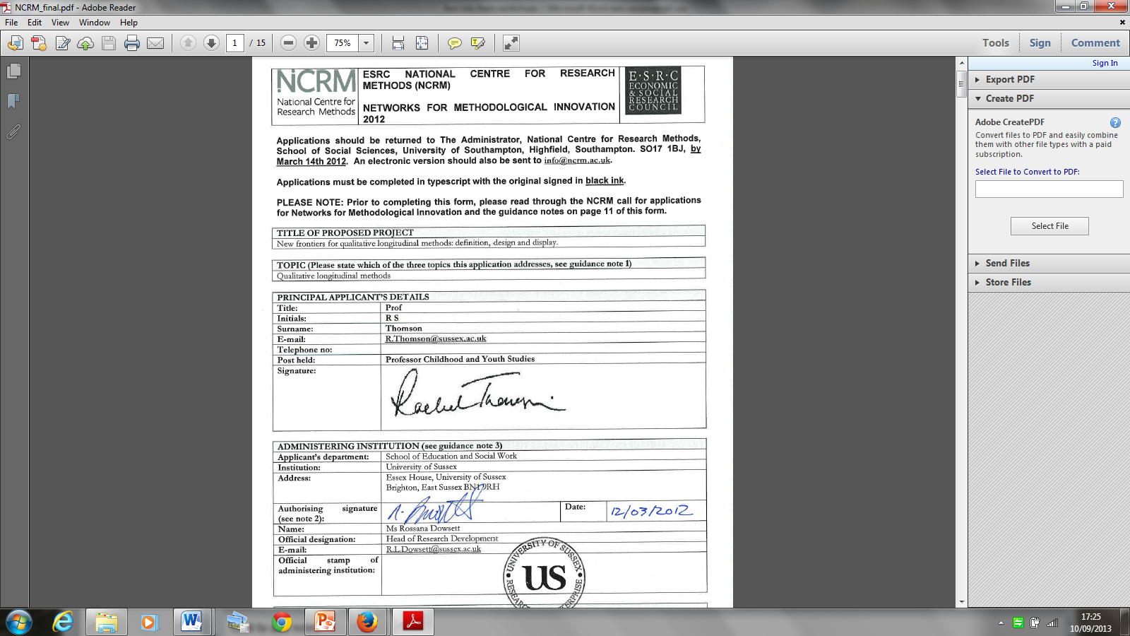
New Frontiers in QLR
Definition: Enabling a focus on the processual object of QLR, how it is and can be conceptualised and at what scale; exploring the inflections brought by different disciplines, and links to other temporal trends including mobilities and narrative research. This includes a consideration of the ethical dimensions of duration and seriality as aspects of initiating and ending research relationships.
Design: What is meant by continuity and change and how are they traced over different timescales? What roles are played by standardisation, incremental and reflexive approaches in QLR? How might QLR be scaled up and scaled down over time and space.
Display: Ways that QL findings can be presented, made accessible and communicated, including intersections between academic and popular forms of communication. Consideration of the practical and ethical dimensions of display within digital media landscapes including privacy and the ownership, control and exploitation of data.

Slide 2
The proposed network will include both synthesising and catalysing activities, securing the legacy of earlier investments while also extending methodological horizons, forging connections with other methodological trends and responding creatively to a changing external environment for research. The network would contribute to a ‘step change in the quality and range of methodological skills and techniques used by the UK social science community’ through participation in the events themselves and through the records of these events and proposed outputs which would be made available to a broader audience over an extended time period.

Slide 3
The network involves researchers at different stages of their career as part of its aim to secure continuity and legacy for the field of QLR. An important part of this would be the provision of 10 bursaries for PhD and early career participants and the ambition to develop training materials for doctoral students as one of the outputs.

Slide 4
Promises
Records of the events. Each event would be recorded and if possible and appropriate broadcast, allowing for the live participation of a wider audience. These records would then be archived on an institutional website and linked to relevant sites in order to maximise access and reach.
A NCRM methodological review paper … renegotiated as a working paper on QLR: doctoral perspectives
Materials for doctoral training in QLR for sharing through Doctoral Training Centres
Further scholarly outputs associated with particular events – for example special issues of journals.

Slide 5
The workshops

Slide 6
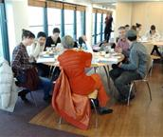
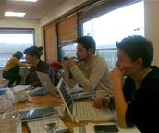
Event 1: What counts as QLR?
(Oct 2012 University of Southampton)
I come down in favour of getting bogged down!
Time that moves in bumpy irregular fashion-it jumps, starts & doubles back
Unusual situations are priceless pearls

Slide 7

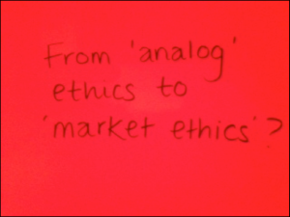

Event 2: The research relationship in time (Cardiff, Feb 2012)
promises that we
cannot keep
What to show and what to cover up?
Whose work/ words is
it anyway?
The dance between waiting and pursuing
unknown research by unknown people
data linger

Slide 8
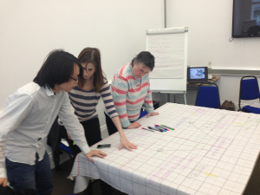
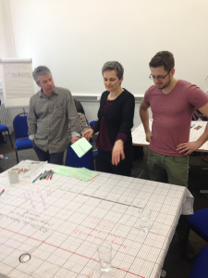
Event 3: (Re)conceptualising the object of QLR, Manchester March 2013
‘behind to we’
specific, descriptive and reflexive: am, are, is
Anchoring devices
What can’t be encoded? What happens to the flotsam and jetsam
The network as QLR
Direction of
analysis

Slide 9
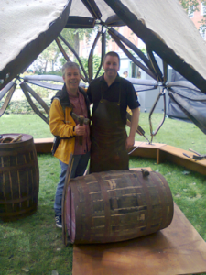
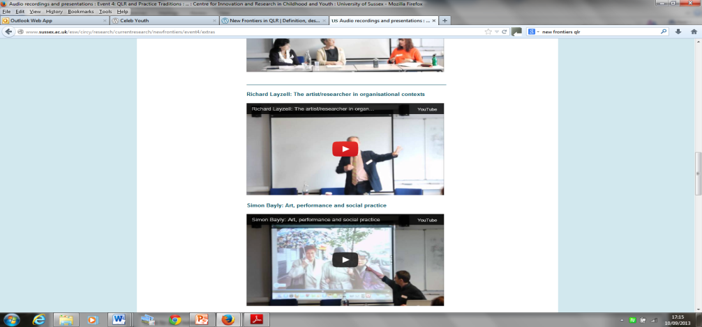
Event 4: QLR and practice traditions
June 2013 Birkbeck
staying open for as long as possible and see what happens
data???
a dance between accepting and rejecting chance, moving between rules and disorder, both feeding each other
The scholar’s gaze on the social reality is a political act
Social research ≠ art. Artefacts of art practice ≠ data.

Slide 10
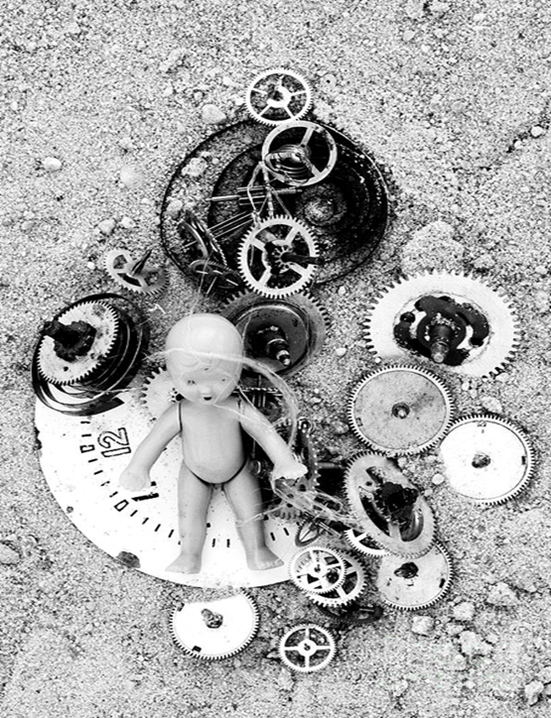
Child in Time animating ideas of development and transition
?

Slide 11
What HAPPENED in the workshops and blog?
Digesting?
Thinking through……
Thinking with…….
Being there…….
Being with …….
‘Continuity and legacy’?

Slide 12
New Frontiers in QLR: next steps
NCRM working paper
5 credit training module for national DTC network
Special issue of IJSRM (pending)
Sage 4 volume series
NCRM methodological innovation project: Face 2 face: tracing the real and the mediated in children’s cultural worlds.
Maintaining blog and website for next 12 months
July 8th 2014 session at ESRC festival of methods

