Slide 1
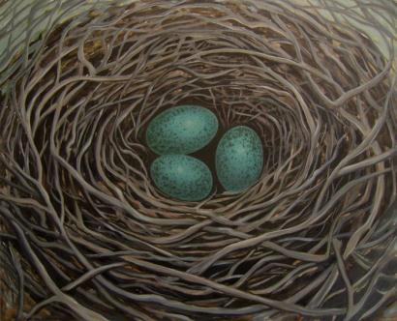
Roots and Wings
Ten Years and Counting . . .

Slide 2
Roots and Wings
Children leading the way . . .?

Slide 3
CURIOSITY
Security
Discovery
MORE
Exploration
Self Esteem
Pleasure
THE FUEL
OF
DEVELOPMENT
Confidence
Repetition
New Skills
Mastery

Slide 4
The Six Core Strengths
Attachment - Being a friend
Self-regulation - Think before you act
Affiliation - Joining in
Awareness - Thinking of others
Tolerance - Accepting differences
Respect - For yourself and others

Slide 5
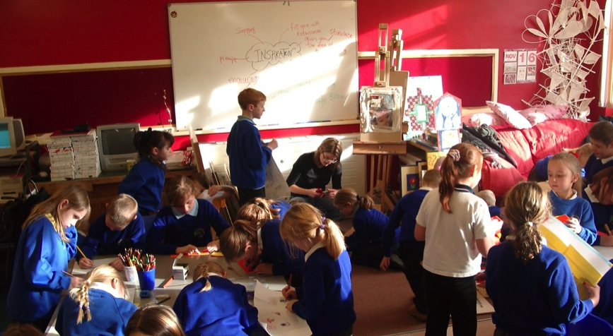
Lunch Time

Slide 6
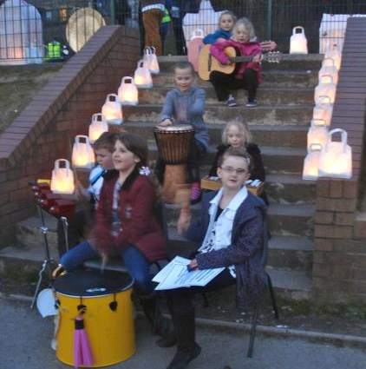
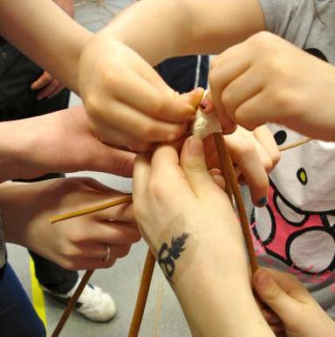
Lanternland

Slide 7
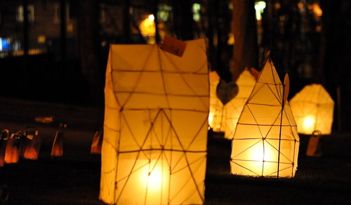
The Playground Transformed

Slide 8
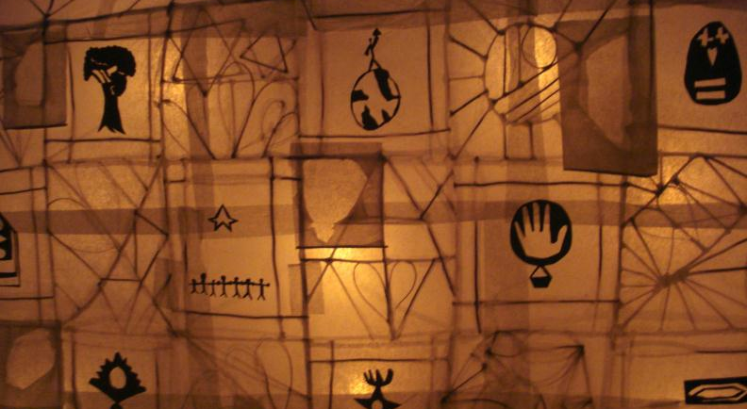
The Lantern of the Community

Slide 9
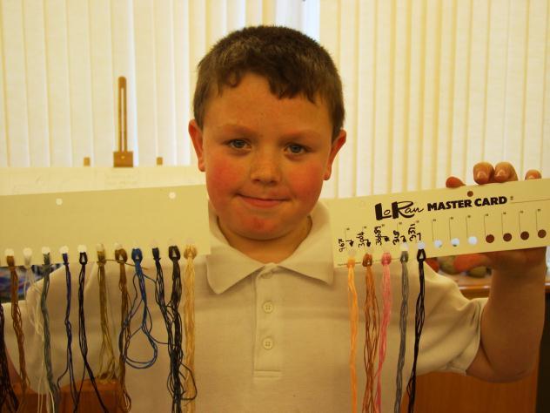
Self-Portraits
Notes:
Simon and his Threads

Slide 10
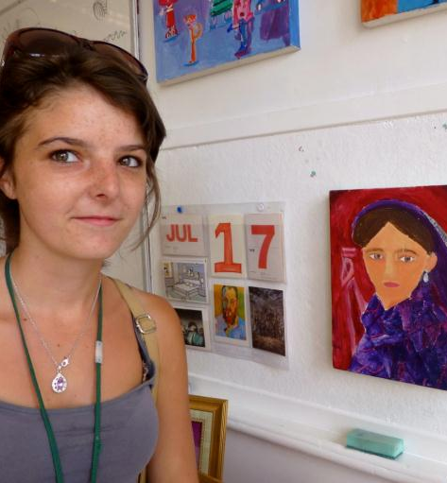
Tammy With A Pearl Earring
My self portrait was inspired by the artist Vermeer, I liked the detail in his painting "A Girl with a Pearl Earring" I borrowed Mary's coat and had fabric placed on my head, dressed like the girl in his painting, and I had several photos taken of me. My next step was to practice drawing myself from the photos with pencils, when I was happy with my drawings I started on my canvas.
I was excited to take this step, It was hard painting my canvas because I had to concentrate, and I needed to have a lot of patience, especially painting my eyes.
I liked chatting to my friends in the art room, whilst doing my self portrait.Every time I see my painting now it puts a smile on face.
Tamara b 1995

Slide 11
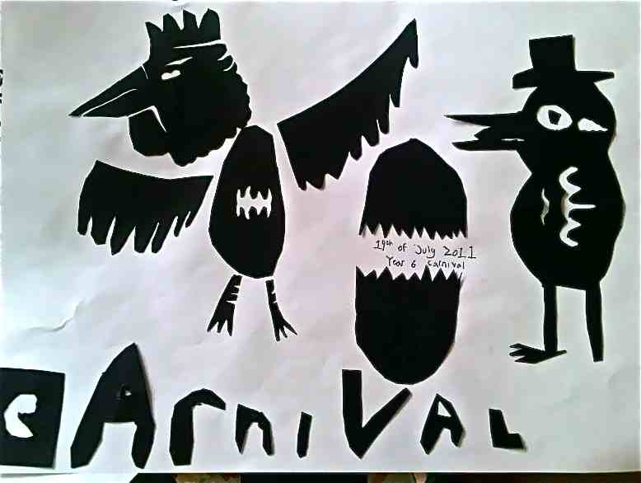
Roots and Wings Carnival
This project makes the community into one big family. It is a tradition. When you are part of it, it makes you feel special.
Bryony, Aged 11

Slide 12
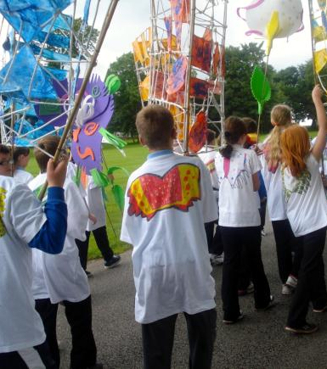
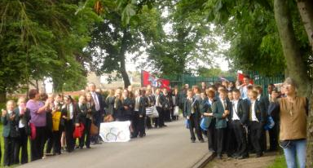
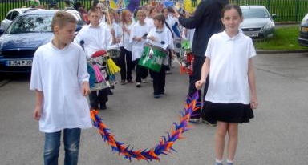
Flying up…

Slide 13
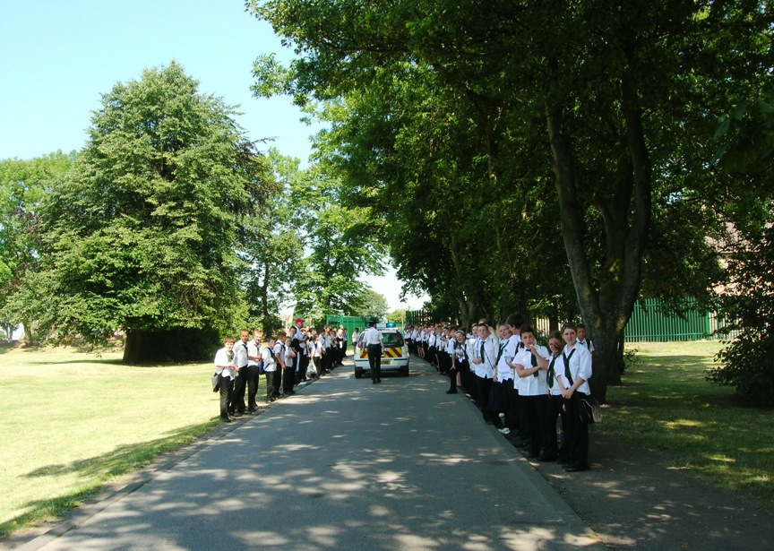

Slide 14
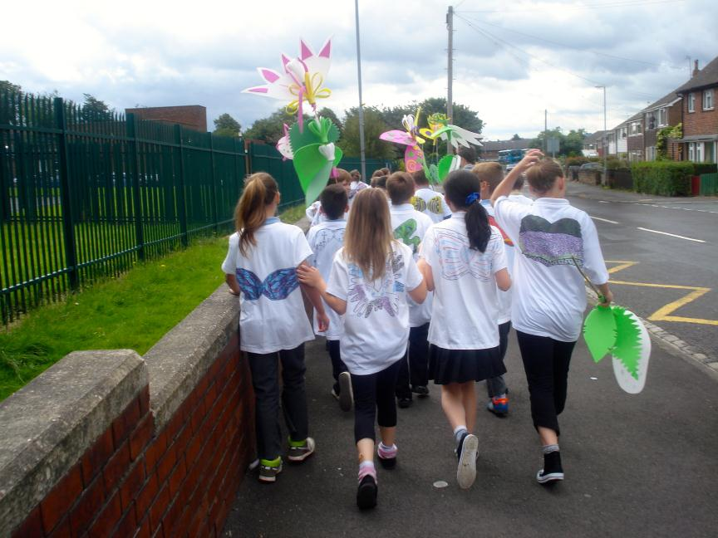

Slide 15
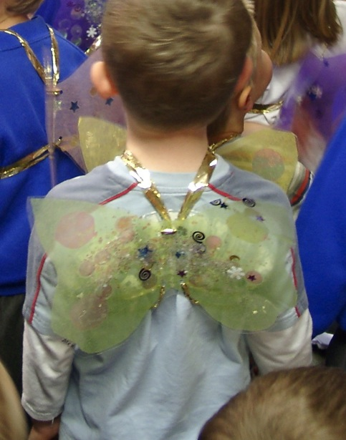
Wings of Happiness

Slide 16
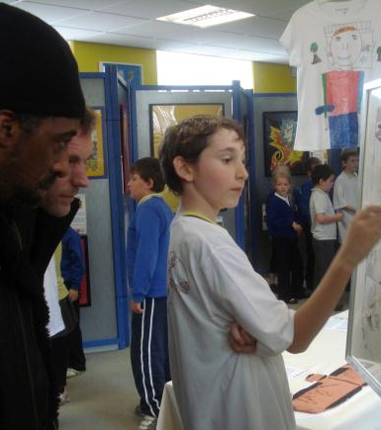
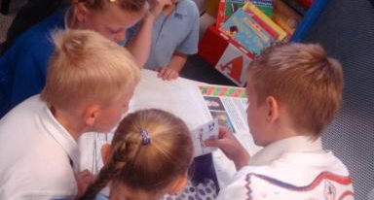
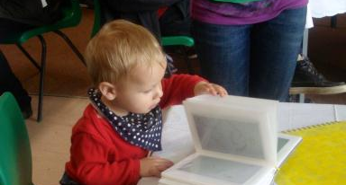
Telling the Tales

Slide 17
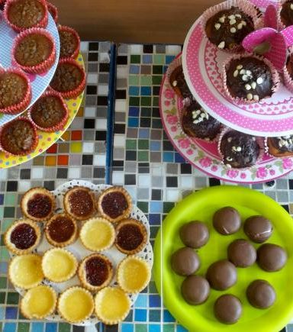
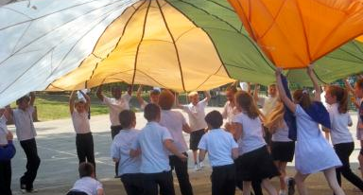
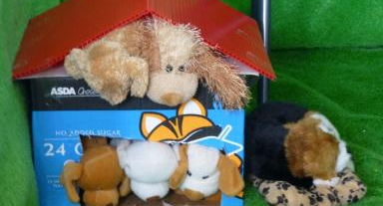
A Big Farewell

Slide 18
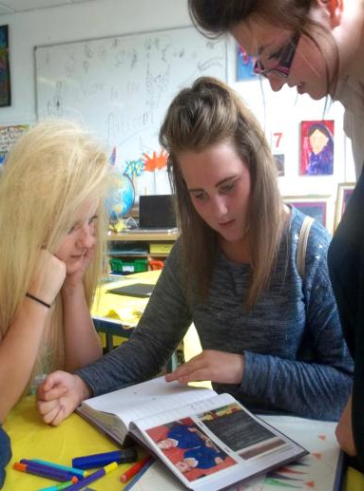
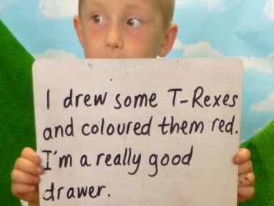
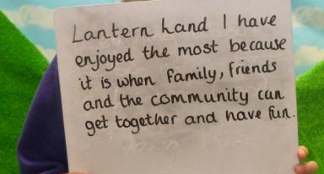
A Time to Remember

Slide 19

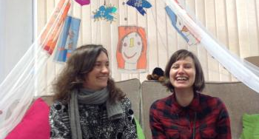
Research and Practice – what goes around comes around . . .

Slide 20
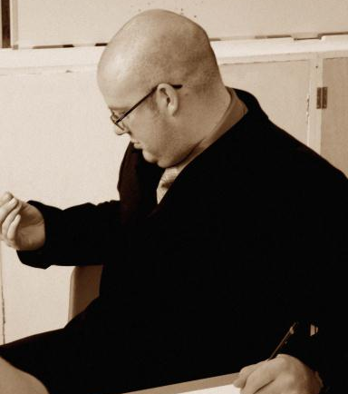
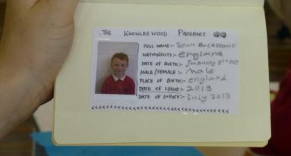
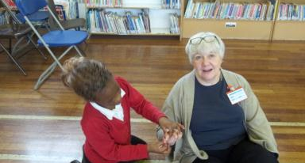
Sustainability redefined

Slide 21
CURIOSITY
Security
Discovery
MORE
Exploration
Self Esteem
Pleasure
THE FUEL
OF
DEVELOPMENT
Confidence
Repetition
New Skills
Mastery

