Slide 1
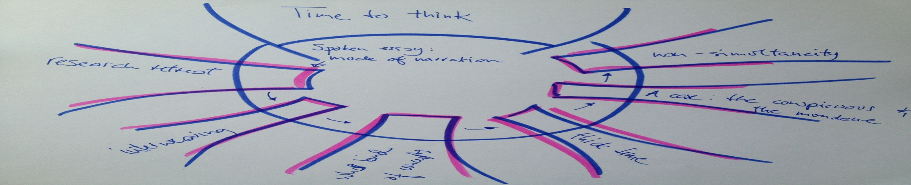
Time to think
Pace, youth and social media
Jette Kofoed
University of Aarhus, Denmark
jeko@dpu.dk

Slide 2


