Slide 1
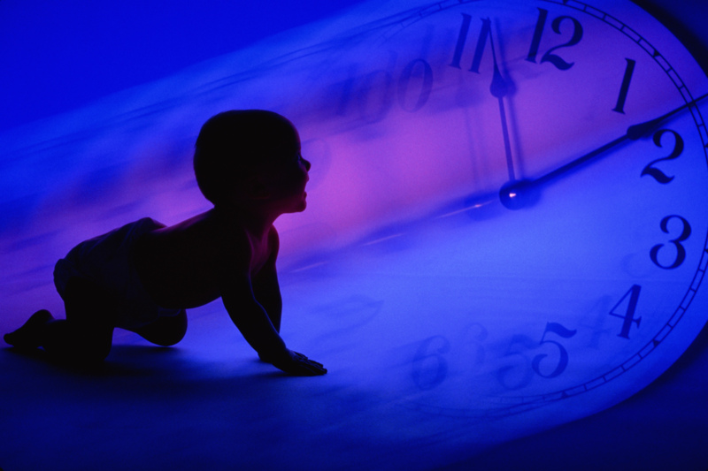
Temporal modes in children's development
Child in Time: animating ideas of development and transition
Sept 12th 2013
University of Sussex
Harriet Bjerrum Nielsen
University of Oslo

Slide 2
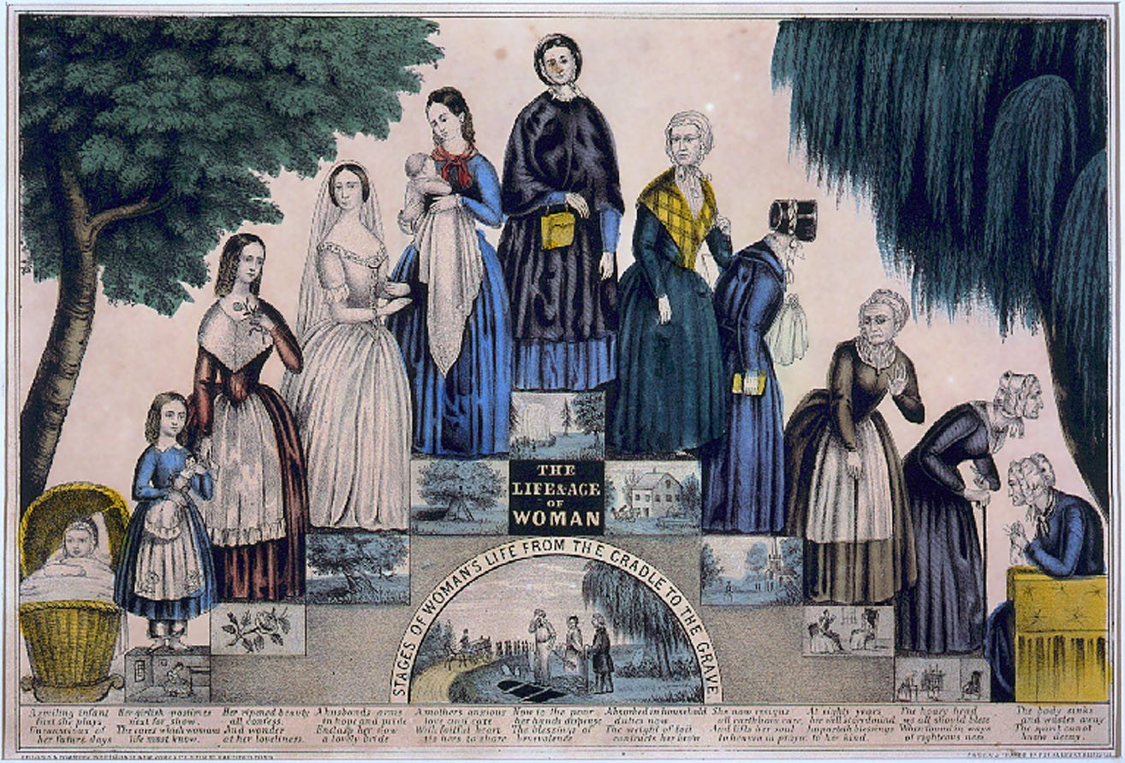

Slide 3
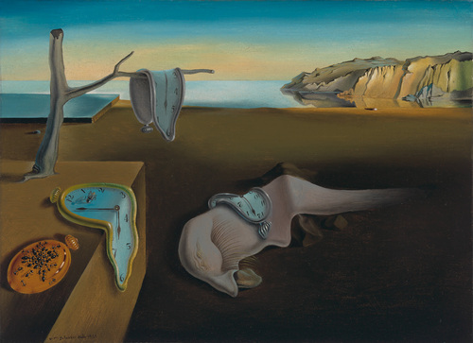
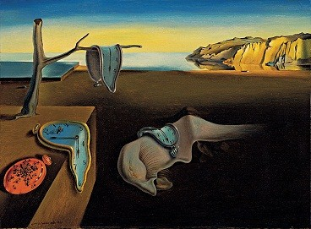

Slide 4
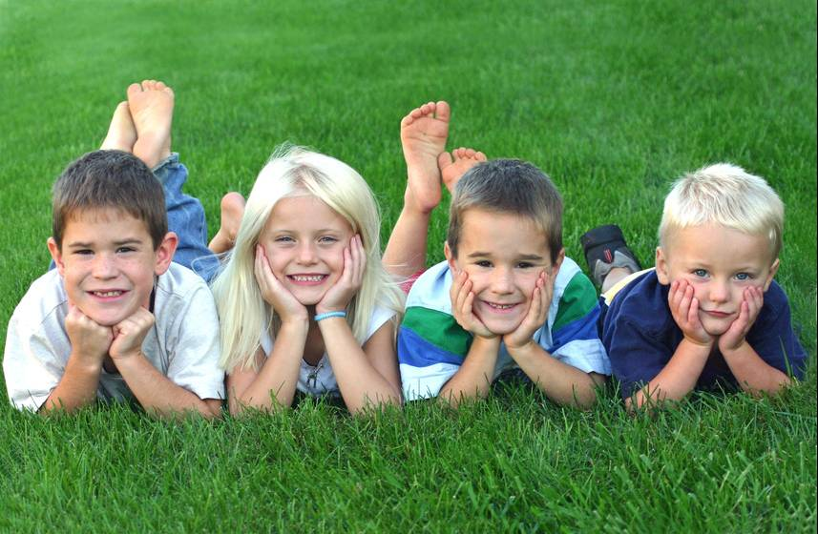

Slide 5


Slide 6
Henri Bergson
" (...) we may speak of the body as an ever advancing boundary between the future and the past, as a pointed end, which our past is continually driving forward into our future. Whereas my body, taken at a single moment, is but a conductor interposed between objects which influence it and those on which it acts, it is, on the other hand, when replaced in the flux of time, always situated at the very point where my past expires in a deed."
(Matter and Memory, 1908, p.88).

Slide 7
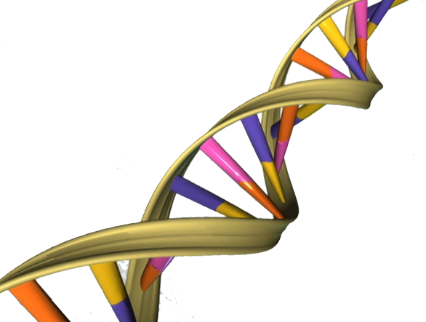

Slide 9
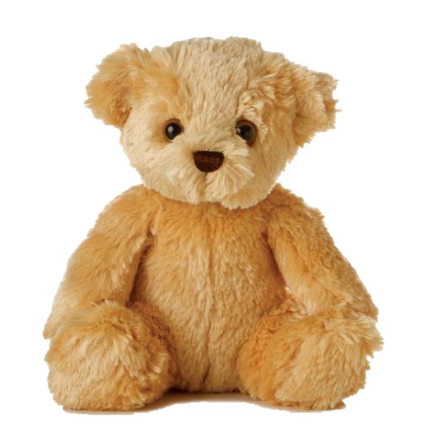
1st grade (7 yrs): Toy animals at work
Astrid approaches Marte again: "What was its name again?" [the teddy at Marte's desk]. Astrid leaves her seat and approaches Marte (...) Kaja has been carrying around a toy giraffe all day, holding on to one of its legs. Sometimes she smilingly "threatens" some of the other children with it (...) Emilie’s toy animal tells her that it wants to stay in the classroom during recess, and is allowed to stay on her desk while Emilie goes out.

Slide 10
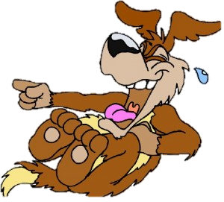
2nd grade (8 yrs): Jokes as a united front
In front of the class, the boys are rehearsing the jokes they are supposed to perform at the show tonight for the parents. Jakob tells his joke so fast that nobody understands it. Halvor’s joke about a green ghost who gets scared by a Norwegian wearing pink underpants receives much laughter among the children. When it is Lars' turn, the boys first discuss among themselves what joke to make, and ends up with a joke about someone who farts. The teacher, Kari, reminds
them that they had agreed that there would
be no jokes about peeing and pooing.
"But fart is ok!” a girl, Tuva, says persuasively.
"It is so popular, Kari!" Nora chimes in.
Kari accepts the fart joke.

Slide 11
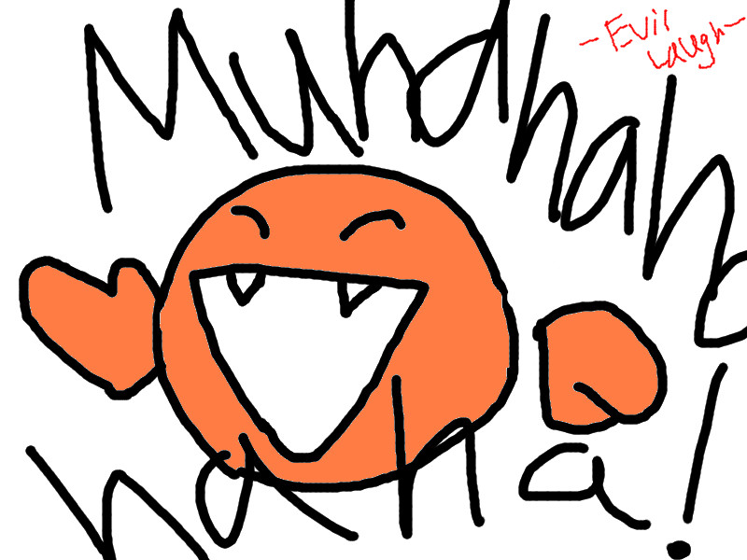
4th grade (10 yrs): Abstract thinking and obstinacy
A group of children talk about the ghost stories they are supposed to hand in tomorrow. Emily thinks it would be fun if the story started somewhat slowly and then ended up like: "bang, crash, dong!" Astrid also has an idea: "Couldn't we do like: Mrs M.Urder?" Emily and the other children laugh out loud. But then it should be Mrs M.Urdered, one says, because it isn't "she was murder", but "she was murdered". So Mrs M.Urdered must be right. Astrid says that there is also a murderer [morder], so he can be Mr Murderer. Mr Murderer and Mrs Murdered, or, no, she corrects herself:
Mrs M.Urdered and Mr M.Urderer. It is also fun that it sounds a bit like another word, which means something quite different [untranslatable from the Norwegian]. The children discuss that it may be a little strange to have a name that indicates that you will be murdered later in your life?

Slide 12

9th grade (15 yrs): Abstractions and emotions
Norwegian lesson – work with poems. Nora becomes indignant when the teacher claims that April/will rhyme. She has a long and principled argument against it: how can one know that it was supposed to be a rhyme inside the head of the author, when it actually does not rhyme?! The four boys and Tuva join the discussion and continue the argument with the teacher. When the teacher finally stops the discussion, Nora brings up a new aspect: ‘Will we get a bad mark because we did not understand this?!’ She continues
to argue and concludes by stating a general law: ‘Only words with identical endings in written and spoken language can be called rhymes!’

Slide 14
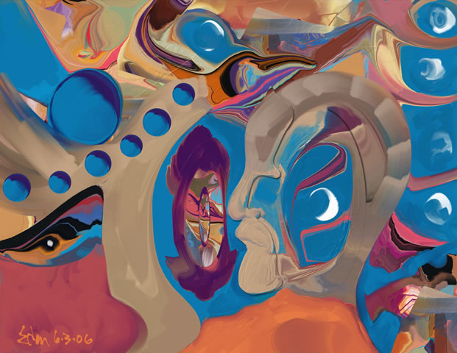

Slide 15
Resignification
It is not, therefore, a question of a linear, cumulative effect that resulted in a symptom, but a reorganisation of already existing memory traces related to new stages of maturation (...). This notion rules out linear determinism and emphasises the relevance of the present when reinterpreting the past (...) In Freud's formulation, phantasies constantly reshape memories retrospectively (...) The concept of aprés coup is related to a theory of the mind that includes several temporalities (32)". (Perelberg 2008, 28-32)
"Thus gradually is formed an experience of an entirely different order, which accumulates with the body (...) it no longer represents our past to us, it acts it; and if it still deserves the name of memory, it is not because it conserves bygone images, but because it prolongs their usefull effects into the present moment" (Bergson1908, 92-93).

Slide 17
Astrid: 1st grade, 4th day of school, 7 yrs
Astrid complains loudly about all her pens being dry. 'Mine too', Kristin says, and the two girls continue discussing the pen situation. The teacher reminds the class of "the zipper". Astrid turns to Nina (who hasn't uttered a word during the entire lesson) and says: 'Remember the zipper!'

Slide 18
Astrid: 3rd grade, 9 yrs
Ola is back in school today. Astrid says to him: ‘It was peaceful in the class while you were gone, you know that?’ ‘Yeah I guess it was’, Ola says friendly. Astrid: ‘Do you know that you are noisy?’ Ola: ‘You are too!’ Astrid grabs his arm and threatens – half in jest – to beat him up during the break. Ola and another boy laugh. Astrid grabs hold of Ola’s sweater anew and Ola protests: the sweater may be damaged. Astrid: ‘I don’t give a shit about that!’ The teacher comes by and reminds Astrid to take off her shoes (a rule in this classroom in winter). Astrid gets up, mumbling: ‘Teachers see everything!’ While she passes Harald, she says: ‘Harald! Take off your shoes’.

Slide 19
Astrid: 6th grade, 12 yrs
Astrid sits on the floor, and two girls are comforting her. She tells me that Ola and Alek have teased her for looking like a boy, that she talks like a boy and behaves like a boy. For some time they have given her the nickname ‘man’ and she can’t take it anymore. It is not because she wants to be a boy that she wears big, loose sweatshirts – it is because she likes it! I suddenly realise from the black stripes on her cheeks that she is wearing mascara. I also notice the feminine t-shirt she wears under her rough sweatshirt (…) After the lesson the teacher asks her why she had cried. Astrid tells her, and she smiles a little when the teacher says: ‘You don’t look a bit like a boy, you look like Astrid!’

Slide 20
Astrid: 8th grade, 14 yrs
Outside the classroom, I see Astrid holding Håkon in an iron grip. He takes revenge and she screams and laughs. She sends him a big, beaming smile (I have never seen that before!). Håkon continues to attack her while she descends the stairs to the canteen. She smiles and hits back, but in a somewhat lazy and flirtatious way. In the canteen she continues the lazy play-fighting with more boys, all the time with a big smile. She sits down, rocks gently to the music, meets the eyes of Thomas, nudging him gently. He seems very attracted to her, and looks at her non-stop. She has developed into a master of the flirt, using her eyes, her smile, her comments, being both active and seductive. Mastering both the boys’ culture and the code of sexuality certainly gives her quite some power. ‘Did you say anything about me’, she says in a husky voice – ‘did you say some shit about me?’

Slide 21
Interview with Astrid: 8th grade,
14-15 yrs
(…) I know I have also talked a lot of bullshit, but you just get it back twice as hard. So then it becomes a bit hopeless. I don’t always feel that I can be me, and say exactly what I want, because I’m afraid that they will throw in a cheeky comment, but…(…) Most of the boys in our class have not yet really understood what discrimination of women is all about. They don’t care.

Slide 22
What times are in this child?

