Slide 1

Families and Food in Austerity Britain: Early findings from a mixed methods study of families and food in hard times
Rebecca O’Connell
Thomas Coram Research Unit
rebecca.oconnell@ucl.ac.uk
www.foodinhardtimes.org
Monday 27th March 2017
CIRCY, University of Sussex

Slide 2
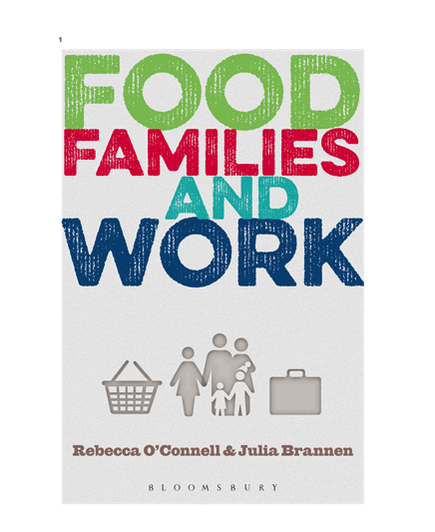
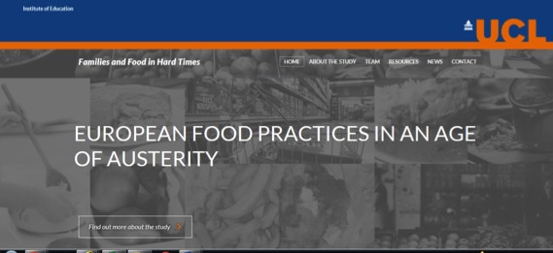

foodinhardtimes.org

Slide 3
Outline
Background
Study design and conceptualising food poverty
Quantitative analysis – identifying UK families at risk of food poverty
Qualitative research – three family cases
Discussion/implications

Slide 4
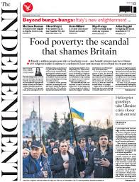
Background
“Demand for food parcels explodes as welfare cuts and falling pay hit home”
(The Guardian, 25 June 2012)
“EU spending cuts to hit Portugal's poor”
(Business Report, 15 Sept 2013)
“Teachers are having to feed children arriving at school hungry and cold in a return to 'Victorian conditions’”
(Mail Online 5 April, 2015)
Notes:
Briefly by way of background, I am sure you are aware of national and international media reporting an increase in the number of children arriving at school hungry, a marked rise in the number of food banks handing out food parcels to families (Euronews, 2011; The Guardian, 2012), reports of families being forced to choose ‘between heating and eating and poorer parents reportedly unable to access or afford healthy diets in the context of rising food prices, the global financial crisis and European austerity.
However whilst there is a growing body of research on food poverty in the global north, we don’t know enough about the extent of food insecurity in the UK and Europe, or about differences between countries or within households. At the international level, research has tended to use statistical household level data whilst qualitative studies at the national level have - for good reasons - often focussed on the experiences of mothers.
Our current study, which is funded by the European Research Council starting grants scheme, is based at The Thomas Coram Research Unit which specializes in research on children and families sets out to address this gap by focusing on young people and their families in three countries, to examine how social contexts and social positionings mediate the experience and extent of food poverty.

Slide 5
Methodology
www.foodinhardtimes.org
How do social contexts and social positionings mediate the extent and experience of food poverty?
International comparative approach
Mixed methods embedded case study design
Incl. young people - extensive and intensive data
‘Contrast of contexts’ (Kohn, 1987) in relation to conditions of austerity:
Portugal
UK
Norway
Phase 1: WP1: Country Reports; WP2: Secondary analysis of national and international data
Phase 2: Interviews and other qual methods with 135 YP and parent/s (45 in each country)
Notes:
To do this Families and Food in Hard Times adopts an International comparative approach and a Mixed methods embedded case study design. Importantly it includes young people’s experiences using extensive and intensive (quantitative and qualitative) data
The research design provides for ‘a contrast of contexts’ (Kohn 1987) in relation to conditions of austerity. It focuses on Portugal, where poor families with children appear to have been most affected by economic retrenchment (Tim Callan et al., 2011), the UK, which is experiencing substantial cuts in benefits to poor families (Ibid.), and Norway which, in comparison with most societies, is highly egalitarian in terms of income and has not been subject to austerity measures (Eurostat,2009).
Phase 1 includes two work packages….
Phase 2 uses range of qualitative methods with 45 YP and their parent or parents in each country…. Mention visual
Today I am going to talk about some of the secondary analyses we have carried out and give a brief account of two qualitative cases that, in the terminology of mixed methods research, elaborate on the quantitative findings and exemplify how patterns based on the quantitative data apply in particular cases.
So there’s a lot to get through meaning I may need to skip a slide or two…

Slide 6
Conceptualising food poverty
Poverty vs insecurity
(See Lambie-Mumford 2014; Lambie-Mumford and O’Connell, 2015)
Food poverty
‘The inability to acquire or consume an adequate quality or sufficient quantity of food in socially acceptable ways, or the uncertainty that one will be able to do so’ (see Dowler et al 2001:2 and taken from Radimer et al 1992 cited in Riches 1997)
Expanded definitions include social participation (e.g. Friel and Conlon, 2004) + socially acceptable procurement (Tait, 2015)
Notes:
‘Within work on ‘poverty’… whether in academia, advocacy or policy, there is usually recognition that the ability to buy or otherwise obtain enough food is an important component, however the condition be defined (Spicker, 2007), with some emphasising the need to meet nutritional requirements and others, social norms of food behaviour (Dowler, 2002)’ (Dowler and O’Connor, 2012:ref).
Though the terminology is emergent and the terms food insecurity and food poverty are often used interchangeably we follow Hannah Lambie Mumford in distinguishing between them such that hh food insecurity refers to a particular, fairly narrow concept that is associated with a widely employed measure used surveys in North America, Australia, and now by the WHO to monitor food security at the household level. It has advantages not least because it has been validated internationally however a major disadvantage is that it is limited to measuring compromise in food quality, quantity and worry about running out of food.
In essence it misses out the social dimension of food that some – including our team – think is central. So we adopt a broader definition – and again follow Lambie Mumford in talking here about ‘food poverty’ – because we think that to ignore the social side of food is to ignore something fundamental and universal about WHAT FOOD IS AND WHAT IT DOES i.e. it is not only a source of nutrients but a means of social inclusion and exclusion, a medium of care, power and control.
(this i.e. social dimension is something that people themselves say matters in consensual approaches to poverty although there is evidence of an austerity effect’ or adapted preferences i.e. lowered expectations)

Slide 7
Food, poverty and inequality
‘Individuals, families and groups in the population can be said to be in poverty when they lack the resources to obtain the types of diet, participate in the activities and have the living conditions and amenities which are customary, or at least widely encouraged or approved, in the societies to which they belong. Their resources are so seriously below those commanded by the average individual or family that they are, in effect, excluded from ordinary living patterns, customs and activities’ (Townsend, 1979: 31).
Notes:
This broader definition of food poverty is consistent with a Townsendian approach to defining poverty that is concerned not inly with what people need to physically survive but what they need in order to participate in society
(thus differs from definitons at the turn of the last century when poverty was understood in more absolute terms and sufficient food was about physical efficiency – reproduction of labour power.)

Slide 8

http://www.eelanmedia.com/tea-for-you-a-lovely-cup-of-tea-for-you/

Slide 9
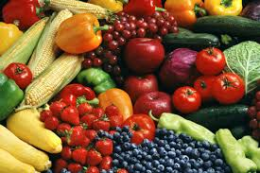

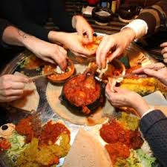
Food: the ‘intimate commodity’
(Winson, 1993)

Slide 10




LCFS and MIS
“Which types of families appear not to be meeting the lower spending threshold for a socially acceptable healthy diet that allows for social participation and how does this change over time?”
Notes:
I’ll start by saying something about the data.
The living costs and food survey collects information on spending patterns and the cost of living that reflects household budgets across the country.
It is used in Defra’s annual Family Food Survey – which is in fact currently the only UK source that systematically monitors the effects of austerity on food patterns (Dowler 2014:166). The Family Food Survey reports what households actually purchase at different levels of income, in relation to the likely healthiness of the diet.
However in our study we are interested not only in nutrition intake but in food poverty defined mutlidimensionally. Given the topic of our study we are also not only interested in household income but in family type.
So we have posed the question on the slide (read out) and we have sought to answer it by comparing data from the LCFS with the food element of the MIStandards, developed by Donald Hirsch and colleagues at Loughborough University and we have worked with Matt Padley in particular so thanks are due to him.

Slide 11
MIS
How much money do families need for a socially acceptable minimum standard of living?
  The MIS ‘includes, but is more than just, food, clothes and shelter. It is about having what you need in order to have the opportunities and choices necessary to participate in society'.
Food Budget standard (FBS):
  Consensual/expert
  Includes social participation
  Costed at Tesco
Notes:
For those who aren’t familiar with the MIS, it calculates how much money different types of family need to achieve a socially acceptable minimum standard of living. It is based on detailed research with groups of members of the public specifying what items need to be included in a minimum household budget. The groups are informed by expert knowledge where needed, for example on nutritional standards. The results show how much households need in a weekly budget and how much they need to earn in order to achieve this disposable income.
The MIS groups’ definition of an acceptable minimumstandard of living is that ‘it includes, but is more than just, food, clothes and shelter. It is about having what you need in order to have the opportunities and choices necessary to participate in society'.​
The food budget standard, which is a component of MIS, is based on focus groups which discuss and agree a diet that is reasonably healthy, practical in terms of lifestyle, and realistic in terms of preferences and treats. Minor adjustments to the menus by a nutritional expert are made to achieve nutritional adequacy for that particular group of the population (Oldfield and Burr, 2008) and the basket is costed. Importantly the food budget standard includes extra shopping for festive occasions and the cost of modestly eating out occasionally, both of which are dimensions of social participation (Ibid).​
To find out which types of families with children (aged under 18 years) might be a risk of food poverty and how this changed over time we compared the food budget standard to actual expenditure of different types of families from 2005 (before the global recession) to 2013 (the last year we have complete data for)
In brief this is what we found…

Slide 12
Proportion of families spending below the FBS 2005 - 2013
Notes:
The results in Figure 3 show that the proportion spending below their FBS has increased over time for all families, from 41% in 2005 to 52% in 2013. The rise is particularly sharp for lone parents with one child (from 40.1% to 61.8%), lone parents with 2 or 3 children (from 63.3% to 70.6%), and couples with 4 children (from 56.3% to 81.8%). The time series does not represent a constant increase over time and there are different peaks for different family types: for some the peak occurs in the proportion spending below their FBS around 2007-8 and then again in 2012-13 (e.g. couples with 4 children and lone parents with 2 or 3 children) but for others the peak was in 2010 and then again in 2013 (couples with one, 2 or 3 children).
In 2005, lone parents with 2 or 3 children are the group with the highest proportion spending below the FBS (63%) followed by couples with four children (56%). However in 2007 couples with four children became the family type with the largest proportion not meeting the food budget standard, and they? remain so, with 82% of these? families spending less than the FBS, followed by lone parents with 2 or 3 children (71%) and lone parents with one child (62%). Therefore it is lone parents and large families (with 3+ children) who have the highest proportion not meeting the FBS.
I’m not showing all our data here because I want to move onto the qualitative research but I want to share one more slide on the quantitative research. Briefly, we wanted to understand what might be driving this pattern so we examined what was happening to household income over this time period, and the FBS as a proportion of income
In essence it can be explained by stagnant or falling incomes and the increasing cost of food
(apologies that line colours for families are different –not time to fiddle with it)

Slide 13
Identifies types of families at risk namely:
Lone parents
Large families
BUT
Missing families at very bottom of income distribution?
How do families manage below FBS?
Who in the household is affected and in what ways?
Notes:
There are limitations with this approach and we need to be careful about how the results are interpreted: The finding that between 30 - 82% of families are spending below the FBS is not the same as suggesting that between 30-82% of families are in food poverty.
The ways people meet their food needs vary widely and there may be reasons other than economic ones which explain why households spend less than appears ‘necessary’ on food. These may include individual, family and cultural preferences for cheaper or less healthy foods, customary cooking practices that involve low cost, healthy, foods, or supplementing bought foods with home grown produce.
Importantly, families may not be spending below the standard because they lack resources. In addition, the diets of those families spending below this amount (whether or not they lack the resources to do otherwise) may not be nutritionally inadequate or socially unacceptable.
However, the findings that the proportion not meeting the FBS increases for all family types over time and that particular family types - those headed by lone parents and large families - are farther from the FBS than others, are certainly a cause for concern and demand explanation.
These findings cannot tell us HOW families manage below the FBS or the ways in which people within famiklies are affected in dofferent ways (intra-household variation).
In the next section of the talk I am going to briefly talk about two families who are cases from our qualitative part of the study that is now underway. Both live in Inner London (some families in our sample will be drawn from a contrasting non urban study area).
Whilst these findings tell us which types of families are most at risk from food poverty, and we are able to make inferences about why, they cannot tell us how families manage to feed themselves when they are spending much less than the FBS, what this experience means for them or the ways in which family members are affected. After introducing the qualitative research, the next section extrapolates from patterns found in the quantitative data by describing three cases that exemplify some of the conditions under which families’ food budgets are constrained, how they cope and how experiences and vary within as well as between households.

Slide 14
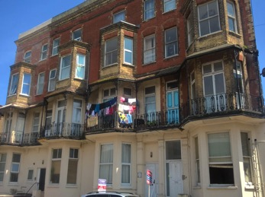
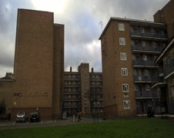
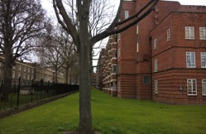
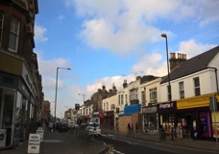
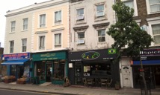
Qualitative research:
Study areas and sample
(n=45)
 | Lone parent | Dual parent | Total
London borough | 23 | 7 | 30
Coastal town | 7 | 8 | 15
Total | 30 | 15 | 45
Table 1: Lone vs dual parent households in the London borough and coastal town
Notes:
One urban and one contrasting area; comparable areas in UK, Portugal and Norway
Rates of child poverty
Time and resources
Profile of area: mix of race and ethnicity; community languages; presence of cheap food shops, fast food; availability of community and/or emergency food provision
Transport, accessibility, connectivity
Previous research in the area/schools (both pros and cons)
London Borough
Urban, inner city
Diverse population, growing middle-class, White UK and other (54%) ; Black/Asian approx. 46%
264,000 population
Good transport links (free buses for children/teenagers)
42% child poverty (after housing costs) (End Child Poverty)
Expensive housing – also poor private rented and social housing, large estates; gentrification
Many cheap food outlets (incl. markets) and community food projects
Coastal area
Coastal, medium size town
Homogenous – mainly White British: 97% WB (2011 census)
50,000 population
Expensive transport (no child fares at school times)
49% child poverty rate
Relatively cheap housing; poor private rented sector and little social housing; some gentrification
Supermarkets but no cheap markets; fewer cheap eating places; many shops in outside town shopping area so transport important

Slide 15
Qualitative research – sample (n=45)
 | London borough | Coastal town | Total
White British | 7 | 8 | 15
Black British/British Asian (2nd generation) | 11 | 0 | 11
European | 2 | 4 | 6
Outside mainland Europe | 10 | 3 | 13
Total | 30 | 15 | 45
Table 2: Mother’s ethnicity/ country of origin in the London borough and coastal town

Slide 16
Qualitative research – sample (n=45)
 | Quantity | Any of: Quality, Social participation, Worry | Food budget constrained only | None
Adult | 18 | 37 | 8 | 0
Child | 8 | 31 | 0 | 14
Table 3: Severe and other dimensions of food poverty adults and children
Notes:
From this sample, we have selected three cases on the following grounds.
A) they exemplify the analysis we have carried out in the quantitative datasets.
Two are lone parents who as shown above are the most likely to be spending less on food than that needed to meet the FBS.
The first case is also a ‘large family’ also shown to be at risk of food poverty.
The second case, also a large family but a two parent household, is chosen because they are not in employment; hence they have a low income in the context of bringing up four children.
B) they are key targets of UK public policy and public discourse: migrant households without right to live in UK are at risk of deportation; lone parent families who have long been the target of policies that have sought to reduce ‘dependence’ on the state; nonemployed household with parents suffering a disability; lastly, large families who are facing discrimination by reduced child allowances.
The first and third cases we describe are living in a deprived part of the inner London borough where fresh food is readily available including in street markets.
The area is also saturated with fast food outlets whilst in the gentrified parts of the borough expensive independent shops and eateries are moving in. The third case of a large, two-parent family is living in the coastal area in south east England, where transport is expensive and there is a limited range of mainly low budget food shops and food outlets.

Slide 17
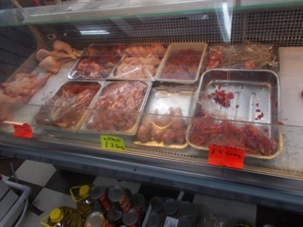
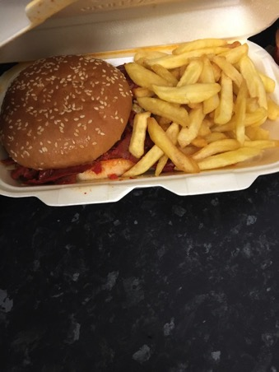
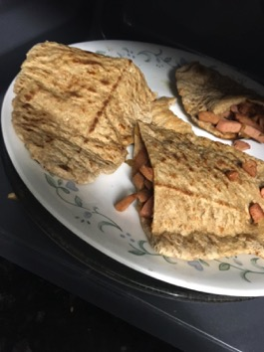
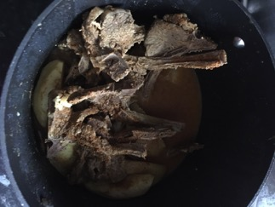
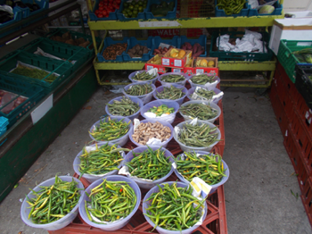
Sahara and Tarek
Notes:
Lone British Asian mother + 6 children including TC age 14 years (male)
Employed 16 hrs pw + own ‘organic’ business; needs car for work
Household Income around £400- 499 pw
Roughly 30% of weekly income on food (£150 pw) – around 90% of the FBS for this family type

Slide 18
Sahara and Tarek
Elasticity food budget
Food budget used for debts and unexpected expenses. M: I’ve noticed whenever I have to pay something or do something I always have to cut into my food budget
M: their needs have got more as they’ve grown ….. but the money’s just stayed the same; you know I can’t feed my kids a few pieces of chicken like I would then when they’re all young – I have to make sure the pot’s full.
Quality
Home cooked food but monotonous + unable to afford as much F&V as would like
TC: it’s curry and rice most of the time, but every now and then we’ll get a take-away.
Notes:
M prioritises utilities, council tax and her DDs, but cuts down on food shopping to pay her debts
that she borrowed to do up the house or to pay for petrol that she needs to get to work:
you know I can’t feed my kids a few pieces of chicken like I would then when they’re all young – I have to make sure the pot’s full.
To a point I really thought I need to get a lock in the kitchen. Once it’s done just lock up – you’ve had your meal
TC: Well there’s a lot of chicken shops to keep us busy, there’s a lot of food shops to keep us busy like.
Eat out very rarely – maybe once in holidays – as the bills are too bis
M: their needs have got more as they’ve grown … they’re big men now, my boys are like 6ft, 6ft 2, their diets are you know .. but the money’s just stayed the same; you know I can’t feed my kids a few pieces of chicken like I would then when they’re all young – I have to make sure the pot’s full.

Slide 19
Sahara and Tarek
Intra household resource distribution
Children said to be good at sharing meal ‘they’re quite good they’ll say like now today there’s chops, they’ll all shout ‘Mum, how many chops each?’ So I’ll say ‘Okay, two or three’ and one potato or two’ but less so treats/snacks M ‘To a point I really thought I need to get a lock in the kitchen. Once it’s done just lock up – you’ve had your meal’
TC: Sometimes people hide them [crisps]. Like even I do, I hide them on the top of the cupboard so no one gets them. Cos they go really fast’.
Social participation
Eating out is ‘a strain’ as is hosting kids’ friends because they don’t come in ones, they come in groups. M: I’ve told my kids straight ‘You invite your friends round, tell them to bring their pocket money, I barely feeds yous lot’

Slide 20
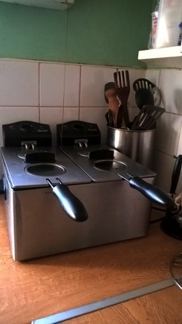
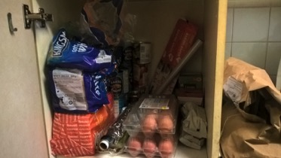
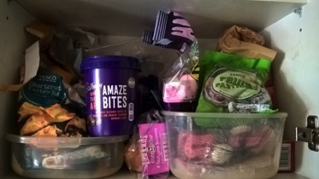
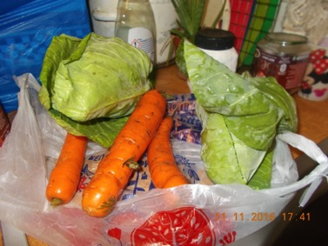
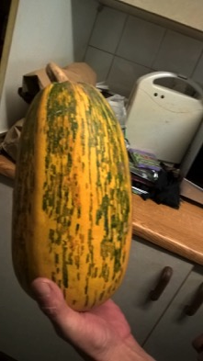
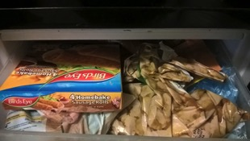
Peter, Diane and Bethany
Notes:
Dual parent, White British family + 4 children aged 5-18 years. TC aged 12 years (female)
Both parents – ill health so unable to work but turned down for ESA and PiP
Expensive local bus fares means need to run a car; debt repayments squeeze family budget
Household income - Job Seeker’s Allowance (JSA) child tax credits and child benefit, housing benefit – about £390 pw
Roughly 25% of weekly income on food (£90-£100 pw) – around 60% of the FBS for this family type

Slide 21
Peter, Diane and Bethany
Reliance on informal support of family network
Grandparents cover essential and emergency + regular dinners cooked for the children and food from their allotment, ‘we get a lot of fresh veg in season. So we’ve got marrow out there, fresh ones, we get carrots when it’s time, we get all sorts of stuff … parsnips’.
Elasticity of food budget
‘you know when you get a bigger bill come in, and that has to be paid – things like the electric and the others, then we find we’re cutting down on the amount we buy, but then we’re also cutting down on the quality’

Slide 22
Peter, Diane and Bethany
Quality/quantity
Both parents occasionally skip meals or miss out protein so that there is enough for the children; ‘we’ll get the chips … but we won’t get the sausage or the fish’ (Diane)
Diet of mixed quality - some meals cooked from fresh ingredients, such as stuffed marrow or Spaghetti Bolognese plus cheap frozen food, like chicken steaks, and chips, cooked in the chip fryer or oven
Social participation
Eating out for this family is a ‘rare Chinese’ and a fortnightly bag of chips
Parents avoid having friends round: ‘if we start feeding other people as well I think we’d be seriously into problems then’ (Peter).
Meals reduced or padded out to facilitate children’s visitors: ‘Bethany prefers to go to other people’s houses. We have had the odd one or two round but basically we don’t increase the food, we just reduce the portions and still have the same….just stretch food, and we might add a couple of slices of bread to it, just to … or peel a couple more potatoes’ .

Slide 23
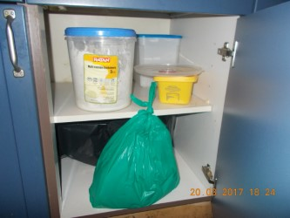
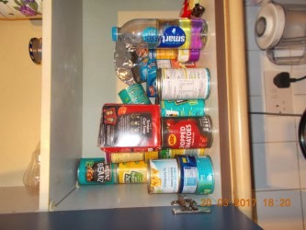
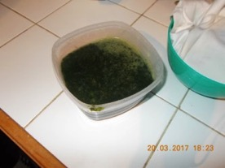
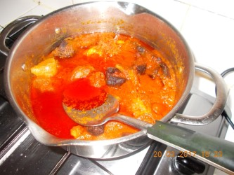
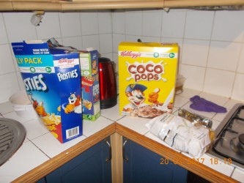
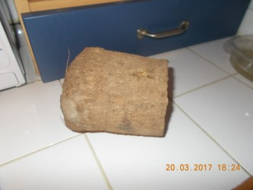
Juba and Lewa
Notes:
Lone Nigerian Mother + 2 children incl. TC age 14 years (female)
M cannot work because does not have legal status; NRPF and no support under section 17 – until second vsiit when re-housed in Ilford limited access to shared kitchen
Household Income: £20 a week cash from church and £20 a week Tesco card from Kids Company
Roughly 60% of weekly income on food (£25 pw) - about 25% of the FBS for this type of family.
Dried food from foodbank (and clothes and uniform from charity shop or donated) across London – 2 buses – weekly
SECOND VISIT….
Here are some - the cereals and the tins are from the food bank - the rest are of Nigerian food she cooks, using yam flour etc. The children eat a mixture of 'English' food and Nigerian and she eats mainly (but not all) Nigerian
Brown thing is yam

Slide 24
Juba and Lewa
Quantity; intra household distribution
Both M and TC skip meals and go hungry: M goes without so the children can eat ‘most of the time I always do fasting and prayer ‘; TC goes without so her younger brother can eat ‘there are times when I just want to leave them [any snacks] for him to eat so that you know he can eat something‘
Quality
Eat meat at home only when gifted from people at church
Social acceptability
M Kid’s Company give us like baked beans … sometimes I don’t really eat like that

Slide 25
Juba and Lewa
Social participation
M I have to keep that [their situation] secret
TC: ‘I don’t really talk to friends about this, cos I feel like they’re going to pick on me or something like that’
M: I can’t bring friends here, because it’s not easy for me, I have to tell them I will meet you at so and so place’
M: ‘any money they give me from church I normally give it to her for like £10 a week for her to spend, because I don’t want her to be looking when her friends are buying things’.
Notes:
Shame has material implications - means
Younger child has universal FSM but not older
Weekends are easier because she needs to use less energy so only eats two meals

Slide 26
Discussion/next steps
Increasing no. UK families at risk over time + some types more at risk than others
Both parents and children may compromise food quantity, quality, social acceptability of procurement and social participation - elasticity of food budget but not at the bottom
Formal and informal support/networks – vary + change over time
Charitable ‘solutions’ i.e. ‘wasted food for surplus people’ (Riches, and Silvasti 2014) MAY temporarily alleviate ‘hunger’ but further stigmatise and exclude the deprived
Living wages, adequate benefits, changes to NRPF and School Food policy
Systematic and mixed methods research needed to measure and monitor multidimensional food poverty
Next steps for FFHT: consolidate UK case analyses according to RQ themes; international comparison
Notes:
Next steps – different analyses by theme and comparison between coastal and urban area – consolidate at UK level the international comparison

Slide 27
Thank you
www.foodinhardtimes.org
UK research team at TCRU
Julia Brannen, Laura Hamilton, Abigail Knight, Charlie Owen, Antonia Simon

