Slide 1
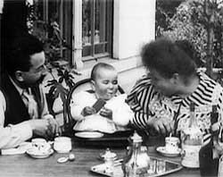
‘The child in cinematic time: Children on film, domestic drama, and Michael Winterbottom’s Everyday (2012)
Bruce Bennett, Lancaster University
12/9/13
Le repas de bebe (Lumiere, 1895)

Slide 2
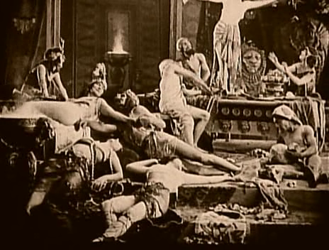
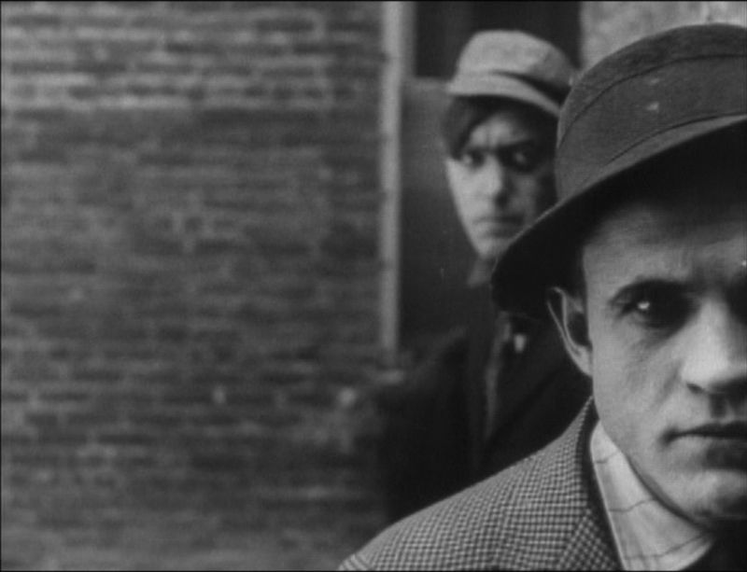
Ancient Babylon in Intolerance (Griffith, 1917)
Gangsters in contemporary New York in Musketeers of Pig Alley (Griffith, 1912)
‘Moving pictures were […] rife with anxieties for the genteel representatives of American culture, including the issues of a working class audience and the sexual awareness of children’ (Gunning 1991: 152).

Slide 3
Jane Addams, ‘The House of Dreams’
‘Thirteen young lads were brought into the Municipal court in Chicago during the first week that “Raffles, the Amateur Cracksman” was upon the stage, each one with an outfit of burglar’s tools in his possession, and each one shamefacedly admitting that the gentlemanly burglar in the play had suggested to him a career of similar adventure’ (Addams (1909) in Mast 1982: 78).

Slide 4
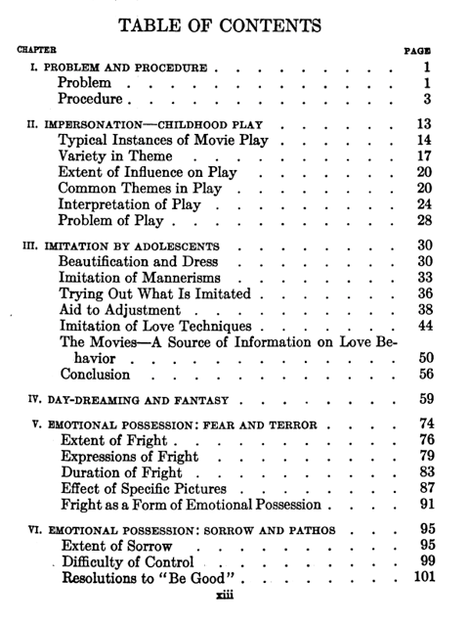
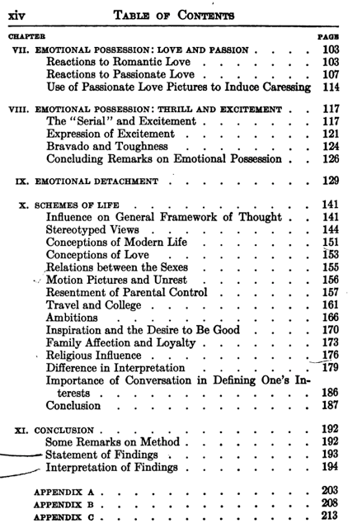
Contents pages from Dysinger and Rutnick, Emotional Responses of Children
to the Motion Picture Situation (New York: Payne Fund Studies, 1933)

Slide 5

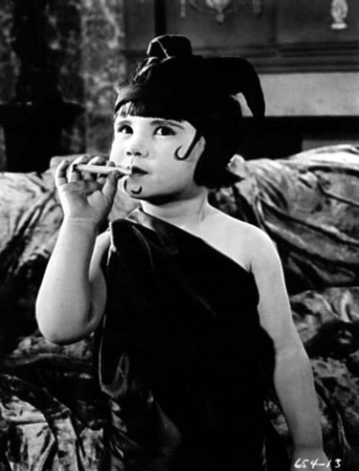
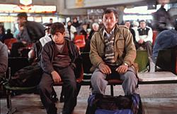
The complexity and historical contingency of images of childhood
The ‘Starchild’ from the conclusion of 2001: A Space Odyssey (Kubrick, 1968)
Orphaned Afghan refugees Jamal and Enayat ,In This World (Winterbottom, 2002)
Five-year old child star Baby Peggy parodies Polish star, Pola Negri in publicity still for Peg O’ The Movies (Goulding, 1923)

Slide 6
From cinematography to chronography – Michel Chion
Time henceforth had a fixed value; sound cinema guaranteed that whatever lasted x seconds in the editing would still have this same exact duration in the screening. In the silent cinema a shot had no exact internal duration; leaves quivering in the wind and ripples on the surface of the water had no absolute or fixed temporality. Each exhibitor had a certain margin of freedom in setting the rhythm of projection speed.
[...] So sound temporalized the image: not only by the effect of added value but also quite simply by normalizing and stabilizing film projection speed [...] The sound cinema can therefore be called “chronographic": written in time as well as in movement (Chion 1994: 16-17).

Slide 7
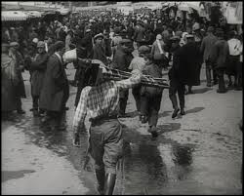
Everyday city life in forward and reverse-motion: Frame from Man with a Movie Camera (Vertov, 1929)

Slide 8
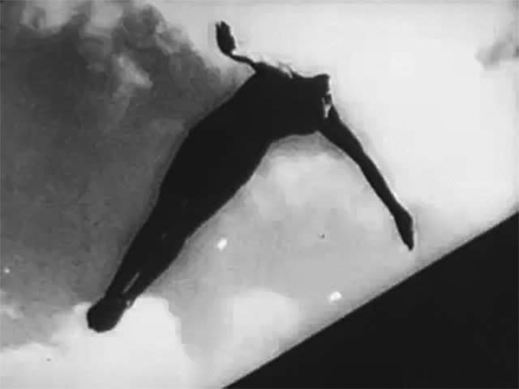
Frame from Olympia (Riefenstahl, 1938)

Slide 9

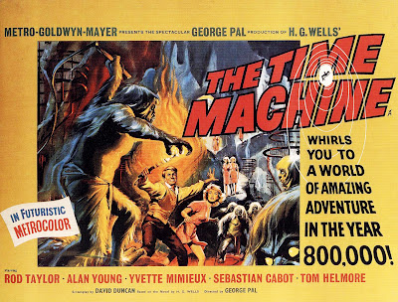
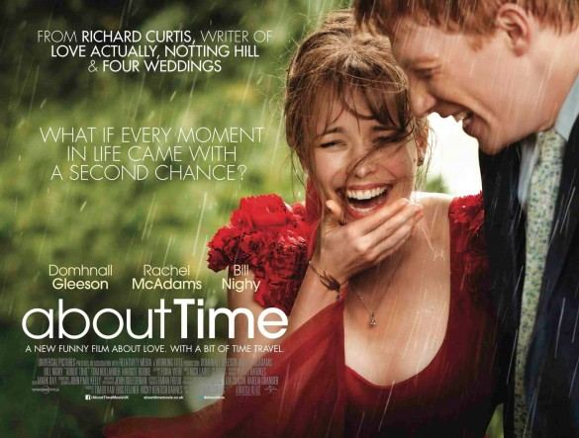
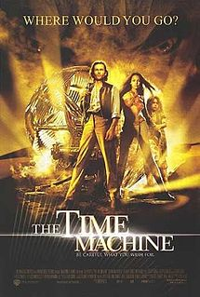
Cinema as time machine

Slide 10
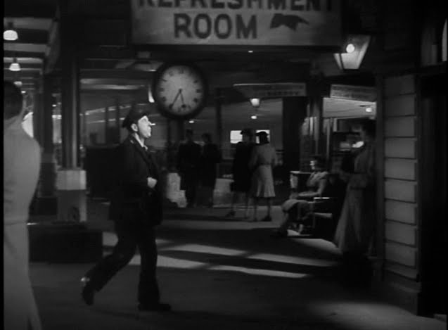
Railway time and mediated temporality: Frame from Brief Encounter (Lean, 1945)

Slide 11
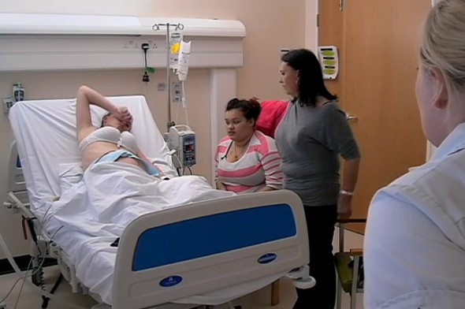
Still from One Born Every Minute (2010, Channel 4)

Slide 12


Slide 13

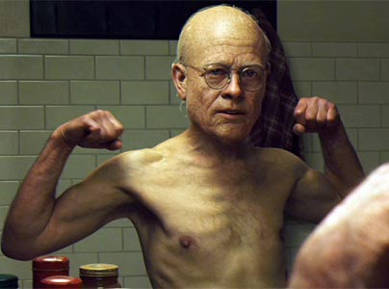
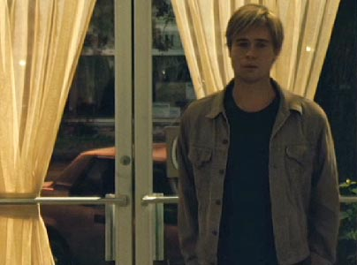
Duration as spectacular special effect: Benjamin Button’s ageing from infancy (top left) to old age (bottom right)
The Curious Case of Benjamin Button (Fincher, 2008)

Slide 14
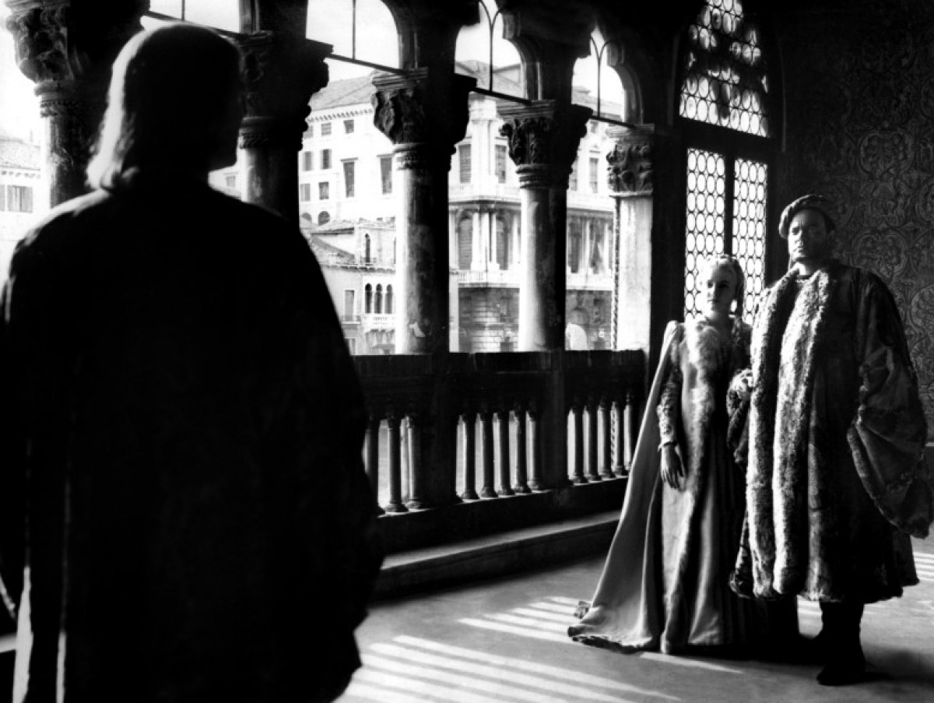
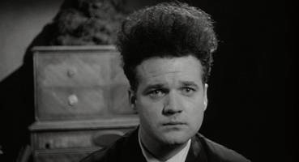
Othello (Welles, 1952)
Eraserhead (Lynch, 1977)

Slide 15
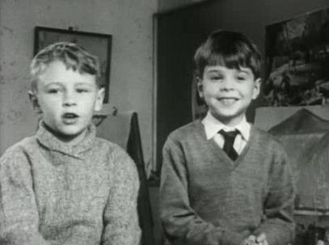
Peter and Neil in Seven Up! (Almond, 1964)

Slide 16
The ‘everyday’ in British film and TV
‘In keeping with its longevity and relative stability, Seven Up is also representative of a persistent fixation in British cinema and television documentary upon the quotidian and the personal – and how best to show them’ (Bruzzi 2007: 22).
‘What I have to believe the film does in a sense is honour the ordinary life – that people who have ordinary lives as opposed to celebrity lives can be very articulate and their lives can be full of changes about which they’d have a lot to say’ (Apted in Bruzzi 2007: 105)

Slide 17
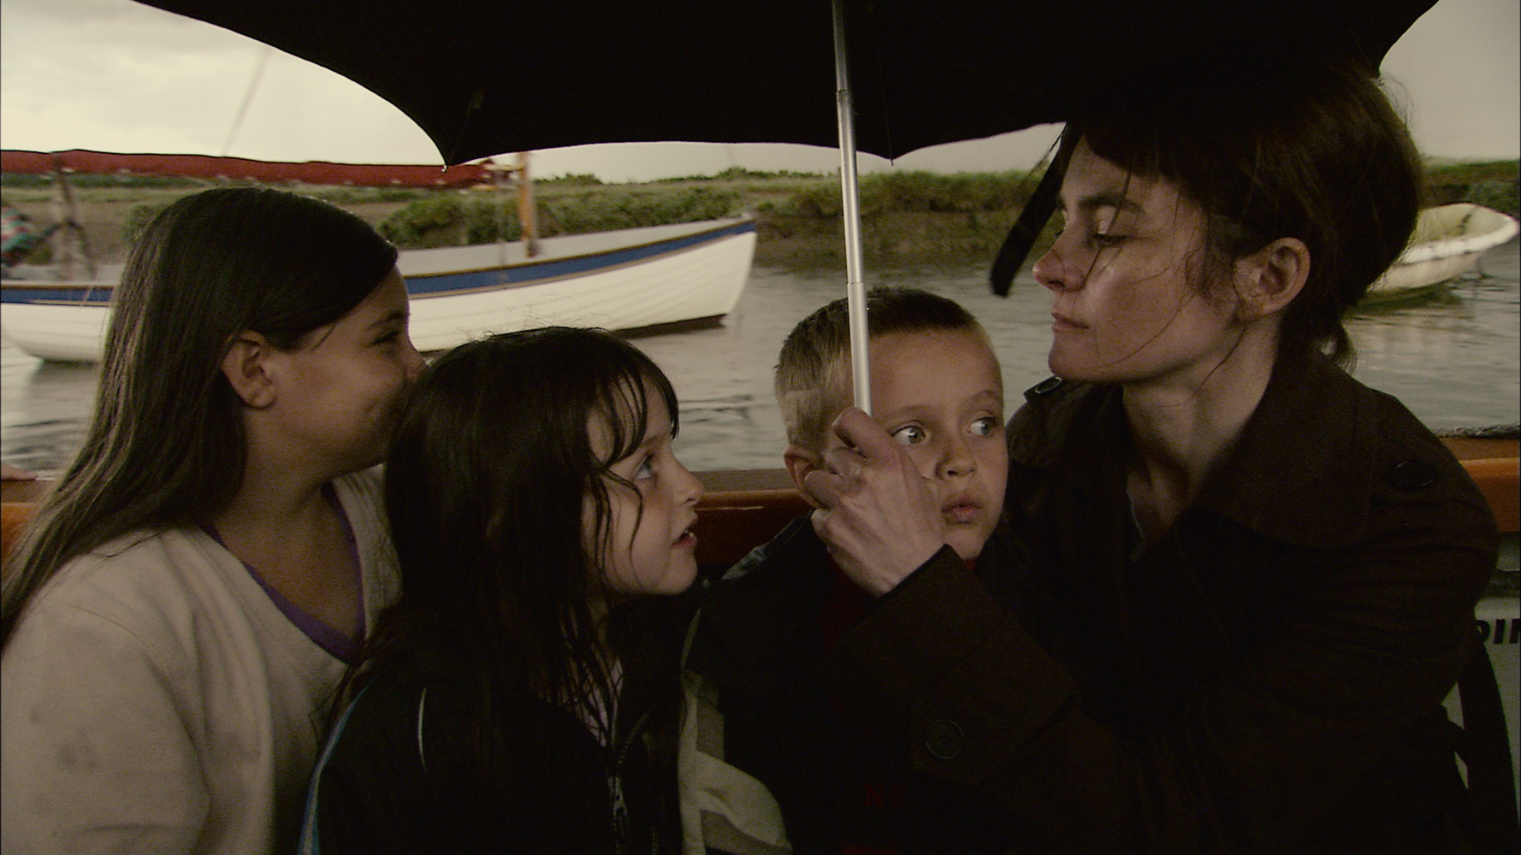
Karen and her children, Stephanie, Katrina and Shaun in Everyday (Winterbottom, 2012)

Slide 18
The problematic status of documentaries
‘Anyone who thinks there’s anything pure about making a documentary film is delusional. Every edit is someone’s judgement. Someone has to make that judgement – in this instance me – so that becomes my view of the world’ (Apted in Bruzzi: 78).

Slide 19
The problematic status of documentaries
‘documentary has come to suggest incompleteness and uncertainty, recollection and impression, images of personal worlds and their subjective construction...What counts as knowledge is not what it used to be’ (Nichols 1994: 1).

Slide 20
References
Stella Bruzzi (2007) Seven Up. London: BFI
Michel Chion (1994) Audio-Vision: Sound on Screen. Columbia University Press: New York
Tom Gunning (1991) ‘From Obscene films to High-Class Drama’ in D.W. Griffith and the Origins of American Narrative Film: The Early Years at Biograph. Urbana and Chicago: University of Illinois Press
Garth Jowett et al (1996)Children and the Movies: Media Influence and the Payenne Fund Controversy. Harvard University Press: Cambridge
Gerald Mast, ed. (1982) The Movies in Our Midst: Documents in the Cultural History of film in America. Chicago: University of Chicago
Bill Nchols (1994) Blurred Boundaries: Questions of Meaning in Contemporary Culture. Bloomington and Indianapolis: Indiana University Press
Clips:
Cops (Keaton, 1922)
Le demolition d’un mur (Lumiere, 1895)
Everyday (Winterbottom, 2012)
Fishing for goldfish (Lumiere, 1895)
Le repas de bebe (Lumiere, 1895)
Seven Up! (Almond, 1964)
Stalker (Tarkovsky, 1979)

