Slide 1
Alternative narratives of social exclusion
The case of school exclusion
Dr Louise Gazeley
University of Sussex

Slide 2







Families and parenting

Slide 3




Social and educational (dis)-advantage

Slide 4






Compensatory approaches, meritocracy or systemic change?

Slide 5

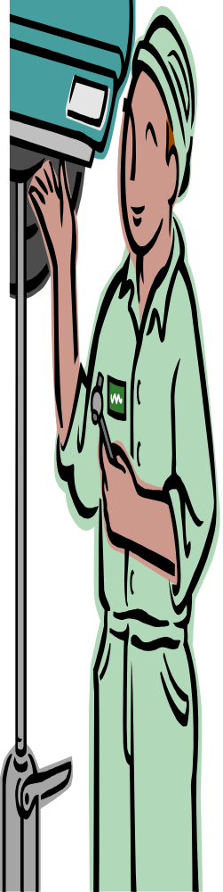




Social mobility and fair access?

Slide 6
Exclusion from school
Notion of an ‘underclass’ – cultural deficit, poor parenting, social deprivation
Interventions and sanctions that limit access to mainstream educational opportunities and qualifications - shape future trajectories whilst also re-producing them
Disproportionate impact on specific social groups – often those least powerfully positioned to resist
Contributory factor in social exclusion - not just a product of it
Importance of the role of teachers as ‘agents for change’ – role of Initial Teacher Education in this
Policy conceptualisations of ‘disadvantage’ and meritocratic, neo-liberal ideology part of what would need to change to deliver a more socially just education system

Slide 7

Aspiring to a more socially just education system?

Slide 8
Readings
Gazeley, L. (2010), The role of school exclusion processes in the re-production of social and educational disadvantage. British Journal of Education Studies, Vol. 58, No. 3, p. 293 – 309
Gazeley, L. (2012), The impact of social class on parent professional interaction in school exclusion processes: deficit or disadvantage? International Journal of Inclusive Education 16, 3, pp.297-311.
Gazeley, L. and Dunne, M. (2013), Initial Teacher Education programmes: providing a space to address the disproportionate exclusion of Black pupils from schools in England? International Journal of Education for Teachers, 39, 5, pp.X- X.
Gillborn, D. (2010), Reform, racism and the centrality of whiteness: assessment, ability and the ‘new eugenics’ Irish Educational Studies, 29. 3. pp.231-252
Reay, D. (2011), What would a socially just education system look like?: saving the minnows from the pike, Journal of Education Policy, 27, 5, pp. 587-599.
Skeggs, B., (2004), Class, Culture, Self, (Routledge, London).
Solomon, R.P., Portelli, J. , Daniel, B-J. and Campbell, A. (2005), The discourse of Denial: how white teacher candidates construct race, racism and ‘white privelege’, Race, Ethnicity and Education, 8, 2, pp.147-169.

