Slide 1

Health & Safety audit 2016
Briefing for Heads of units
September 2016

Slide 2

Health & Safety Audit in EngInf 2016
Welcome!
2

Slide 3

Health & Safety Audit in EngInf 2016
Why are you here?

Slide 4

Health & Safety Audit in EngInf 2016
The law
Effective health and safety auditing provides the framework for compliance with the legal duty to monitor, maintain and review all matters and arrangements of Health & Safety.

Slide 5
Health & Safety Audit in EngInf 2016
The law
By adhering to the Audit requirement and process, an organisation will be able to demonstrate that Heath & Safety is pro-actively managed in accordance with legislative, insurers and Fire Department requirements.
Notes:
Source: http://www.health-safety.net/Page/Audits

Slide 6

Health & Safety Audit in EngInf 2016
Accepted best practice
Safety audits are widely accepted to be best practice as they enable organisations to focus resources on areas of need, prioritise actions and facilitate continuous improvement.
Notes:
The Health and Safety Executive’s guidance document HSG65 "Successful Health and Safety Management" recommends that audits are undertaken. Indeed, safety audits are widely accepted to be best practice as they enable organisations to focus resources on areas of need, prioritise actions and facilitate continuous improvement.

Slide 7

Health & Safety Audit in EngInf 2016
What is an audit
Audit:
an official inspection of an organization's accounts, typically by an independent body.

Slide 8
Health & Safety Audit in EngInf 2016
What is a Health and Safety audit
The Health and Safety Executive define safety audits as:
“The collection of independent information on the efficiency, effectiveness and reliability of the total health and safety management system and drawing up plans for corrective action.”
http://safety.rospa.com/safetymatters/info/safety-audits-ebook.pdf
Notes:
Heath and Safety Executive: http://www.hse.gov.uk/leadership/auditing.htm
Quote from http://safety.rospa.com/safetymatters/info/safety-audits-ebook.pdf

Slide 9

Health & Safety Audit in EngInf 2016
What is a Health and Safety audit
Efficiency
Effectiveness
Reliability
Notes:
Heath and Safety Executive: http://www.hse.gov.uk/leadership/auditing.htm
Quote from http://safety.rospa.com/safetymatters/info/safety-audits-ebook.pdf

Slide 10

Health & Safety Audit in EngInf 2016
What is a Health and Safety audit
The total health and safety management system
Notes:
Heath and Safety Executive: http://www.hse.gov.uk/leadership/auditing.htm
Quote from http://safety.rospa.com/safetymatters/info/safety-audits-ebook.pdf

Slide 11

Health & Safety Audit in EngInf 2016
What is a Health and Safety audit
Drawing up plans for corrective action
Notes:
Heath and Safety Executive: http://www.hse.gov.uk/leadership/auditing.htm
Quote from http://safety.rospa.com/safetymatters/info/safety-audits-ebook.pdf

Slide 12
Health & Safety Audit in EngInf 2016
What is a Health and Safety audit
An alternative definition:
“An audit is a methodical, independent and documented assessment of a business’ system and processes, in which it is measured against regulated criteria to make sure health and safety standards are being upheld.”
http://www.theworkplacedepot.co.uk/news/2013/10/08/importance-health-safety-audit/
Notes:
Quoted from http://www.theworkplacedepot.co.uk/news/2013/10/08/importance-health-safety-audit/

Slide 13

Health & Safety Audit in EngInf 2016
Standard
University of Sussex has stipulated audits of Schools to use The Universities Safety and Health Association (USHA) standard
http://www.usha.org.uk/
Notes:
Universities Safety and Health Association (USHA) http://www.usha.org.uk/

Slide 14

Health & Safety Audit in EngInf 2016
SEF to conduct HSE audits
University has contracted SEF (Sussex Estates and Facilities) to audit the Schools on a yearly cycle

Slide 15

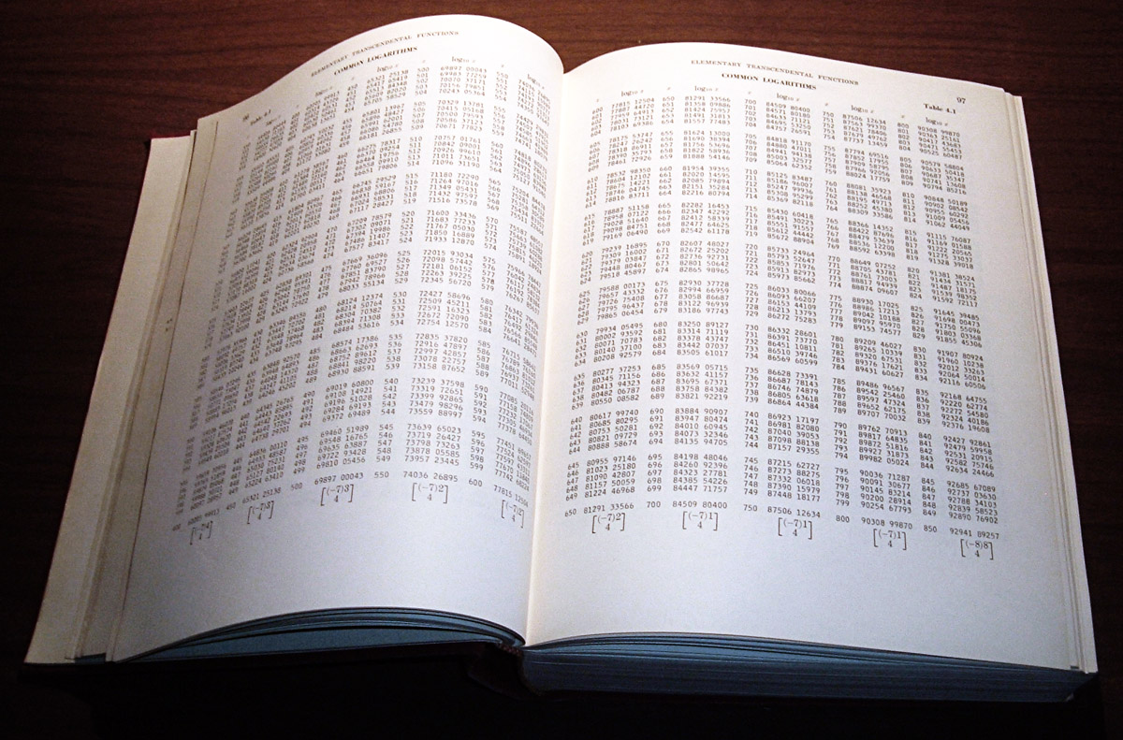
Health & Safety Audit in EngInf 2016
Standard
The Universities Safety and Health Association (USHA) standard
is a hefty book…

Slide 16


Health & Safety Audit in EngInf 2016
Standard
For practical purposes, the criteria are set out in sections

Slide 17
Health & Safety Audit in EngInf 2016
HSE audit: 2016
Four criteria sections:
Leadership
Planning for emergencies
Health and Safety Arrangements
Risk assessment and risk control

Slide 18
Health & Safety Audit in EngInf 2016
HSE audit: 2016
Leadership
Policies
Roles and responsibilities
Embedded in management structure
Training and resources

Slide 19
Health & Safety Audit in EngInf 2016
HSE audit: 2016
Planning for emergencies
Procedures
Recovery plans
Lessons learnt incorporated

Slide 20
Health & Safety Audit in EngInf 2016
HSE audit: 2016
Health and Safety Arrangements
Assessment and control of hazards
Responsibilities clearly assigned
Integrated
Documented

Slide 21
Health & Safety Audit in EngInf 2016
HSE audit: 2016
Risk assessment and risk control
Risk management cycle
Risk register
Formal methodology
Up-to-date

Slide 22
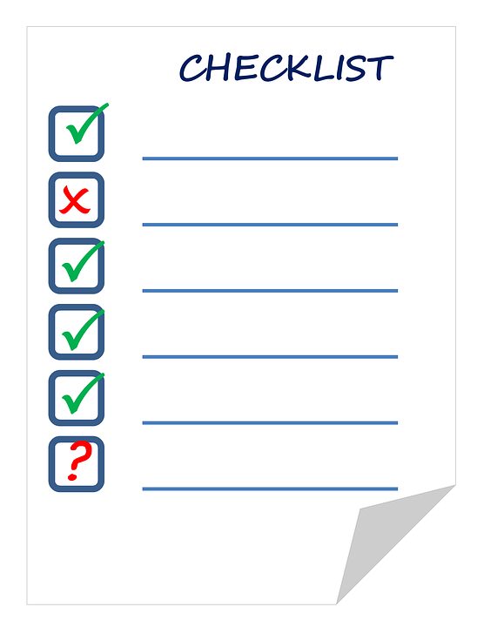
Health & Safety Audit in EngInf 2016
Where from here
A one-page summary
Criteria for units
Documents you need to forward

Slide 23


Health & Safety Audit in EngInf 2016
What if…
Notes:
A School could pass with flying colours to a high standard – or need to build on current achievements

Slide 24

Health & Safety Audit in EngInf 2016
What if…
Audit’s intended outcomes
Capture of current achievements
Recommendations for improvements
Notes:
The audit is not intended as a crime-and-punishment exercise. Rather, its goals are to compile a capture of current state-of-play, and to provide recommendations and identify goals towards an improvement level of compliance.

Slide 25



Health & Safety Audit in EngInf 2016
Where from here
Notes:
The audit process recognises that there are obstacles each unit faces in developing and maintaining a comprehensive HSE management system.
SEF will continue to support local efforts, within the scope of its contract and resources.

