Slide 1
Women Leaders in Finnish Universities: Doing/Undoing Gender?
CENTRE FOR HIGHER EDUCATION AND EQUITY RESEARCH
Professor Louise Morley, University of Sussex, UK, and Dr Rebecca Lund, University of Oslo, Norway.

Slide 2

Women Leaders in Finnish Higher Education: A Counternormative Force?
How does gender materialise in leadership?
What difference does difference make? Generative/ Disparaged/ Disqualified form of externality?
What are women/feminist leaders ceasing to be/ in the process of becoming?
Areas of affective intensity?

Slide 3
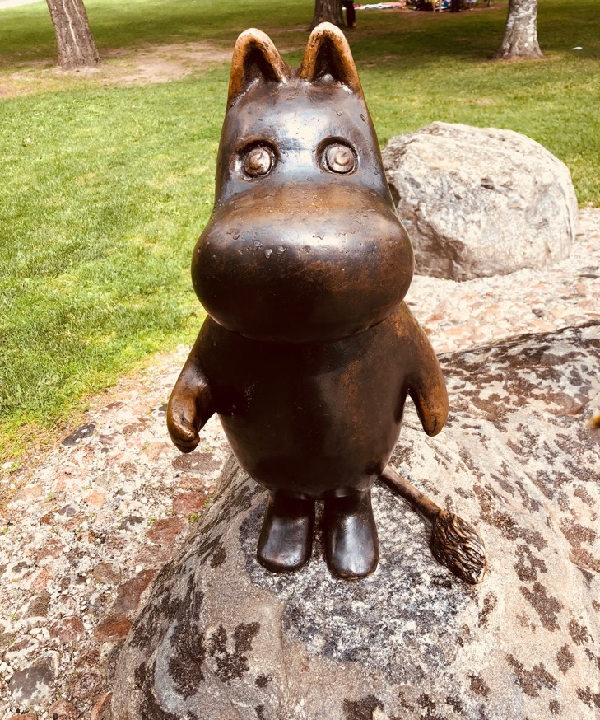
Gender Occupying Contradictory and Contested Spaces
Miniaturised
Gender not a performance indicator in the Global League Tables/ Prestige Economy.
Feminism appropriated by Neoliberalism (individual winners)
Post-Feminism
Magnified
Gender Pay Gap
MeToo and Time’sUp Movements
De-binarying/ Queering/ Trans awareness.

Slide 4

Finland: Sophisticated Policy Architecture for Gender Equality?
Government Action Plan for Gender Equality 2016-2019
30 measures that each ministry has responsibility to implement in their area of jurisdiction.
Work-life balance, equal pay and reduction of gender segregation in work and education.
A working group supports and monitors implementation.
Ministries must assess the impact of these measures on a regular basis.
Gender Equality Statistics
Published every second year by Statistics Finland.
Where are the Women Leaders?
Female rectors in 2017: 12.5%. (2 out of 16)
Female professors in 2015: 29% (728 out of 2513)
Academy of Finland: Research Council chairpersons and members: 50%
Academy of Finland funded professors: 31.7% (13 out of 41).

Slide 5
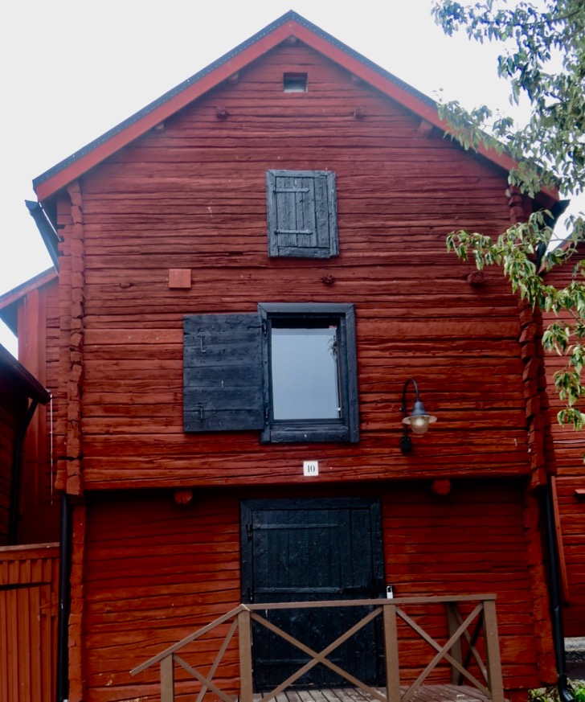
Methodology
10 semi-structured interviews with women university leaders in 5 Finnish universities.
Research directors, heads of department, deans and a vice-president.
Eight full professors.
Aged from 40-65; 9 heterosexual.
Disciplinary backgrounds in humanities, social sciences, business and technology.
Questions: interpretations, challenges, approaches, aspirations and perceptions of senior leadership.

Slide 6

Disidentification
Uneasy sense of standing under a sign to which one does and does not belong (Butler, 1993: 219)
Distance from hegemonic or normative conceptions of what that identification might entail.
On the receiving end of the violence (symbolic or actual) inflicted by hegemonic norms.
Form of subversive performative citation or re-working of hegemonic norms, rather than simple opposition to those norms.
Question?
Do hegemonic norms of leadership get altered/ transformed / resisted by minority subjects/ occupants?

Slide 7

Findings: Affective Intensity
Navigating Neoliberalism/ Global Prestige Economy
Leadership = Anti-Intellectual/ Disruption of Scholarship/ Research
Ageism, Sexism and Chrononormativity
Neuroliberalism: Governing via Affect.

Slide 8

Neuroliberalism: Governing through Neurosis
Constellation of behaviourism, neuroscience and economics.
Neoliberal systems of governance + psychological expressions of power and influence (Whitehead et al., 2017).
Governance of behavioural externalities AND internalities.
Structural problems solved by viewing them as behavioural.

Slide 9

Subverting Neuroliberalism: Post-Heroic Leadership?
Feminist Change Interventions = Relational Leadership?
Mediating the toxic effects of competitive individualism and performance measurement?
Re-articuloating Performance Indicators
I want the output to be them as great professors, not the output to be countable things in terms of research grant money (iv10).

Slide 10
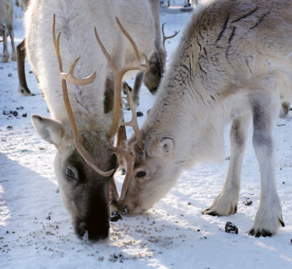
Chrononormativity
Temporality = a tool and marker of power (Freeman, 2010)
The use of time to organise individual human bodies toward maximum productivity.
The ordering of time reflects a logic of (hetero)normativity.
Question?
Women = always the wrong age?

Slide 11


Chronobiopolitics and Temporalised Bodies: Socially Reduced to a Misreading of One’s Body
Older Women
Redeemers/ Enablers of Future Generations
I have that kind of a mentor role but like a, respected elderly professional’s mentor. I think that the younger, they come and ask from me, for example, advice to the career issues (iv 1).
Aged by Culture
A retired colleague of mine … she told that I know a way how you stay visible. And one way is to have always beautiful young doctoral students around you (iv1).
Bedblockers
We for example decided to take one, professorship and make two posts for young researchers (iv9).
Younger Women
Reprofuturity
Women of a certain age… of the fertile age are not necessarily recruited (iv4).
Lack
… there’s a strong perception of being a young woman. People treat you in certain way …In a way that you have to prove your expertise and your capabilities (iv3).
Anxious
They get really nervous and stressed…’nobody would ask ever again if I don’t say yes to writing this or joining this project’ (iv10).

Slide 12

Gendered Discomforts and Making a Difference?
Changing the affective economy
Mentoring, soothing, reassuring, and cognitively restructuring.
Modelling (heterosexual) work/life balance.
Undoing/ de-emphasising neoliberal performance indicators e.g. scholarship rather than entrepreneurship.
Policy/ Structural change? Less so.

Slide 13

A Counter-Identification of a Post-Gender (and Post-Neoliberal) Utopia that Incorporates Multiple Alternative Futurities?
What ways of knowing can allow us to think differently about gender and leadership?
What conditions of possibility exist for feminist leadership?
How to shift from a politics of representation to i.e. counting more women into neoliberal universities to a politics of vision, and indeed, of hope?

Slide 14
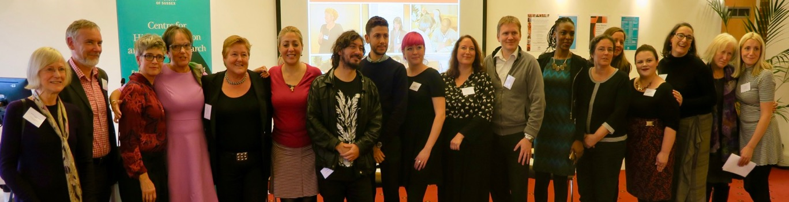
Follow Up?
Morley, L. & Crossouard, B. (2017) Women in Higher Education Leadership in South Asia: Willfulness and Willingness. In, Morley, L. (ed) Europa World of Learning 2017 Essays on Gender Equality. London: Routledge.
Morley, L. and Crossouard, B. (2016). "Gender in the Neoliberalised Global Academy: the Affective Economy of Women and Leadership in South Asia." British Journal of Sociology of Education 37(1): 149-168.
Morley, L., & Crossouard, B. (2016). Rejection, Refusal, Reluctance, Revisioning: Women in Higher Education Leadership in South Asia. Studies in Higher Education. 46(5), 801-814.
Morley, L. (2014) Lost Leaders: Women in the Global Academy. Higher Education Research and Development 33 (1) 111–125.
Morley, L. (2013) "The Rules of the Game: Women and the Leaderist Turn in Higher Education " Gender and Education. 25(1):116-131.
Lund, R. (2018). The Social Organization of Boasting. Gender and Education. https://doi.org/10.1080/09540253.2018.1482412
Lund, R. & Tienari, J. (2019) Passion, Care and Eros in the Gendered Neoliberal University. Organization. 26(1), 98-121.
Lund, R., Merilainen, S. & Tienari, J. (2019) New Masculinities in Universities? Discourses, Ambivalence and Potential Change. Gender, Work and Organization.
https://doi.org/10.1111/gwao.12383
CHEER Website: www.sussex.ac.uk/education/cheer
Twitter: @SussexCHEER
Facebook: www.facebook.com/groups/CHEERSussex/

