Slide 1
Women Leaders in Finnish Universities:
Navigating Neoliberalism, Narrating Neuroliberalism, and Nurturing New Imaginaries
CENTRE FOR HIGHER EDUCATION AND EQUITY RESEARCH
Professor Louise Morley, University of Sussex, UK

Slide 2
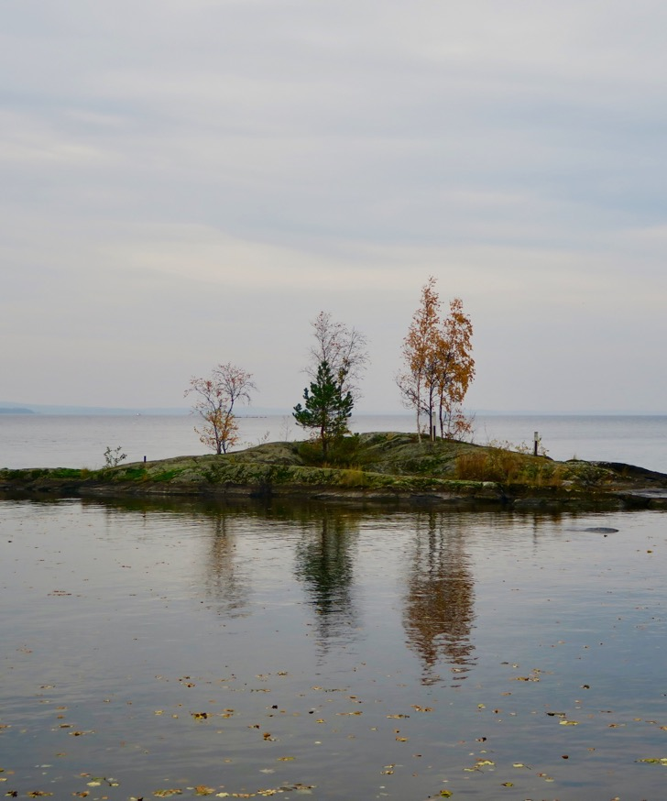
Women Leaders in Finnish Higher Education: A Counternormative Force?
How does gender materialise in leadership?
What difference does difference make? Generative/ Disparaged/ Disqualified form of externality?
What are women/feminist leaders ceasing to be/ in the process of becoming?
Areas of affective intensity?
Is the category of women leaders an imagined community?

Slide 3
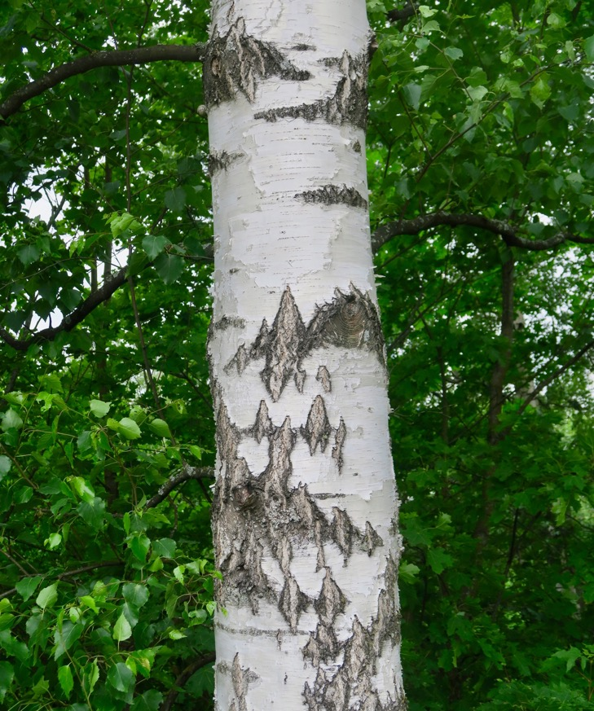
Avoiding Essentialism and Exceptionalism?
What possibilities are emerging from:
Assemblages/ relational potential of policy interventions?
Global speaking back to patriarchal power?
Including more women in higher education leadership?
Revisioning of gender?
Question
What is gender-sensitive/ gender-free leadership?

Slide 4
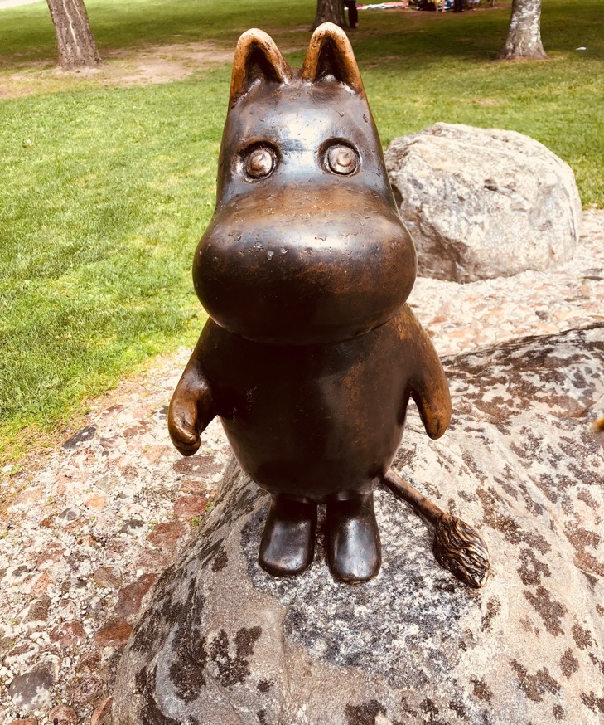
Gender Occupying Contradictory
and Contested Spaces
Miniaturised
Gender not a performance indicator in the Global League Tables/ Prestige Economy.
Feminism appropriated by Neoliberalism (individual winners)
Post-Feminism
Magnified
Gender Pay Gap
MeToo and Time’sUp Movements
De-binarying/ Queering/ Trans awareness.

Slide 5
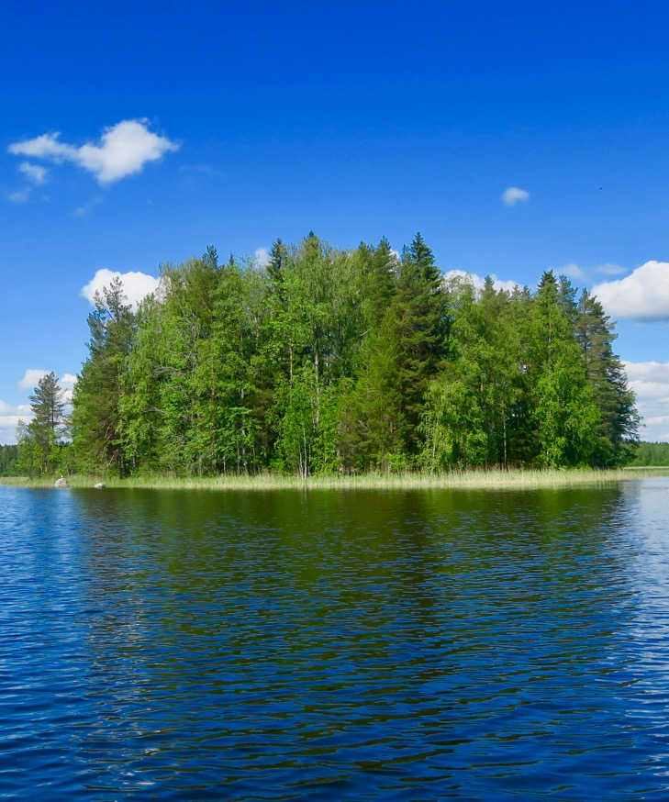
Finland: Sophisticated Policy Architecture for Gender Equality?
Government Action Plan for Gender Equality 2016-2019
30 measures that each ministry has responsibility to implement in their area of jurisdiction.
Work-life balance, equal pay and reduction of gender segregation in work and education.
A working group supports and monitors implementation.
Ministries must assess the impact of these measures on a regular basis.
Gender Equality Statistics
Published every second year by Statistics Finland.
Where are the Women Leaders?
Female rectors in 2017: 12.5%. (2 out of 16)
Female professors in 2015: 29% (728 out of 2513)
Academy of Finland: Research Council chairpersons and members: 50%
Academy of Finland funded professors: 31.7% (13 out of 41).

Slide 6
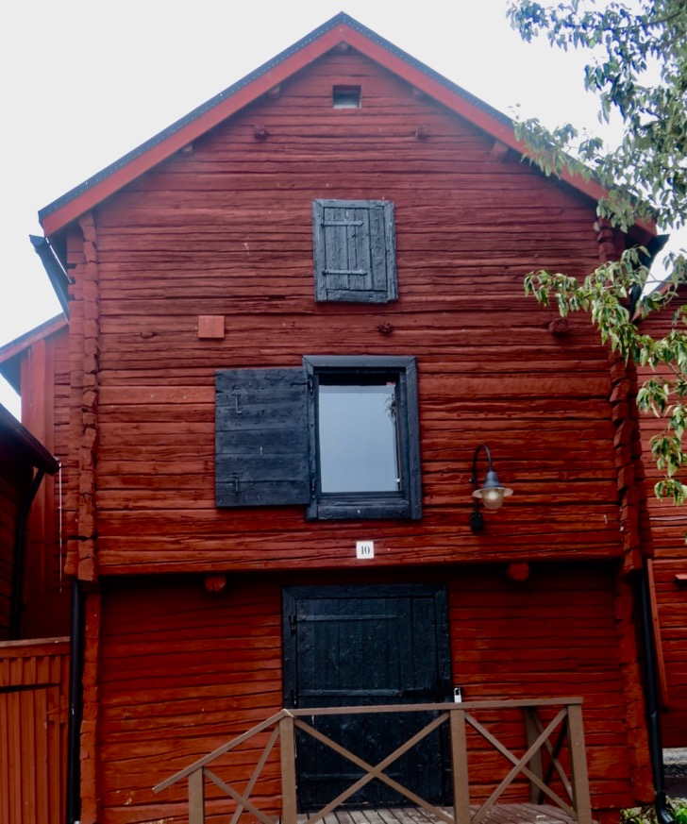
Methodology
10 semi-structured interviews with women university leaders in 5 Finnish universities.
Research directors, heads of department, deans and a vice-president.
Eight full professors.
Aged from 40-65; 9 heterosexual.
Disciplinary backgrounds in humanities, social sciences, business and technology.
Questions: interpretations, challenges, approaches, aspirations and perceptions of senior leadership.

Slide 7
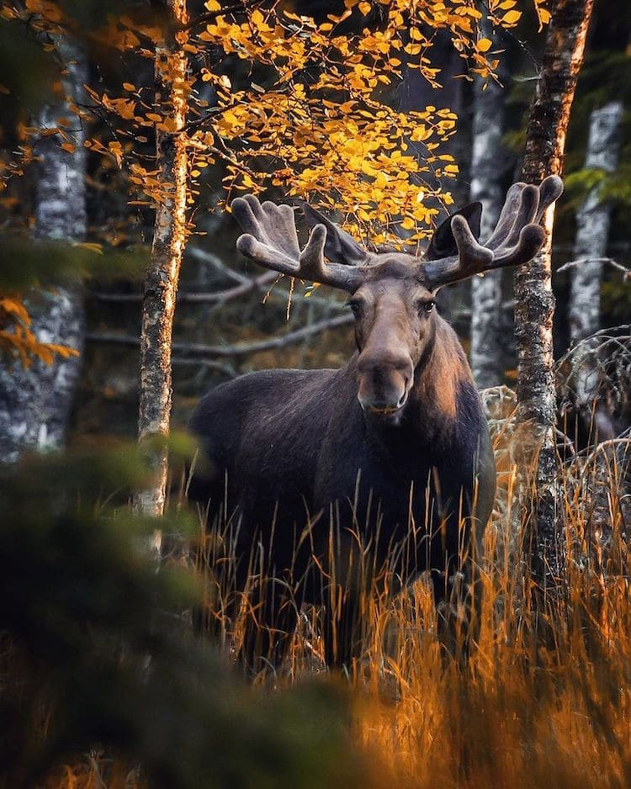
Disidentification
Uneasy sense of standing under a sign to which one does and does not belong (Butler, 1993: 219)
Distance from hegemonic or normative conceptions of what that identification might entail.
On the receiving end of the violence (symbolic or actual) inflicted by hegemonic norms.
Form of subversive performative citation or re-working of hegemonic norms, rather than simple opposition to those norms.
Question?
Do hegemonic norms of leadership get altered/ transformed / resisted by minority subjects/ occupants?

Slide 8

Findings: Affective Intensity
Navigating Neoliberalism/ Global Prestige Economy
Leadership = Anti-Intellectual/ Disruption of Scholarship/ Research
Ageism, Sexism and Chrononormativity
Neuroliberalism - Governing via Affect.

Slide 9
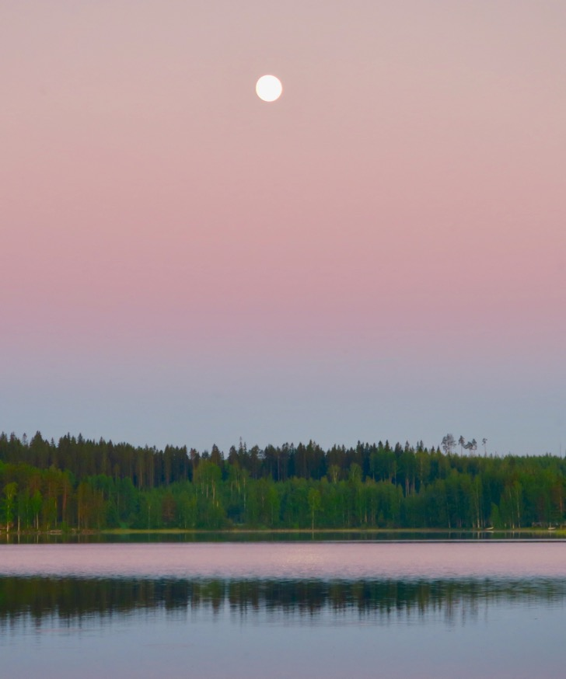
The Political Economy of Neoliberalism
Late Capitalist Economy (Deregulation/ Markets)
Globally Circulating Cluster of Policy Measures (Privatisation)
Cultural Regime/ Governing Rationality that Privileges Price and Profit (Financialisation/ Uberisation/ Unbundling/ Precarity/ Disposability/ Gig Economy)

Slide 10


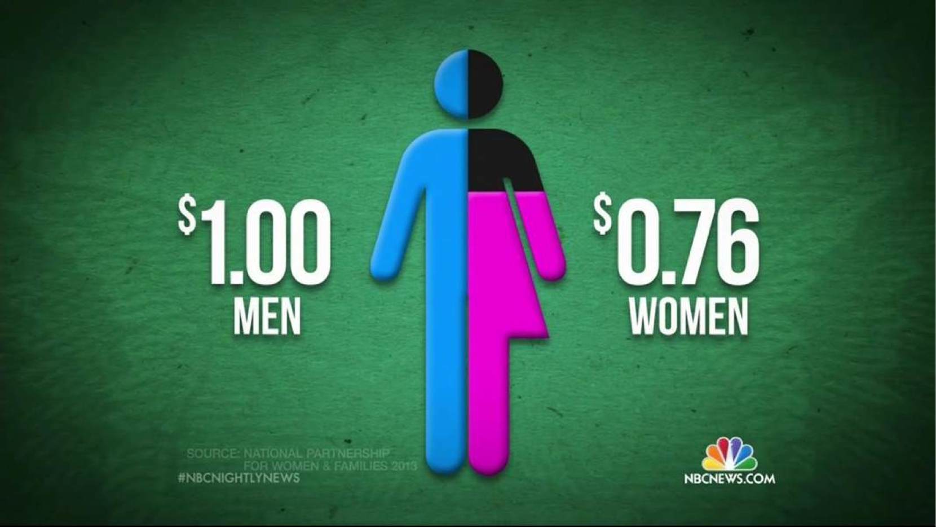
Provocations: Neoliberal Intellectual Culture is …
Making academic labour, activity and productivity intelligible via metrics and norms?
Eroding/ re-articulating counter-hegemonic knowledges?
Reducing leadership to the amplification of dominant messaging systems?
Creating and promoting ontological antagonisms?
Re-evaluating value?
Ironically producing critical texts!
(1000 academic articles between 2002-2005)
In a market calculus, what is not measured? Gender Equality?

Slide 11
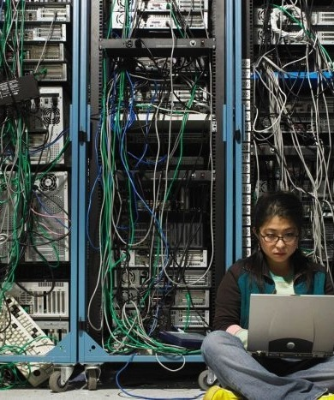
Entangling and Installing Neoliberalism in Higher Education
MATERIAL
Funding: linked to policy narratives/ priorities
Audit: condensed quality indicators
Employment Regimes: Performance pay/ tenure/ promotion = epistemic hierarchies.
DISCURSIVE
Truth-telling: peer review/ impact/ appraisal/ search agencies/ esteem/ reputation
Closure of the political universe/ TINA Effect
Performative Repetition
Reputation and Impression Management.

Slide 12

The Affective Economy
Drive for Distinction/ Differentiation
Crisis Discourse/ Disaster Capitalism/ Catastrophising
FOMO in Policy Formation
Affective Contagion/ Circulation
Shame/ Guilt / Pride / Fear/ Desire/ Happiness
How do these interact with structures of inequality?
Trial by public exposure
Success / Failure narratives
Competition erodes solidarity?
Neoliberalism cultivates and optimises differences
Passionate Attachment/ Pleasure
Rewards and Injuries.
Visceral reactions of the ’losers’.

Slide 13
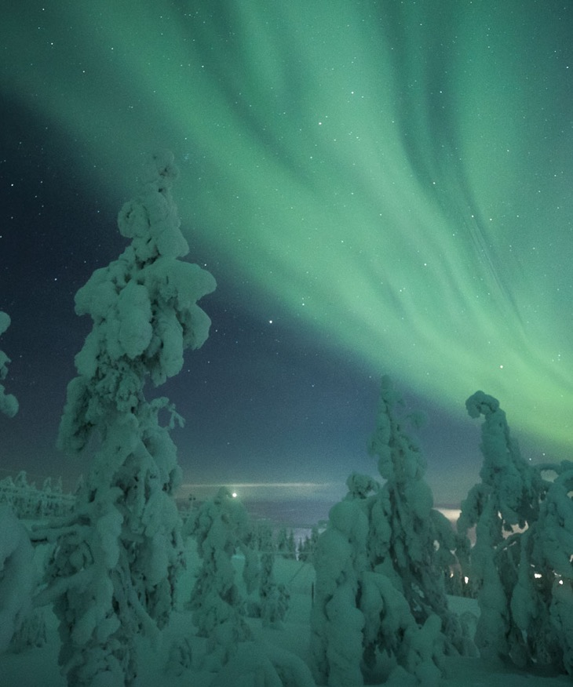
Neuroliberalism
Constellation of behaviourism, neuroscience and economics.
Neuroliberalism is ‘[a] rationality of government that takes its subject as the neurotic citizen and involves an orchestrated attempt to govern through neurosis.’ (Isin, 2004)
The coming together of neoliberal systems of government with psychological expressions of power and influence (Whitehead et al., 2017).
Desire to govern behavioural externalities AND internalities.
Structural problems solved by viewing them as behavioural.

Slide 14

Resilience
Embracing danger/ precarity/ austerity as inevitable.
Plasticity and Ontological Antagonisms: Contort rather than Challenge.
Responsivity over Signification.
Encouraging unhealthy practices – narcissism, self-promotion, boasting, attribution.
Mental Health = technologies of self-management - mindfulness, positivity.
Fragility and Vulnerability.
Welfare has slipped into wellbeing?
Question?
Distraction/ Displacement from policy failures?

Slide 15

Subverting Neuroliberalism:
Post-Heroic Leadership?
Feminist Change Interventions = Relational Leadership?
Mediating the toxic effects of competitive individualism and performance measurement?
Shifting the Performance Indicators
I think I have enjoyed it. I think it’s been nice... I mean a lot of this it’s domestic work. It relates to reproduction of the institution but a lot of it is also about community and building community and building a sense of belonging also to the institution (iv4).
I want the output to be them as great professors, not the output to be countable things in terms of research grant money (iv10).

Slide 16
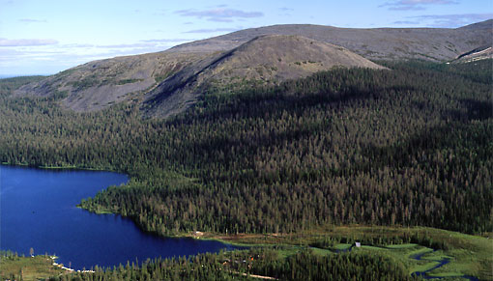
Ontological Antagonisms
and Interest Representation
On the one hand you had these neoliberal pressures that we have to perform … on the other hand you want to ensure that … people have time to breathe and don’t work so hard that they actually have a breakdown …how do you as a leader try to engage with that very difficult balance …because you have, two very different pulls? (iv2).
And I think for the most part those kinds of jobs are now constructed in such a way that feminists wouldn’t like to be part of it. …And I think that jobs are constructed in such a way that it becomes a part of a club that a lot of women just don’t want to be members of. And once you do join that club and become vice-chancellors and senior managers, they’re not sisters (iv10).

Slide 17
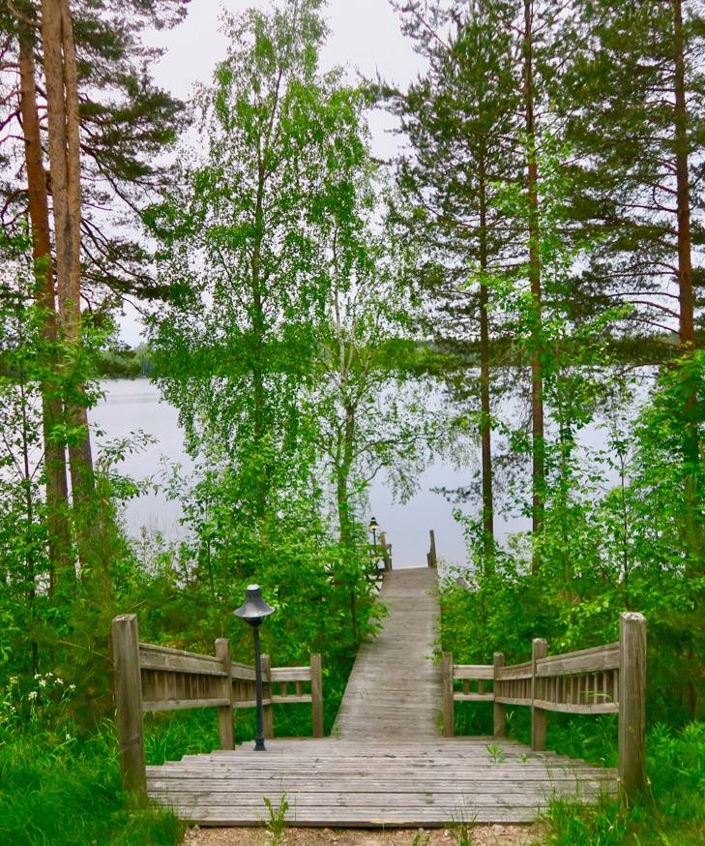
Gendered Discomforts
and Making a Difference?
Changing the affective economy
Mentoring, soothing, reassuring, and cognitively restructuring women who have been damaged by the psychic life of gendered power.
Modelling (heterosexual) work/life balance.
Undoing/ de-emphasising neoliberal performance indicators e.g. scholarship rather than entrepreneurship.
Policy/ Structural change? Less so.

Slide 18
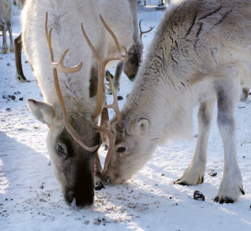
Desire to Disidentify:
Political Economy of Neoliberalism vs. Feminist Utopianism
I think probably if (universities) hadn’t been through the process of transformation they’ve been through in the last 30 years, I would have had a very different career trajectory and I’m someone who might well have been a vice-chancellor by now. (iv10)
Question?
Can there be a counter-identification of a post-gender (and post-neoliberal) utopia that incorporates multiple alternative futurities?

Slide 19

Leadership Disrupts Intellectual Work?
Structural and Visceral Loss/ Melancholia
I’m a researcher by heart. I know that. And that is …why I get stressed is that I would like to do research myself, and write myself (i/v1).
I think that very many people that I know complained about these kind of administrative tasks are so, take so much of your time and there’s so little time for research (iv7)
Questions?
Can leadership be scholarly?
What counts as intellectual work? Projectisation? (Brunila & Hannukainen, 2017)
Intellectualism = Entrepreneurship/ Knowledge Capitalism?

Slide 20

Chrononormativity
The use of time to organise individual human bodies toward maximum productivity.
The temporal ordering of time reflects a logic of (hetero)normativity that delimits difference.
Temporality = a tool and marker of power (Freeman, 2010)
Work/Life Balance = biological, reproductive and family time as heteronormative time/space constructs.
Question?
Women = always the wrong age?

Slide 21

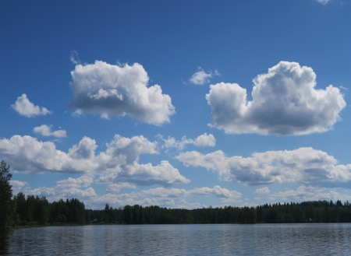
Chronobiopolitics and Temporalised Bodies: Socially Reduced to a Misreading of One’s Body
Older Women
Redeemers/ Enablers of Future Generations
I have that kind of a mentor role but like a, respected elderly professional’s mentor. I think that the younger, they come and ask from me, for example, advice to the career issues (iv 1).
Aged by Culture
A retired colleague of mine … she told that I know a way how you stay visible. And one way is to have always beautiful young doctoral students around you (iv1).
Bedblockers
We for example decided to take one, professorship and make two posts for young researchers (iv9).
Younger Women
Reprofuturity
Women of a certain age… of the fertile age are not necessarily recruited (iv4).
Lack
… there’s a strong perception of being a young woman. People treat you in certain way …In a way that you have to prove your expertise and your capabilities (iv3).
Anxious
They get really nervous and stressed…’nobody would ask ever again if I don’t say yes to writing this or joining this project’ (iv10).

Slide 22

Questions: Leadership
as a Counternormative Force?
What ways of knowing can allow us to think differently about gender and leadership?
What conditions of possibility exist for feminist leadership?
How to shift from a politics of representation to i.e. counting more women into neoliberal universities to a politics of vision, and indeed, of hope?

Slide 23

Making Alternativity Imaginable:
How Can We ….
Identify new lexicons/ vocabularies for intersecting gender and leadership.
Align imaginations/ concepts/ actualisations for women leaders?
Imagine, exchange knowledge and research the future of gender-free universities that we want to see.

Slide 24
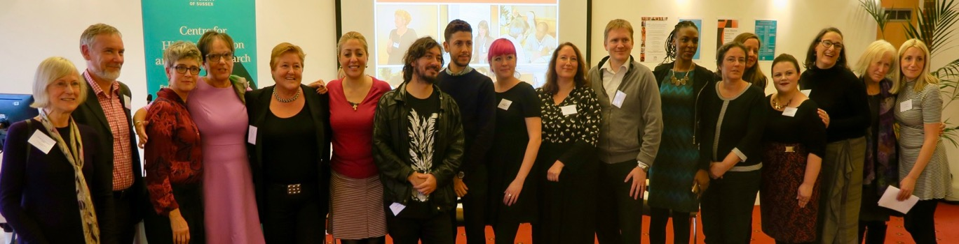
Follow Up?
Morley, L. & Crossouard, B. (2017) Women in Higher Education Leadership in South Asia: Willfulness and Willingness. In, Morley, L. (ed) Europa World of Learning 2017 Essays on Gender Equality. London: Routledge.
Morley, L. and Crossouard, B. (2016). "Gender in the Neoliberalised Global Academy: the Affective Economy of Women and Leadership in South Asia." British Journal of Sociology of Education 37(1): 149-168.
Morley, L., & Crossouard, B. (2016). Rejection, Refusal, Reluctance, Revisioning: Women in Higher Education Leadership in South Asia. Studies in Higher Education. 46(5), 801-814.
Morley, L. (2014) Lost Leaders: Women in the Global Academy. Higher Education Research and Development 33 (1) 111–125.
Morley, L. (2013) "The Rules of the Game: Women and the Leaderist Turn in Higher Education " Gender and Education. 25(1):116-131.
Lund, R. (2018). The Social Organization of Boasting. Gender and Education. https://doi.org/10.1080/09540253.2018.1482412
Lund, R. & Tienari, J. (2019) Passion, Care and Eros in the Gendered Neoliberal University. Organization. 26(1), 98-121.
Lund, R., Merilainen, S. & Tienari, J. (2019) New Masculinities in Universities? Discourses, Ambivalence and Potential Change. Gender, Work and Organization. https://doi.org/10.1111/gwao.12383
CHEER Website: www.sussex.ac.uk/education/cheer Twitter: @SussexCHEER
Facebook: www.facebook.com/groups/CHEERSussex/

