Slide 1

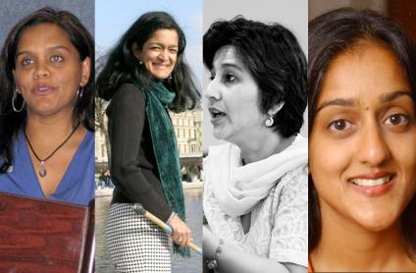
Women in Higher Education Leadership in South Asia:
Rejection, Refusal, Reluctance, Revisioning
Diversity, Democratisation and Difference: Theories and Methodologies
Professor Louise Morley
Centre for Higher Education
and Equity Research (CHEER)
University of Sussex, UK
http://www.sussex.ac.uk/education/cheer

Slide 2
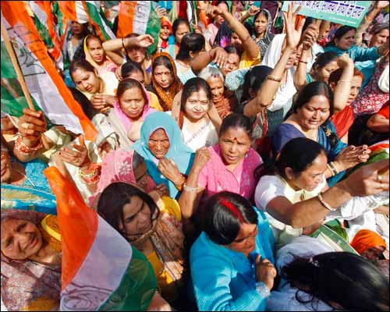
Provocations: Identifying Women Leaders
What is it that people don’t see?
Why don’t they see it?
What do current practices reveal and obscure?

Slide 3
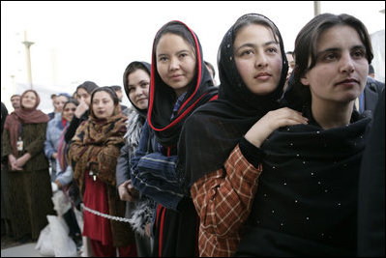
A Two-Way Gaze?
How are women being seen e.g. as deficit men?
How are women viewing leadership e.g. unliveable lives?

Slide 4
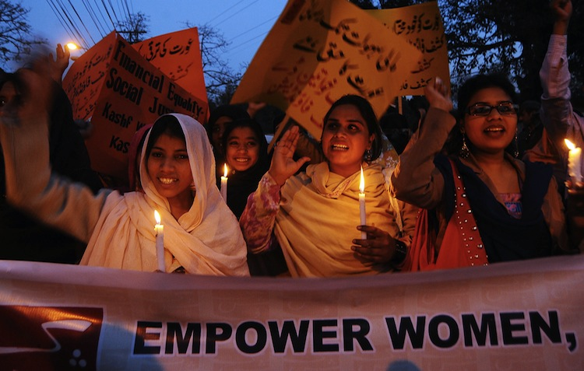
Evidence
Literature and Policy Review
Statistical Review
30 Interviews
(19 women and 11 men) Afghanistan, Bangladesh, India, Nepal, Pakistan, Sri Lanka.
What makes leadership attractive/unattractive to women?
What enables/ supports women to enter leadership positions?
Personal experiences of being enabled/ impeded from entering leadership?

Slide 5
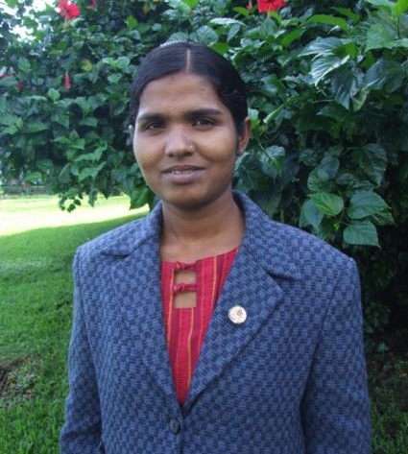
Higher Education in Nepal
Higher Education sector = expansion
(Sijapati, 2005)
Over 55% of the population under 25 (Glencorse 2014)
Policy focus on Quality/ STEM
No female Vice Chancellors
No attention to women or gender in the UGC Nepal Annual Report
Lack of gender-disaggregated statistical data
Ranked 112 out of 142 countries in the 2014 Global Gender Gap Report (WEC, 2014)

Slide 6
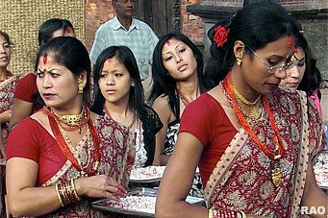
Barriers to Women's Access to Senior Academic Posts
Political appointments.
Promotion criteria.
Strong family obligations.
Low level of girls’ education.
Lower salaries than men.
Geographical barriers.
Men are in the majority in teaching positions.
Lack of implementation of gender responsive policies and programmes.
Lack of control over budget and decision-making power.
More career interruptions than men.
Less mobility than men.
Less access to resources for research work.
Lack of technological development.
(International Federation of University Women Report 2013),

Slide 7
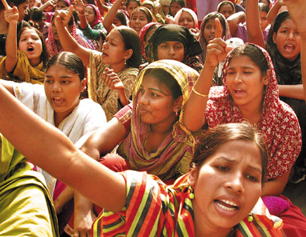
Where are the Women in South Asia?
Lack of Gender-Disaggregated Statistics
No linear trends in women’s representation
Numbers of female academics have increased
Gender distribution of male to female academics unchanged
Significant differences by disciplinary field of studies
Absent from Senior Leadership

Slide 8
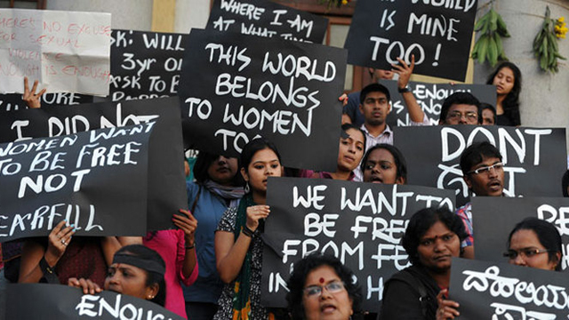
Policy Silences
Gender = category of analysis in relation to female students, not staff.
Quality, not Equality = knowledge economy, good governance, STEM, digital economy.
Lack of Research-based Evidence.

Slide 9
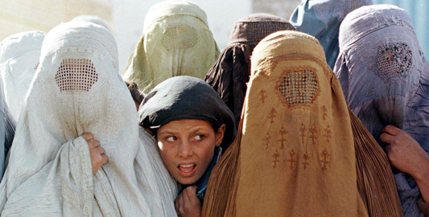
Narrating Difference
Recruitment and Selection
(Political/lacking transparency)
Passionate attachment
(Disciplines/ research)
Authority
(Does not ‘stick’ to women)
Gendered Divisions of Labour
(Women = domestic domain)
Exclusionary Networks
(Male Domination/ sexual propriety)
Hostile cultures
(Toxic/ stressful)

Slide 10
Gendered Cultures
The men they also do not like the female to be a leader, that I have also faced the problem…They want to see the male as the leader, not the female.
(Female Dean, Nepal)
I have presented three papers abroad… People get jealous instead of feeling pride that’s she growing…I realised that people are so jealous of people who, especially women, who were growing and getting out of the institution. (Female Senior Lecturer , Pakistan)
There is not closed culture for the men, they are free to go outside but the
women cannot because it’s prohibited in some place of my country, for the
women go alone abroad without their husband.
(Female Vice Dean, Afghanistan)
You have to keep proving every time yourself okay? Whereas somebody sits in that position of power, he need not prove, but a lady has to prove every time.
(Female Director, India)
One of our PVCs dresses quite flamboyantly… you know, wearing trousers is frowned upon in the university... So now, when she applied for the VCship, she stopped wearing trousers and got a sari. So I want a place where you don’t have to make such choices, make such compromises. (Female Professor, Sri Lanka)
You know a woman if she’s networking and lobbying then immediately she’s branded as being very ambitious and very pushy.
(Female Pro-Vice Chancellor , Bangladesh)

Slide 11
Barriers Enablers
Internationalisation
Policies
(affirmative action, gender mainstreaming, work/life balance)
Women-only Provision
(leadership development/ universities)
Mentoring
Professional Development
Family
Evidence
(Research/ Gender-Disaggregated Statistics)
The Power of the Socio-Cultural/ Gender Appropriate
Social Class and Caste
Lack of Investment in Women
Organisational Cultures
Perceptions of Leadership
Recruitment and Selection
Family
Gender and Authority
Corruption

Slide 12
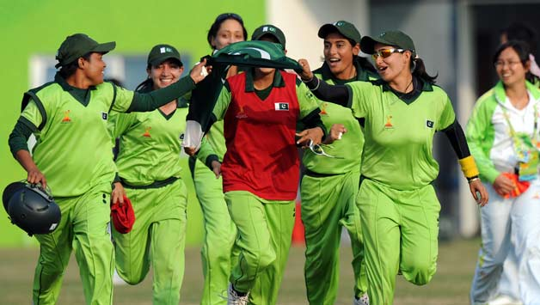
Moving On
Women are
Rejected
Refusing/ Self Excluding
Reluctant
Change
Not counting more women into existing structures/ systems
Need for
Revisioning of Leadership

Slide 13
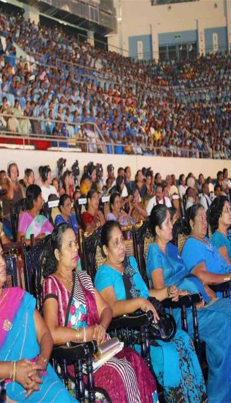
Follow Up?
Morley, L. & Crossouard, B. (2015) Women in Higher Education Leadership in South Asia: Rejection, Refusal, Reluctance, Revisioning. Pakistan: British Council.
Morley, L. (I2014) Lost Leaders: Women in the Global Academy. Higher Education Research and Development 33 (1) 111–125.
Morley, L. (2013) "The Rules of the Game: Women and the Leaderist Turn in Higher Education " Gender and Education. 25(1):116-131.
Morley, L. (2013) Women and Higher Education Leadership: Absences and Aspirations. Stimulus Paper for the Leadership Foundation for Higher Education.
Morley, L. (2013) International Trends in Women’s Leadership in Higher Education In, T. Gore, and Stiasny, M (eds) Going Global. London, Emerald Press.

