Slide 1
Widening participation in Sweden from a Gender perspective
Associate professor • Caroline Berggren • dep of education and special education

Slide 2
Who Wants Widening Participation?
Parents
Government
Higher Education
Employers

Slide 3
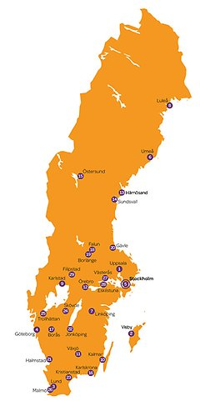

Slide 4
What level to target for successful WP?
Individual – men
Institutional – departments or institutions (university – university college)
Societal – the educational system, and location of higher education institutions

Slide 5
Individual
A large group of working class men do not study at HE
Many women study at HE, also those from less schooled family background
But is this actually a free, individual choice?

Slide 6
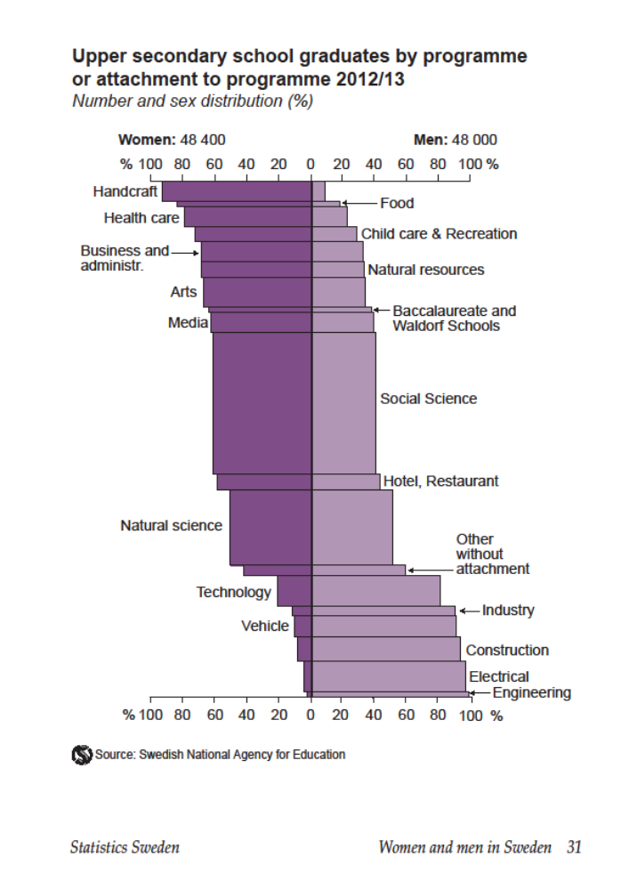

Slide 7
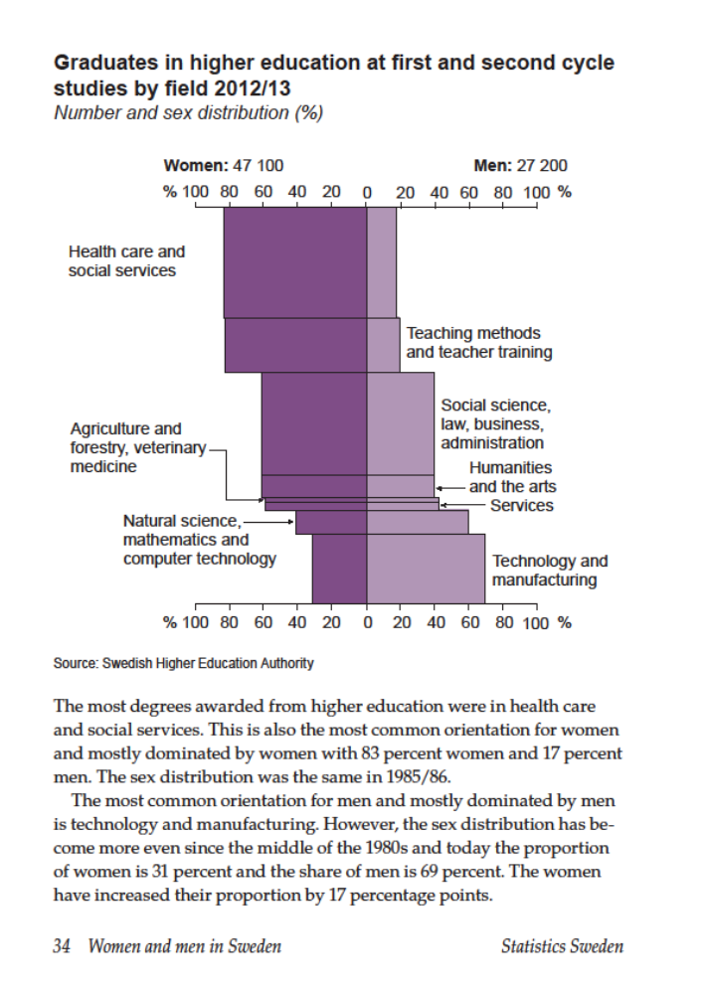

Slide 8
Institutional
Departments
Examples of unsuccessful positive discrimination
Law – second generation immigrants
Psychology – men, veterinary medicine – men
Institutions
Compare Uni of Gothenburg with Chalmers Uni of Technology
Compare Malmö university college with Lund University

Slide 9
Societal
Structure of the educational system
Admission quotas
Financial Aid and Student Fee

Slide 10
Educational system
Comprehensive elementary school 1962
Comprehensive upper secondary school 1970s
Expansion of HE 1977 - inclusion of training schools into HE university -> higher education
Municipal adult education 1970s
Swedish Scholastic Aptitude Test, SweSAT 1977
Free pre-school for six year olds 1975
(not included in educational system yet)

Slide 12
Educational system
Upper secondary school 1994 – all eligible to HE
Swedish Scholastic Aptitude Test, SweSAT 1991 – all could take the test
Affordable/free pre-school for all children 1991 (1½ - 7 years)
Curricula for pre-school 1998 - included in the educational system

Slide 13
Educational system
Upper secondary school – vocational students not longer eligible for HE- 2011
Choice of subjects in grade 6 - 2011
Swedish Scholastic Aptitude Test, SweSAT
more study places allocated
Pre-school only 15 hours/week if parents unemployed or on parental leave

Slide 14
Solution
Merge men’s traditional programmes and education into higher education!

Slide 15
My Dreamworld for WP
Expand pre-school, free for all children, all ages irrespectively of parents unemployment or maturity leave
Increase prestige of pre-school teachers, by increasing their salary (a lot!) and by decreasing number of children in each group

