Slide 1
Why Should Women Lead Research?
CENTRE FOR HIGHER EDUCATION AND EQUITY RESEARCH
Professor Louise Morley

Slide 2

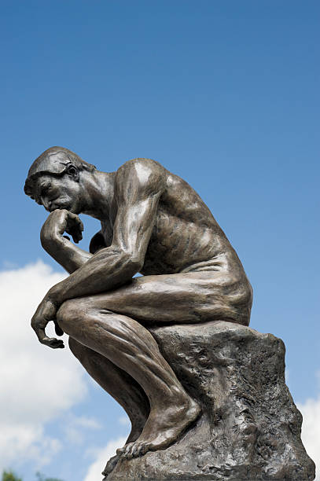

Provocations: Who is Entitled to Think?
How, why and where, and by whom is knowledge generated?
Who decides what counts as knowledge?
How can women be better represented as knowledge producers, rather than just as knowledge workers?
How do we make research authority ‘stick’ to women?
How can the inclusion of more under-represented groups in research leadership transform knowledge itself/ promote equalities?

Slide 3

Women’s Credibility Deficit
in the Global Research Economy
Women less likely to be:
Journal editors/cited in top-rated journals (Tight 2008)
Principal investigators (EC 2011)
Awarded large grants (Husu 2014)
Awarded research prizes (Nikiforova 2011)
Conference keynote speakers
(Schroeder et al. 2013)
On high salaries in STEMM research (New Scientist 2018)
= Misrecognition
= Epistemic Injustice

Slide 4

Gendering Authority
Men are nearly 4 times more likely to be quoted as experts in UK media
(Global Institute for Women's Leadership 2018)
The Politics of Citation (Ahmed, 2013)
See Tumblr’s Congrats, you have an all male panel!

Slide 5
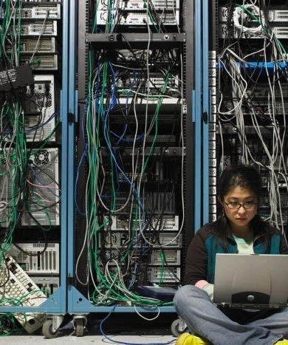
Entangling Gender and Research
Research makes the world intelligible in specific ways.
Women are participating unequally in the research economy through which social meanings and knowledge are generated.
Entanglement of under-represented groups and research is not just about access but also about knowledge itself.

Slide 6
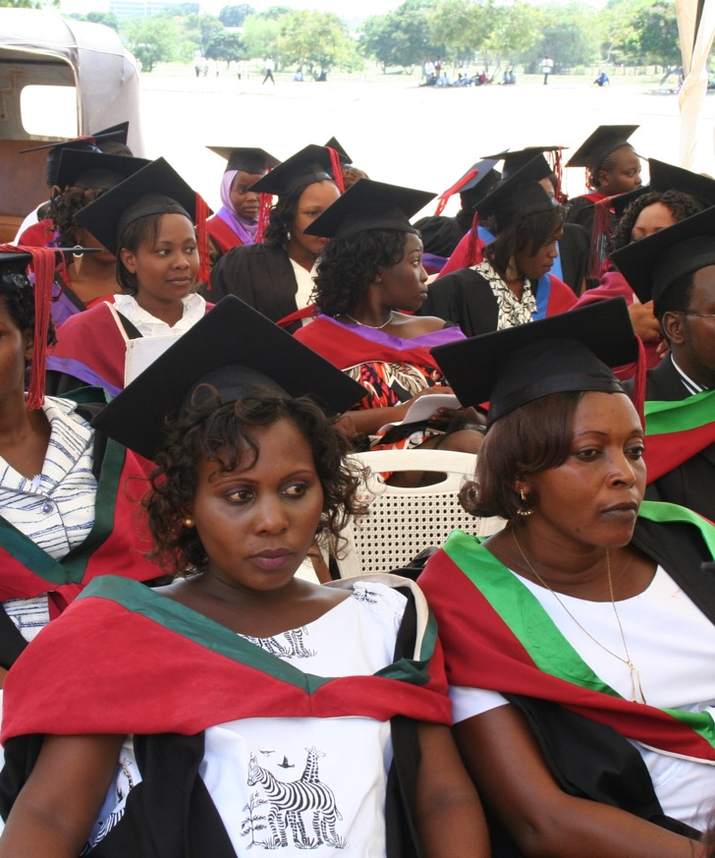
Unequal Geographies of Knowledge: Invisible Women and Southern Theory
Data Bias and Knowledge Gaps
Women in Britain are 50% more likely to be misdiagnosed following a heart attack:
(heart failure trials generally use male participants)
Speech-recognition software is trained on recordings of male voices.
(Google’s platform is 70% more likely to understand men) Criado-Perez, 2019; Rees, 2011).
Southern Theory/ Core and Periphery
Cognitive Inclusion of diverse voices and indigenous knowledges
Recognise social theory from societies outside the dominant European and North American metropole.
Eurocentric theory claims to universality.

Slide 7
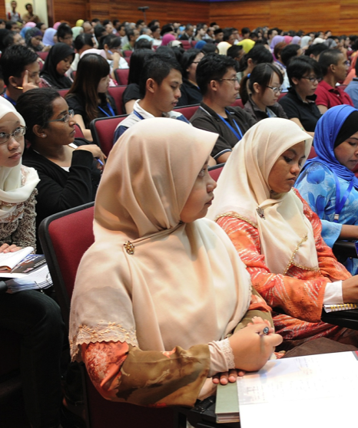
Gendered Opportunity Structures in the
Global Knowledge Economy
Knowledge:
Form of capital
A global commodity
Site of contestation and maldistributions.
Exclusion of certain:
Social groups
Ideologies
Methodologies
Produces:
Epistemic/ Material exclusions
Normative reproduction
Intellectual closures
Repetition of privilege

Slide 8

Inclusion = Representational Space?
Counting more under-represented groups into existing systems, structures and cultures = an unquestioned good (Morley, 2012, 2014, 2015).
Under-represented group(s) = access, smart economics, disadvantage and remediation.
Products, processes, services, excellence = neutral.
Power and privilege = under-theorisation.
Redistributive justice measures = social engineering.
Equity / Affirmative Action = threat to excellence and justice.

Slide 9

Challenges for Women in the Global Research Economy
Europe: Recasting Identities of the Roma, as producers, rather than objects of inquiry/ crisis of representation (Morley et al, 2018).
South Asia: struggle to establish research careers/ university leaders (Morley and Crossouard, 2016).
Malaysia: gendered division of labour (Morley et al. 2016).
East Asia: misrecognition/ research authority does not stick to women (Morley, 2015)
Finland: anxiety over research productivity in the neoliberal economy/ contracts (Morley and Lund, 2019).

Slide 10

Contextual Challenges
The Political Economy of Neoliberalism
Knowledge Capitalism/ Market Orientation/ Dominance of Economic Interests
Financialisation of Research
Metrification - performance indicator in the audit society/ global league tables/ individual career progression
Research and the construction and destruction of academic identities
Projectisation/ contractualisation - fracturing/ fragmenting knowledge into fundable projects
Technologisation - emphasis on what works
Precarity - labour force on short-term contracts.

Slide 11
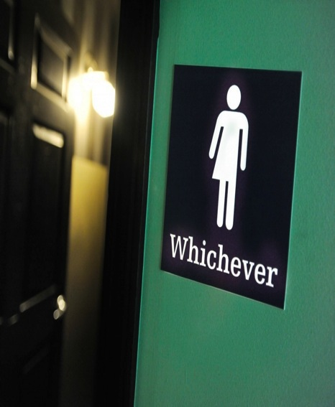
Gender Occupying Contradictory and Contested Spaces in the Global Knowledge Economy
Miniaturised
Gender not a performance indicator in the Global League Tables/ Prestige Economy.
Feminism appropriated by Neoliberalism (individual winners)
Post-Feminism
Magnified
Gender Pay Gap
MeToo and Time’sUp Movements
Diversity appropriated for corporate branding?
De-binarying/ Queering/ Trans awareness.

Slide 12
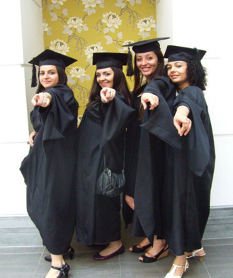
Our Tasks?
Increase representation
of women in knowledge cultures
Promote/ trouble gendering of knowledge
Apply gender research to social change.

Slide 13

Action for Change
Intersectionality - Increase the representation of women as research leaders + knowledge from diverse communities.
Reinforce the gender dimension e.g. how will the research benefit women in wider society?
Promote transparent procedures in the appointment of research gatekeepers.
Recognise/ Reward scholarship as intellectual and social, not just entrepreneurial.
Encourage knowledge exchange across diverse sectors, nations and disciplines.
Evaluate - hold to account and consider contract compliance.
Imagine and research the desired futures we want to see.

Slide 14
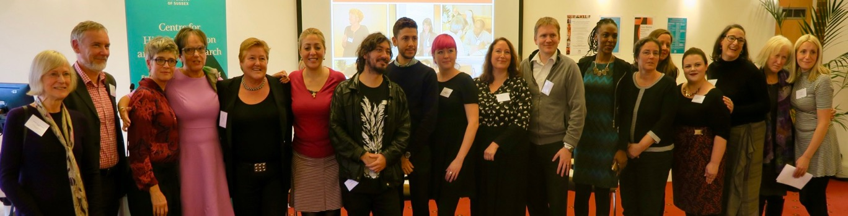
Follow Up?
Morley, L., Alexiadou, N. Garaz, S. González-Monteagudo, J. Taba, M. (2018) Internationalisation and Migrant Academics: The Hidden Narratives of Mobility. Higher Education. 76 (3): 537–554.
Morley, L. (2018) Gender in the Neoliberal Research Economy: An Enervating and Exclusionary Entanglement? In, Kahlert. H. (Ed.) Gender Studies and the New Academic Governance. Global Challenges, Glocal Dynamics, and Local Impacts. Wiesbaden: Springer VS (pp. 15-40).
Morley, L. and Crossouard, B. (2016). Gender in the Neoliberalised Global Academy: the Affective Economy of Women and Leadership in South Asia. British Journal of Sociology of Education 37(1): 149-168.
Morley, L. Berma, M., and Dato' Hj Abdul Hamid, B. (2016) Managing Modern Malaysia: Women in Higher Education Leadership. In, Eggins, H. (Ed) The Changing Academy – The Changing Academic Profession in International Comparative Perspective. Dordrecht: Springer Publications: 137-154.
Morley, L. (2015). Troubling Intra-actions: Gender, Neo-liberalism and Research in the Global Academy. Journal of Education Policy 31(1): 28-45.
CHEER Website: www.sussex.ac.uk/education/cheer
Twitter: @SussexCHEER
Facebook: www.facebook.com/groups/CHEERSussex/

