Slide 1
Which Inequalities Have Surfaced/ Been Reinforced by the
Pandemic Crisis?
CENTRE FOR HIGHER EDUCATION AND EQUITY RESEARCH
Professor Louise Morley
COVID-19, Women and Governments Webinar,
University of Malta, July 2020

Slide 2
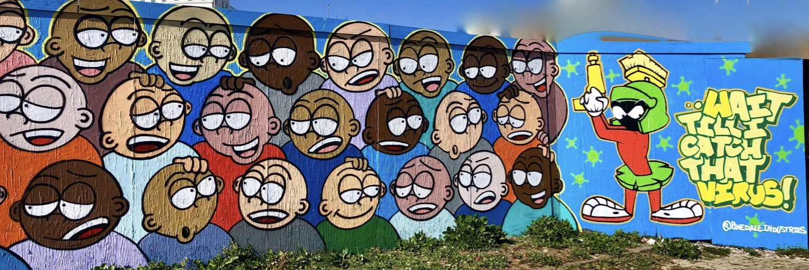
COVID-19
Exposed the fragilities of neoliberal capitalism/ crisis injustice – welfare services.
Reinforced necropolitics - whose humanity counts? Whose lives matter?
Infected relationships, infrastructures, mobilities, networks, activities, cultures, and mental health as well as bodies.
Revealed priorities, values and maldistributions: unevenness in access to education, healthcare, housing, and nutrition.
Normalised structures of intimacy as long-term monogamous relationships in which partners share living space.
Emphasised the potency of the post-human e.g. digital, screens, masks, visors, water.
Amplified and coincided multiple crises e.g. Black Lives Matter; Climate Change; Decolonisation; fragile states; conflict; border crossings.
Created an affective economy that circulates fear, anxiety, loss, frustration, insecurity, trauma.
Highlighted absurdity of our previous modus operandi – The Great Pause.

Slide 3
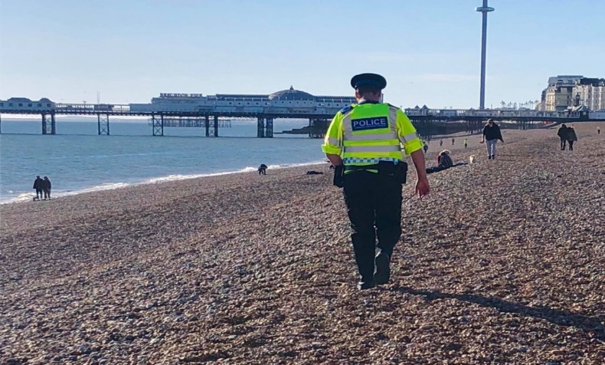
An Assemblage of Gendered Forces: Which Women?
Retraditionalised heteronormative constructions of the household.
Responsibilised women with childcare, elderly care, home schooling, hygiene (OECD).
Invisibilised communities e.g. LGBTQAI+. Women = heterosexual mothers.
Ignored intersectionality and diverse agentic capacities - BAME, class, disability, trans.
Homogenised category of vulnerability- ageist and racist discourses of risk/‘the other’.
Disrupted Public/ Private Boundaries- employers requisitioned homes/ personal spaces; assumes resources. Home as a gendered site, with leisure-work-care-assemblages. Living at Work, rather than Working from Home.
Created preconditions for domestic violence - women locked down with abusers/ support services closed/ immobility. Home as a safe/ frictionless place to retreat from contagion?
Silenced gender equality initiatives e.g. suspension of EP committees; roll back on reproductive (Poland), trans (Hungary, UK GRA) rights.
Reasserted authority as male - lack of women experts/ scientists.

Slide 4


Public Health v the Economy Binary
Sacrificed women’s careers and economic viability to provide care at home. In Europe and North America, working women contribute 35% - 45% of their country’s GDP. 740 million women globally work in the informal economy.
Slowed women’s economic progress - half a century (UN, the World Economic Forum).
Endangered women on the frontline - 79% of healthcare workers in the UK are women.
Revealed the Gender Pay Gap (18% to 45% in the UK), and industry segregation.
Disposed of women who are precariously employed - Gig Economy. Mothers 47% more likely to lose jobs than fathers (Institute of Fiscal Studies), and more likely to be furloughed and hours cut back 50% more.
Ignored how British women take more places at university, get better grades, graduate at higher rates and go on to postgraduate work more often than men.

Slide 5
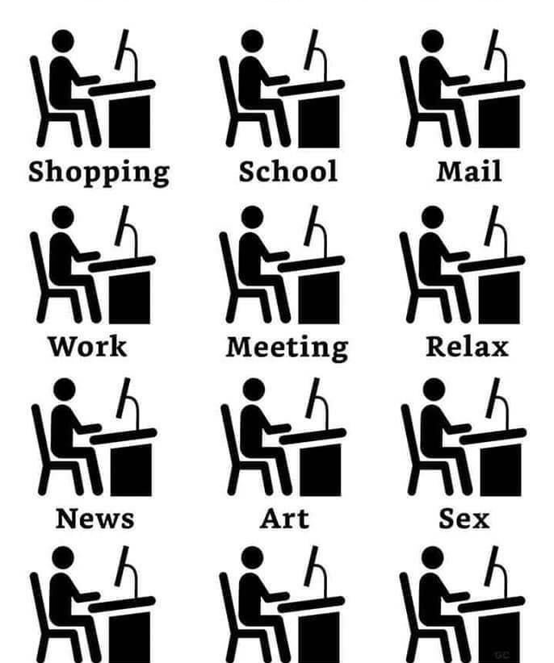
What New Land Do We Inhabit?
Shifting temporalities and contingencies- stillness- Zen- staying with the present/ trouble.
Snapping Points and Resistance.
Slowing down in the Post-mobility world – implications for internationalisation – valorising the local without parochialism and nationalism.
Maintaining global coalitions and nomadic thought.
Reflecting/Acting to create the gendered order that we want to see?
Renewal, rather than returning to pre-pandemic ‘normality’.

Slide 6
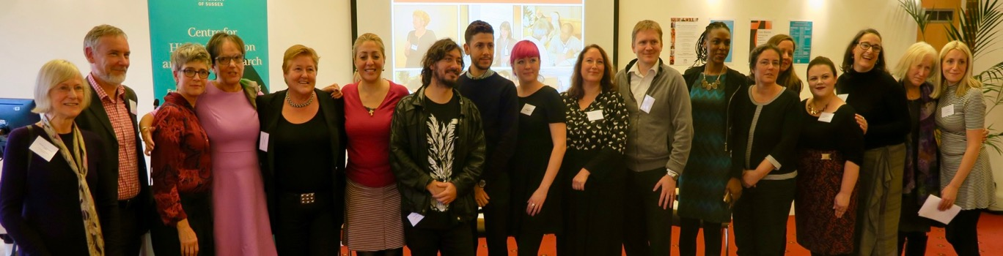
CHEER Website: www.sussex.ac.uk/education/cheer
Twitter: @SussexCHEER
Facebook: www.facebook.com/groups/CHEERSussex/

