Slide 1
Transitioning within and between doctoral spaces for writing and knowing
Dr Rebecca Webb R.C.Webb@sussex.ac.uk
with Dr Tamsin Hinton-Smith j.t.hinton-smith@sussex.ac.uk
and Dr Emily Danvers e.danvers@sussex.ac.uk
Notes:
Transitions to becoming an academic researcher are shaped through complex trajectories of different lives and experiences. This paper explores the possibilities of one writing group for social science doctoral researchers in supporting processes of writing and ‘coming to know’. Drawing on the work of Gordon (2008), on ‘haunting’ to deconstruct ideas of ‘internationalness’, it questions the possibilities of the group as a means to intervene in a range of transitions throughout the life course of the doctoral journey. In so doing, it draws, particularly, on recent interview data concerning the ways in which ‘international’ students speak knowledgeably about their own experiences of academic writing in English in two universities in the UK. Initial analysis of some data, questions ways in which doctoral researchers feel adequately supported to transit between a range of language and cultural scripts. It also challenges normative assumptions of ‘good’ academic writing in ways that invoke doctoral student’s legitimacy as knowers in ways that must be taken seriously.
Gordon, A. (2011) Some Thoughts on Haunting and Futurity, borderlands, 10, 2, 1-21

Slide 2
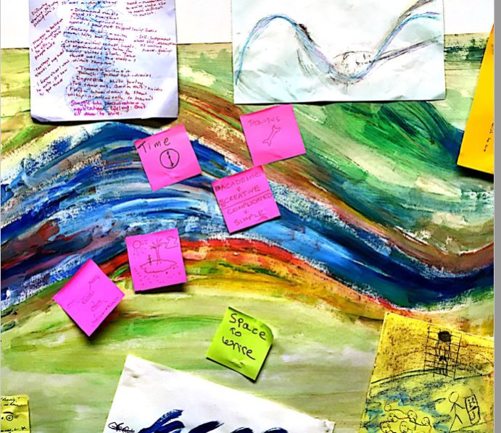
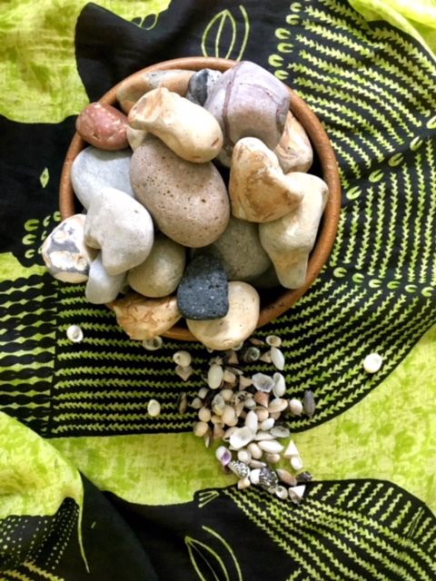
Writing into Meaning
Notes:
Introduce you to a writing space for doctoral researchers called Writing into Meaning’. It is a writing group for doctoral and early career researchers to explore and develop their academic writing in a supportive democratic environment in which there are always opportunities for writing and then talking about the process of writing within each session. Originally it had been imagined that the group would very much focus upon those doctoral researchers at that tricky stage of returning from field work – often at the end of the third year – and transitioning into full-on writing immersion (often conceived as the ‘writing up’ stage). Fascinatingly, this is not quite how the group has functioned – doctoral researchers at different points in their doctoral writing journeys have accessed the group and for different reasons. This has helped us to conceive of the idea of ‘transitioning through and between – much more of a transitioning meander rather than a series of straight lines or clearcut hops of leaps from one thing to another.
In fact the group has rather developed legs and goes outside the confines of ESW – we now offer the writing group as part of the researcher development programme as part of the doctoral school, and also run sessions for Free University Brighton to which doctoral researchers are most welcome, and also operate the group with colleagues in other universities in the UK and Japan, Nigeria and Germany. The image on the left is taken from an ‘River of Life’ activity where writers explored aspects of their writerly identity at different points in their life course and the image on the right suggests a ‘free writing’ activity with which we sometimes start a session where we select a pebble to hold and to act as a focus in order to centre and focus in a relaxed and mindful way.
So the ideas on which we touch in this presentation have grown out of interviews with 19 doctoral researchers and open focus group. Many of those interviewed either came to the writing group regularly or had dipped in and out and others had not. The focus group had all experienced the writing group.
All those interviewed were asked about questions relating to their status as ‘international ‘ students so recognized by the university because of their particular status as not permanent citizens of the UK. We’d had some small grant funding to conduct this research which was designed to ascertain whether their were particular needs and challenges of ‘internationalness’ that the University of Sussex was not meeting – and should – in terms of support for writing – after all an integral dynamic of being a doctoral researcher.
We are indebted to Dr Marta Paluch for not only conducting many of the interviews but in also collating and offering her perspectives on much of the data and the issues and the themes that emerged.

Slide 3
The international as ‘haunted’ signifier
One interviewee refers to ‘being caught between places’ as an international student…. They talk about wanting to challenge what they see as the imperial dominance of English writers in the doctoral writing process whilst also recognising the value and influence on them of some writers, saying: ‘this is uncomfortable’.
The same interviewee also talks about writing [in whatever language] as a ‘changing process’, dependent on one’s emotional context.
They acknowledge ‘English’ giving ‘validation to writing in other languages’. They also recognise that they are able to appreciate the way power circulates in discourses of academic writing – at a sophisticated level - as a consequence of being an international student: ‘in this sense it has been a productive experience’.
Notes:
So in theorising this short presentation and in presenting some data with which to think we have worked with two papers predominantly that have enabled us to interrogate a range of ideas of transitions for doctoral writers where these encompass significant movements from ‘stage to stage’ during the doctoral journey – moving on from the proposal, being given permission to go to the field, completing a first full draft, submitting a final thesis , and then revising thesis after the viva voca. But others focus on transitions which are more subtle: momentary (these could occur within the writing group itself) or rather ephemeral (feeling lost and directionless one minute in the writing process and then hitting on an idea or a phraseology the next in order to feel empowered to ‘move on’); or liminal – shifts or transitions that maybe don’t seem to be about either ‘moving on or moving back but that are about feelings of being out of place somehow and trying to fit in place. Indeed much of the writing that emerges within the writing group links to ‘finding a position from which to write’ in order to say whatever it is that the researcher wishes to say.
One paper from which we have derived a wealth of conceptual resources is that of Avery Gordon, ‘Some Thoughts on Haunting and Futurity’ in which – in an entirely different and altogether more urgent and precarious space – she interrogates the idea of ‘haunting’ as that which is concerned with ghosts not as those that are a thing of the past, but as those who are fore ever with us, appearing and ‘demanding their due’ at challenging moments where ‘the cracks appear’ and when disturbed feelings won’t go away. This spoke to us in terms of the ways in which those who were part of our research described their relationship with the term ’international’ as one of a ‘haunting’ signifier that creeps up on them in different forms at different moments as they think about how they wite and are represented in their writing.
In the quotes here

Slide 4
Translation as a site of transition
One interviewee discusses what they see as the ‘politics of exploitation and….of colonisation implied in the work of translating,’ whilst also speaking about the necessity of effective use of academic English in order for their supervisor to be able to understand their work. ‘The translation is for the benefit of the supervisor’ [not for the doctoral researcher or their research]
Other interviewees indicate just how much time is taken up by the issue of translation and the myriad of decisions translation engenders at different transition points in the doctoral journey. Interviewees discuss struggling over the ‘deeper meanings of words’ …’You feel that you’re not doing justice to the text, that you lose the essence, the richness of the excerpts’ [in translation from one language/dialect into English]
However, international doctoral researchers also recognise their skills and the potential future-orientated power of their position:
‘It’s a good use of my skills…to be able to access this world and make it then accessible for others who can’t otherwise access it…’ Some are aware of bridging worlds in ways that will benefit them in their future careers…
Notes:
Another paper on which we have drawn has been Anderson’s about the ‘international education agenda, focussing on the experiences of international women students in New Zealand as they transition through their doctoral degree Again, this paper has resonances for us in our own context as we have began to make sense of our interview data. One of the key themes that emerged from Anderson’s work focussed upon the unspoken discursive constructions of ‘new Zelandness’ and ‘international-ness’ and the challenges of cross-cultural navigation this posed for ‘international’ students: the assumptions students made and that were often made about them by the host nation/place/space of study about them.
In relation to cross-cultural navigation and transitioning through the doctoral degree, the problematisation of the idea of ‘translation’ has emerged time and time again in different ways through the data.
The first quotation from an interviewee captures both a sense of haunting referenced on the previous slide – past histories shaping the way they make sense of their present and possibly the future – as well as the complications of cross-cultural navigation of translation as an international student. Not only does this student recognise the centuries-old investments in the imposition of English academic writing customs and conventions on them, they also acknowledge that it is only through getting to grips with this that they and their supervisor are going to be able to communicate effectively throughout the doctoral degree process.
Subsequent comments and quotations align to other points made by Anderson in her paper in terms of what is involved in translating from one language to another which also comes with a financial cost to the international student. However a range of comments also focussed on the recognition of the privilege and power of the position of negotiating and surviving this transition a s international doctoral researcher in terms of generating global connections and in the power and possibilities for bilingual and trans-global academics in ways not open to monolingual or more nationally focussed ones and the need to hold in mind the contradictory discursive framing of the ‘international’ doctoral researcher in this regard.

Slide 5
Writing into Meaning (WIM) as a space of ‘safety’ or ‘risk’?
Many interviews highlighted the challenges of ‘translating cultures’ - both their own as doctoral researchers - but also the experiences and data gathered from their own country contexts to be ‘understood’ by their supervisors. One interviewee suggested that that ‘having a supervisor who knows the region where you are doing your research is important’. Another interviewee discussed a sense of a ‘barrier’ between them and a supervisor because the supervisor did not know the fieldwork context
‘Working and living in different contexts you find that every community has its own rules and that also works for academia. You have to learn what is important’
Interviewees also commented on the problems of translating the opaque requirements of them in terms of expectations of their academic writing. This emerged time and time again as a theme.
Notes:
In presenting some further data here from the interviews, we wanted to start to think about the implications of the data for the ‘Writing into Meaning’ project. The sentiments and direct quotations here suggest the challenges of establishing ‘the rules of the game’ within the discursive context of the ‘international’ doctoral researcher making sense of Anglophone and UK university and subject disciplining norms.
The first set of comments suggest the emotional and intellectual labour required for international students to transition and translate multiple cultural contexts of their own home culture and their understanding of their fieldwork culture in such a way that could then be ‘understood’ by the English supervisor in such a way that they could make progress together. In the comments here – as with the comments of Anderson’s interviewees, one can pick up on the levels of frustration experienced by doctoral researchers. The second comment explicitly refers to ‘learning what is important’
The third set of comments focussed very much again on frustration but also surprise in relation to language and translation – some interviewees felt let down by their own host country or region for not having taught them English academic conventions that seemed applicable in UK universities – writing conventions that were too descriptive and less analytic than what seemed to be demanded in their English university. But also international doctoral researchers also picked up from each other that their were different ‘codes’ of language between supervisors within their English host country which meant that the ‘rules of the games’ were very unclear to them.

Slide 6
Provocations arising….
We are aware of some of the benefits of the WIM space for some doctoral researchers regardless of the ways in which discourses of ‘internationalness’ (or otherwise) are constructed. Many doctoral researchers tell us that they have found it to be a space of positive endorsement; openness; welcome; serious interrogation of the process of writing; and they welcome the opportunity to write together alongside others.
BUT…..
In setting out to create a social and intellectual doctoral space that is about ‘uncertainty’, ‘emergence’ and gentle antagonism of academic writing norms do we sacrifice making explicit some tacit norms that might help ‘international’ students at different transition points in the doctoral writing journey? Do we pay sufficient attention to the ‘rules of the game’?
Notes:
This throws up some challenges for Emily, Tamsin and I as we think about the role of ‘Writing into Meaning’ as a productive and inclusive doctoral researcher space for writing where the ‘rules of the game’ can both be exposed but also challenged and we feel that this is something we need to think about further as a consequence of our initial readings of the data from this small research project.
How should we work with the tension posed by a reading of some of our data?
Can ‘not knowing’ always be constructed positively and powerfully if you feel that there are rules that ‘haunt’ and others that elude you?
We set out to provide the opportunity to transit into new places of self invention and discovery, but is this how some ‘international’ students experience the group?
In her article, Anderson discusses a Chinese doctoral researcher who explains that in her experience in China, you are familiar with the environment and you are familiar with all the people which means that you all head in the same direction even if you don’t know whether that’s the way you
want to be. The student suggests that if you are in a totally different environment, there is the possibility of being and doing things so differently in ways that may be alarming but also utterly revelatory…..
We therefore walk the tightrope between safety and peril within the WIM group with a view to supporting and yet energising all those who attend.

Slide 7
References
Anderson, V. (2008) The International Education Agenda: International and New Zealand Women Students Sites, New series 5(2), pp. 57-80.
Gordon, A. (2011) Some Thoughts on Haunting and Futurity borderlands, 10(2) pp. 1-21

