Slide 1
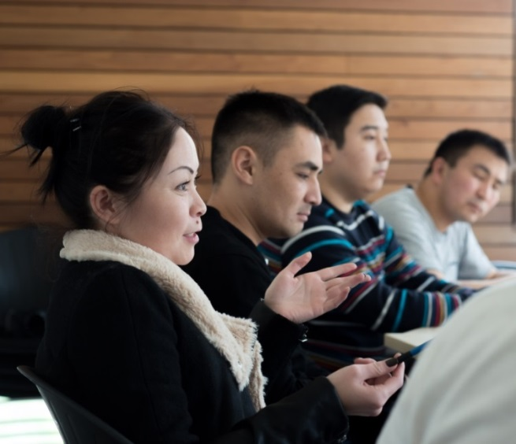
CENTRE FOR HIGHER EDUCATION AND EQUITY RESEARCH
Changing Learning: Learning to Change?
(Part of an international, postgraduate teaching programme)
Rebecca Webb

Slide 2
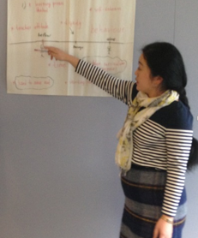
CENTRE FOR HIGHER EDUCATION AND EQUITY RESEARCH
What I Am Asking?
What does it mean to learn as a post-graduate student on an international teacher education programme in one university in the UK contemporaneously?
What does learning imply of the learner?
(Webb & Crossouard, 2015)
What is presumed of the power of learning to change?
(Bingham, Biesta and Rancière, 2010)

Slide 3
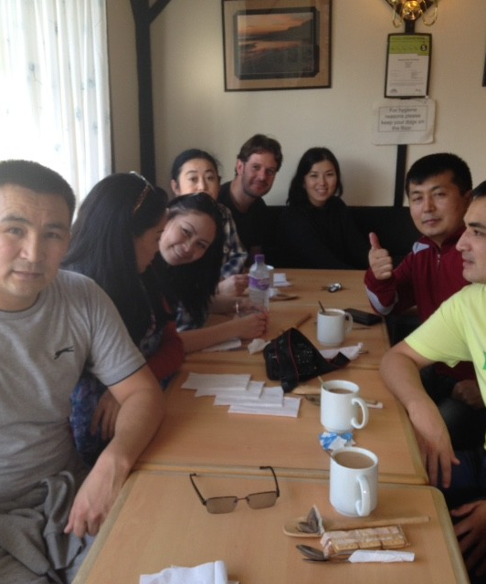
Subjects and Objects:
The Students? The Programme?
  SUBJECTS:
  Scholarship programme – Central Asian state
  ‘Expert teachers’ of mathematics, physics, chemistry, biology and English
  Development of professional, pedagogic, academic and English language competencies
  Transference of knowledge from one country to networks of schools and informing wider policy ‘change’ agenda
  OBJECT:
  Post-graduate International Education Diploma Programme – ‘professional’ and ‘academic’.

Slide 4
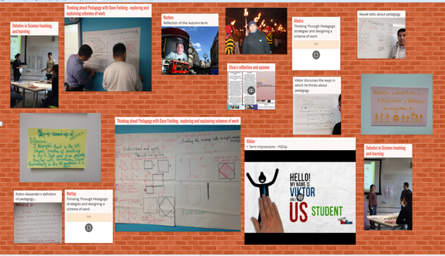
CENTRE FOR HIGHER EDUCATION AND EQUITY RESEARCH
Configuring An ‘Ethnographic’ Interview Methodology
Inviting students to interrogate a ‘‘Padlet’ Sharing Wall’
to facilitate in a dialogue on ‘learning, ‘the learner’, ‘change’

Slide 5
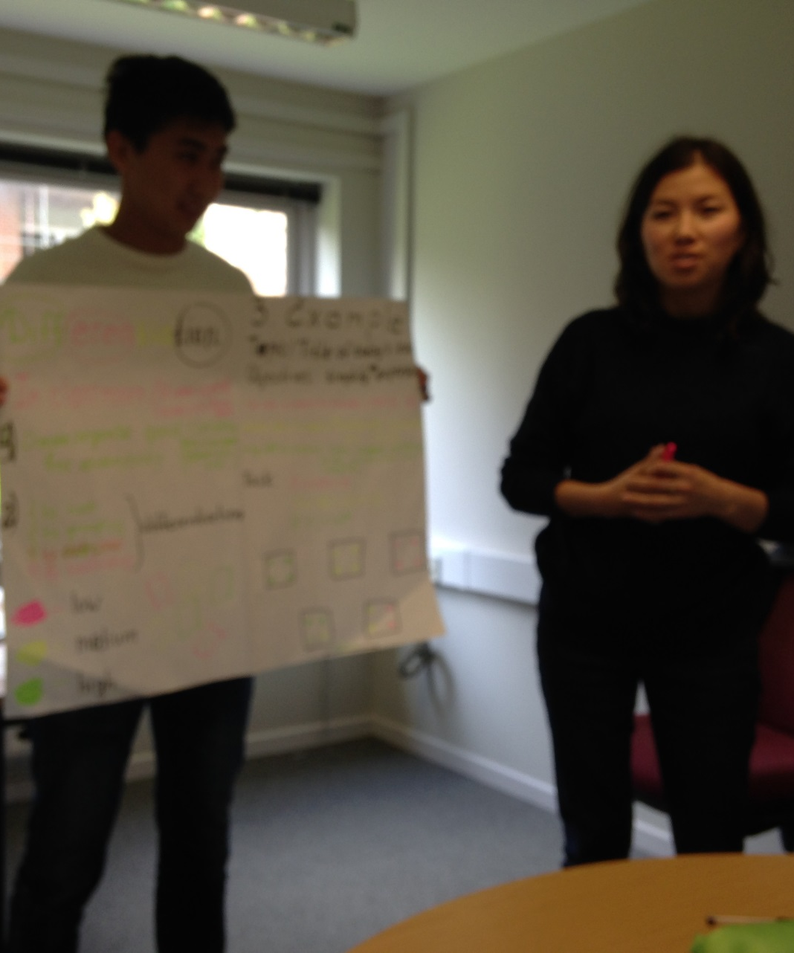
Conceptualising the Data: Qualification
Qualification as opportunity
I have qualification that will be looked up to. No-one in my school has this…
It will help my family…good for my country to grown
Qualification as responsibility
I cannot waste this…my country deserves me to give back
I must show how I can use this…
Qualification as burden
[Sigh…] Much will be expected of me…

Slide 6
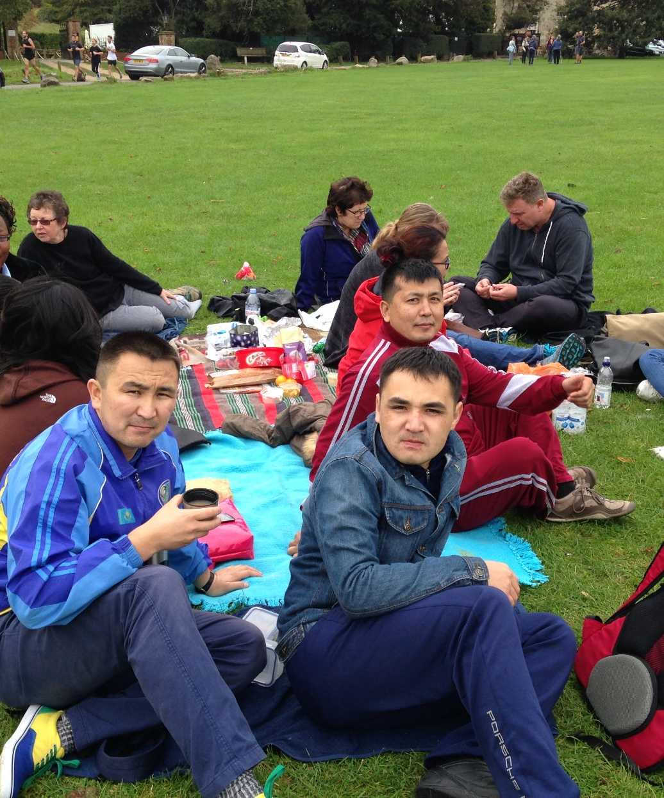
Conceptualising the Data: Socialisation
Having been ‘done unto’ in order to now do, know, say, be part of, act:
Language of enhanced cognition; knowledge; individual ‘change’ of working towards ‘mastering’ the natural and social world:
Now I can….understand, see, think that…….
Then I was finding strange that…now I am getting it that…
I am part of bigger body of teachers…
It is very interesting that….
I learn that…now I know….

Slide 7
CENTRE FOR HIGHER EDUCATION AND EQUITY RESEARCH
Conceptualising the Data: Subjectification
  ‘Mastery’ and Inquiry
  How can I implement my new theoretical knowledge?....I am quite sure that there will be big differences between my previous lessons and my future lessons because of what I have learnt…[sigh]…I just not so sure now.’
  Complexity and Paradox
  ‘Something has changed in me…educational ideas are complex and I am not sure about how I can begin to share some of the deep changes in me with other teachers who have not had the same experience as me….’
  ‘I have to live with difficulty of this….things that are not clear….that is new for me…but it is good to live with this difficulty’… ‘Globalisation and localism present challenges for me…I don’t know what I think at the moment’
  ‘I am less sure about our model of elite schools now…but I think it is important to think about this longer…how to educate everyone in our huge country…what a challenge’
  Affect and Subjectivity
  ‘Strangely I feel more powerful inside but less sure about my ideas and what I know. What do I know? But I think I need to keep thinking deeply…to have courage to think deeply…I don’t want to think on surface…’
  ‘I speak more fluently English now and it makes me feel more of me and to be proud to be from my nation…we must assert our national identity…’ ’I must live with pain – here’ [holds side of her stomach]

Slide 8
CENTRE FOR HIGHER EDUCATION AND EQUITY RESEARCH
Conclusions
I find that there is a ‘complication’ in the model of straightforward transference of learning presumed to ‘change’ the learner, in terms of transference from:
    teacher to student
    one nation space to another
A discourse of power and politics is always shaping an ‘excess’ of learning
There are implications for HE curricular and pedagogic policy rationalities, especially by way of categorically prescribing, ‘what will be learned’ by students.

