Slide 1
Challenging the Mechanistic within Research Methodologies:
Using Butler to work both within and against interpretivism
Dr Rebecca Webb, Lecturer in Education, University of Sussex

Slide 2

Aims of the session
To share some initial responses to the key reading
To locate Butler’s work within a research paradigm
To link this to a view of methodology as in process
To discuss and illustrate some conceptual understandings
of key ideas of Butler’s work with reference to a research group

Slide 3

Key text …

Slide 4
PARADIGM | METHODOLOGY | DATA ANALYSIS
Poststructural Feminist | Knowledge is viewed as contested Generate ‘stammering knowledge’ (Patti Lather) Any given account will only be one way of making sense of ideas of social reality There will be no such thing as uninterested knowledge – the political is always implicated in research and research texts Any ‘Truth claims’ should be open to reflexive exploration The researcher is always implicated in the construction of knowledge (identity/subjectivity and positionality cannot be discounted) Highly qualitative | Multiple meanings and layers of language will analysed and interpreted The non-linear process of interpretation will be valued Use will be made of a range of textual accounts of different ways of seeing and experiencing the world to produce a research text The expert ‘gaze’ and suggestion of one interpretation is challenged

Slide 5
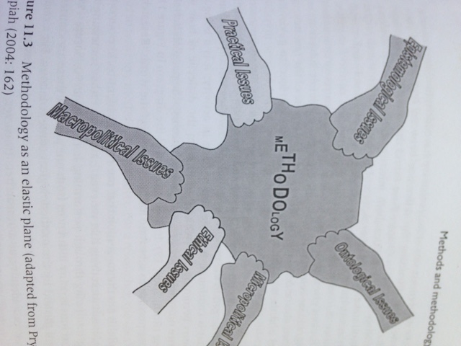
Methodology as elastic plane …
* permission for use from Dunne, Pryor and Yates, 2005, 167

Slide 6
A research context for thinking with
Macropolitical: Neoliberal context of being an ‘Early Researcher’ in the social science academy in the UK
Micropolitical: Feminist assertions of cherishing moments of coming together and thinking together…
the sociality of a research group to ‘spark’ ideas with which to think…
Ontological and Epistemological matters: Working with ideas of ‘vulnerability and resistance’ as: performative;
mutually constitutive; political and as a challenge to paternalistic notions of ‘vulnerability’ as weakness
Ethical issues and practical matters: Power dynamics of the group – who to be and how to work – challenging the ‘cosiness’ of a sociality of ideas…..how might we challenge each other?

Slide 7

Structural/Poststructural
Structuralism is a way of locating the world within permanent, closed structures of which language is a part
Poststructuralism is about working both within and against structures.
It requires the idea of structuralism to cast itself against without rejecting structures per se. PS ideas are dependent on a constant deferral of meaning

Slide 8
Performativity
Presumes that as humans we are invariably acted upon and acting
Challenges normative categories that place rigid structures around understandings of the way people ‘do’ their lives
Processes of ‘doing’ and ‘being’ as human are both about: being acted upon; and the conditions and possibilities for acting. Being acted upon and taking action often occur at one and the same time
Gender performativity accentuates a process of repetition that produces
gender subjectivity
‘Gender is not a performance that a prior subject elects to do, but gender is performative in the sense that it constitutes an effect the very subject it appears to express’ (Butler, 1996, 380)

Slide 9
Agency
Agency derived from the constitution of performative acts
Performativity challenges the idea of the individual as the voluntary actor
Willed volition rather than determined action
Enactment rather than individual possession
Works against humanism as that which is the powerful shaper of identity
and existence and also against essentialism
There is no ‘essence’ of the ‘real thing’

Slide 10
‘Liveable lives’
Agency as a purposive and significant reconfiguration of cultural and political relations
The public gathering as inflected by the presence of the police
Feminism as a network of solidarity and resistance
– destabilising reproductions of inequality and injustice
– holding open the place to criticize violence inflicted on women and minorities
Asking ourselves, whose lives were never liveable?
Mobilising vulnerability and directing democracy as a
deliberate mobilisation of bodily exposure

Slide 11
Gender, bodies, infrastructure
Gender is performative: the dual dimension of performativity
The relationality of the gendered body means that it cannot be fully ‘disassociated from infrastructures and environmental conditions of its living’ (Butler, 2014, 8)
‘Am I that name?’ – Performative effects of being one name and not another
How do we relax the coercive hold of gender norms without transcending
all norms for the purposes of living more ‘liveable lives’?
How can embodiment challenge masculinist ontologies of bodily action in the academy?

Slide 12
Vulnerability and resistance
The space of vulnerability and resistance as precious space
– precarity to be embraced even as it renders the doing of it as painful
‘The more a practice is mastered, the more fully subjection is achieved. Submission and mastery take place simultaneously, and it is this paradoxical simultaneity that constitutes the ambivalence of subjection’ (1995a, 45-46)
Precarity of the body as a way of resisting power:
enacting ‘a form of resistance that presupposes vulnerability of a specific kind’ (2014, 4)
Importance of thinking vulnerability and resistance together and as relational

Slide 13
Conclusions
Used the article as a catalyst to collective sharing and thought
Located Butler within a broadly poststructural paradigm
Challenged the ‘mechanistic’ of research methodology by way of a focus upon researcher subjectivity as dynamic of a research process
Illustrated some key conceptual ideas of the work of Butler

